Slide 1
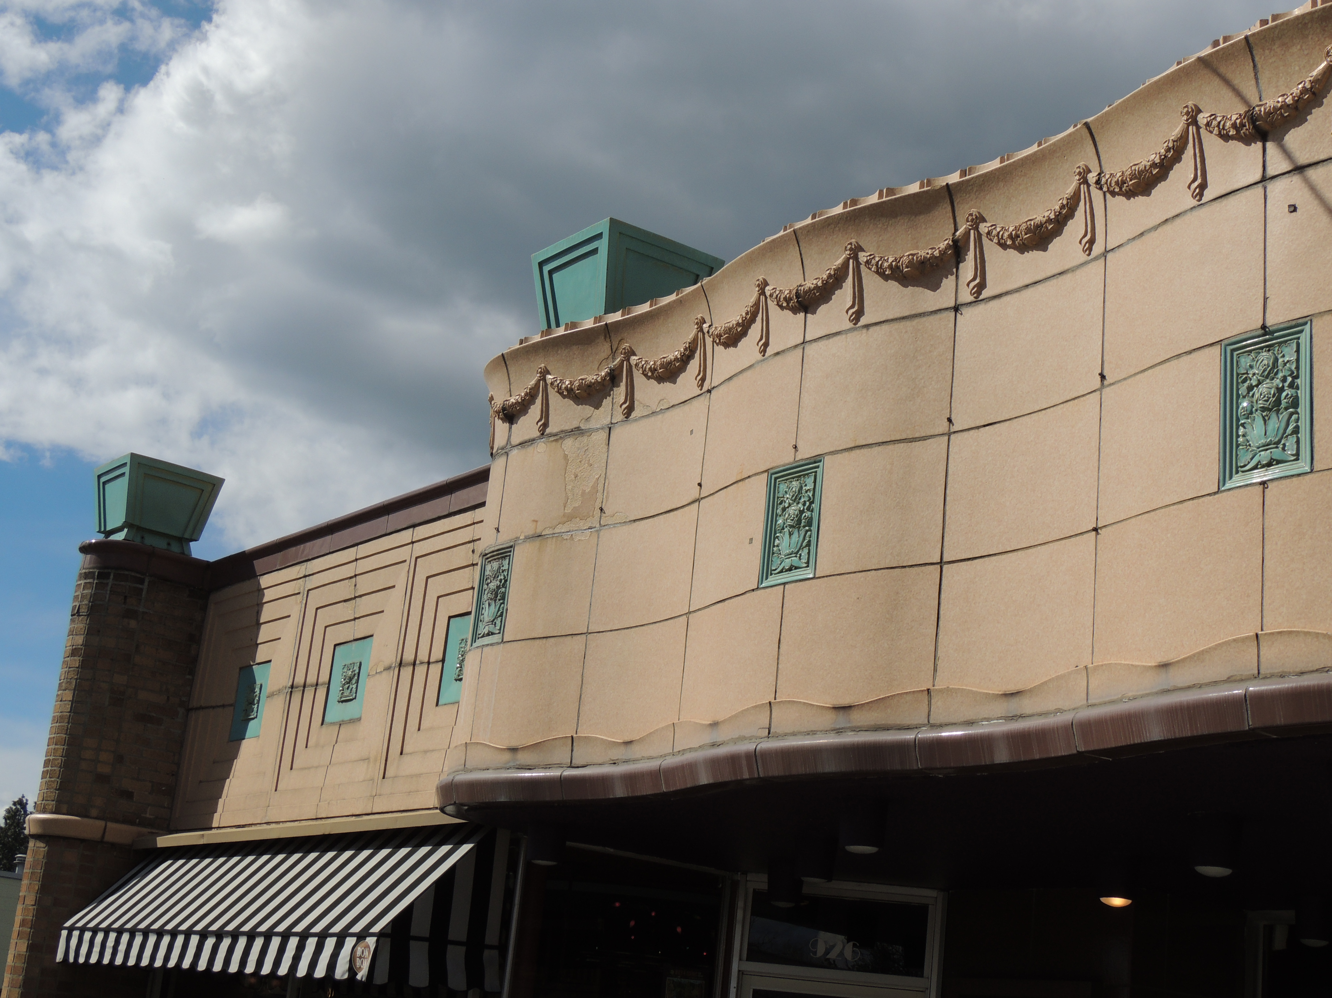
Adding Demolition Review
In Centers & Corridors
Plan Commission Workshop
9/11/24

Slide 2
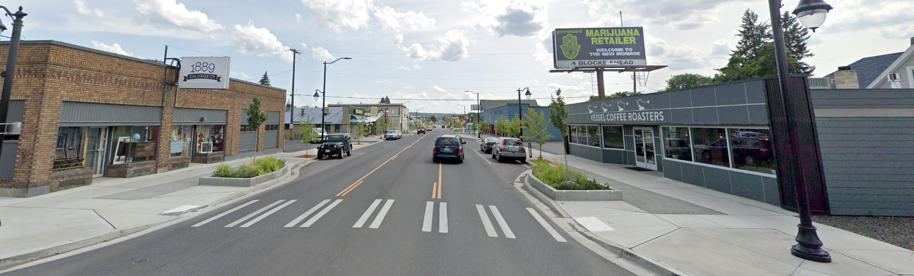
Why do this?
We understand that development makes sense in Centers and Corridors.
Many of these corridors have a distinct sense of place – historic buildings are a big part of this sense of place. We should consider some regulations that focus development to avoid demolition of historic buildings.
The HP Office/SHLC already reviews demolitions downtown and in National Register Historic Districts, this proposal expands to C&C zones (pre-dates 7/2005)

Slide 3
Centers & Corridors Study – June 2024
Historic Preservation (page 36)
There are currently few protections against the demolition of historic buildings within the urban fabric of some historic Centers. Placing appropriate controls on demolition of historic structures in Centers and Corridors and standards that support adaptive re-use can help ensure historic structures support the development of a sense of place in centers, linking these areas past and its future.

Slide 4
Current Code SMC 17D.100.230
If a building within the downtown boundary zone or within one of Spokane’s 15 National Register Historic Districts is found eligible for listing on the Spokane Register, the Spokane Historic Landmarks Commission has some regulatory review.
The SHLC cannot deny demolition within these areas.
Demolition permits will not be issued until the replacement structure has been approved by the SHLC through a Certificate of Appropriateness process (CoA) and building permits are in hand or a financial commitment from the owner is received.
Ordinance change in 2018 gave review of replacement structures to the SHLC.

Slide 5
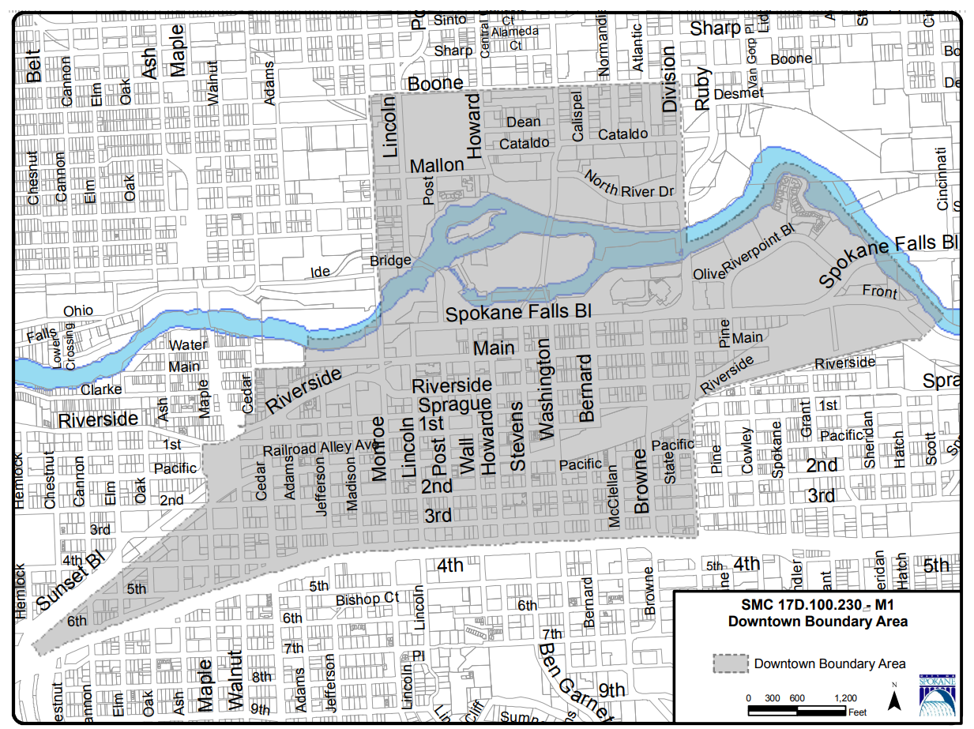
Downtown Overlay Zone Map

Slide 6
15 National Register Districts within the City
Rockwood Historic District
Peaceful Valley Historic District
Browne’s Addition Historic District
Marycliff-Cliff Park Historic District
9th Avenue Historic District
West Downtown Historic Transportation
District
East Downtown Historic District
Riverside Avenue Historic District
Nettleton’s Addition Historic District
Corbin Park Historic District
Fort George Wright Historic District
Felts Field Historic District
Hillyard Historic Business District
Mission Avenue Historic District
Desmet Warehouse Historic District

Slide 7
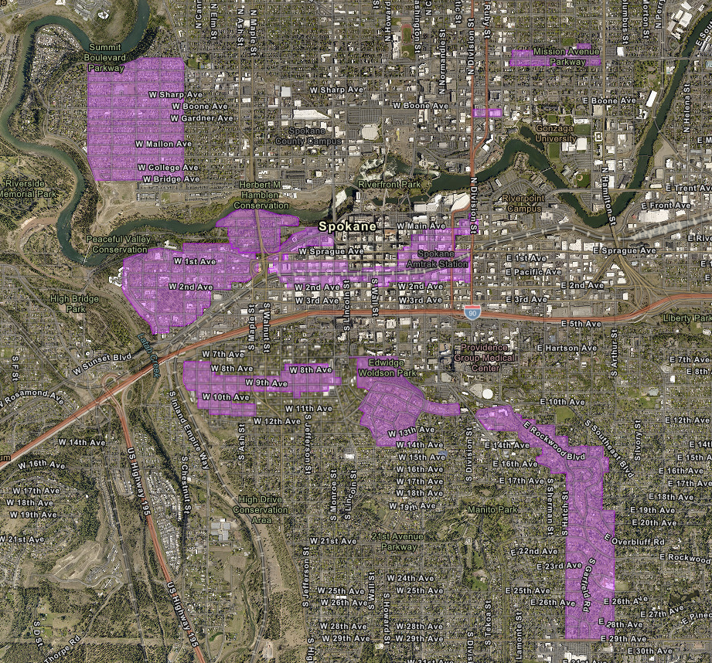
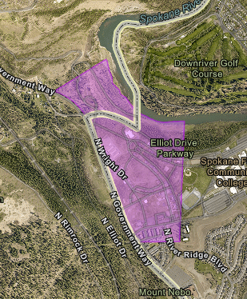
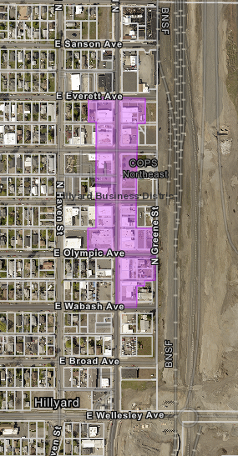
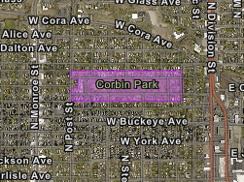
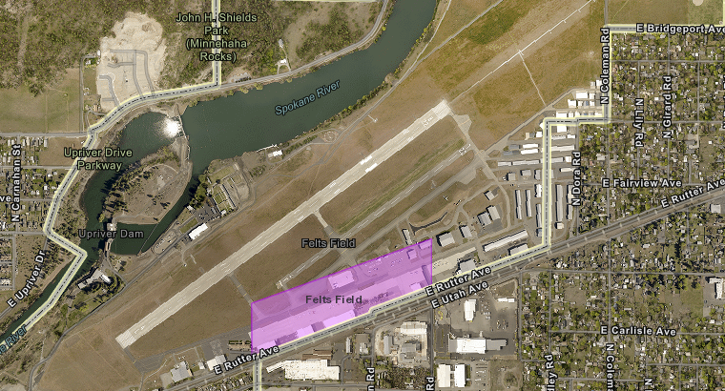
15 National Register Historic Districts within the City of Spokane

Slide 8
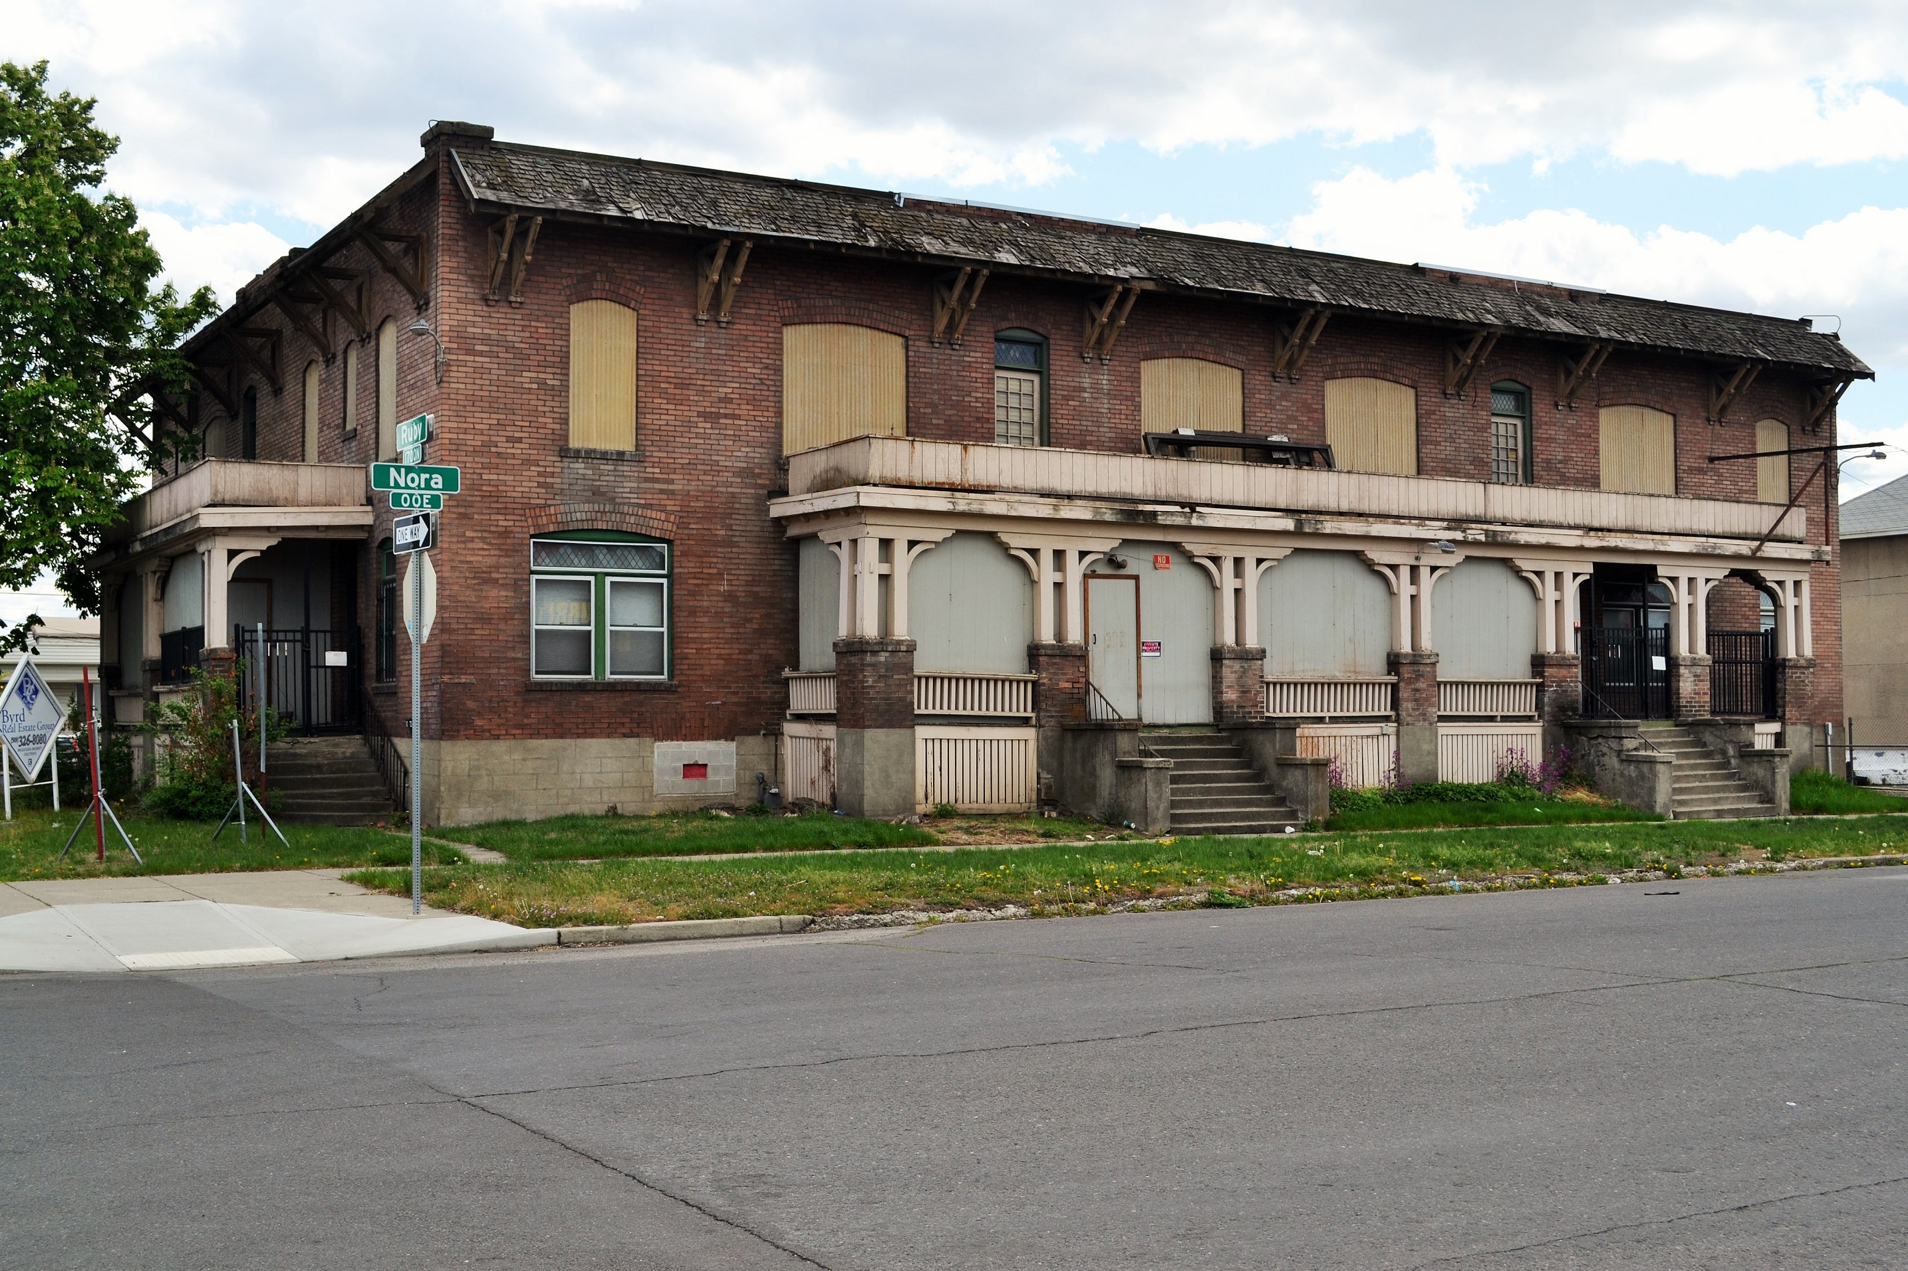
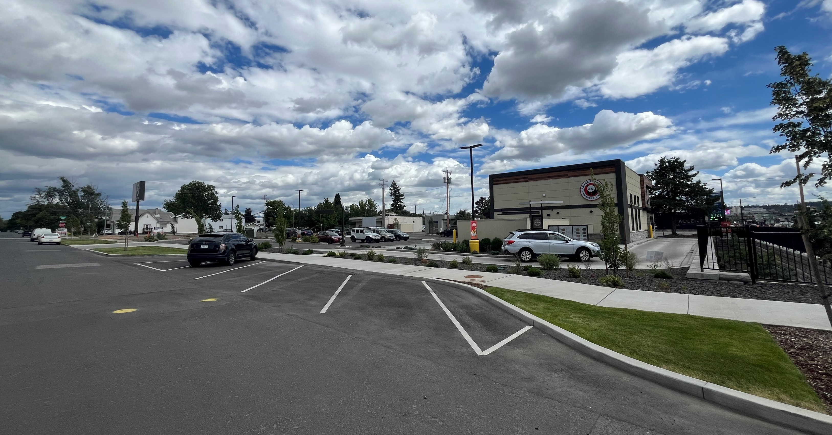
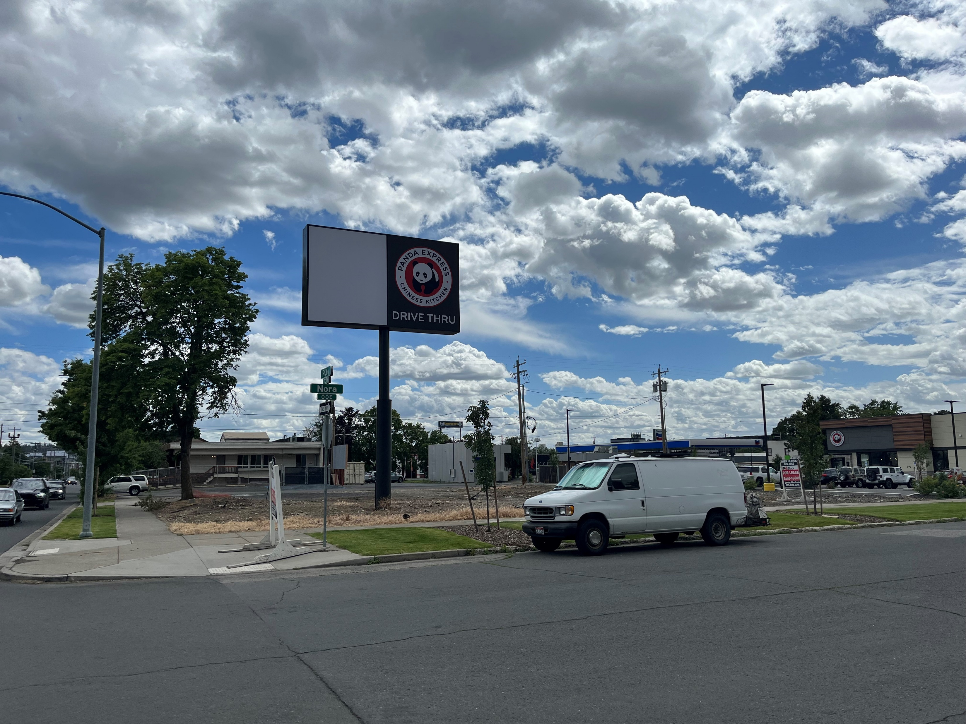
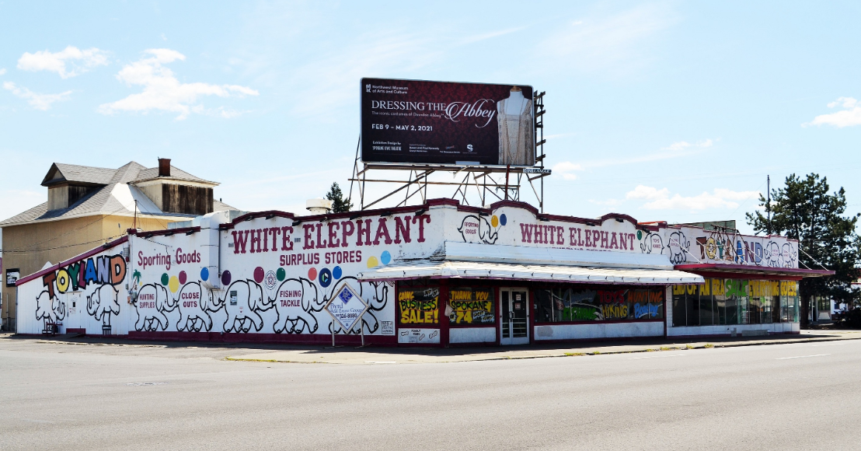
Adding Centers & Corridors to SMC 17D.100.230
Basically, just adding in language for “Centers & Corridor Zones as defined in Chapter 17C.122” throughout the ordinance

Slide 9
What would this mean?
A building within a Center & Corridor that is proposed for demolition:
  Determination of Eligibility – the building would have to be at least 50 years old and meet one of our criteria for listing:
    (Category A) Those structures that are associated with events that have made a significant contribution to the broad patterns of our local history; or
    (Category B) That are associated with the lives of persons significant in our past; or
    (Category C) Property embodies the distinctive characteristics of a type, period, or method of construction or represents the work of a master, or possesses high artistic values, or represents a significant and distinguishable entity whose components lack individual distinction; or
    (Category D) That have yielded, or may be likely to yield, information important to prehistory or history; and
    (Category E) A property that represents the culture and heritage of the city of Spokane in ways not adequately addressed in the other criteria, as in its visual prominence, reference to intangible heritage, or any range of cultural practices.

Slide 10
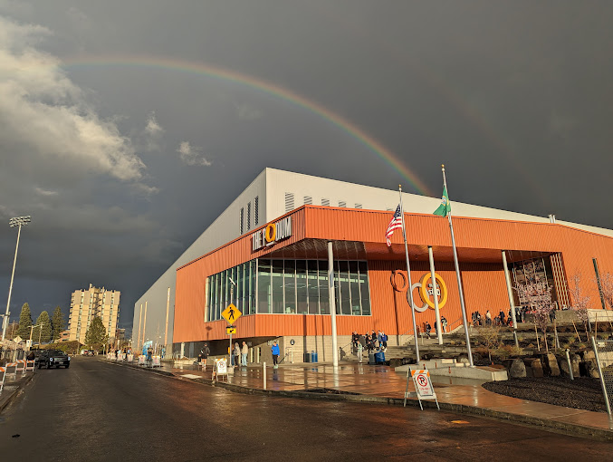
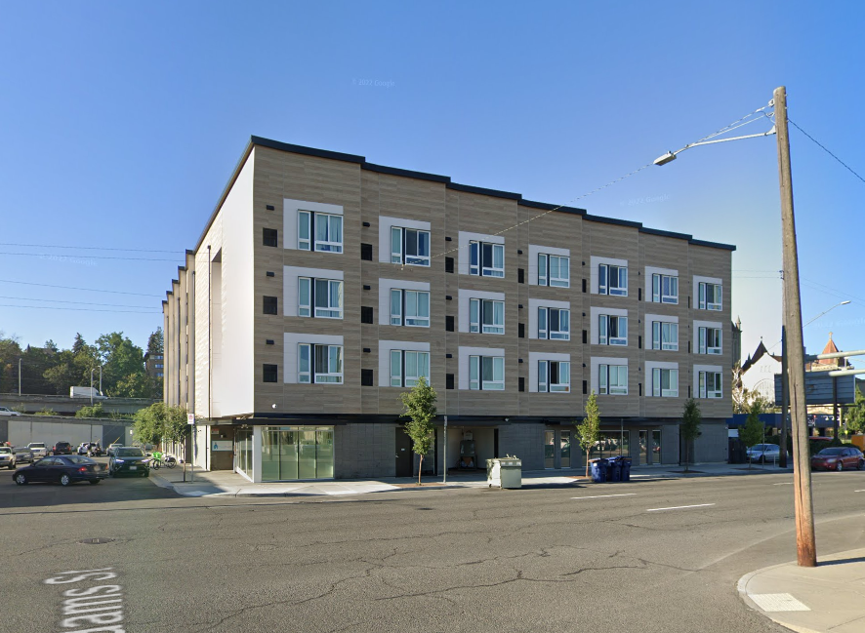
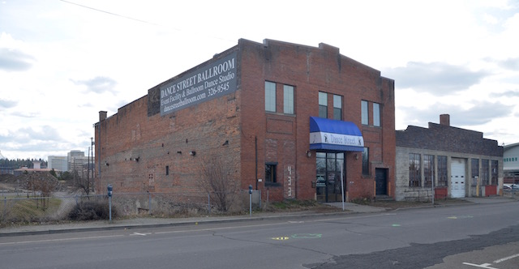
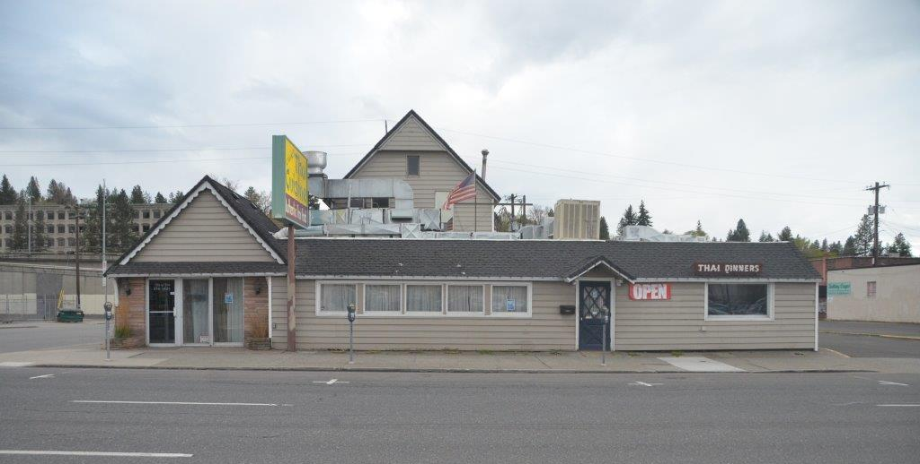
Eligibility
Owner may choose to hire a consultant to write a report on eligibility.
Staff will review any document provided by owner/consultant and make their own recommendation to the SHLC:
  A public hearing will be scheduled on the next SHLC agenda (code says within 30 days of receipt of application)
  Decision of SHLC on eligibility is final (can be appealed to the Hearings Examiner)
Properties from 2018/19 that were reviewed for eligibility – Carnation Dairy Garage, Dance Studio and The Shack Restaurant

Slide 11
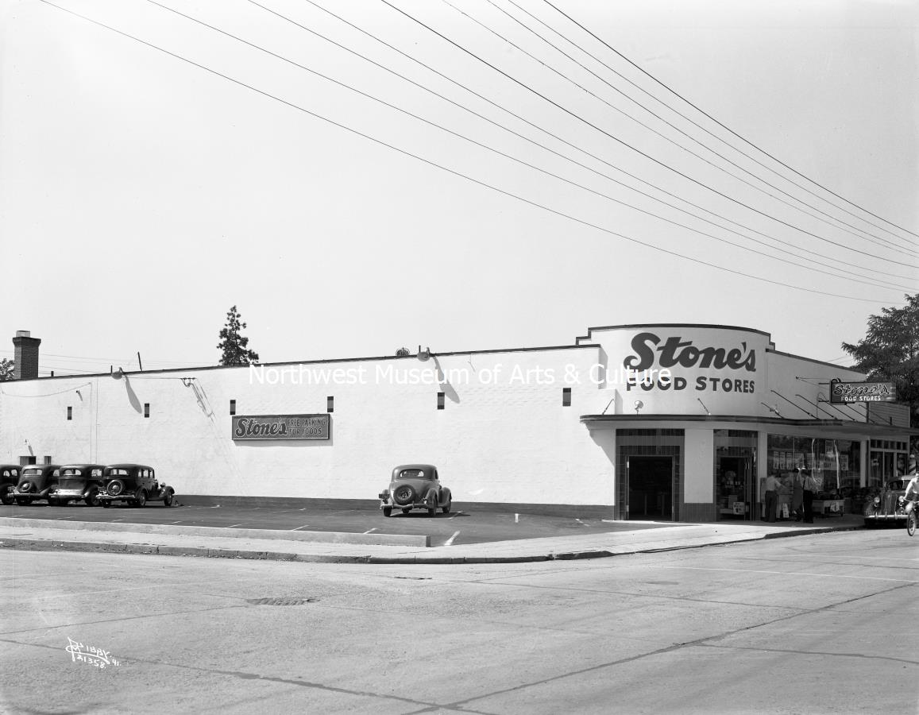
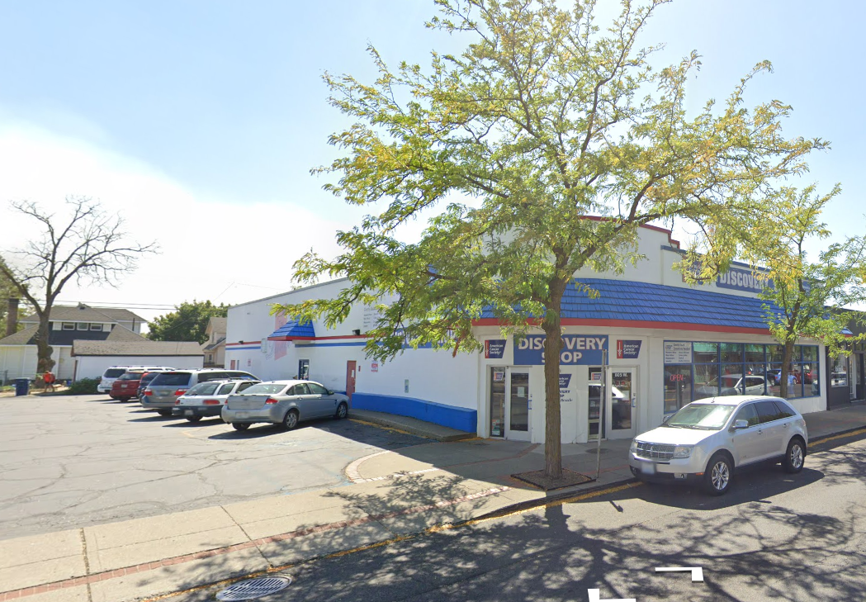
Integrity
In addition to age and meeting the SMC criteria to be eligible, a property must also have “integrity.” Integrity meaning that there is enough original material or form to convey the property’s historic significance.
801 W Garland – Stone’s Food Store 1941
2022

Slide 12
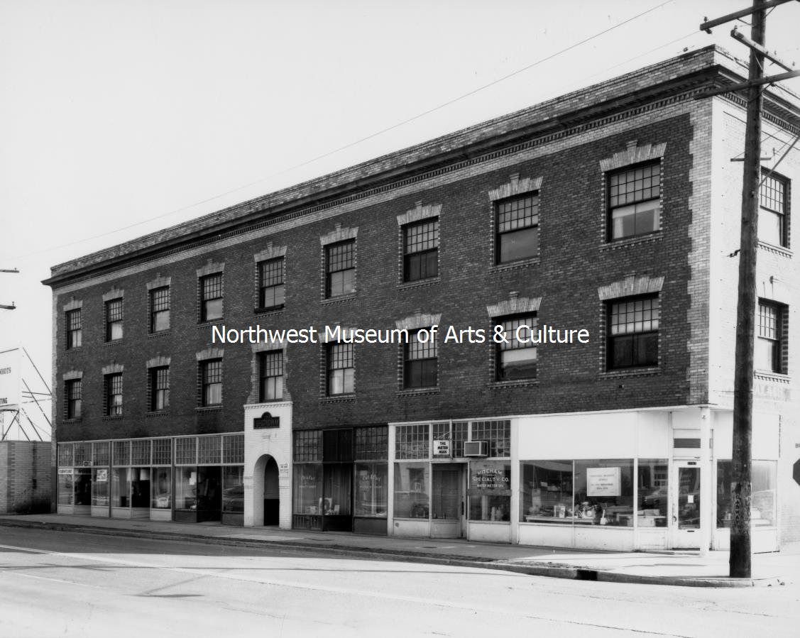
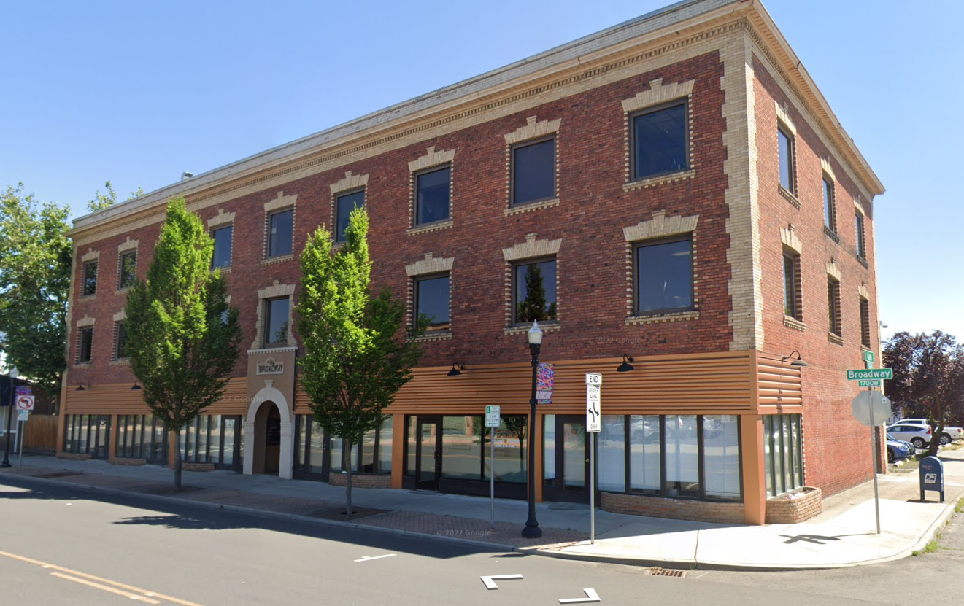
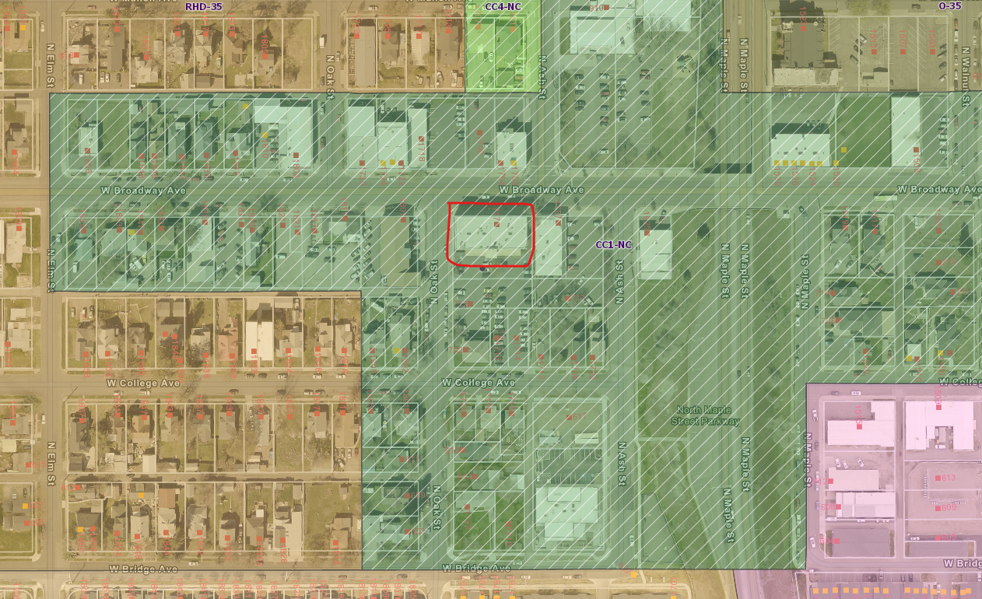
If found not eligible, that is the end of Historic Preservation review
1717 W Broadway (left) and today (right) – Center & Corridor 1 - NC

Slide 13
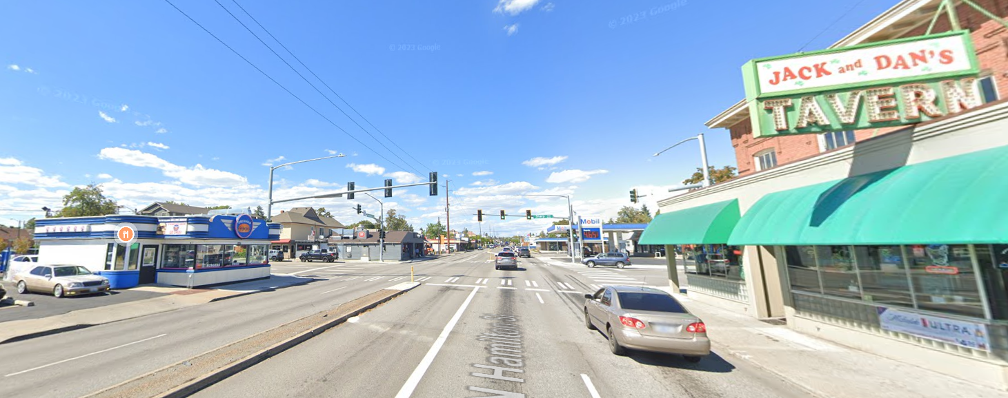
If found eligible:
Historic Preservation staff would review the replacement structure for a couple of “objective” design items – size and materials. All other regular zoning and design guidelines will be completed by appropriate agencies.
Once the replacement structure is approved by staff, full building permits and financial commitment from the property owner would be required prior to the demolition permit being issued.
This it to avoid speculative demolition and loss of historic buildings without concrete plans for redevelopment.

Slide 14
State’s Changes to Design Review
House Bill 1110 and House Bill 1293 both discuss design review through Boards or Commissions.
A carve-out was made for historic preservation design review when it concerns LISTED historic properties or LOCAL historic districts.
The Historic Preservation staff felt that we should take this opportunity to align our SMC with those new state laws.
Removing the SHLC review of new construction for the downtown zone, CC zones (a new area to be added) and the National Register Historic Districts for “objective design” standards.
  Size (more info on next page)
  Materials (should reflect those in other historic areas of Spokane such as brick, stone, wood)
All other design requirements will be assured by other departments at the City.

Slide 15
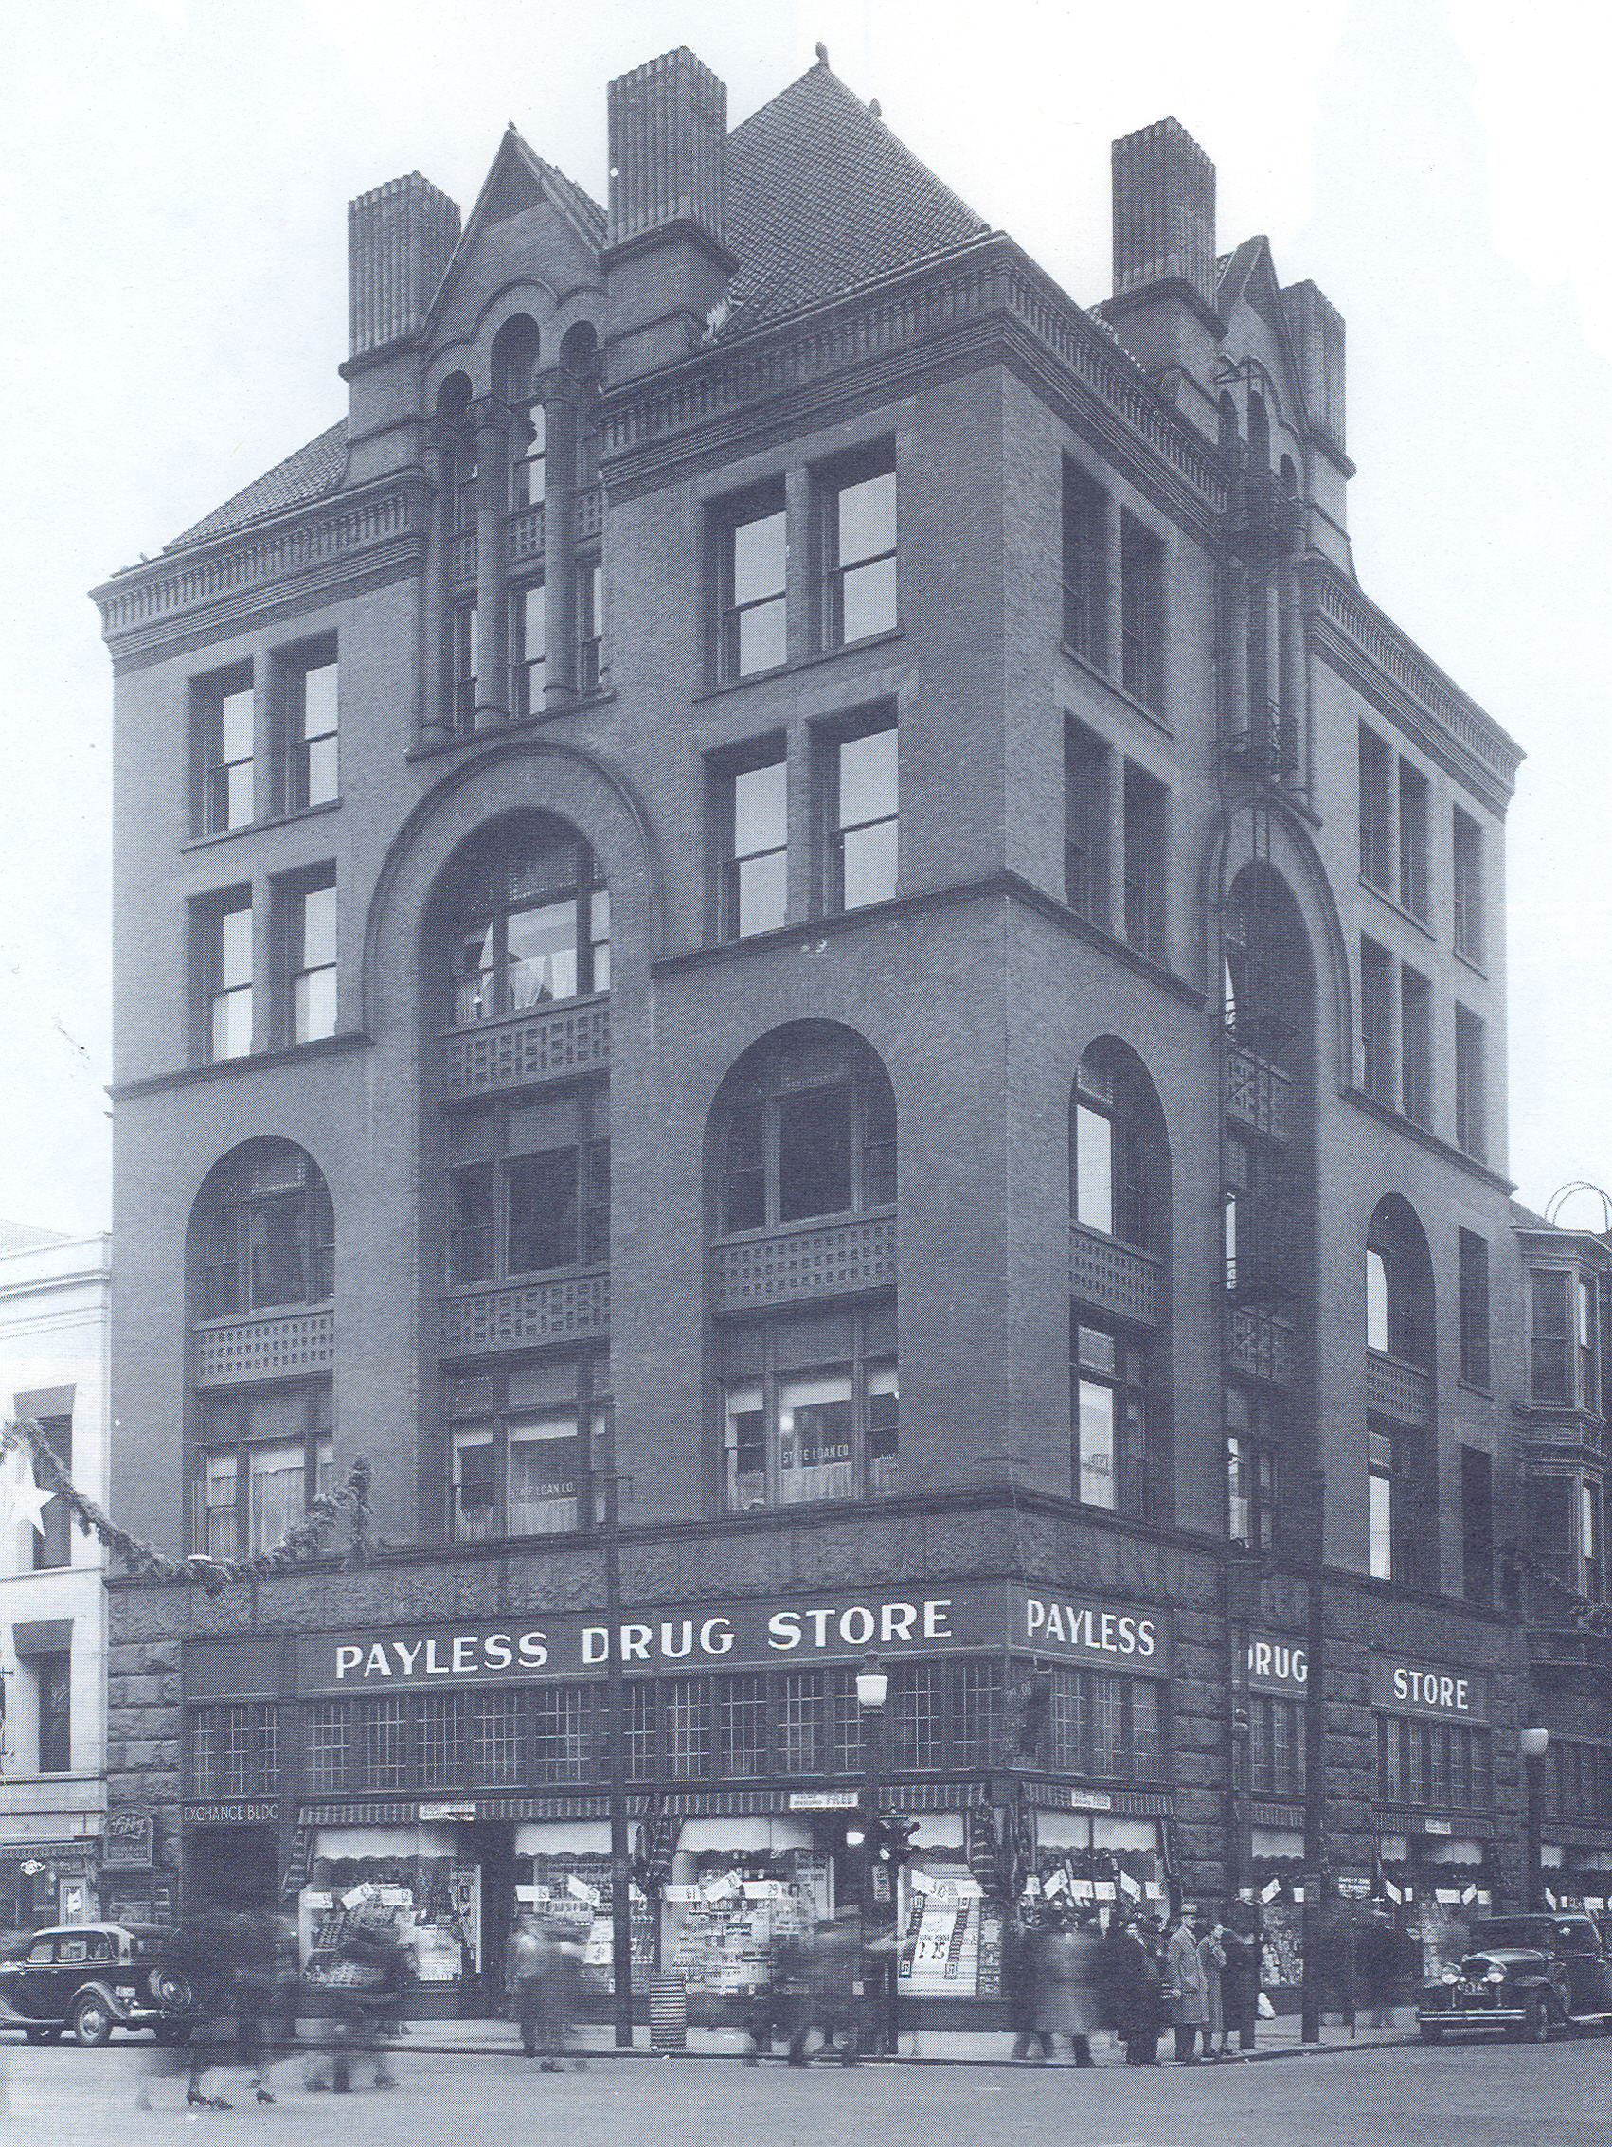
Additional Changes to SMC 17D.100.230
Replacement structure footprint should be equal to or greater than the square footprint of the building to be demolished. The footprint of the new construction will be located on the footprint of the demolished building.
For eligible structures in the downtown boundary area and centers and corridors, the replacement structure must also have overall square footage equal to or greater than 100% of that of the eligible structure(s) to be demolished. Size of the replacement building will be limited only by the underlying zoning of the area.
For contributing properties in a National Register Historic District, the replacement structure must also have a square footage equal to or greater than 75% but not larger than 150% of that of the contributing building(s) to be demolished.
*Deviations from these specific guidelines may be approved by the Historic Preservation Officer in consultation with the Planning Director at their discretion

Slide 16
Additional Changes to SMC 17D.100.230
Also removing the language that allowed for a building smaller than at least 60% of the floor area ratio* of the demolished, historically eligible building if:
  Current code allows smaller buildings if there is a public benefit (green space or public art)
  Current code allows the owner to “submit plans in lieu for design and approval by the city’s design review board subject to applicable zoning and design guidelines”
*Planning is getting rid of “floor area ratio” in their codes, so we are happy to remove it as well.

Slide 17
Code Cleanup
Additional Changes to SMC 17D.100.230
Changing the provision that called for either/or:
  Building permit for the replacement building OR Financial commitment of the owner…
  To: the owner must have both the building permits for the replacement structure in hand AND a demonstrated financial commitment for the project before the demolition permit may be applied for and issued.
Clarifying that a Certificate of Appropriateness is for the replacement building, not the demolition permit.
Demolition permit may be administratively reviewed by staff as long as all other provisions are met.

Slide 18
Outreach
Website: https://www.historicspokane.org/centers-and-corridors
Notice of Intent to Adopt and SEPA review – Commerce (August 16)
SEPA checklist to agencies (August 16)
Email to Centers & Corridors list via Planning Department (August 16)
Provide slides to Spokane Historic Landmarks Commission – August 21 at the regular meeting of the SHLC (3 pm)
Plan Commission Workshop #1: August 28
Plan Commission Workshop #2: September 11
In person Open House: Wednesday, September 18, 4 pm following SHLC meeting in City Hall City Council Briefing Center
Online Open House: Thursday, September 19, 12 noon
Plan Commission Hearing: Wednesday, October 9, 4 pm

