Slide 1
Robertson-Raznik building 307 W Riverside
Commercial
Certificate of Appropriateness

Slide 2
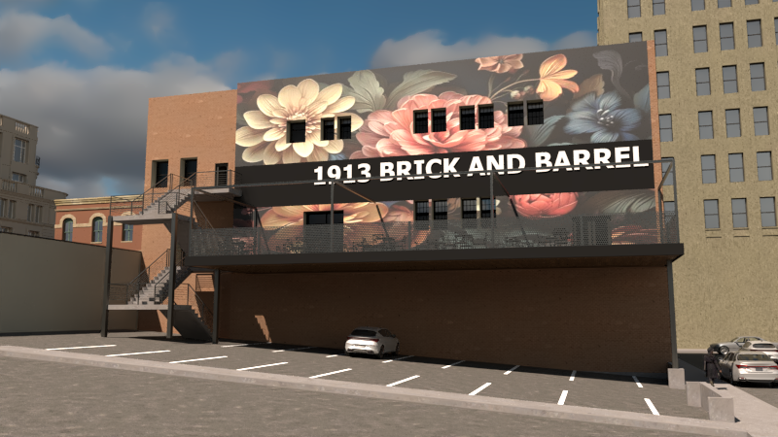
Proposed east elevation

Slide 3
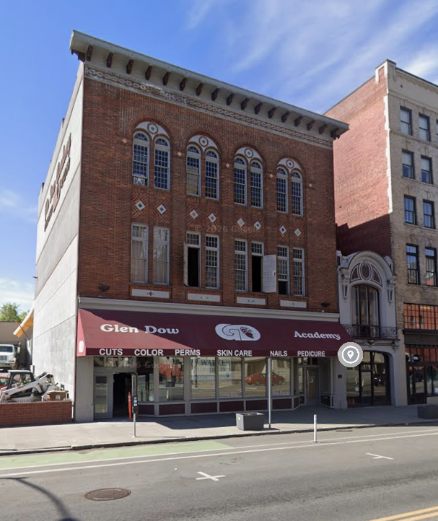
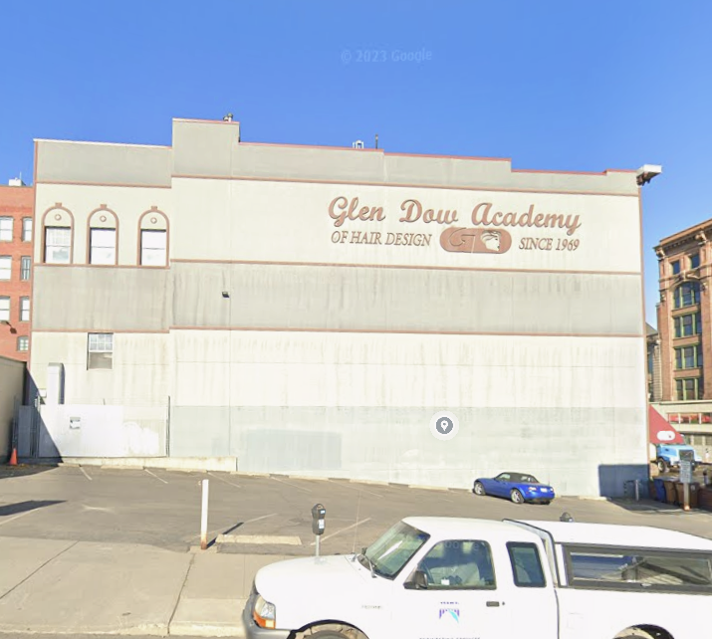
Building Currently:

Slide 4
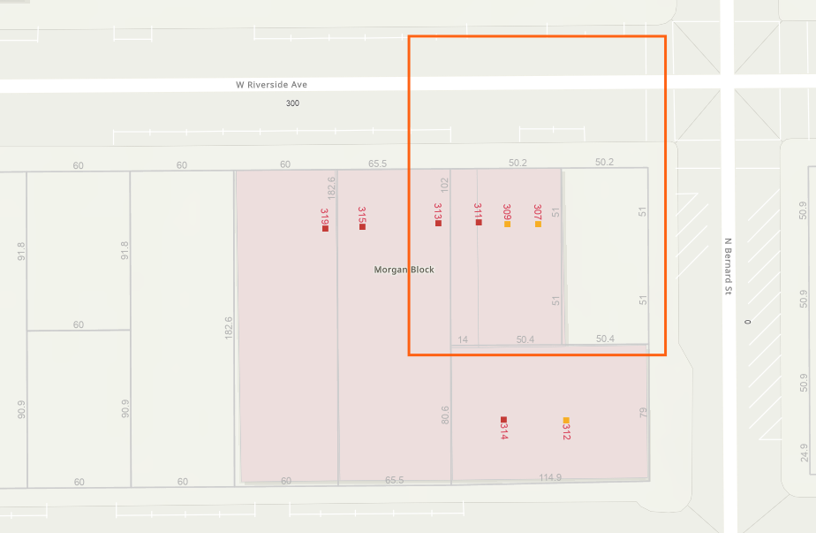
307 W Riverside – Individually listed Robertson-Raznik Building (1912 and 1913)

Slide 5
PROPOSAL:
• Primary Elevation:
Addition of a new center section storefront including double doors on the north elevation. Doors on the east and west sides of the elevation will remain.
• Changes to the east elevation include:
Decking system at the 2nd floor level
2 new doors and 4 new windows to be added to the 2nd floor. Proposal includes two sets of double-doors. Proposed windows are metal-clad wood windows.
Add 9 new window openings to the 3rd floor, remove one existing window to accommodate stairway door. Proposed windows are metal-clad wood windows.
False decoration around the windows on the rear of the 3rd floor east elevation will be removed and simplified. One window will be removed to accommodate the door opening for the 3rd floor.
Add an exterior staircase that goes from ground level to the 3rd floor to accommodate a second means of egress for the residential units

Slide 6
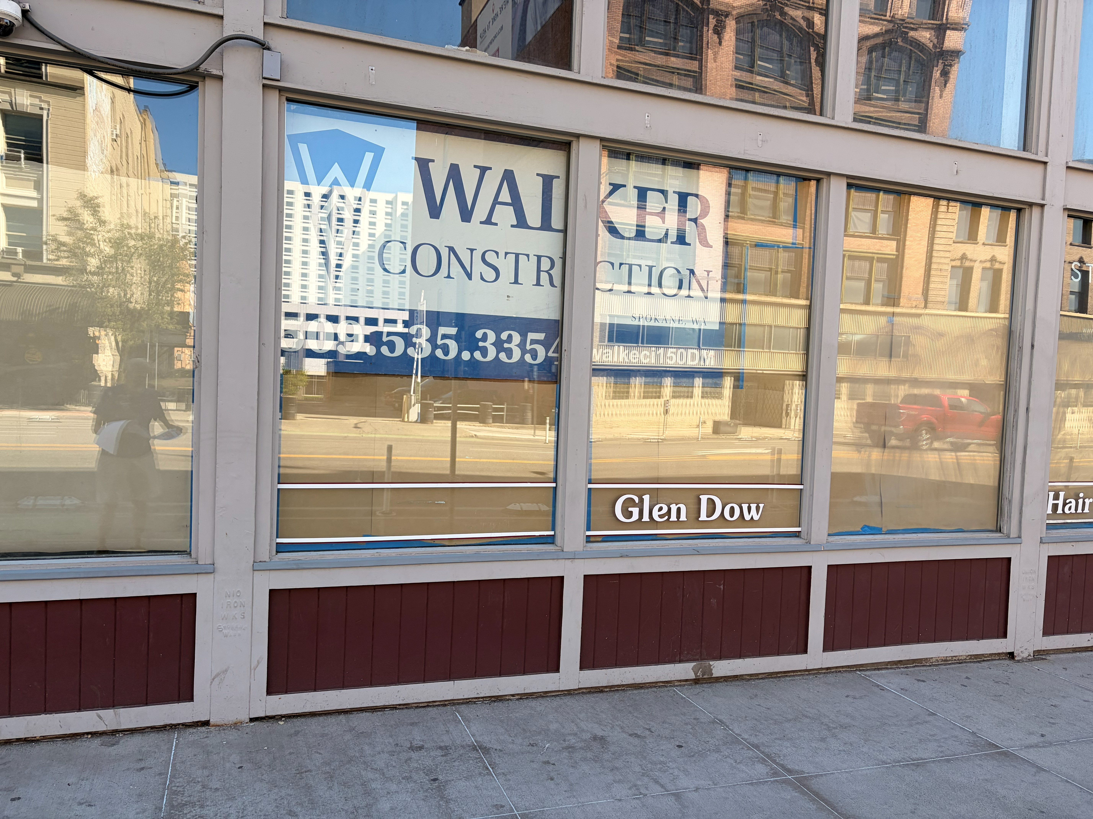
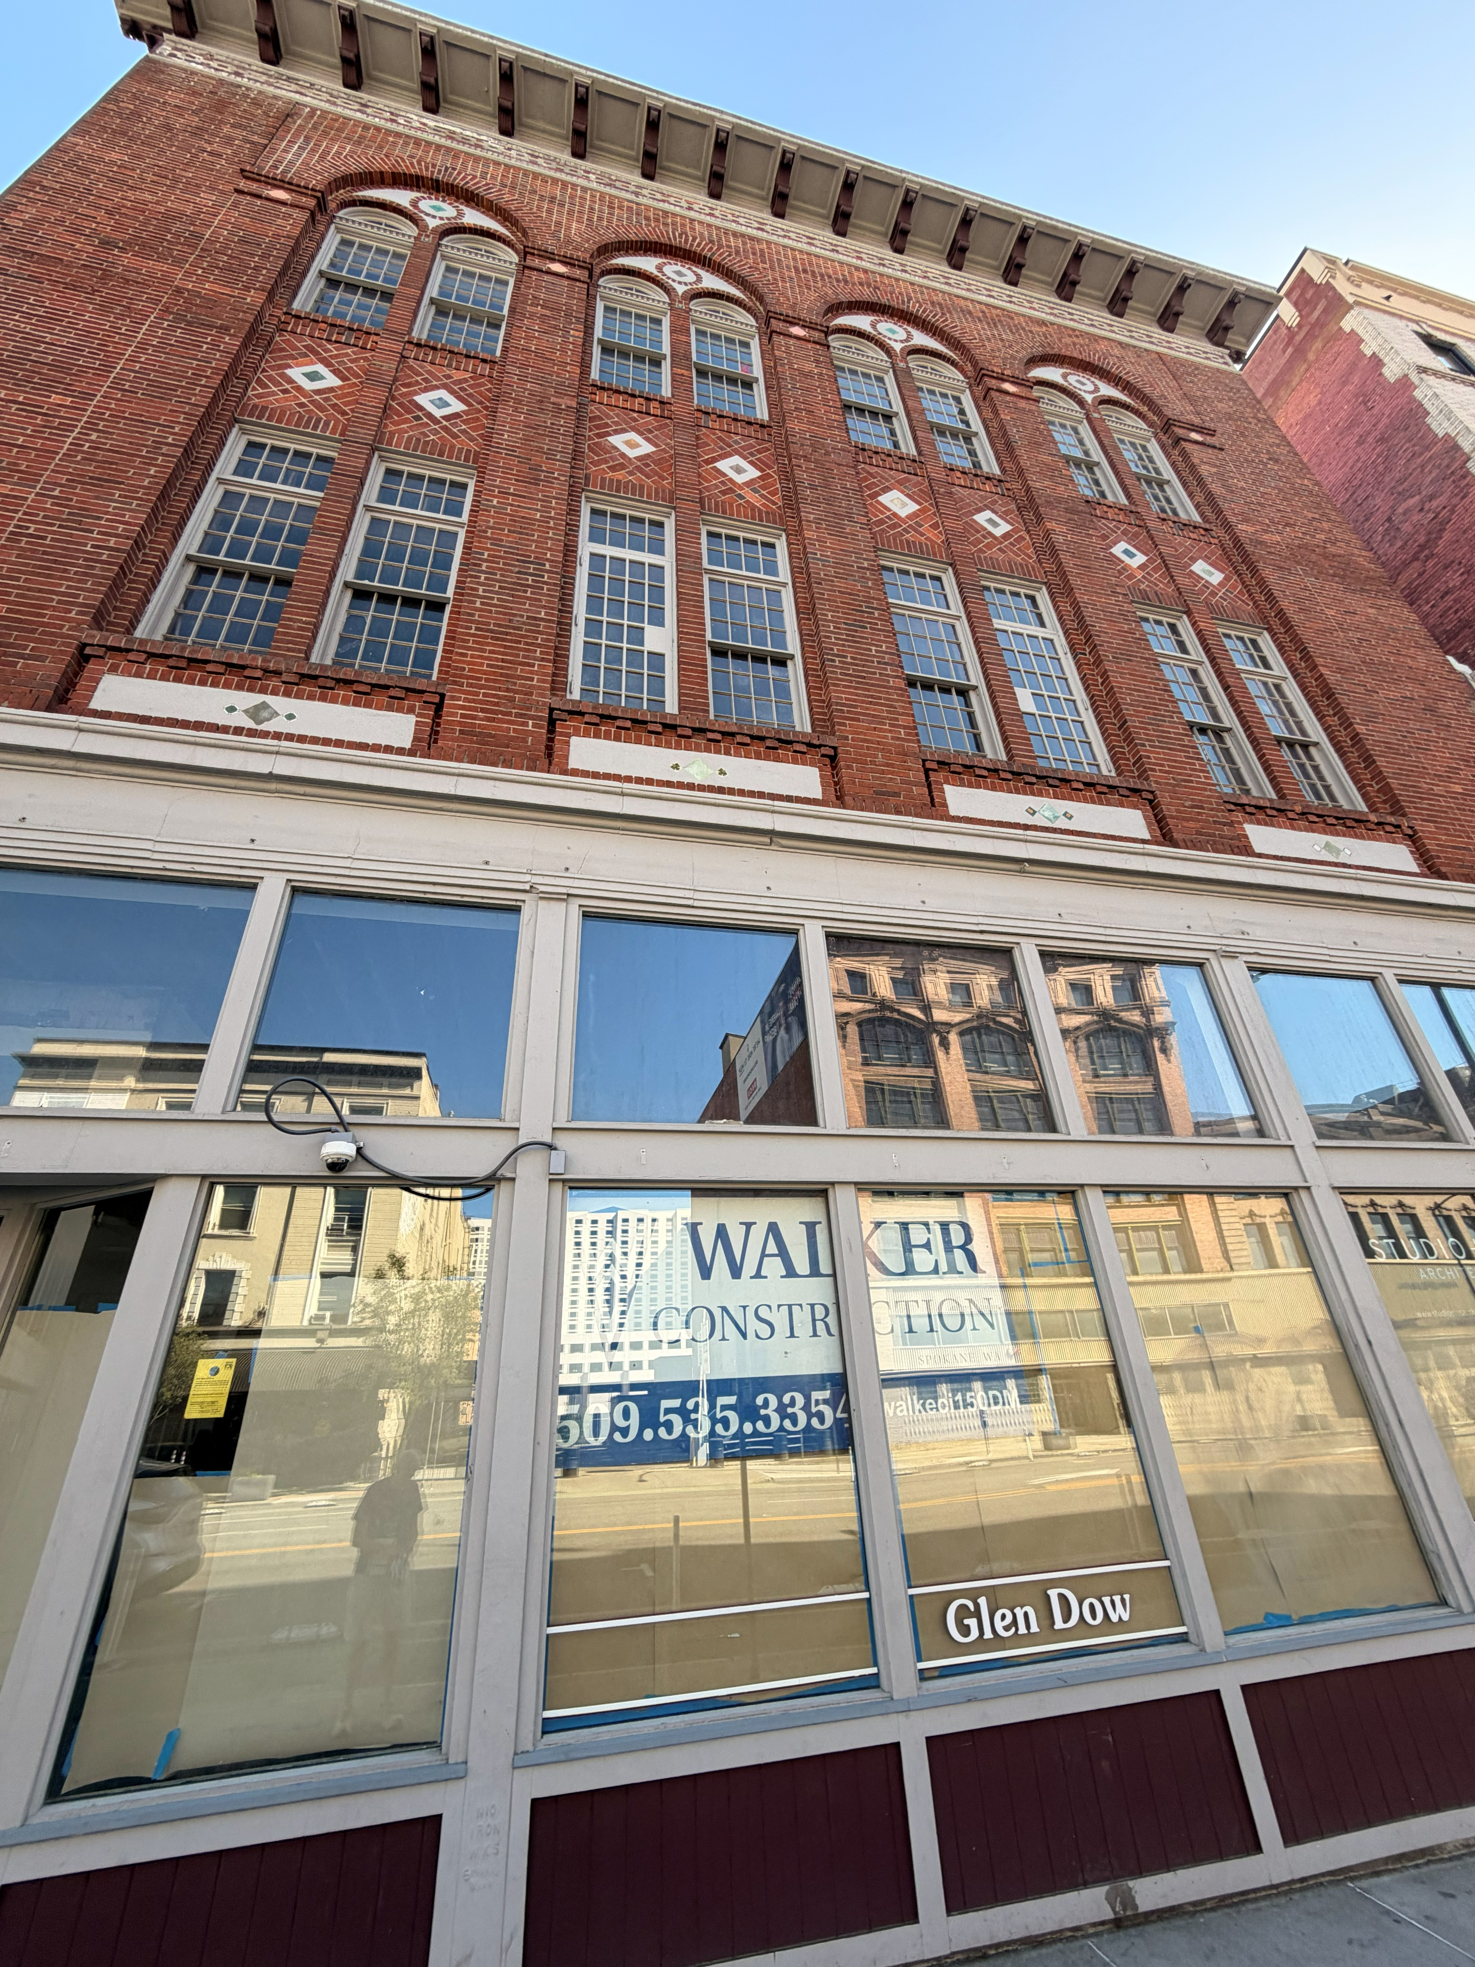
Primary Elevation: Addition of a new center section storefront including door on the north elevation. Doors on the east and west sides of the elevation will remain.

Slide 7
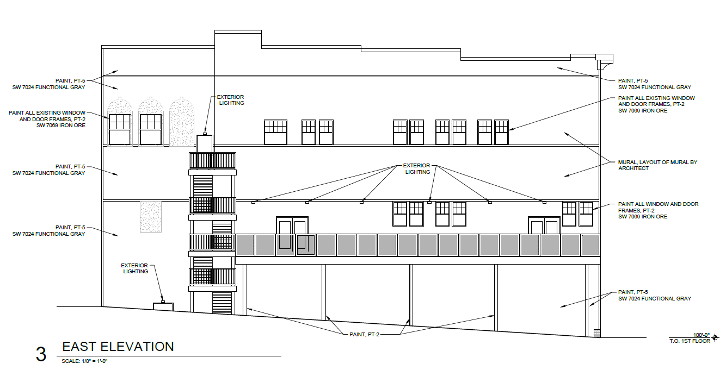
East Elevation:
These windows have been removed

Slide 8
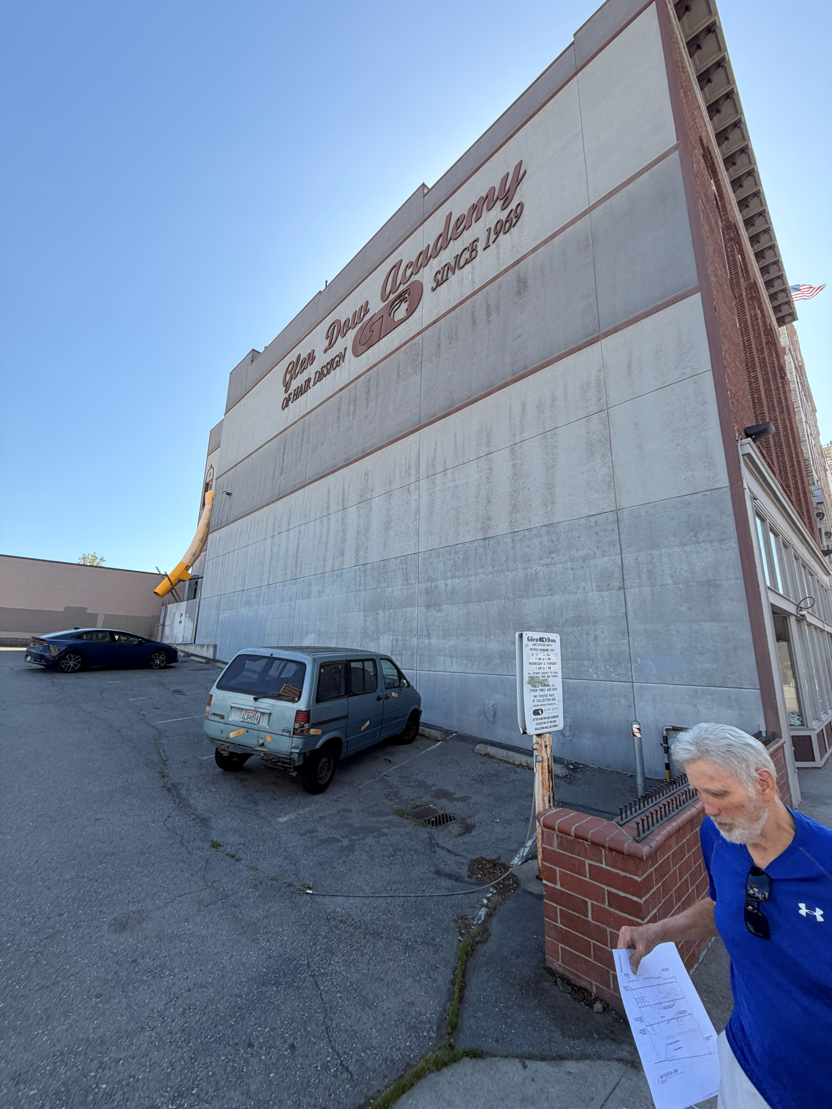
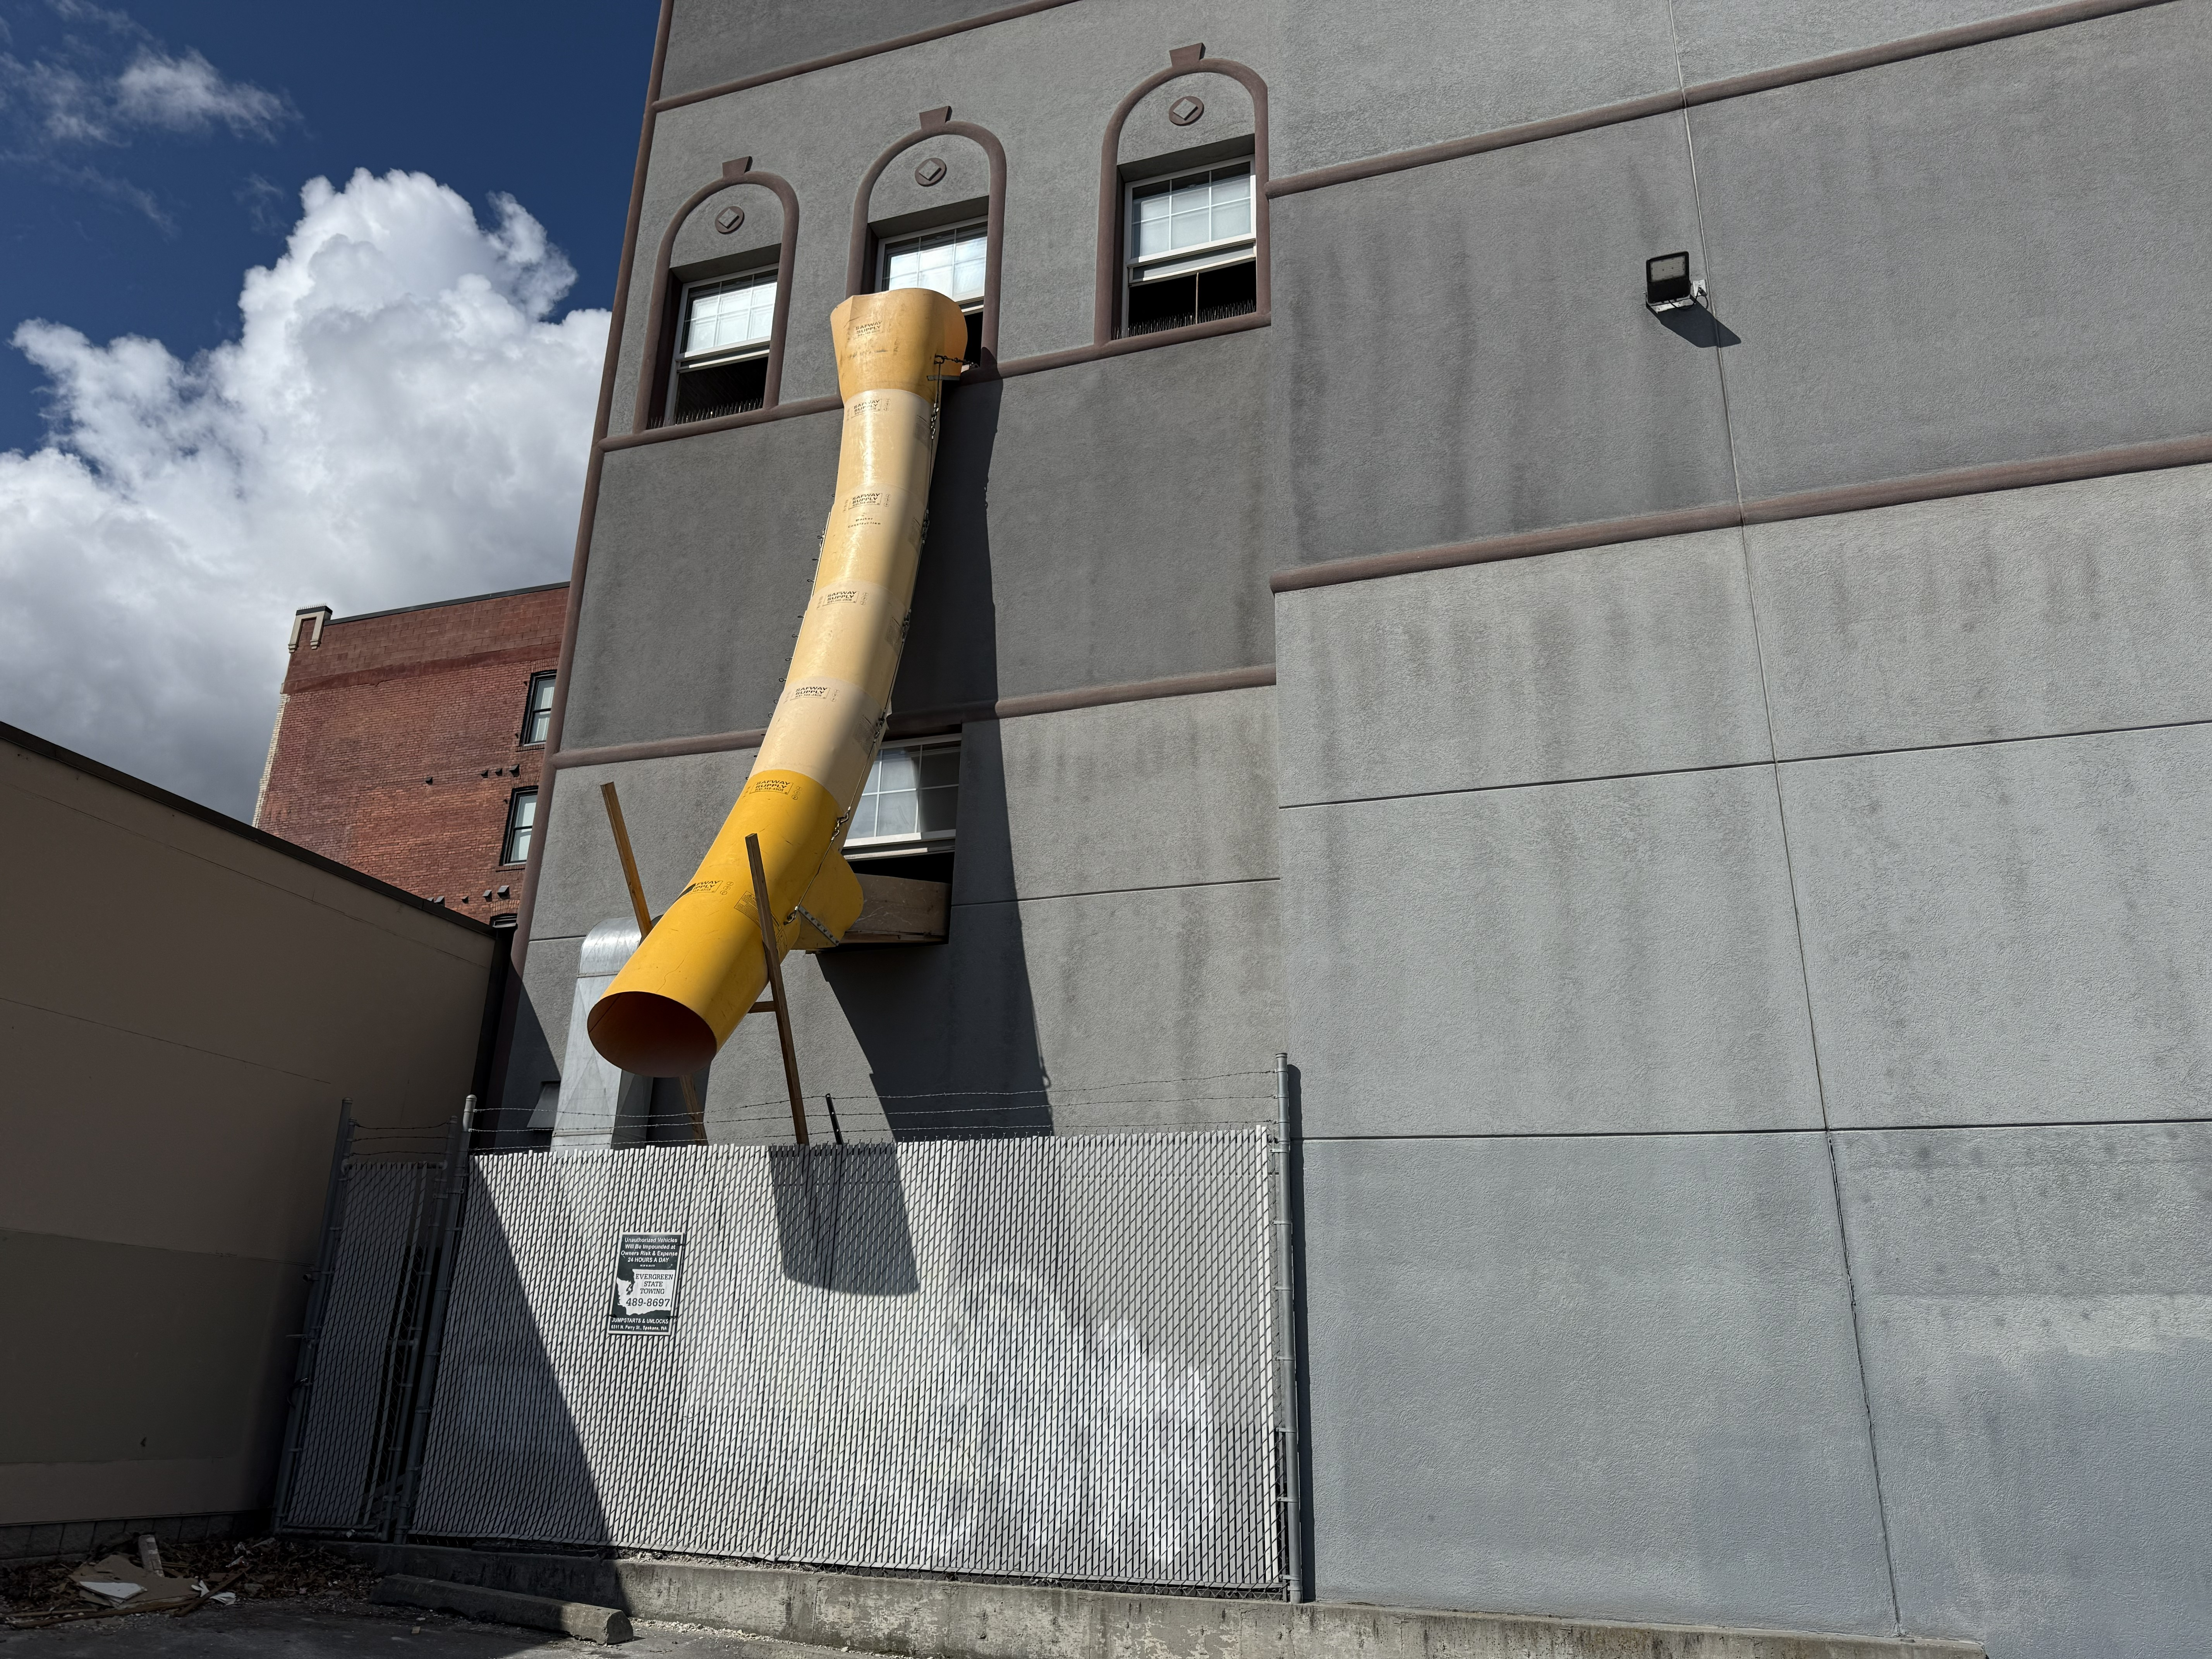
East Elevation - Current:

Slide 9
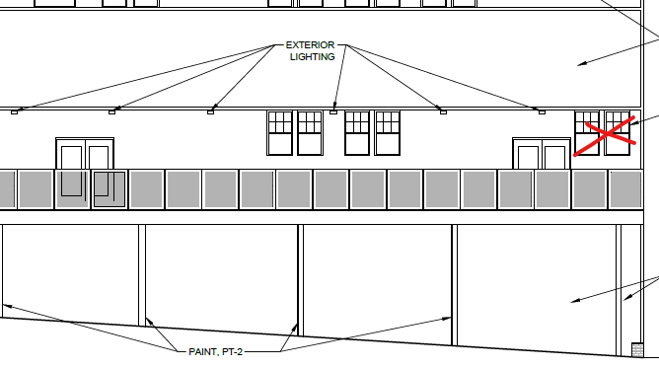
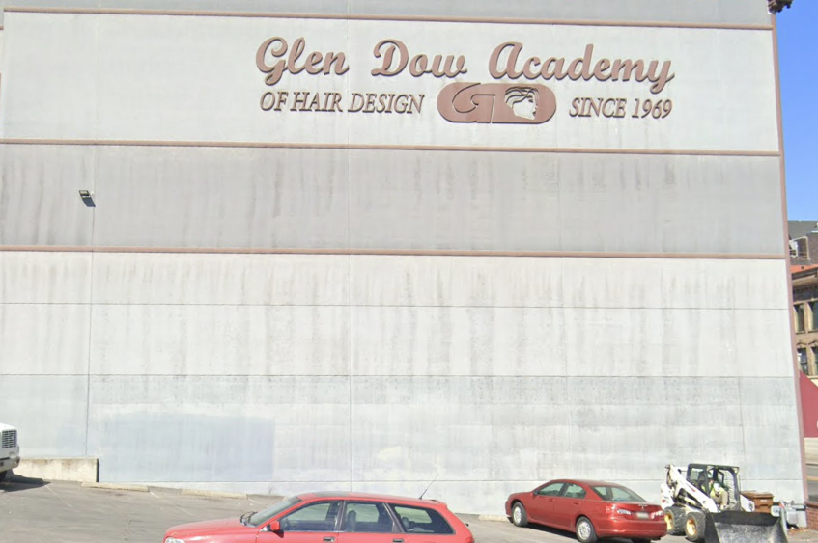
Second level proposed changes:
Decking system at the 2nd floor level will have posts holding up the deck with resident parking under.
2 new doors and 4 new windows to be added to the 2nd floor. Proposal includes two sets of double-doors. Proposed windows are metal-clad wood windows. They will be painted to match the rest of the building.

Slide 10
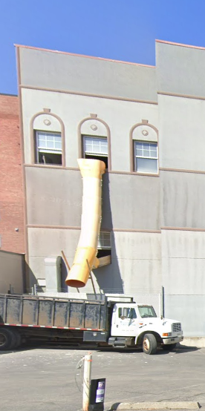
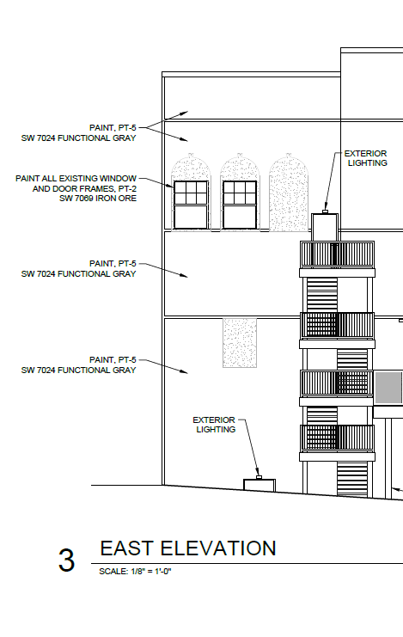
East Elevation – south end changes:
Remove decorative stucco details around windows
Remove one window at the 3rd floor level to accommodate a door for the exterior stairway
Add an exterior stair to access the 3rd floor
Remove one window at the 2nd floor level

Slide 11
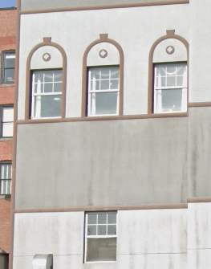
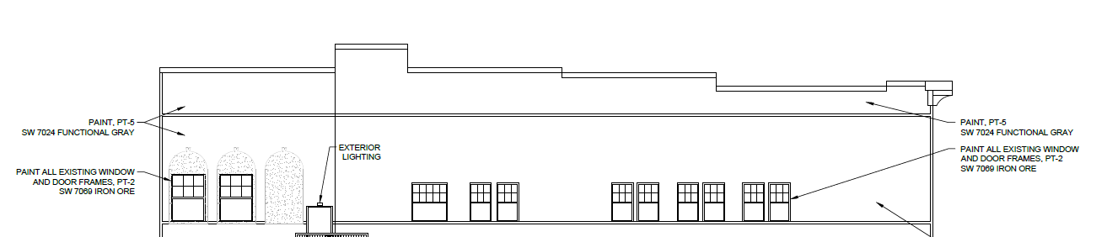
East Elevation – 3rd Level:
Remove decorative stucco details around windows
Remove one window at the 3rd floor level to accommodate a door for the exterior stairway
Add an exterior egress stair to access the 3rd floor with an entry door on the 3rd level

Slide 12
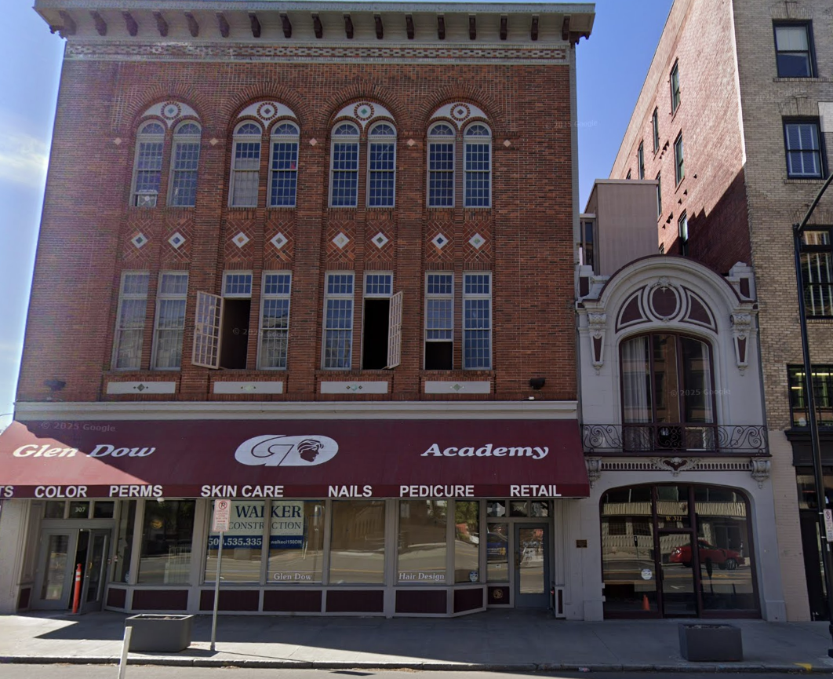
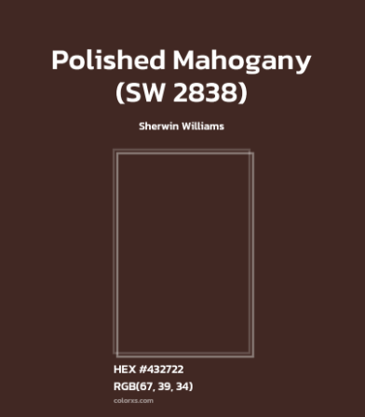
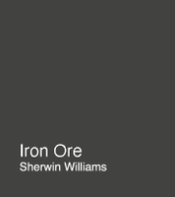
Proposed paint colors for trim (similar to existing)
Window and door trim on Robertson and east elevation/Raznik body
Details on storefront – both buildings
Windows and doors on east elevation

Slide 13
Secretary of the Interior Standards:
Standard Number 1: A property will be used as it was historically or be given a new use that requires minimal change to its distinctive materials, features, spaces and spatial relationships.
The Robertson-Raznik Building has seen several different uses over its 100+ year old history. Most recently, the building has been home to the Glen Dow hairdressing school. A new use is being made to keep the building in productive use downtown and consists of a restaurant/bar use on the 1st and 2nd floors with residential units on the 3rd floor.
This proposal includes a new feature introduced to the building on the east elevation. That feature is an outdoor deck which is located on the 2nd floor of the building and projects to the east. The proposal includes two new openings for double doors that will service the deck space as well as 4 new window openings to light the interior. The deck railing will be a laser cut metal railing (design TBD).

Slide 14
Standard Number 1: A property will be used as it was historically or be given a new use that requires minimal change to its distinctive materials, features, spaces and spatial relationships, con’t.
In order to accommodate the new housing use on the 3rd floor, several new window openings will be cut into the building, including 9 new windows. One existing window (vinyl) will be removed to make way for a door into the space from the new exterior stair.
There will also be an exterior staircase that will offer egress from the 3rd floor housing units which is a new element introduced for the change in use to residential.
One window on the rear of the 2nd floor will be removed. This is not a historic window.
The proposed work to change the use to restaurant/arcade and residential will include changes to the building, most significantly on the east elevation. However, the changes proposed will not change the distinctive materials, features spaces

Slide 15
Standard Number 2: The historic character of a property shall be retained and preserved. The removal of historic materials or alteration of features and spaces that characterize a property shall be avoided.
The work on the front façade will remove the three center windows at the storefront level and replace them with a storefront system with double doors. The existing storefront may be a product of the work done to accommodate Glen Dow Academy in 1986.
The storefront change will not damage or remove historic materials and therefore meets Standard #2.
The work on the east elevation will not disturb historically significant materials. Windows that will be removed (2) are vinyl replacements – no historic photos or plans of the original east elevation exist to confirm whether there were windows in the rear. New windows added will be metal clad wood windows finished in SW Iron Ore paint color.
The east elevation was built with the intent of a neighboring building covering it, so it had no detailing that is impacted by this change.

Slide 16
Standard Number 9: New additions, exterior alterations or related new construction will not destroy historic materials, features and spatial relationships that characterize the property. The new work will be differentiated from the old and will be compatible with the historic materials, features, size, scale and proportion, and massing to protect the integrity of the property and its environment.
The proposed deck on the 2nd floor of the Roberson-Raznik Building will not destroy historic materials or features of the historic building. The new deck will be differentiated from the original building and obviously be a new addition to the building. The same can be said for the exterior stair which is needed for the 3rd floor residential use.

Slide 17
Standard Number 10: New additions and adjacent or related new construction will be undertaken in such a manner that, if removed in the future, the essential form and integrity of the historic property and its environment would be unimpaired.
The deck and exterior stair could be removed in the future if someone wanted to build another building to the east of the Robertson-Raznik Building and there would be little evidence of the deck addition – however, there will be new openings for two sets of double doors as well as a door at the 3rd floor level that may need to be returned to a bricked-in state.

Slide 18
RECOMMENDATION:
Approve the application for the changes proposed to bring a new use to the building to include both restaurant and housing spaces. Changes are in compliance with the Secretary Standards because they are not removing or dramatically changing character-defining features of the Robertson-Raznik Building. The project meets The Secretary of the Interior’s Standards #1, #2, #9 and #10.

