Slide 1
Proposed Changes to
1204 West 11th Avenue
Spokane, WA 99204
Proposed changes include:
Addition of shed roof dormer to utilize a closet as a bedroom
Conversion of three small shed dormers into peaked “doghouse” dormers due to water damage (SHLC will only review the one east facing dormer)
Addition of inset balcony to the upstairs bedroom

Slide 2
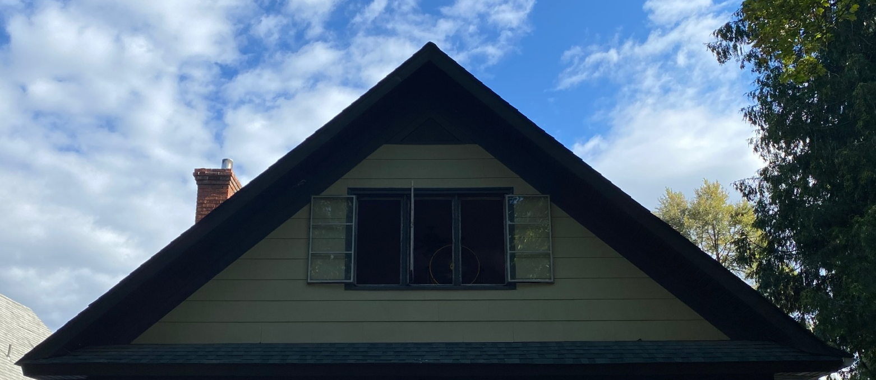
Front Gable
Current – 3 aluminum or steel sash casements probably from the 1950s

Slide 3

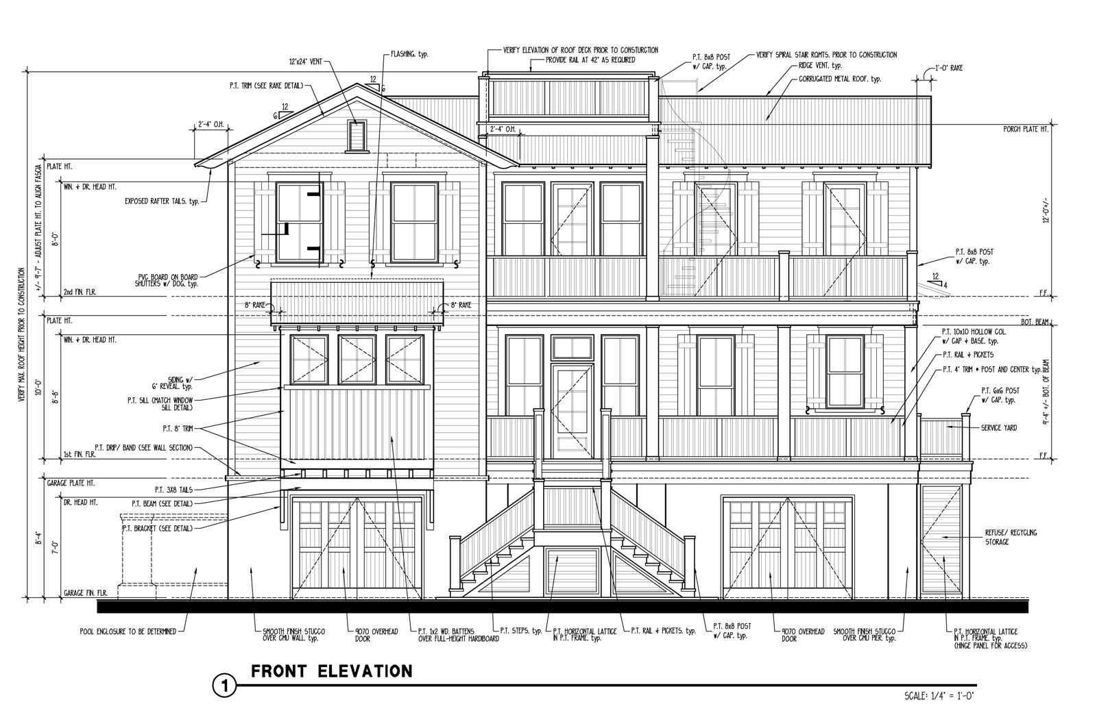
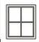
Front Gable Balcony
Original Proposal

Slide 4
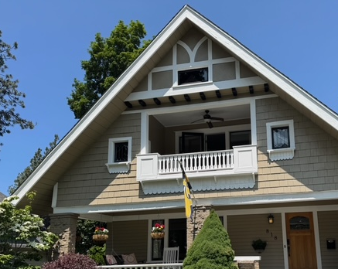
Front Gable Balcony Comparison
818 West 14th Avenue

Slide 5
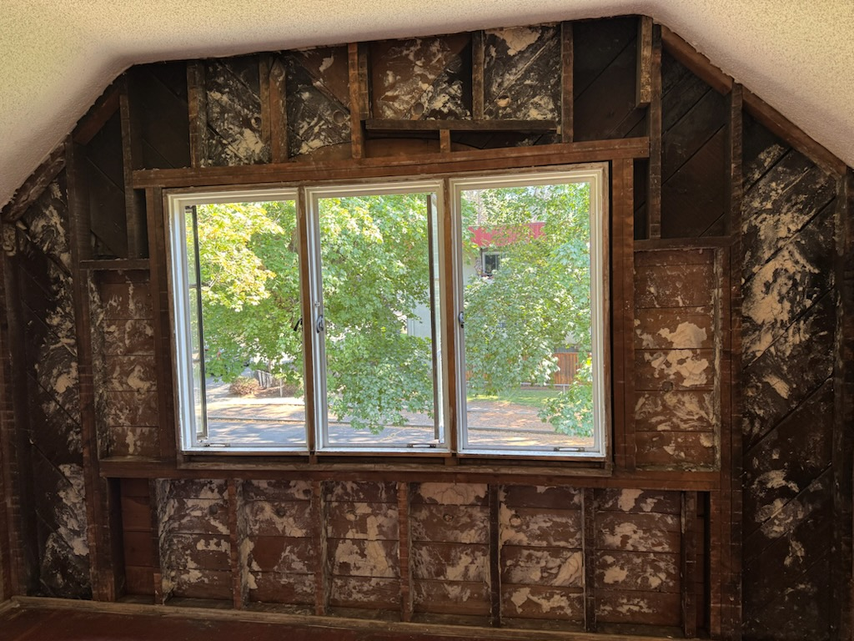

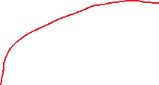
Previous balcony framing visible
Notes:
Approximately 7’ 6” wide and 6’ 3” tall; looks to have had arched opening (would not look appropriate with craftsman look the home has now).

Slide 6
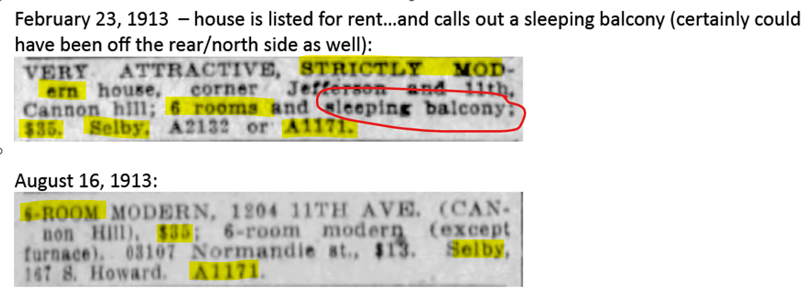

Slide 7
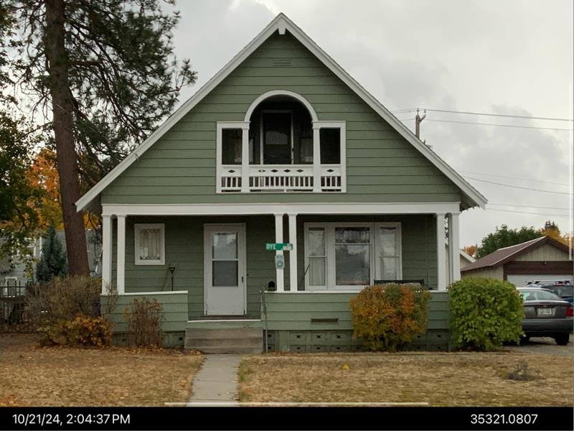
728 E 31st – 1908 Built Date

Slide 8
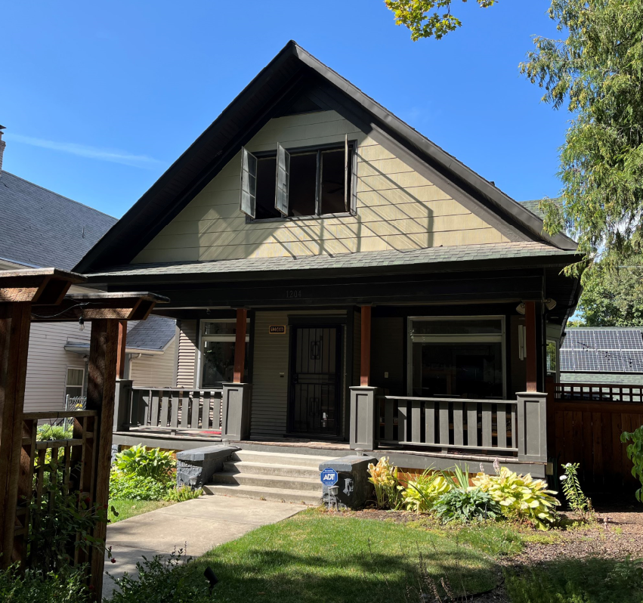
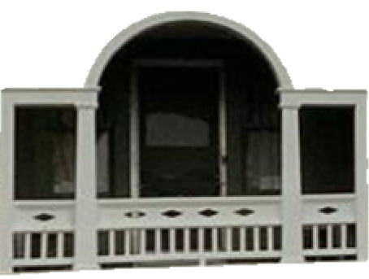
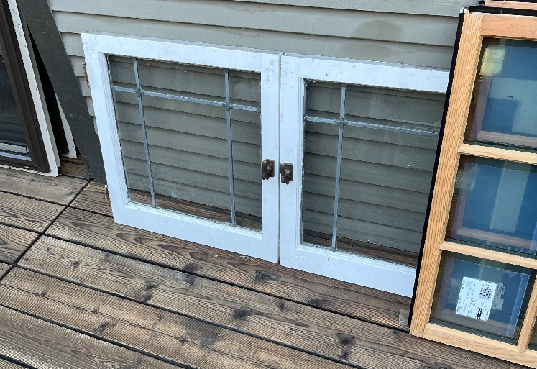

Slide 9
Secretary of the Interior’s Standards
Standard #3: Each property will be recognized as a physical record of its time, place and use. Changes that create a false sense of historical development, such as adding conjectural features or elements from other historic properties, will not be undertaken.
Standard #6: Deteriorated historic features will be repaired rather than replaced. Where the severity of deterioration requires replacement of a distinctive feature, the new feature will match the old in design, color, texture and, where possible, materials. Replacement of missing features will be substantiated by documentary and physical evidence.

Slide 10
Staff Recommendations
The proposal to add a recessed 2nd floor porch/balcony with a Palladian style opening would recreate the original appearance of the gable end of the house based on physical evidence (framing evident inside the gable end) and contemporary newspaper advertisements that note a “sleeping balcony” was a feature of the house. Therefore, the work on the south/street-facing façade meets Standards #3 and #6 and should be approved.

Slide 11
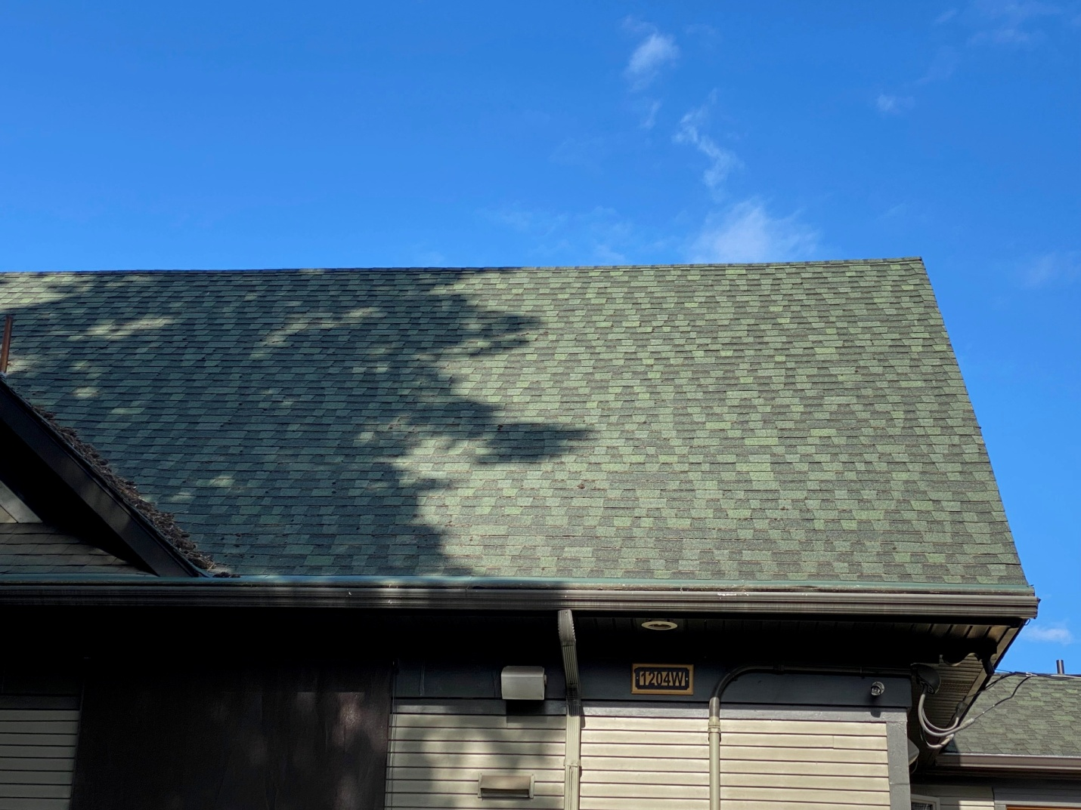
Bedroom Shed Dormer
Current roof – rear or north-east elevation

Slide 12
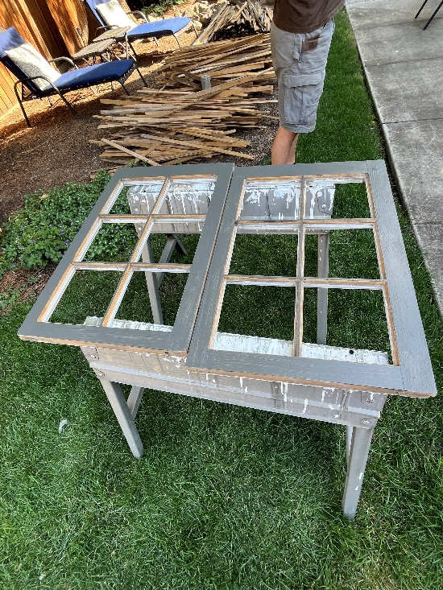
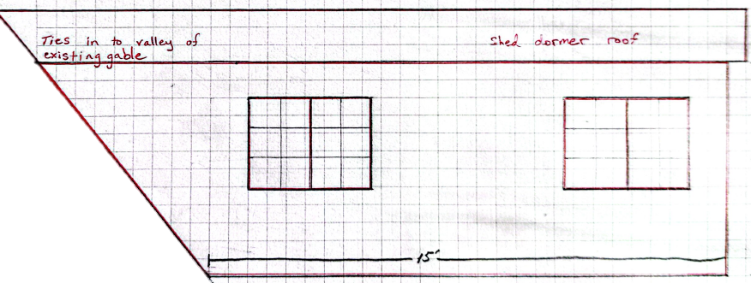
Bedroom Shed Dormer
Proposed shed dormer attached to gable on left; upstairs closet becomes bedroom. Windows are wood casement style in size to meet fire egress code for a bedroom.

Slide 13
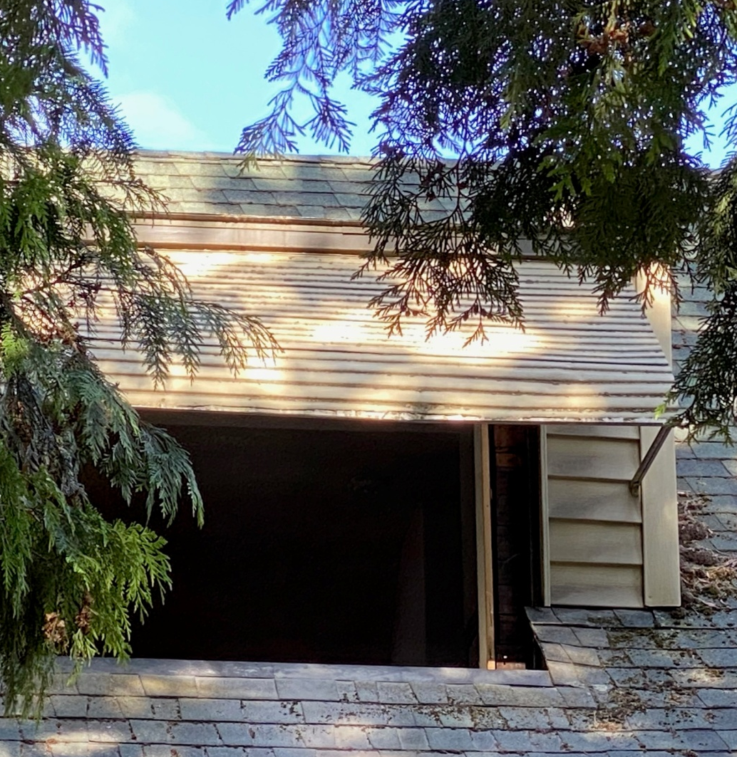

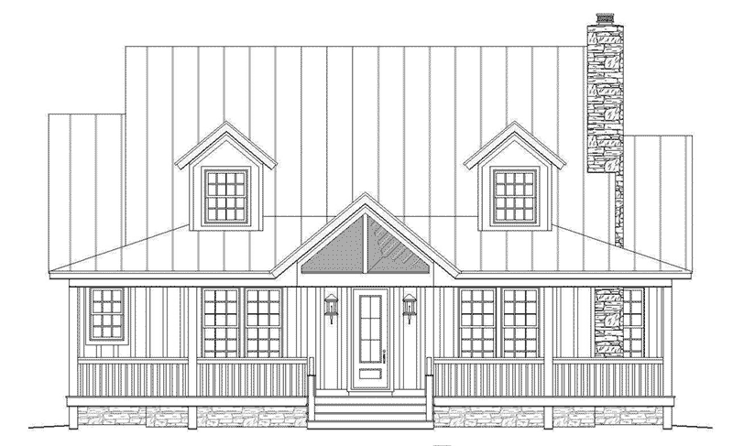
Proposed Peaked Dormers (3)
Proposed window would be a wood casement that would match the two on the shed dormer to the north (pictured on left).

Slide 14
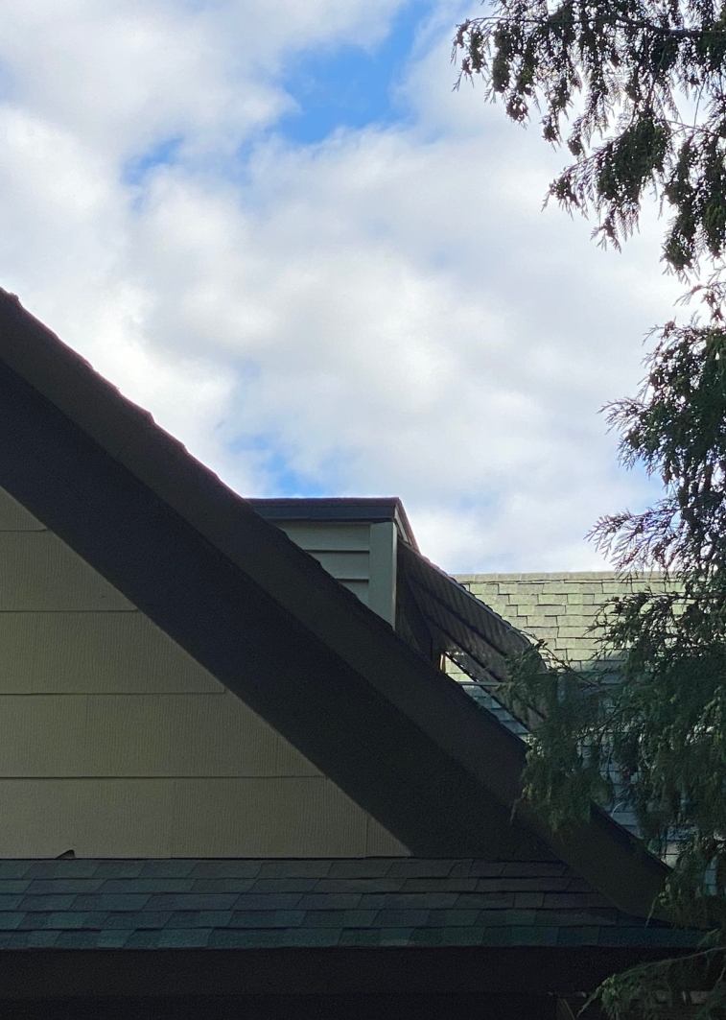
Leaking Dormer (East side)
SHLC will only review the east facing dormer since it is on a highly visible elevation.

Slide 15
Secretary Standards for
East Elevation Roof Changes
Standard #9: New additions, exterior alterations, or related new construction will not destroy historic materials, features, and spatial relationships that characterize the property. The new work will be differentiated from the old and will be compatible with the historic materials, features, size, scale and proportion, and massing to protect the integrity of the property and its environment.
Standard #10: New additions and adjacent or related new construction will be undertaken in such a manner that, if removed in the future, the essential form and integrity of the historic property and its environment would be unimpaired.

Slide 16
Staff Recommendations
From the front/south elevation, the addition of the shed style dormer will not be visible because it will be located behind the cross-gable of the roof. While large, this dormer will be located on the rear portion of the house which is generally where additions such as this are preferred. The new dormer will include two egress sized wood windows that are 6:6 casement style. Siding on the dormer should match the main body of the house with narrow wood siding.
The roof change of the east facing dormer will also be minimally visible from the street-facing façade of the house on the sidewalk. Changes will be visible from Jefferson side of the house which is the secondary elevation of the property. The east facing dormer is not original to the house, although it is difficult to determine when it was added. This dormer is not a character-defining feature of the house and a change of roof form will be more compatible with the existing house than the almost flat roof that is currently on the dormer. Adding a wood 6:6 casement window will be more appropriate than the large plate glass window that is there now. This window will match the two windows on the new shed dormer to the north/rear of the property on the east elevation.
The work will not destroy historic materials of the house. The new work will be compatible with the historic materials, features, size, scale, proportion and massing of the existing house. The work could be removed in the future and the current form and integrity of the property would be unimpaired.
Staff recommends that the work on the east elevation be approved.

