Slide 1
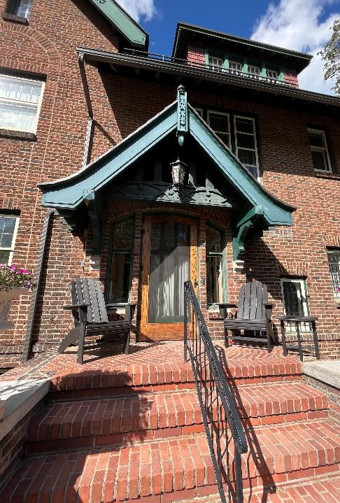
William & Anne Murgittroyd House
516 W Sumner Avenue
Residential Special Valuation

Slide 2
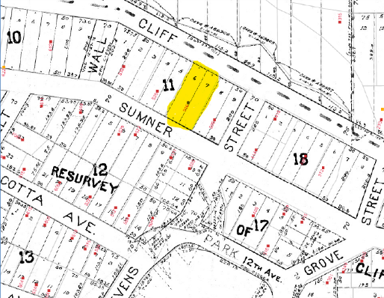
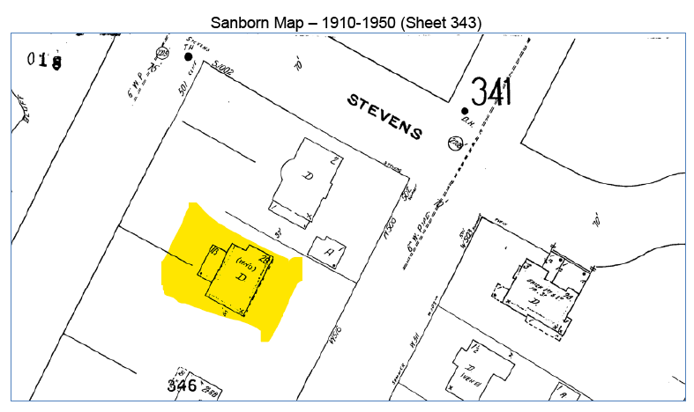

Slide 3
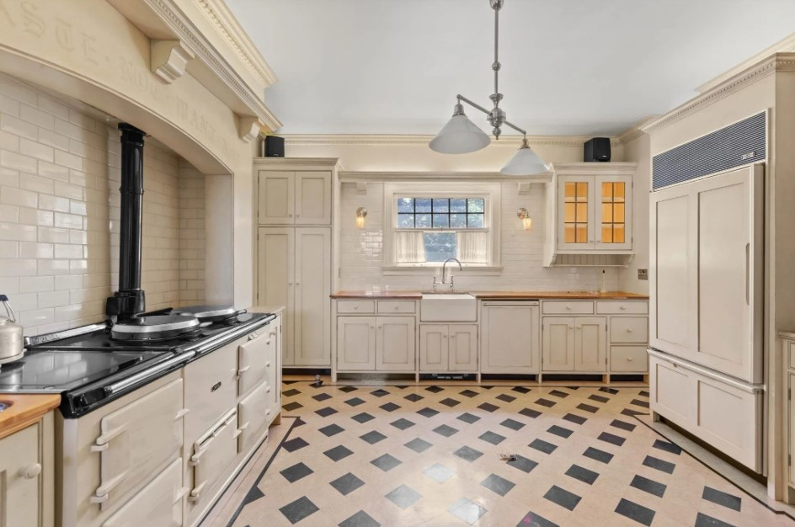
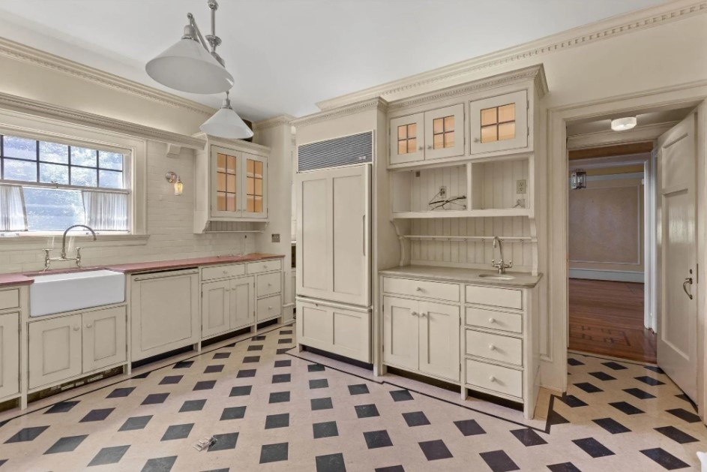
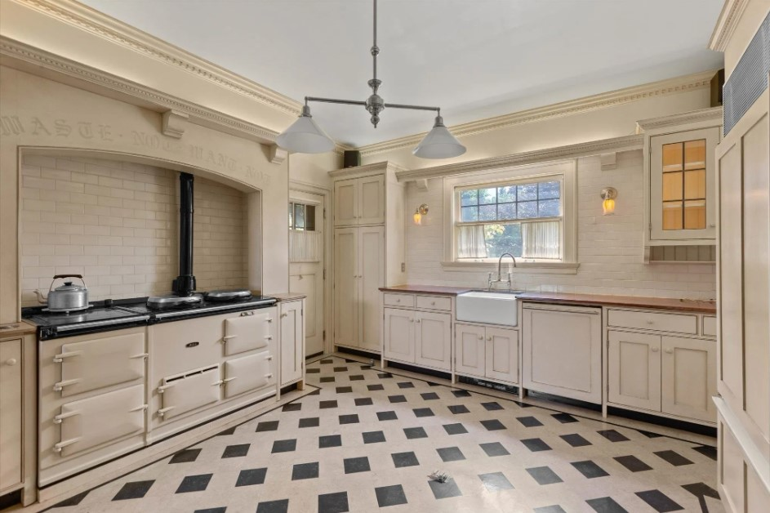
Kitchen Before

Slide 4
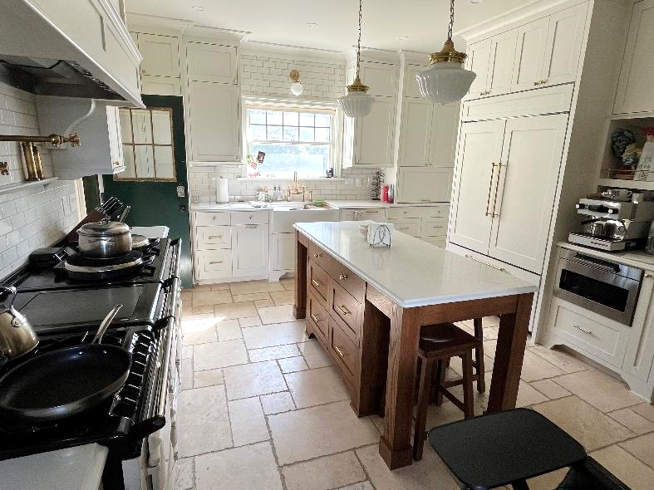
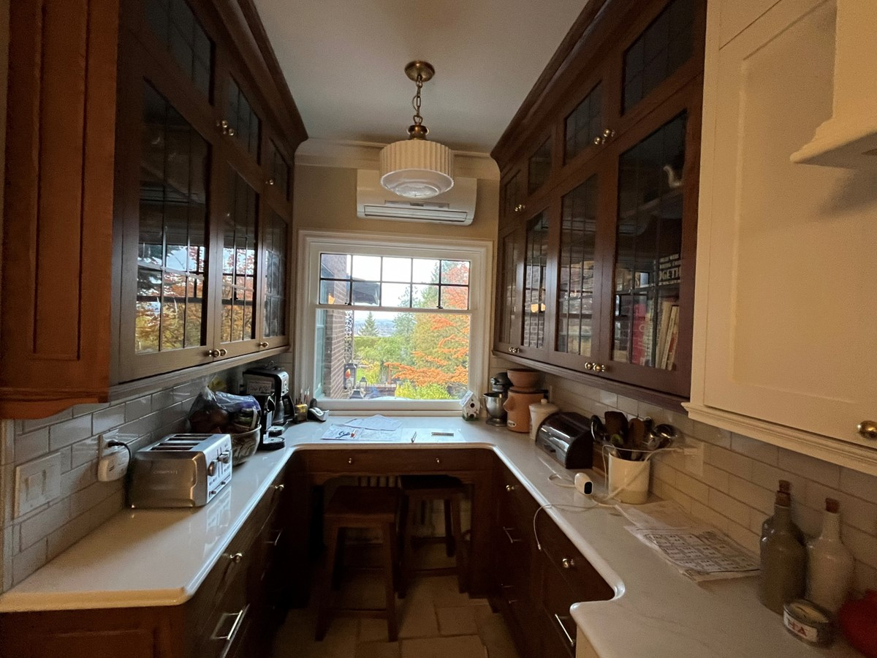
Kitchen After

Slide 5
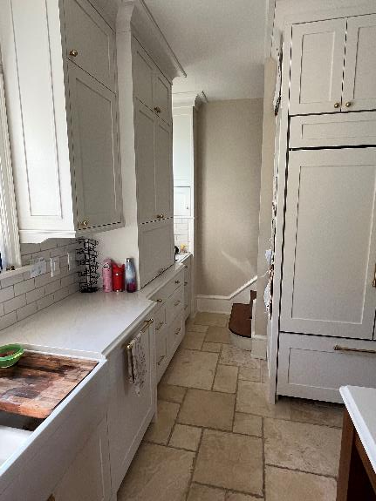
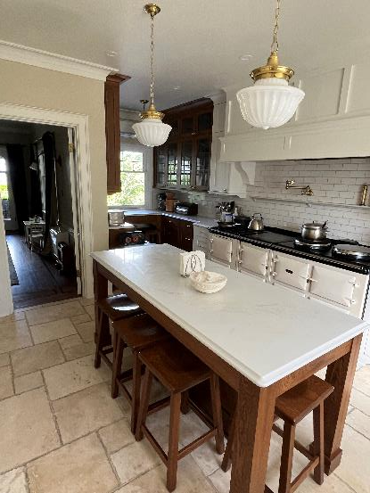
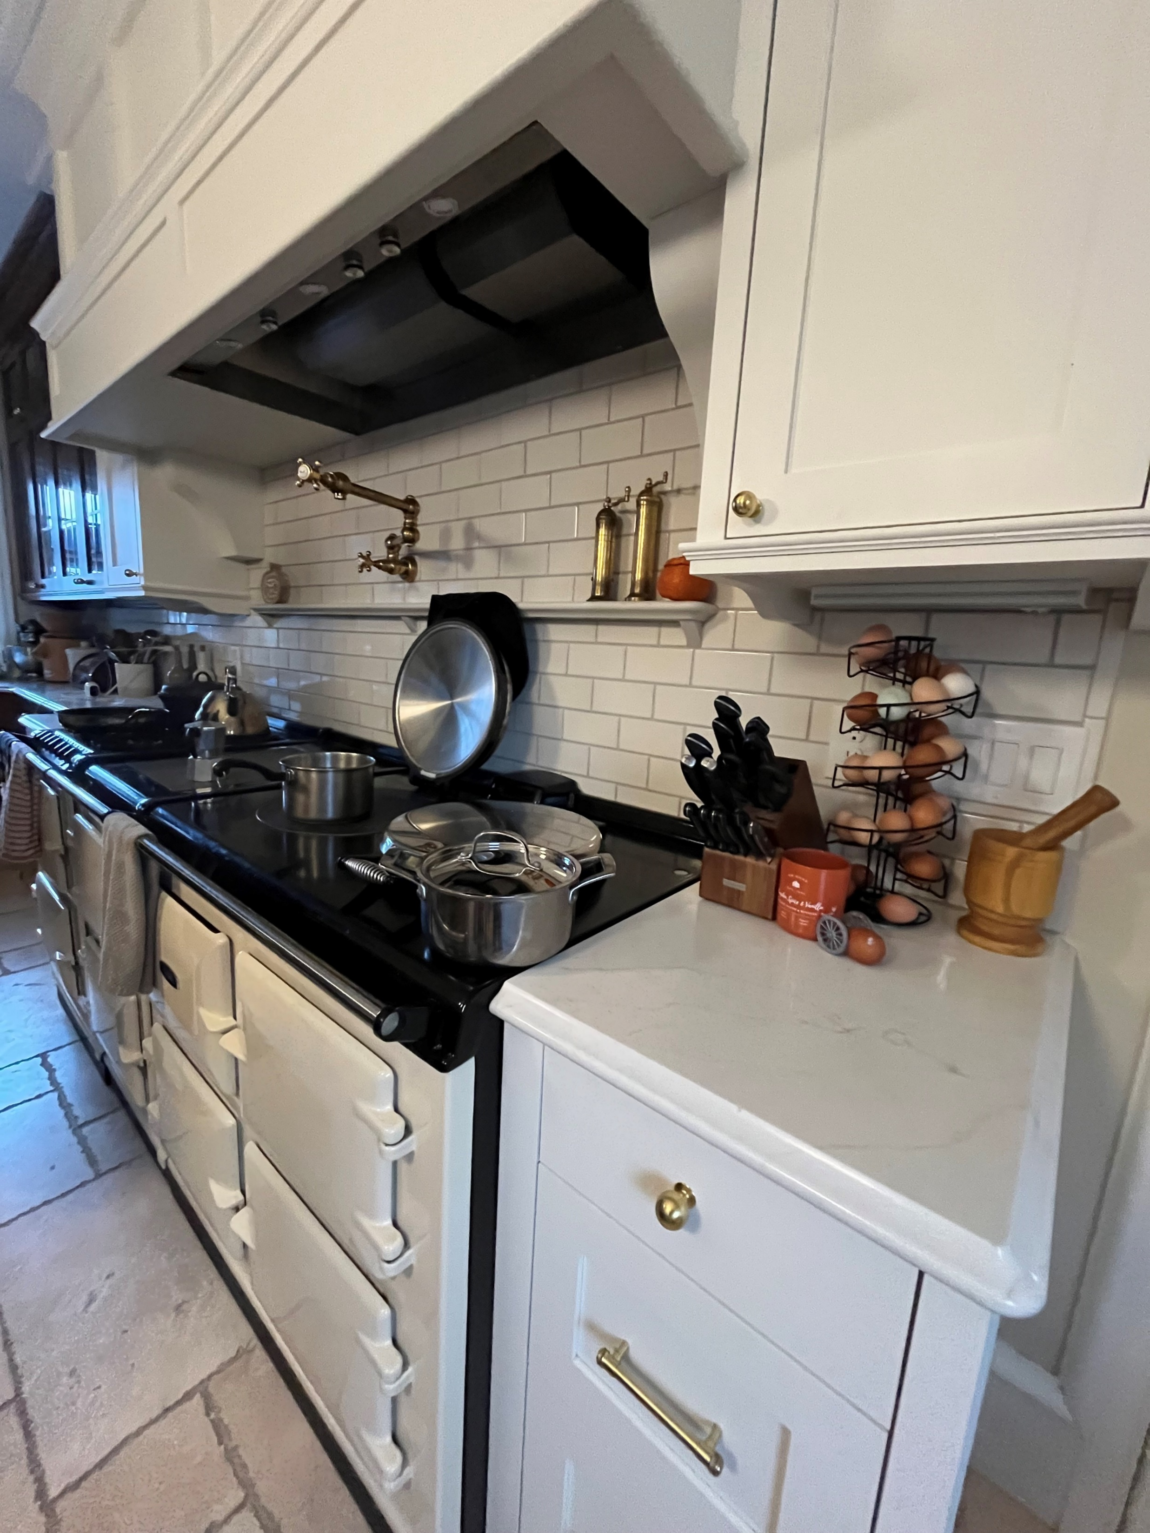
Kitchen After

Slide 6
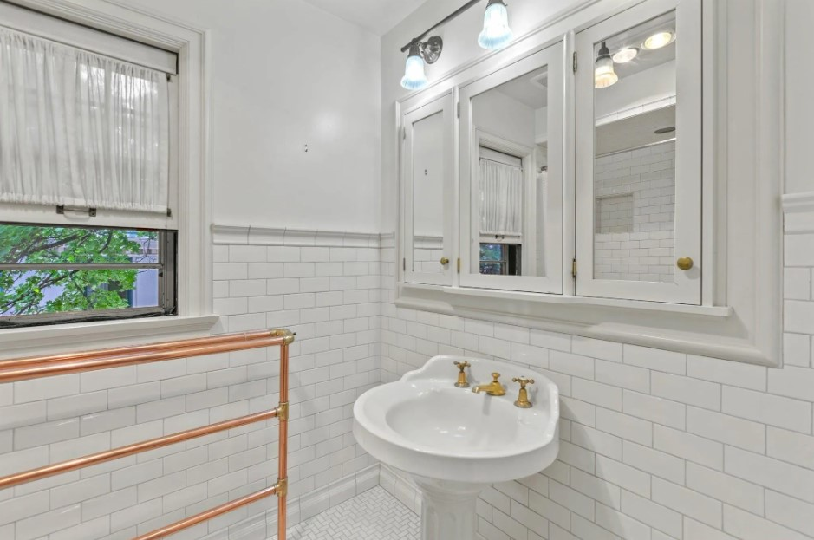
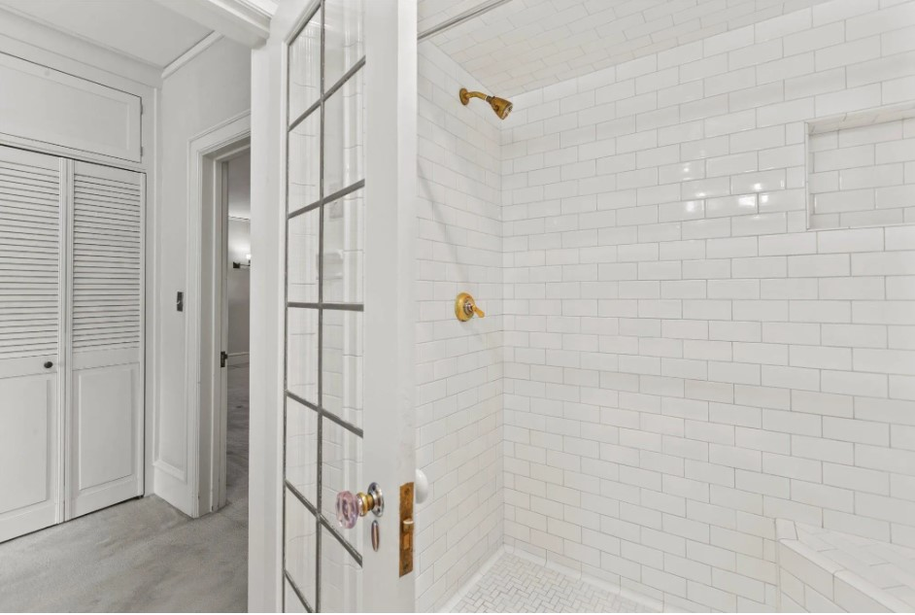
Master Bath - Before

Slide 7
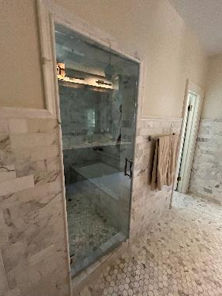
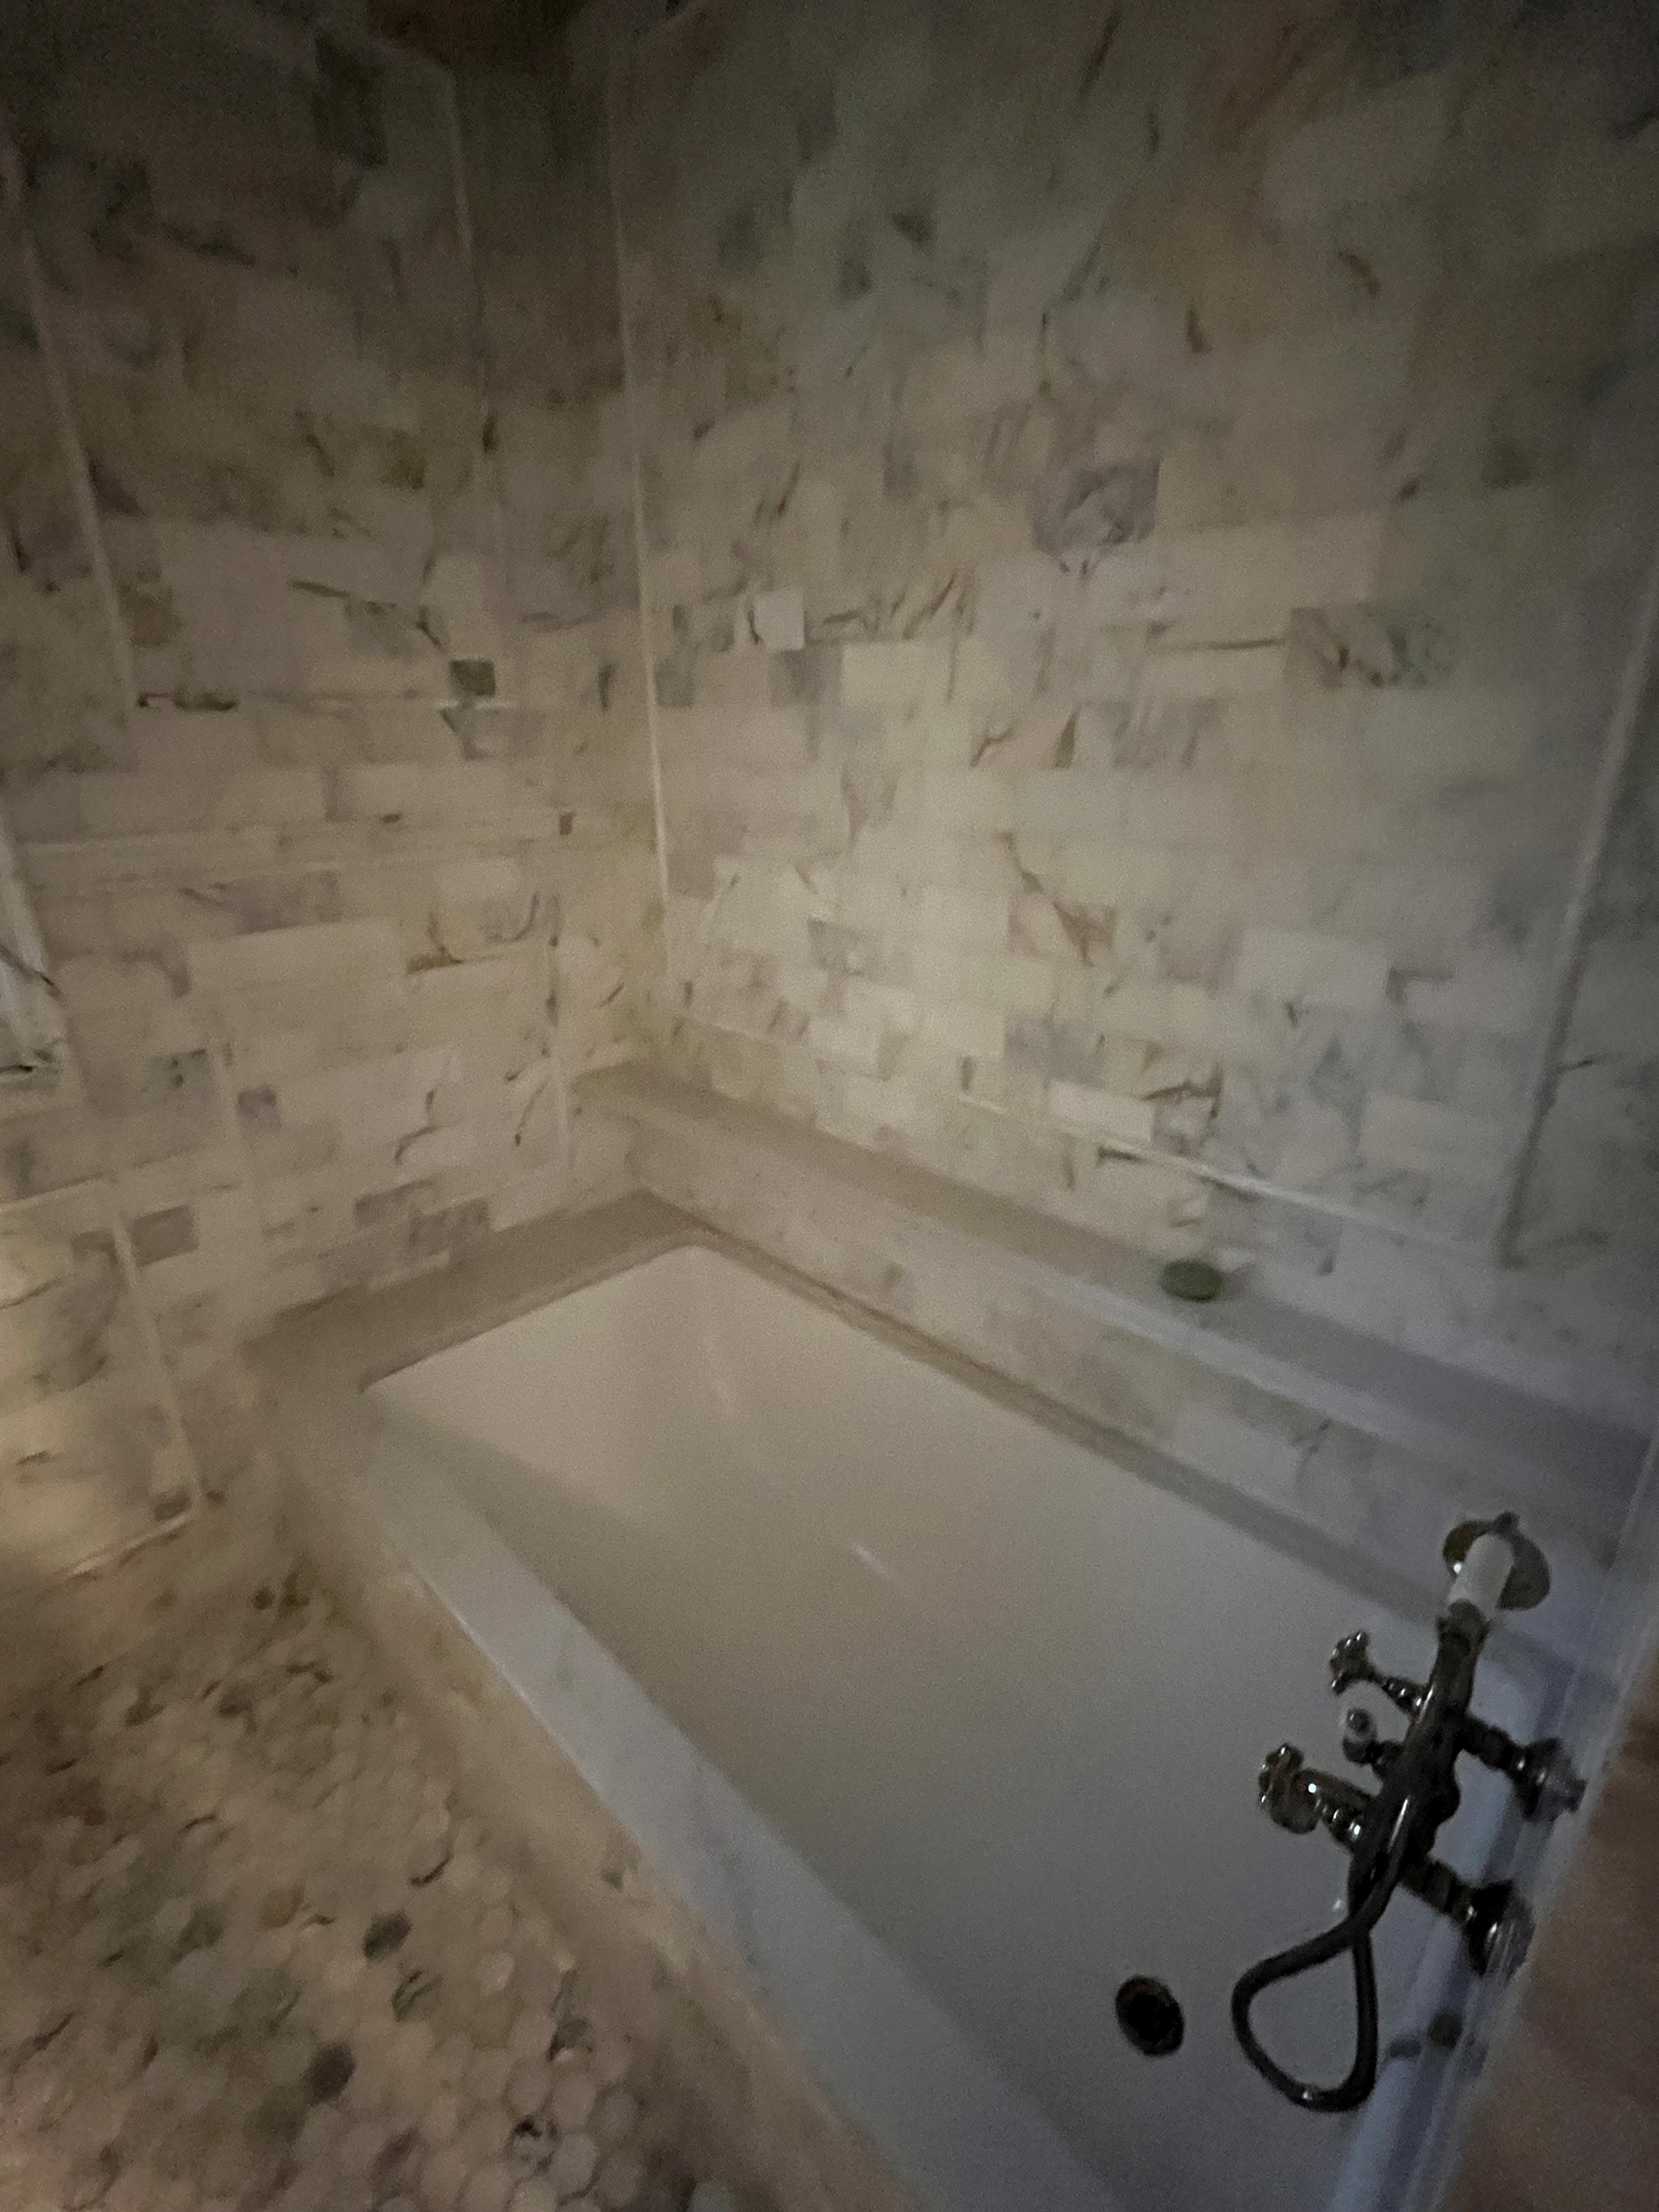
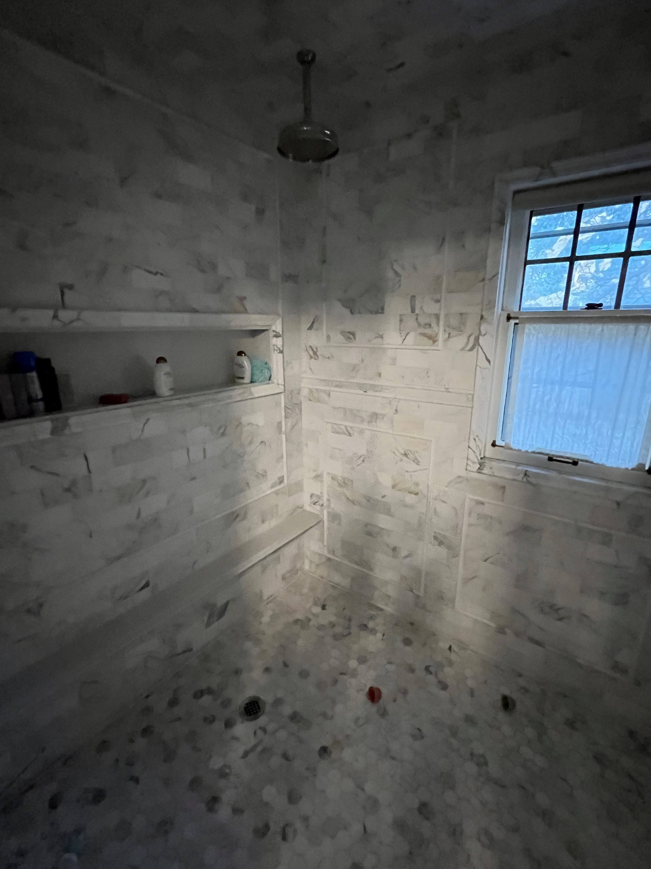
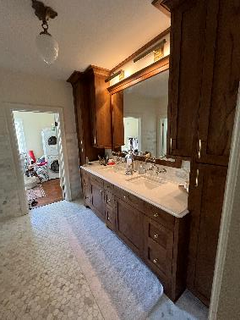
Master Bath - After

Slide 8
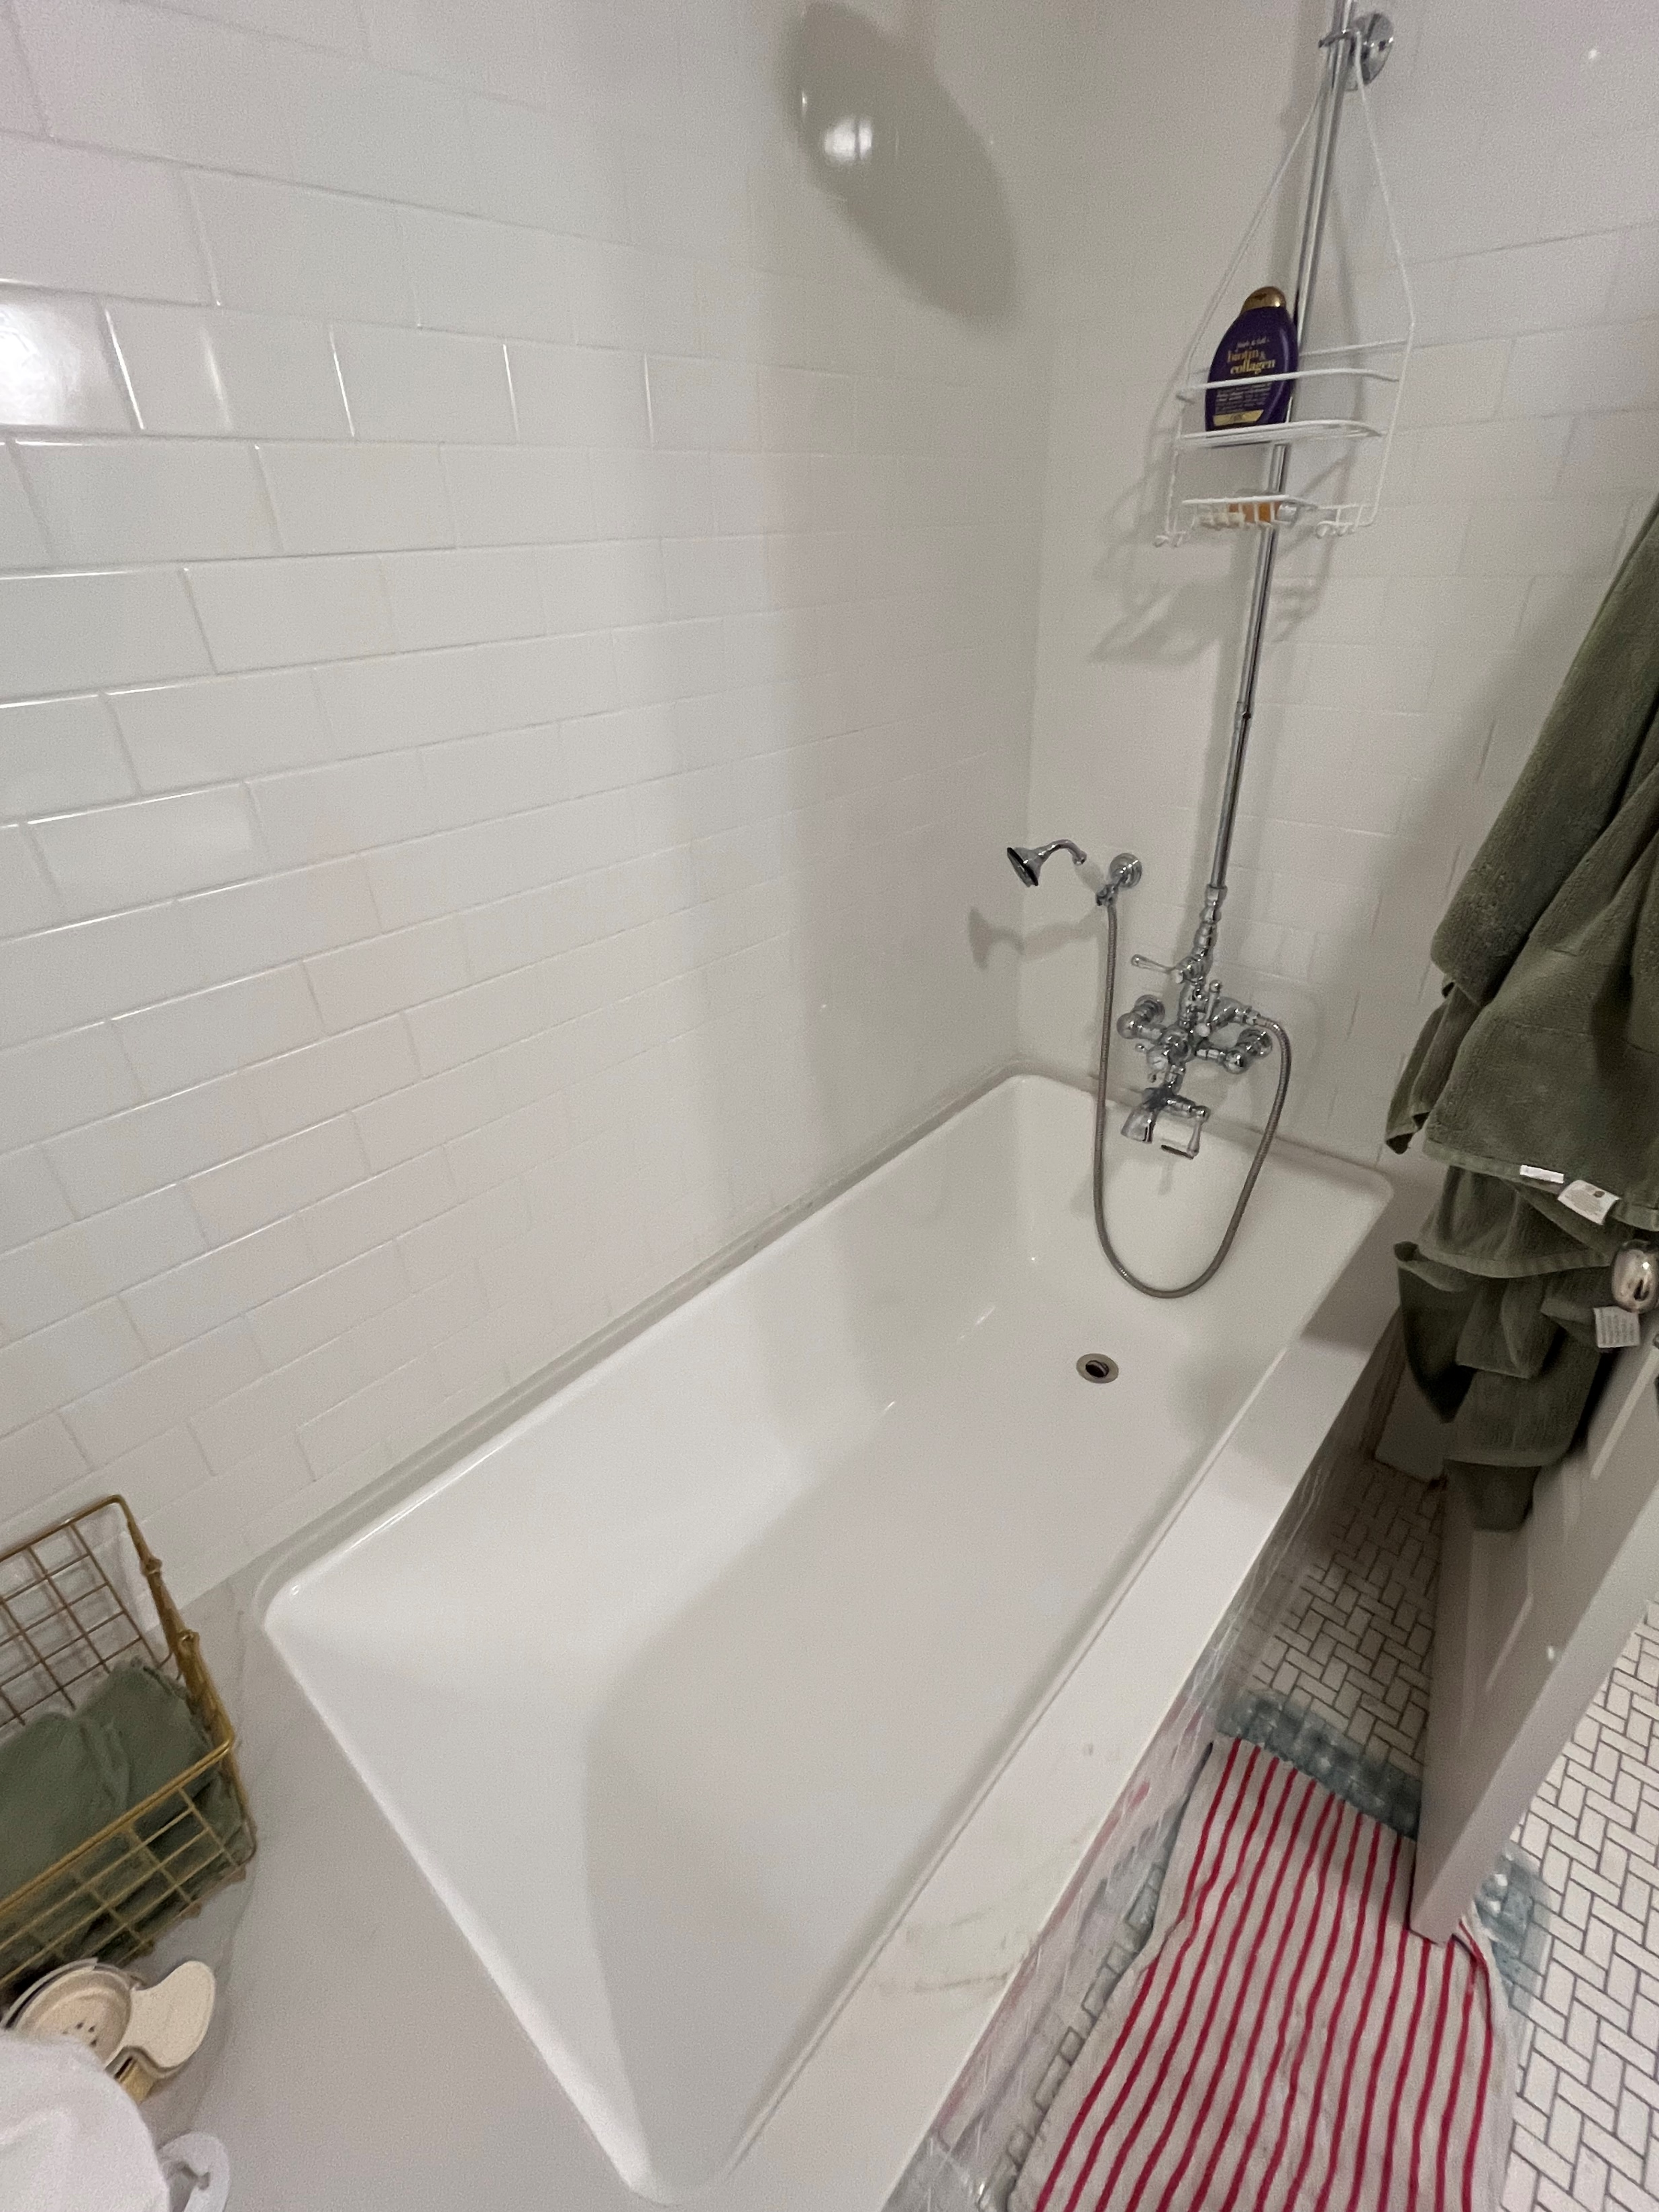
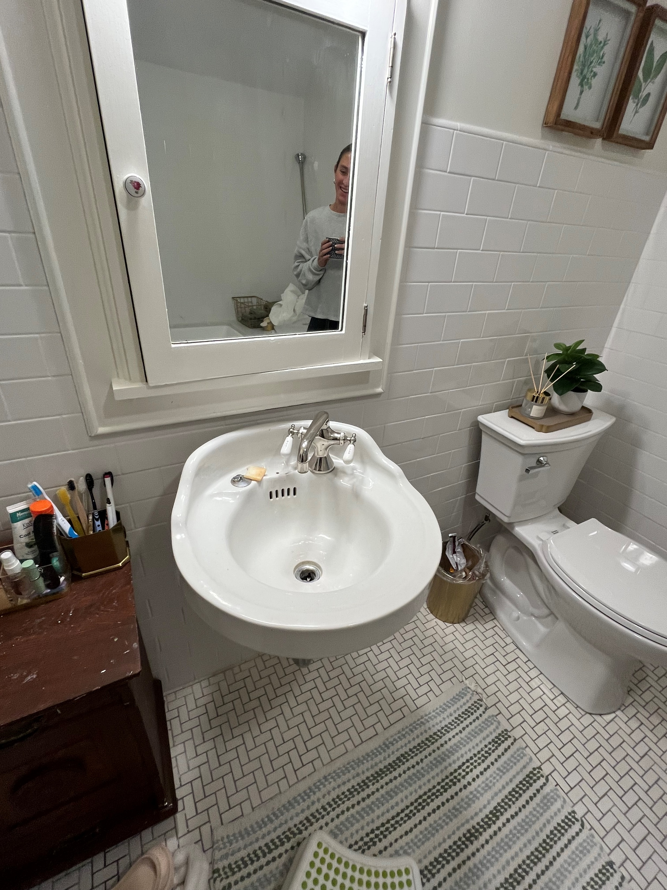
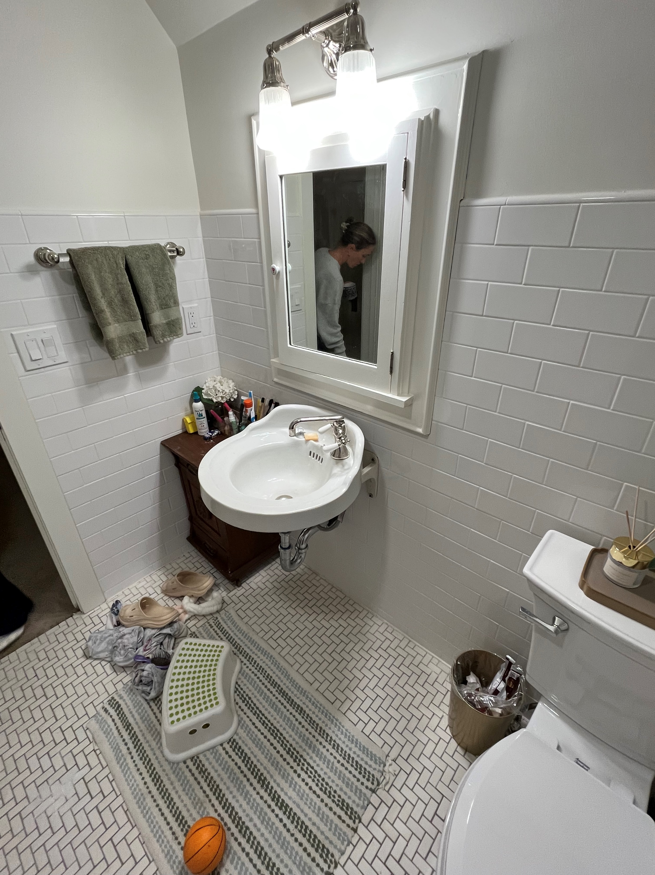
3rd Floor Bath – After Repairs

Slide 9
Expenses
Claimed expenses are allowable in the amount of $569,612.
Landscaping costs beyond the work to remove the ivy from the house’s façade was removed (allowed for $1000).
There were also invoices for work/payment that was outside of the 2-year period prior to application in the amount of $99,930.35.
Staff added in $43,502 paid in pro-rated property taxes during the rehab period.

Slide 10
Murgittroyd House
516 W Sumner

