Slide 1
Green-Hughes Printing Co. building
WINDOW REPLACEMENT
19 W Pacific Avenue
Commercial
Certificate of Appropriateness

Slide 2
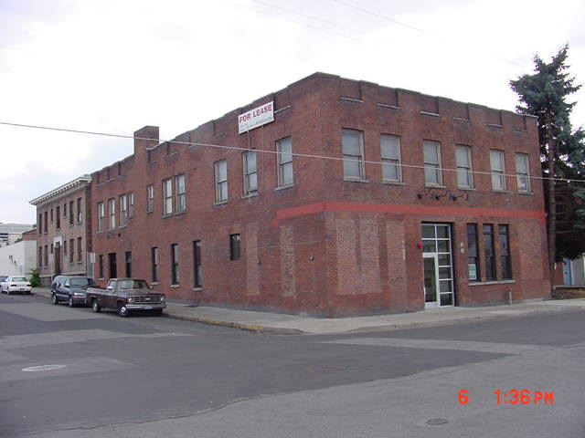
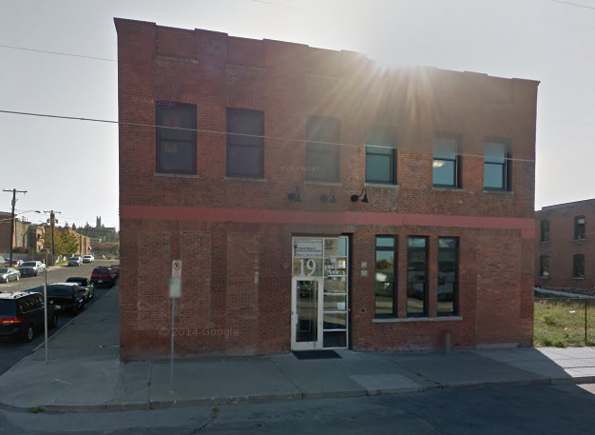
19 W Pacific Avenue
Green-Hughes Printing Company
SHRP listed 2002

Slide 3
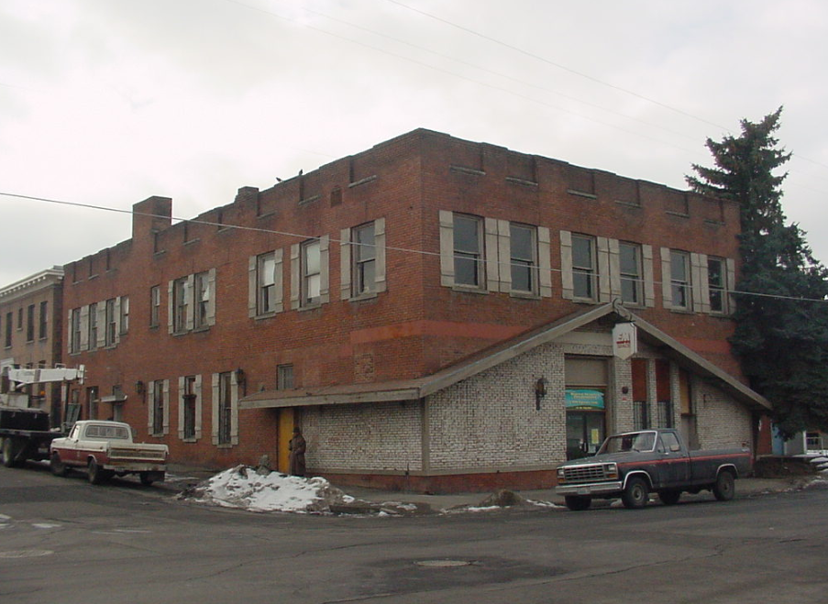

Slide 4
PROPOSAL:
We looked at this project a few months ago for the addition that was proposed. A subsequent scope change was added to what was approved – a change of the windows in the historic building. The windows proposed are an aluminum storefront style that will match the existing windows in terms of size and grid style. They will also match the windows on the new addition.

Slide 5
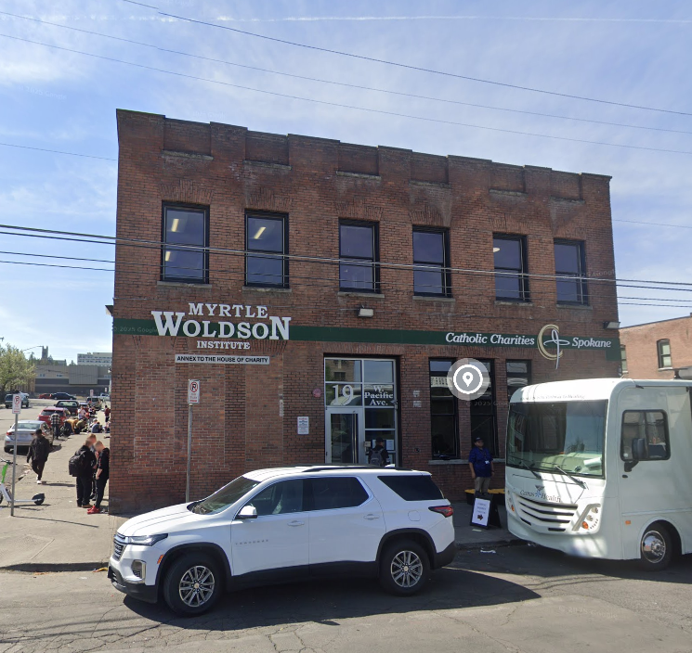
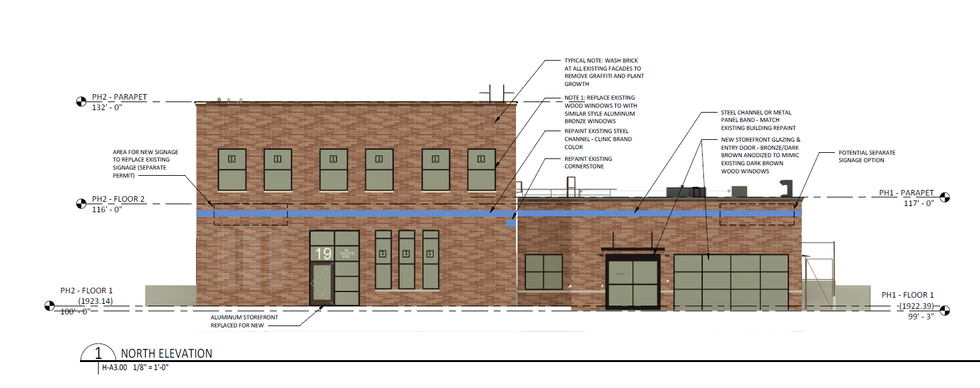
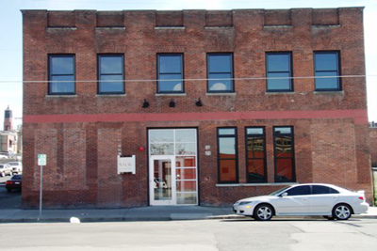
North elevation showing window replacement and configurations

Slide 6
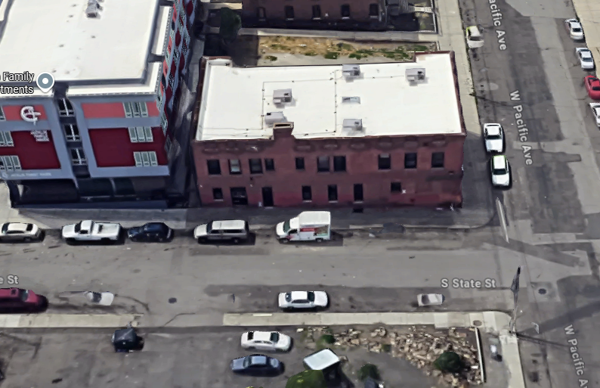
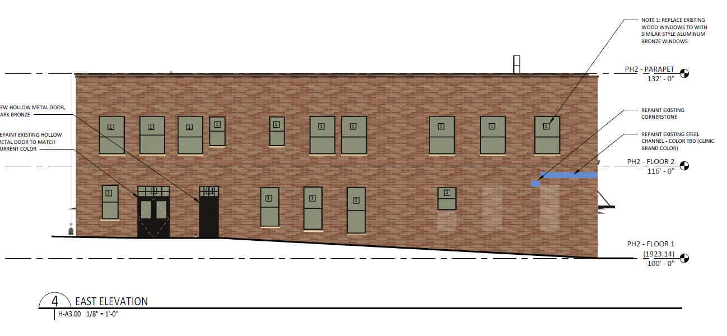
East elevation showing window replacements

Slide 7
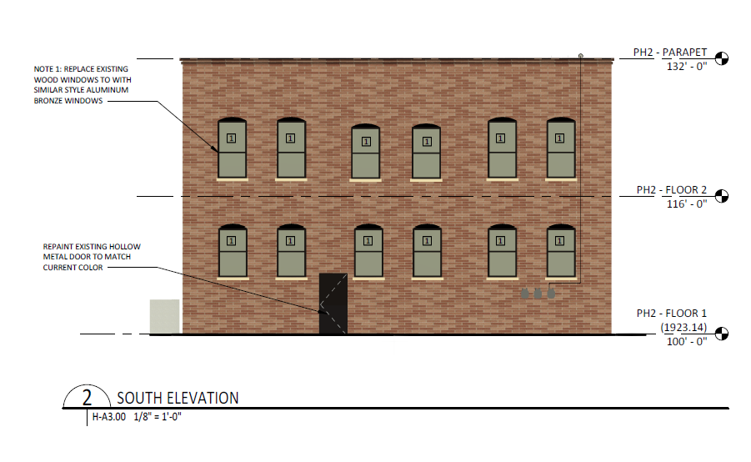
South elevation showing window replacements

Slide 8
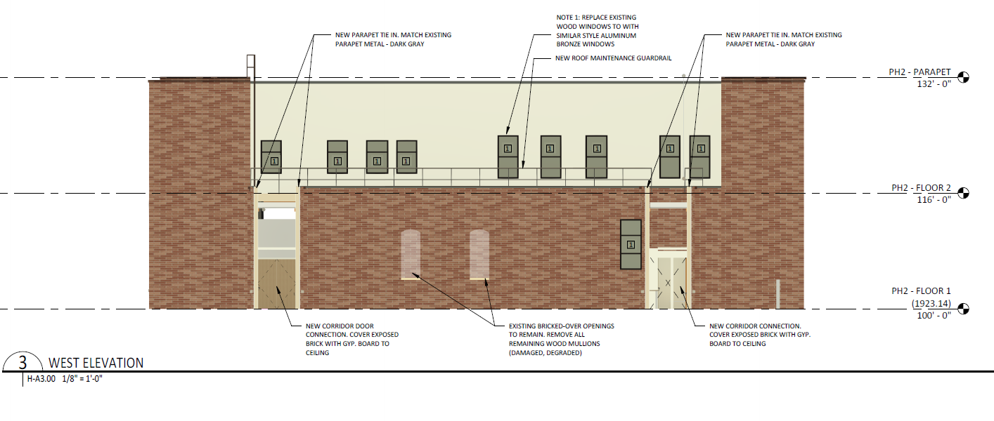
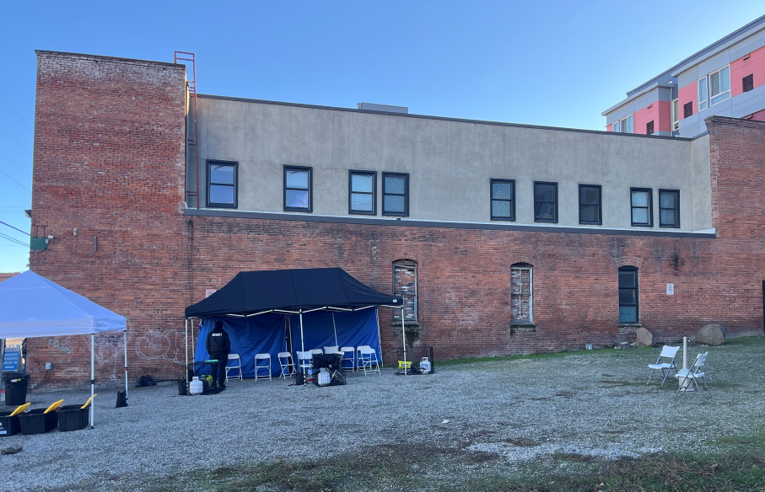
West elevation showing window replacements

Slide 9
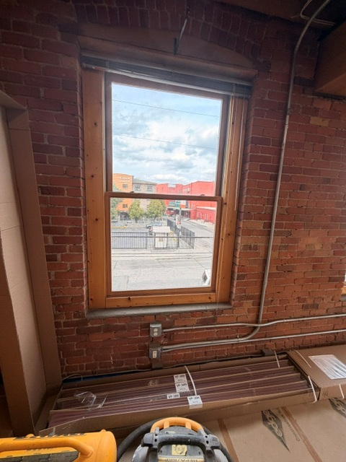
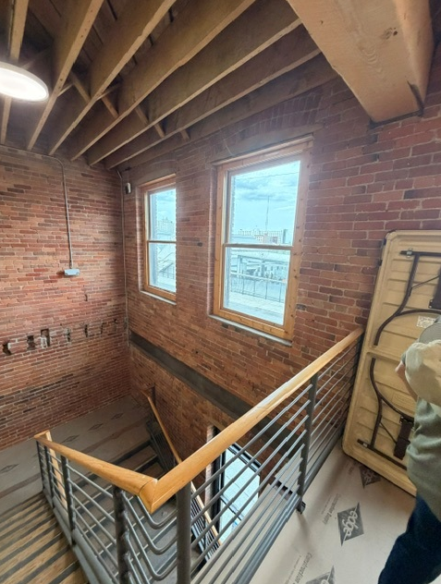
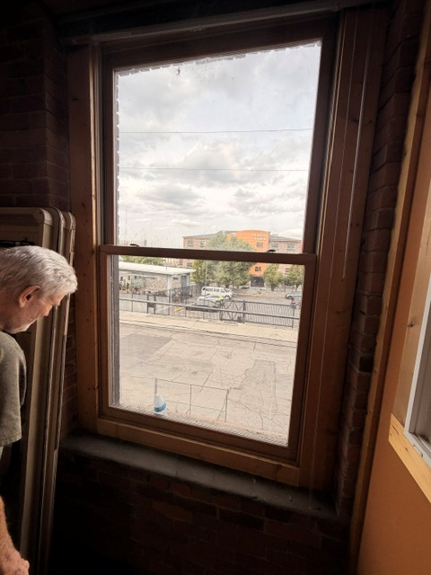

Slide 10

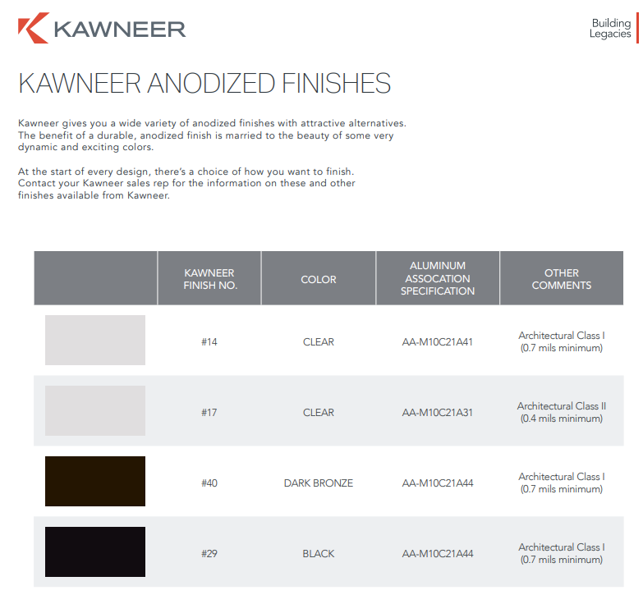

Proposed replacement product

Slide 11
RELEVANT STANDARDS THAT THIS PROJECT MEETS:
Standard #2: The historic character of a property will be retained and preserved. The removal of distinctive materials or alteration of features, spaces and spatial relationships that characterize a property will be avoided.

Slide 12
Staff Commentary on Standard #2:
At the time that the Green-Hughes Printing Company Building was listed on the Spokane Register of Historic Places in 2002, several original windows had been removed and replaced. There were 59 original wood windows and 37 remained at that time. As a result of the loss of architectural integrity, the building was listed on the Spokane Register of Historic Places under categories A and B and not category C.
During an initial remodel of the building in 2002 as noted in a Special Valuation application, the first-floor windows had been replaced as well as the storefront. In 2005, all second-floor windows were replaced with metal-clad wood windows, and it was noted that they were to have a black metal finish on the exterior to “match the recently replaced first floor windows” according to the Certificate of Appropriateness. Today, none of the windows on the 1911 building are original.
This project will not remove any distinctive materials that characterize the property. The windows planned for replacement are approximately 20-25 years old. The Kawneer Optiq Offset fixed series window in a bronze finish will bring continuity to the building’s design and will be compatible with the new addition that is being constructed to the west of the existing building.

Slide 13
STAFF RECOMMENDATION:
Approve the application because the addition meets the Secretary of the Interior’s Standard #2 – no historic materials are being removed. Because the building is not listed under Category C for its architecture, we have flexibility with the proposed replacement product.

