Slide 1
Green-Hughes Printing Co. building - Addition
19 w pacific Avenue
Commercial
Certificate of Appropriateness

Slide 2
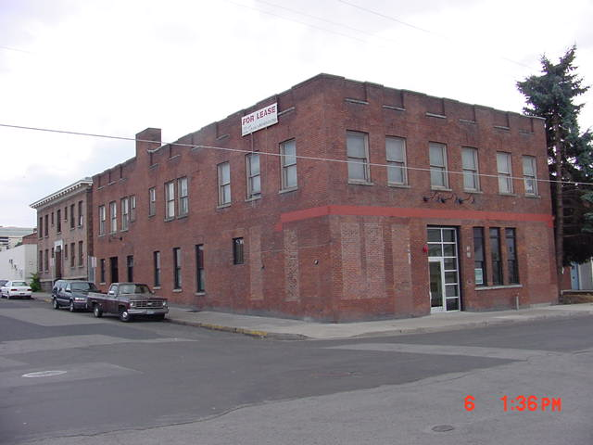
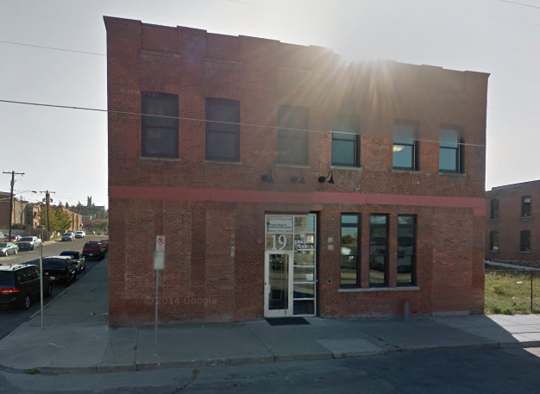
19 W Pacific Avenue
Green-Hughes Printing Company
SHRP listed 2002

Slide 3
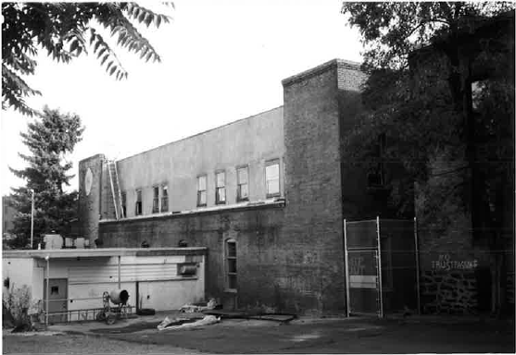
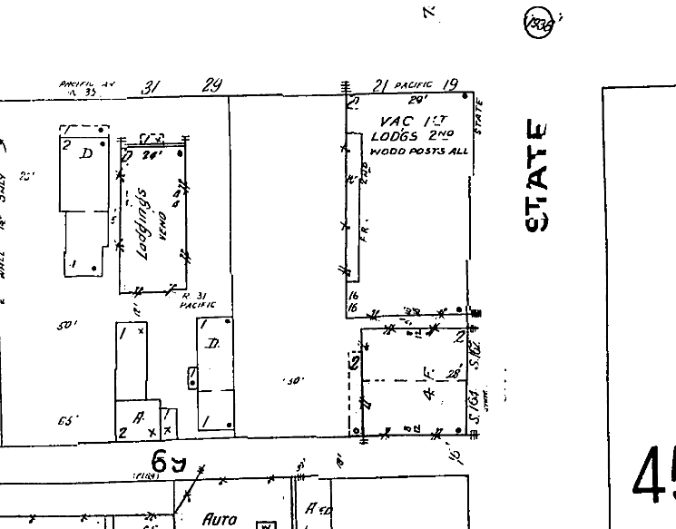
19 W Pacific Avenue
1910-1950 Sanborn Map:

Slide 4
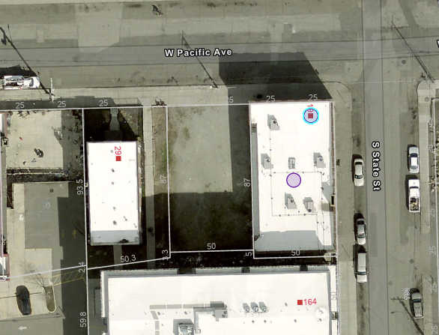
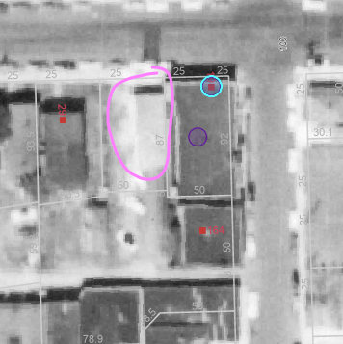
Current:
1958 Aerial showing the small building to the west (built sometime between 1953 and 1958):

Slide 5
PROPOSAL:
The project is for construction of a large, one-story addition to the Green-Hughes Printing Company Building to the west of the main historic building. It will be connected to the Green-Hughes building by two corridors that will be located on the west elevation through two existing windows which will be converted to hallways.

Slide 6
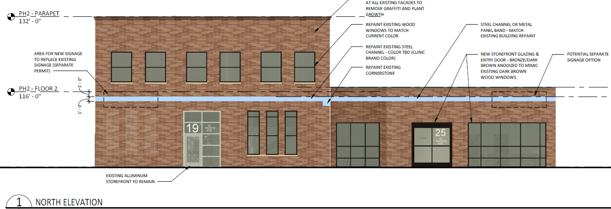
North elevation showing new addition with recessed connecting corridor

Slide 7
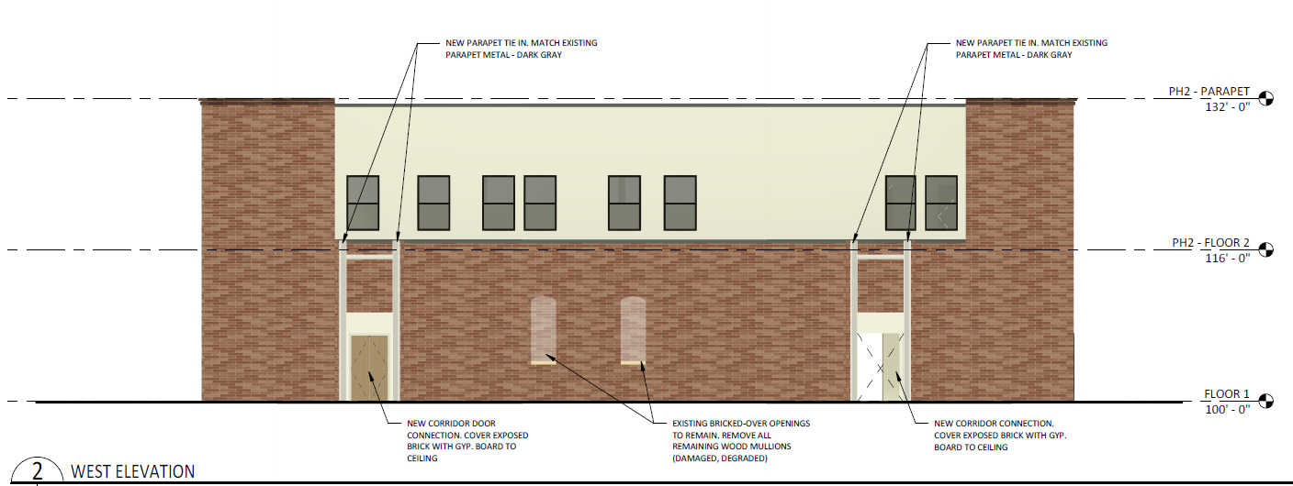
West elevation where new addition will be, showing windows that will be opened to create connecting corridors.

Slide 8
RELEVANT STANDARDS THAT THIS PROJECT MEETS:
Standard Number 9: New additions, exterior alterations, or related new construction will not destroy historic materials, features, and spatial relationships that characterize the property. The new work will be differentiated from the old and will be compatible with the historic materials, features, size, scale and proportion, and massing to protect the integrity of the property and its environment.

Slide 9
Staff Commentary on Standard #9:
The addition will be differentiated from the old through the use of aluminum storefronts and window units.
The visual separation between the buildings is achieved through the 12’ span and 14’ recess to the corridor that joins the two structures together.
While historic window openings will be used to connect the addition, these windows are on a non-primary elevation (west) and two of the four windows that exist on that elevation have been bricked up at some point in the past.
The addition will be compatible with the historic building through the use of brick veneer.
The historic, 2-story building will remain the larger of the two structures. The addition being maintained at 1-story ensures that the historic building is the dominant of the two.

Slide 10
RELEVANT STANDARDS THAT THIS PROJECT MEETS:
Standard Number 10: New additions and adjacent or related new construction will be undertaken in such a manner that, if removed in the future, the essential form and integrity of the historic property and its environment would be unimpaired.
Staff Commentary: If the addition were to be removed in the future, the historic Green-Hughes Printing Co. Building will appear much as it does today. The openings that are being created to connect the historic building to the addition could easily be rebuilt if needed.

Slide 11
STAFF RECOMMENDATION:
Approve the application because the addition meets the Secretary of the Interior’s Standards #9 and #10.

