Slide 1
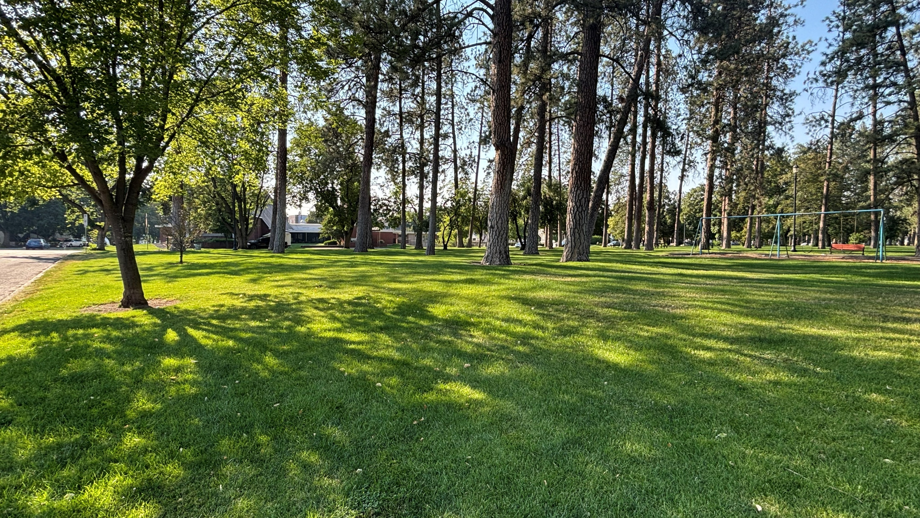
Coeur d’Alene Park Restroom
Certificate of Appropriateness Review
New Construction – Browne’s Addition HD
Slide 1
Notes:
Hello, I’m Heather Smith with the City of Spokane Parks and Recreation Division. Today, I’ll be presenting an overview of the planned restroom replacement project at Coeur d’Alene Park along with Troy Bishop and Andrew Leeper from ALSC.

Slide 2
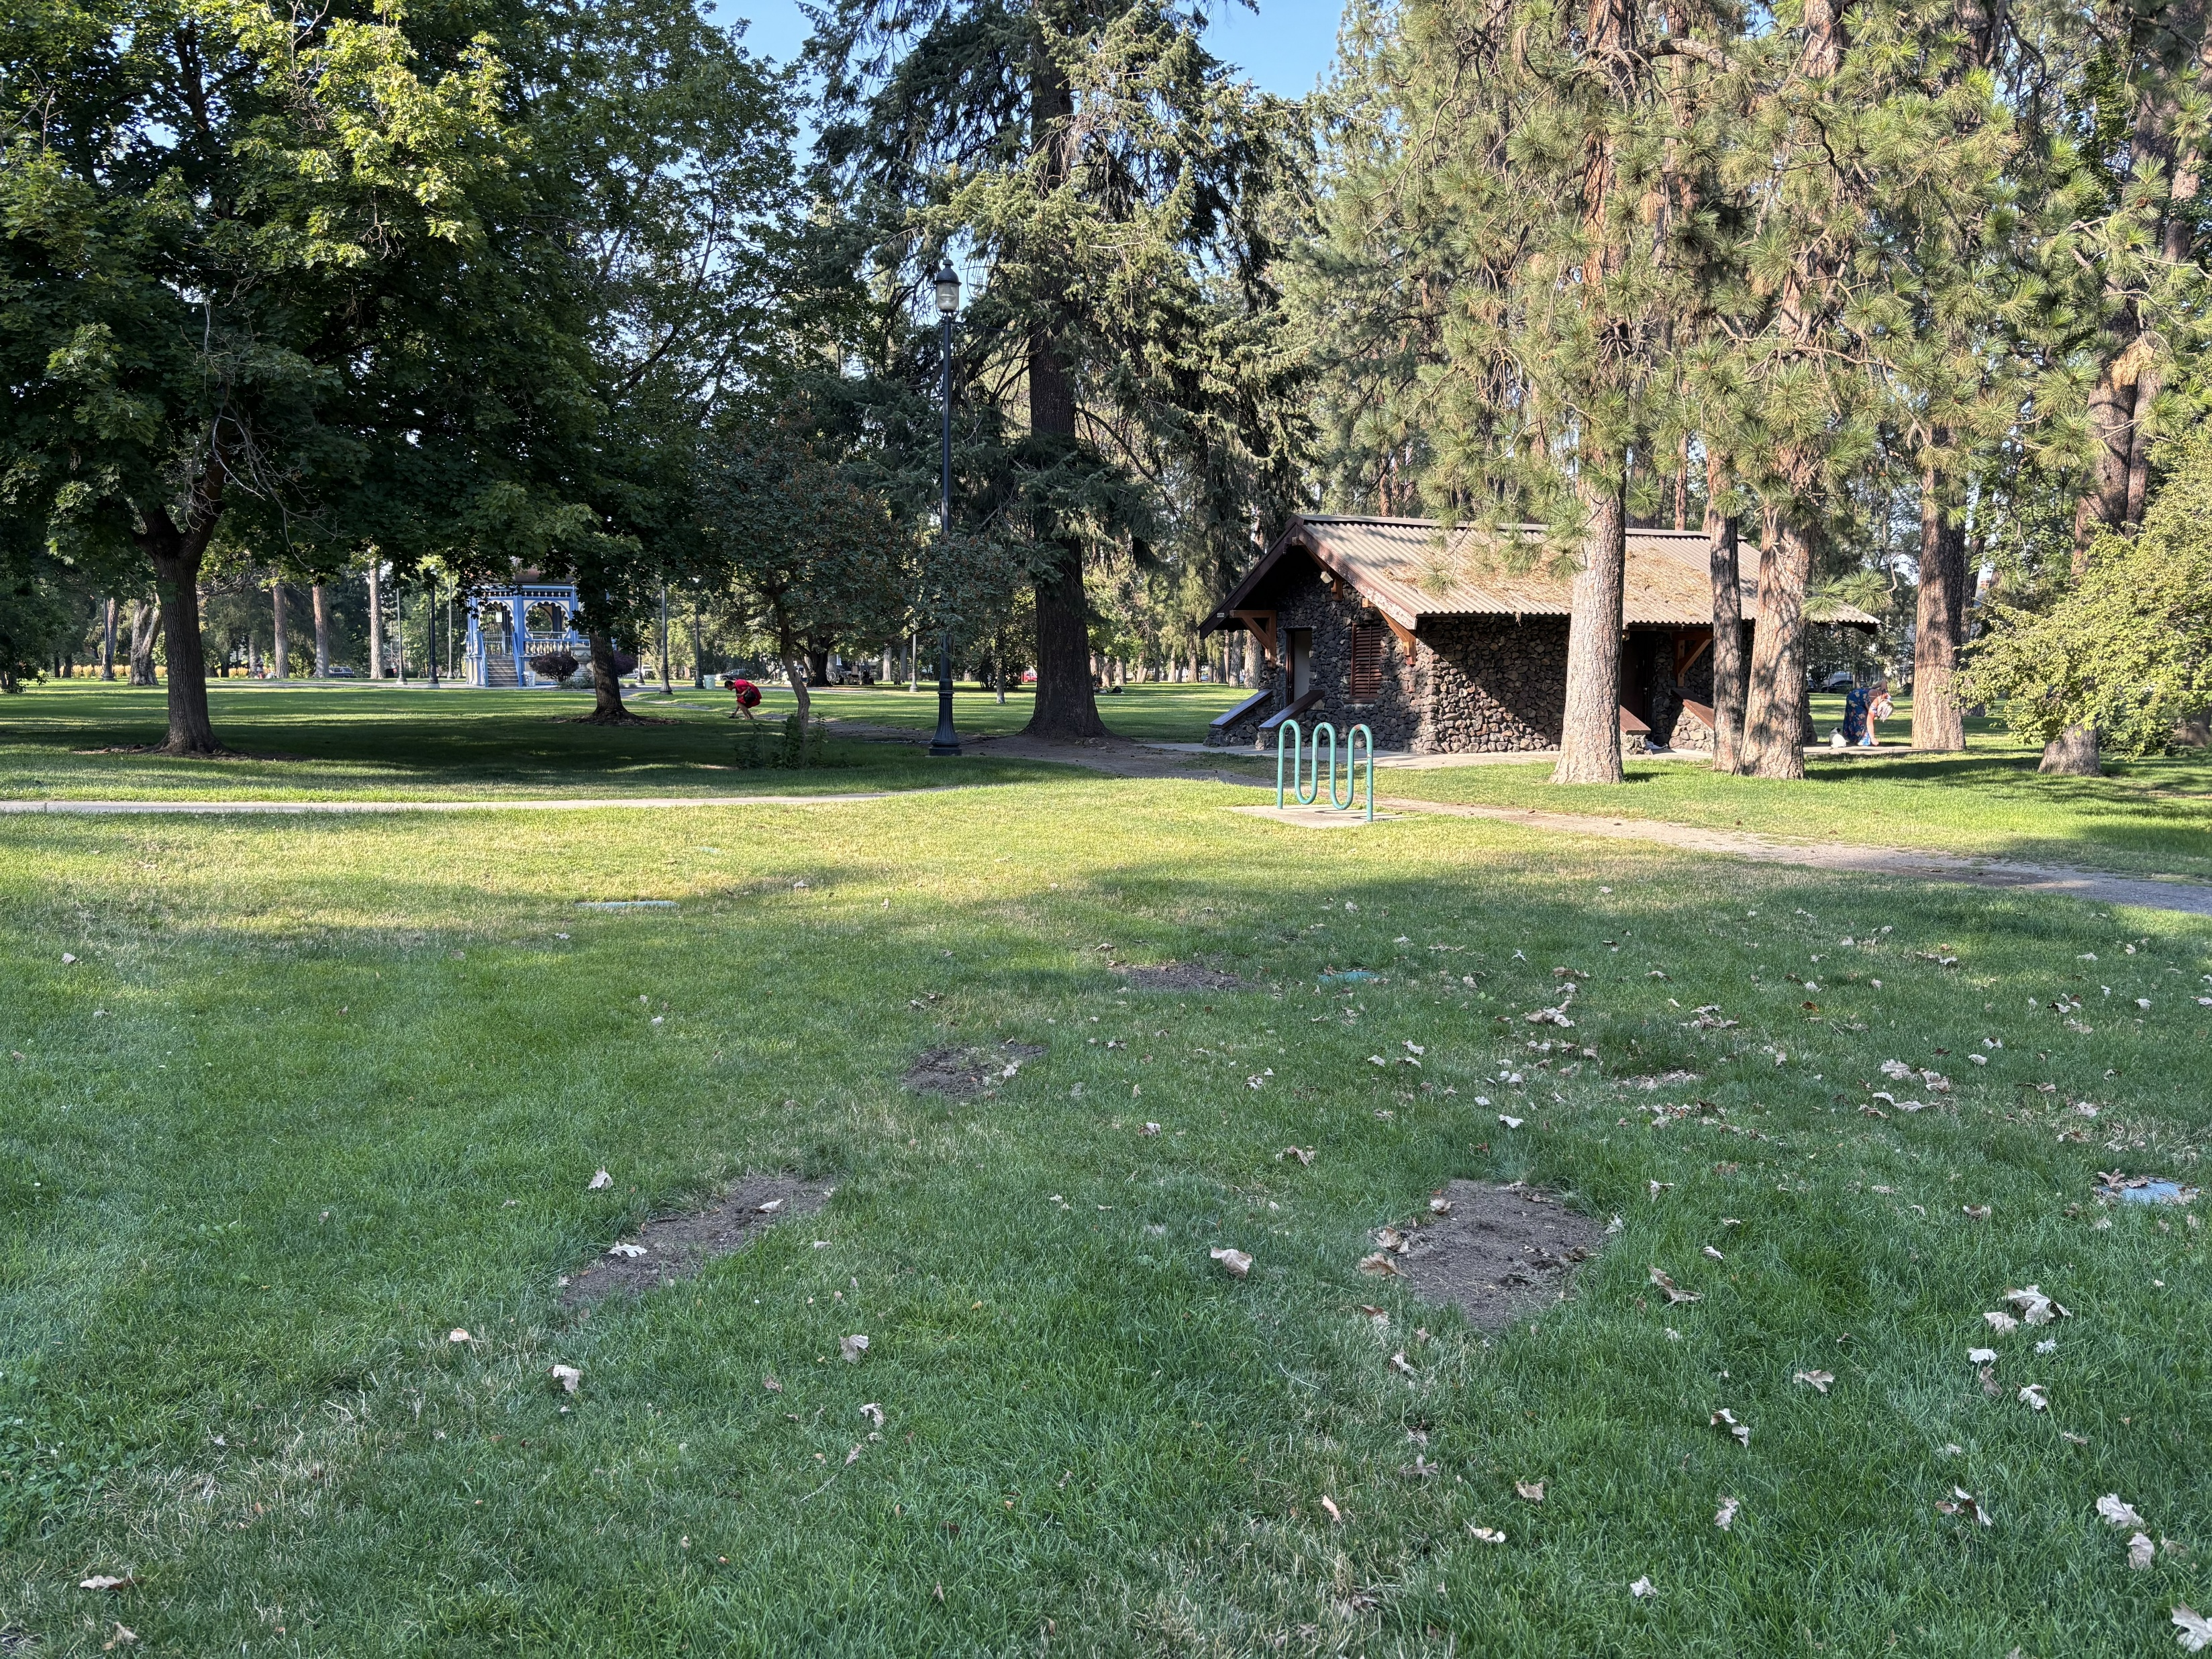
Project Description
  Project includes:
  (1) New restroom building
  (2) New play areas for ages 2-5, 5-12
  New ADA accessible pedestrian pathways
Notes:
In response to community desire, the Coeur d’Alene Park Restroom and Play Replacement is replacing the third poorest conditioned playground in the City, constructing (1) new restroom building to replace the existing historic restroom which is highly susceptible to vandalism and is often out of service and providing new ADA accessible pedestrian pathways.

Slide 3
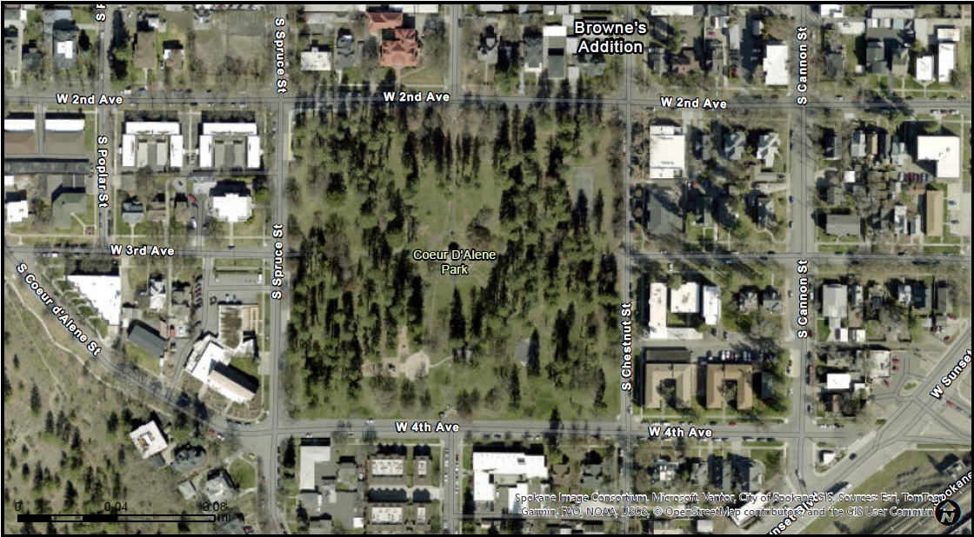
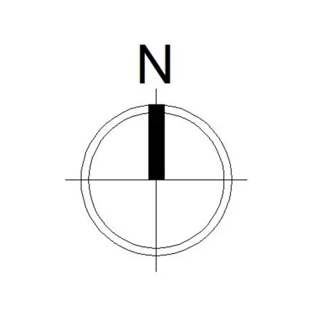
EXISTING GAZEBO
TO REMAIN
EXISTING RESTROOM TO REMAIN
EXISTING PLAYGROUND TO BE REPLACED
EXISTING SPLASHPAD TO REMAIN
Slide 3
Notes:
This aerial image highlights Coeur d’Alene Park, showing the existing playground along with the historic restroom facility. The orange rectangle shows where in the park the project is located. The restroom will be preserved and re‑envisioned in a way that honors its long-standing significance to the neighborhood

Slide 4
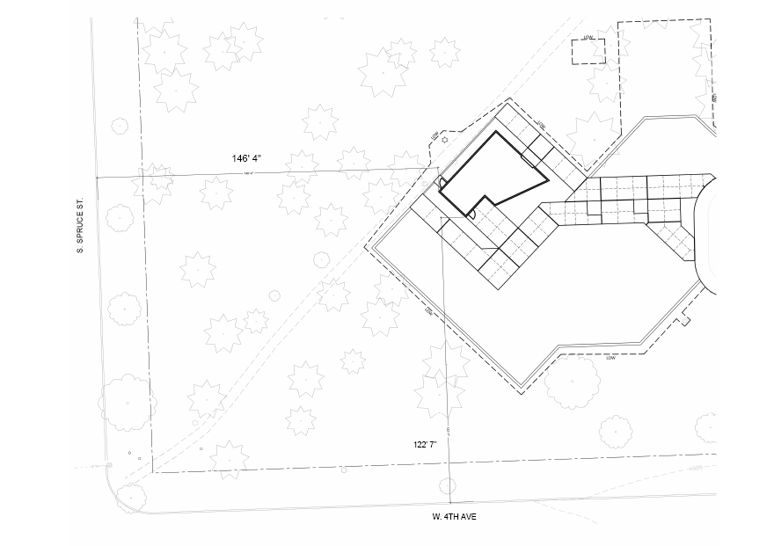
Setbacks
146’ 4”
122’ 7”

Slide 5
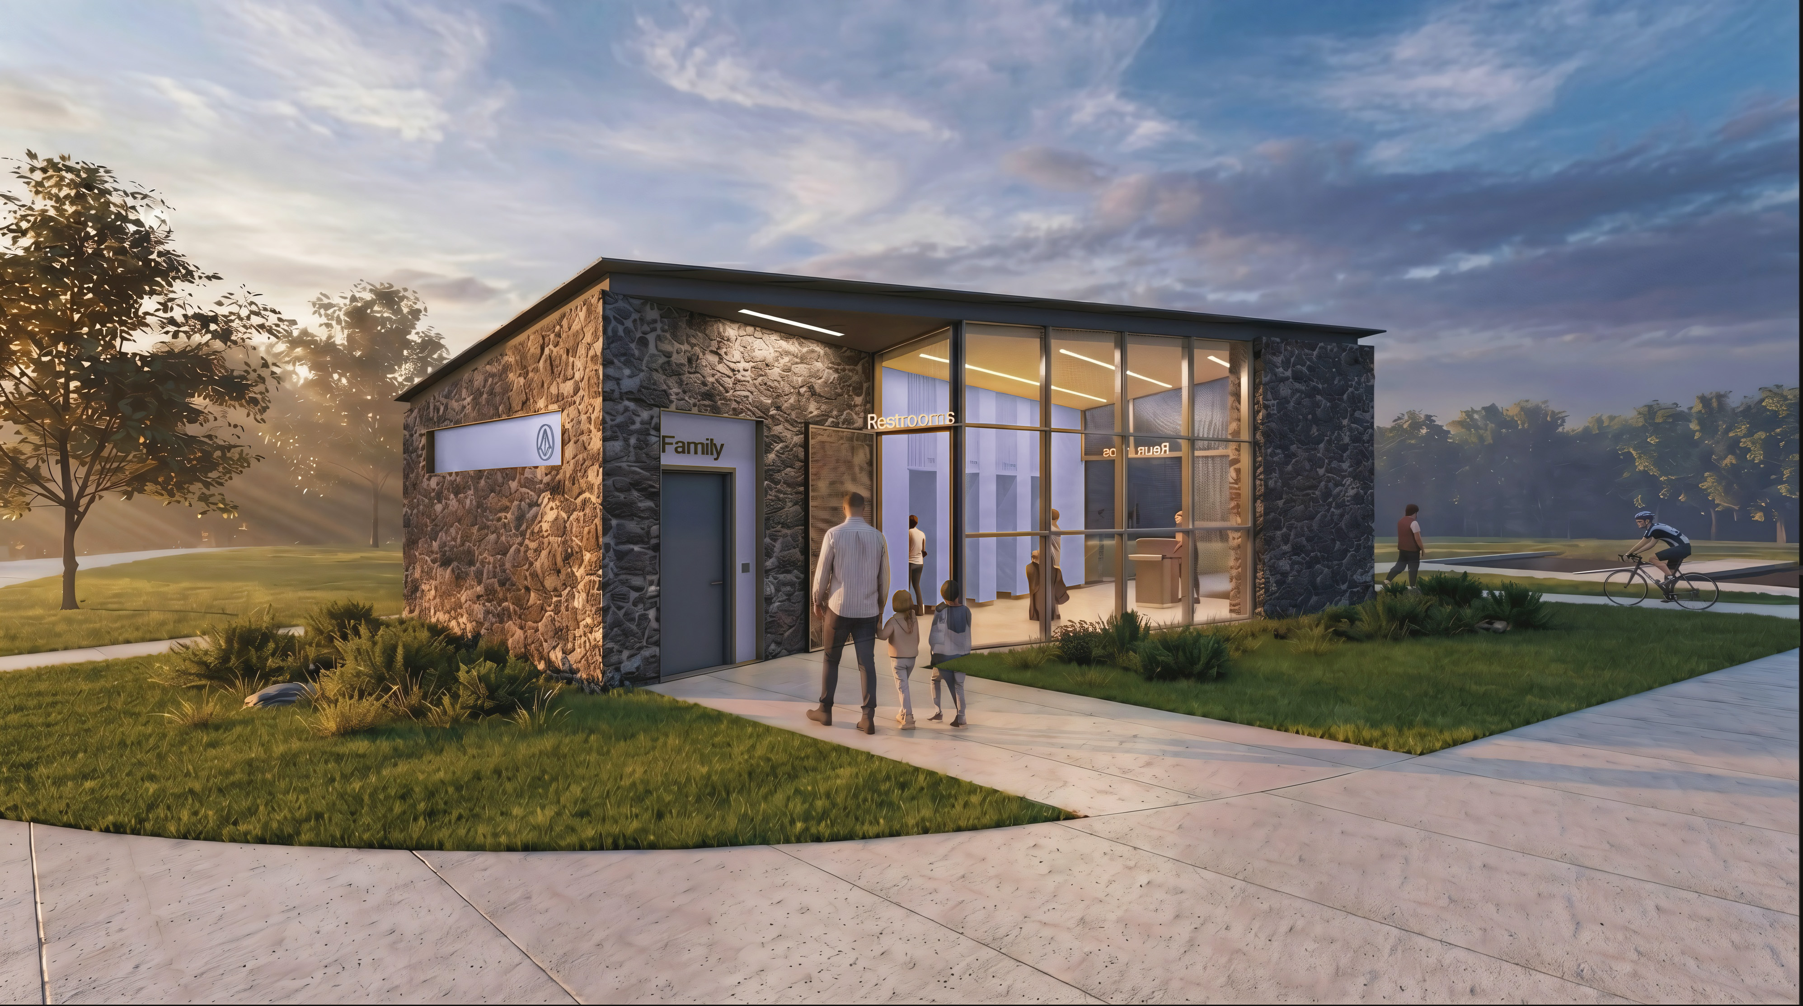
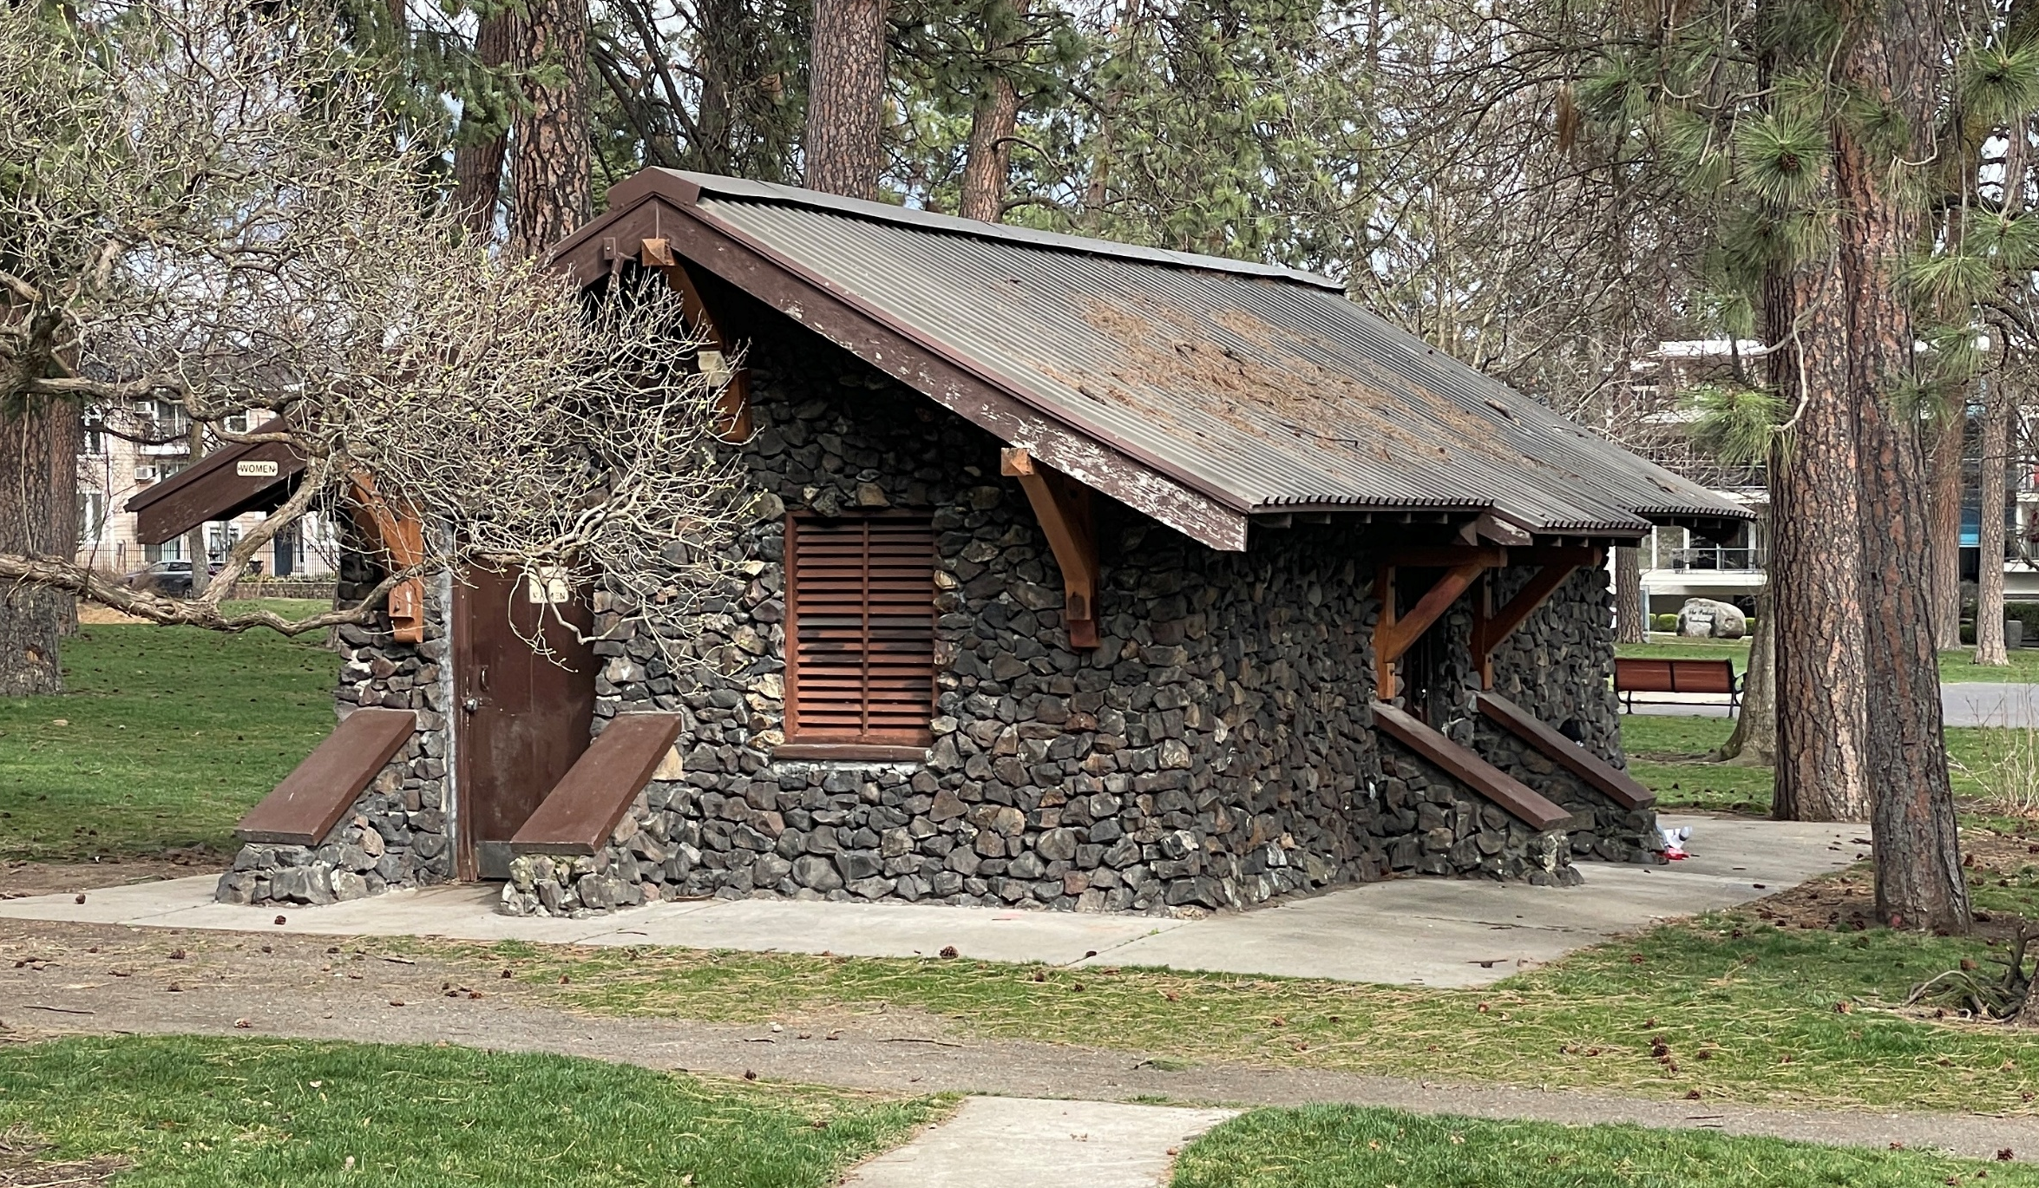
Slide 4

Slide 6
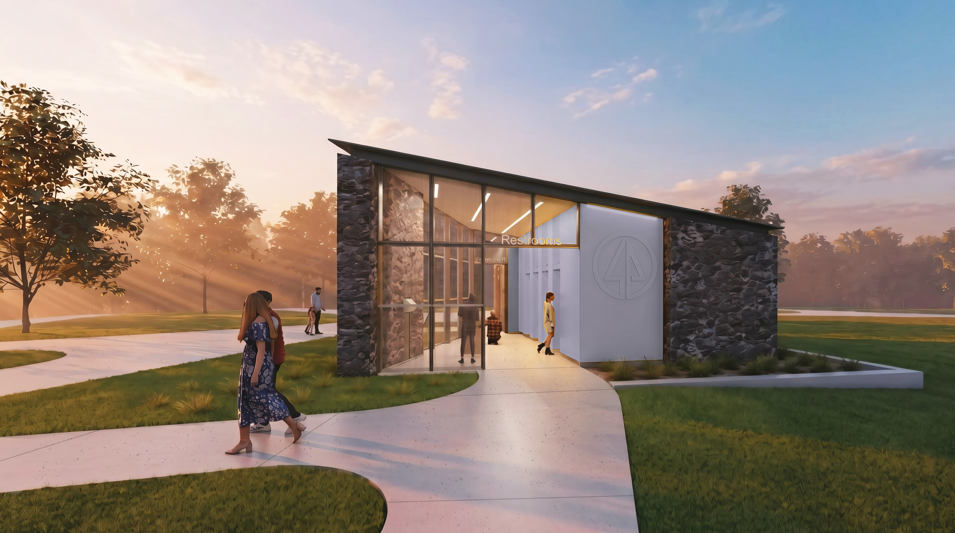
Slide 4

Slide 7
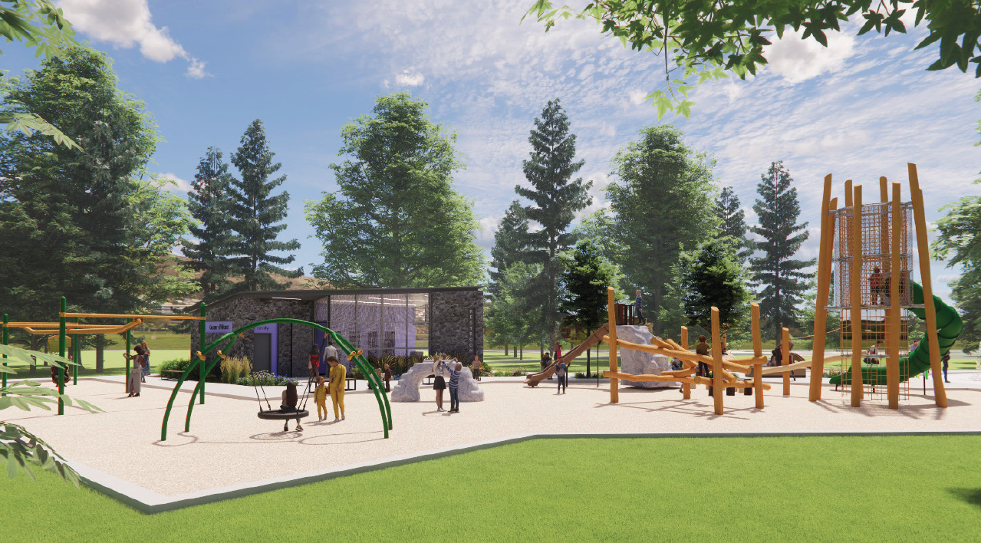

Slide 8
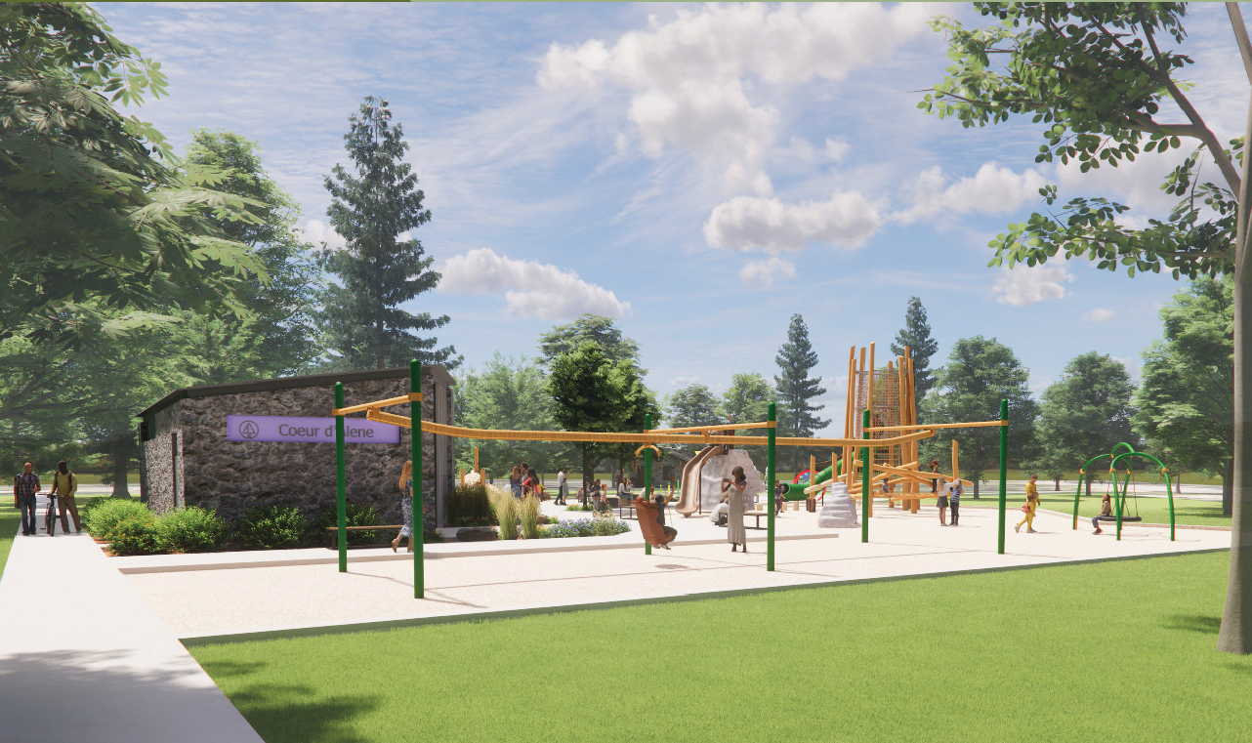

Slide 9
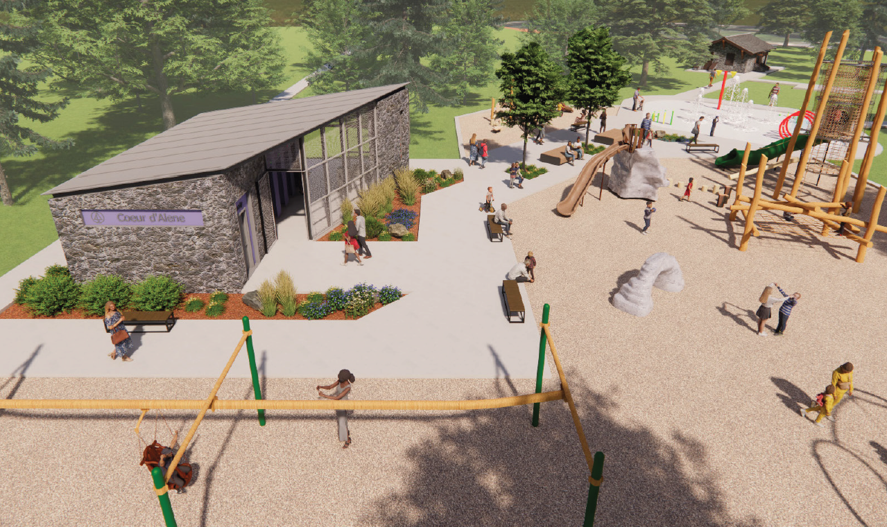

Slide 10
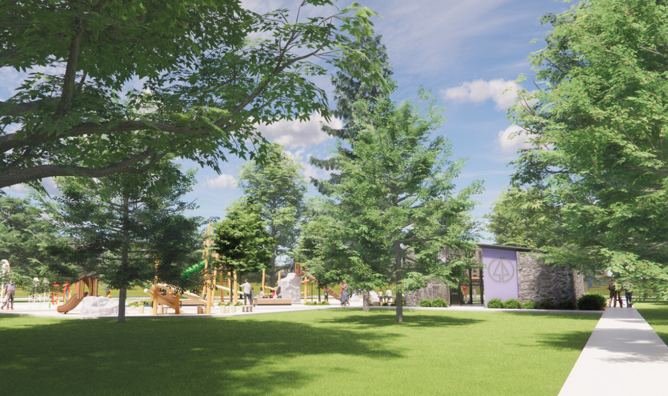

Slide 11
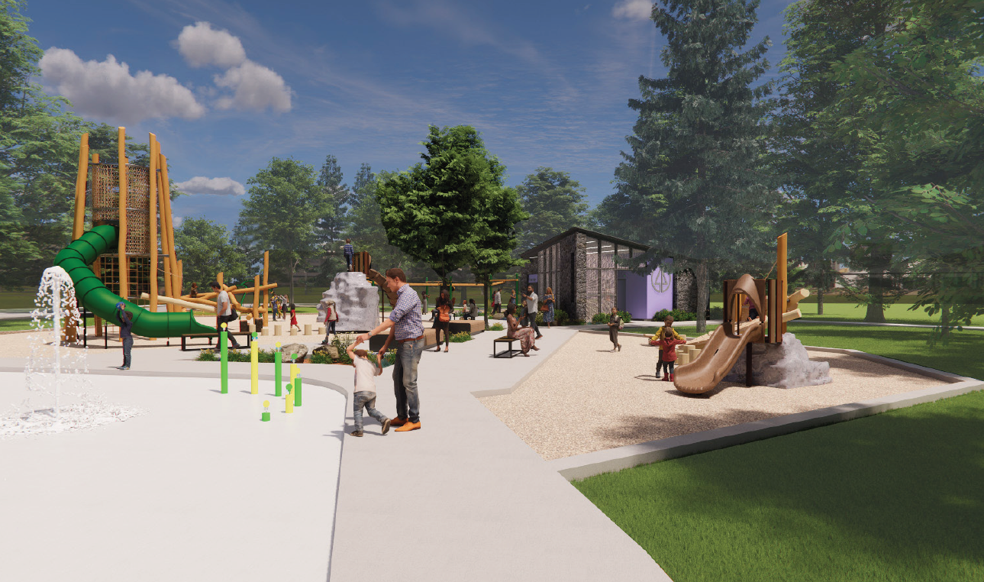

Slide 12
RELEVANT STANDARDS (Secretary of the Interior’s Standards):
Standard Number 9: New additions, exterior alterations, or related new construction shall not destroy historic materials that characterize the property (or district). The new work shall be differentiated from the old and shall be compatible with the massing, size, scale, and architectural features to protect the historic integrity of the property and its environment.

Slide 13
Compatibility & Differentiation with facing blockfronts. This proposal is inside the park itself, so doesn’t include adjacent buildings (since there are none). What will be adjacent to the restroom facility is new play equipment and sidewalks. In light of the fact that the park does reside within the Browne’s Addition Historic District, it is important to use the facing blockfronts to determine both compatibility and differentiation.

Slide 14
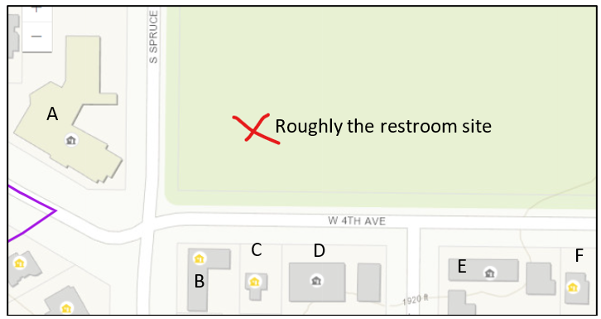
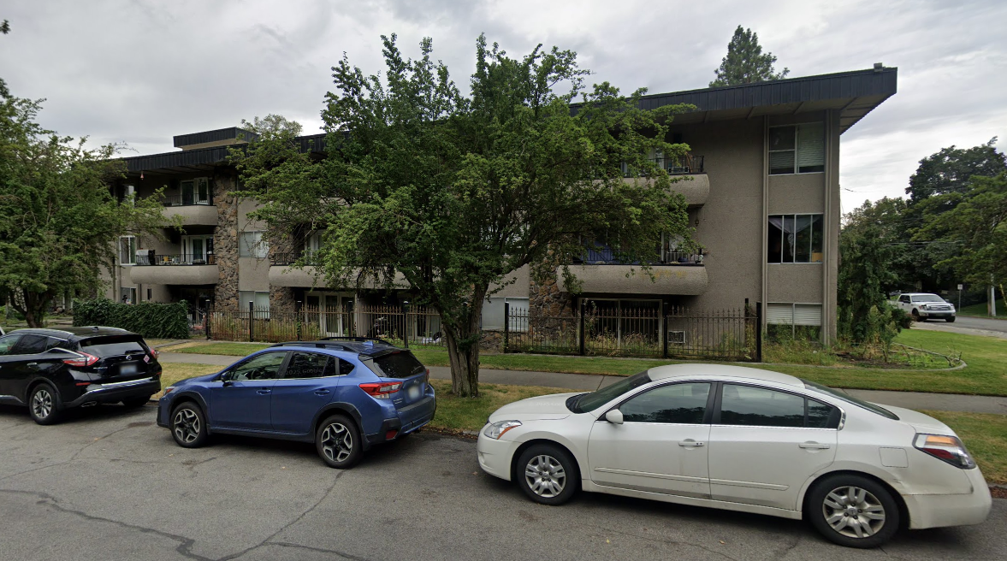
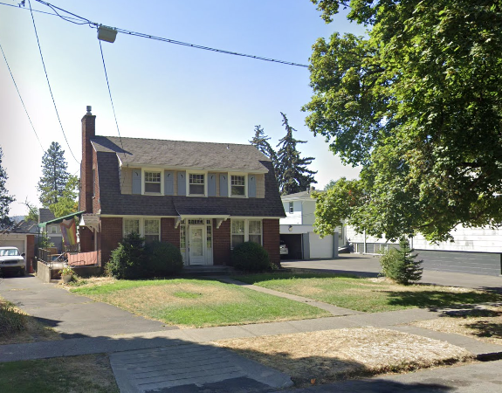
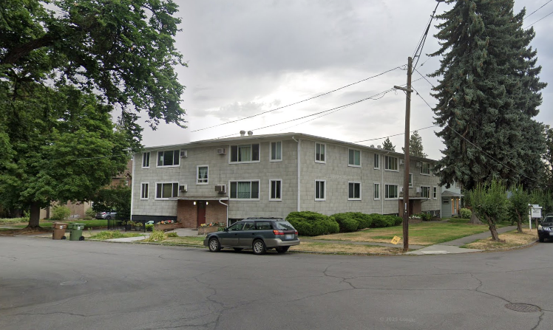
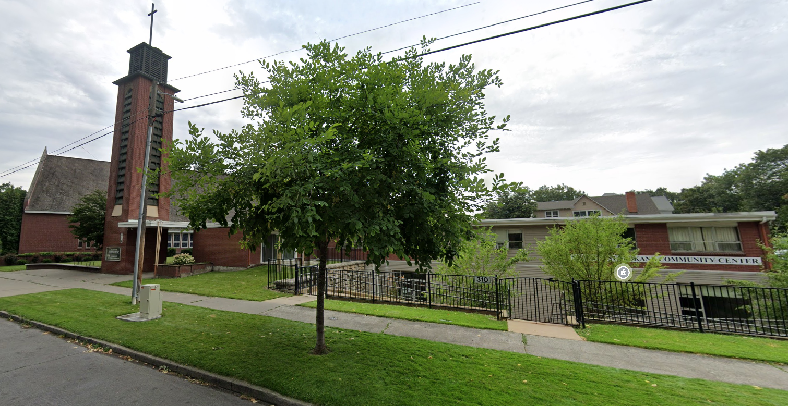
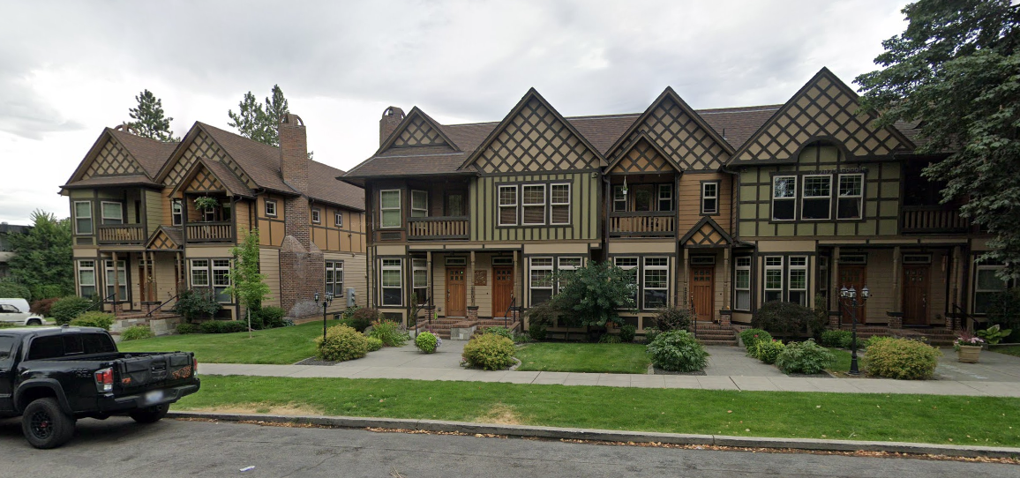

Slide 15
The field of historic preservation has long used the concept of “context sensitive design” but uses the term “compatible.” Designing for a specific site within the historic district allows for compatible new construction in one spot that may not be suitable for another site within the district.

Slide 16

It is important to note that “compatibility” is not “comparability.” Compatibility can be defined in terms of the absence of conflict; in more casual and visual terms, it can mean being a good neighbor in that a building “fits in.” Comparability is a very close state of compatibility, in that the two things have enough in common that they can be compared meaningfully.
Apples and oranges are compatible, but not comparable!

Slide 17
Context-sensitive new construction is firmly grounded in compatible contemporary design: design that is clearly of the 21st century and doesn’t try to fool the viewer into thinking that it might be historic, but at the same time, it still fits into the historic district as compatible design.

Slide 18

The design strategy recommended for most new buildings in the Browne’s Addition Historic District is an “invention within” approach – one that clearly references common building types and/or building types in the district without replicating them. Instead, these designs incorporate historic forms and details and “reinvents” them to seem more contemporary.
Exterior materials
Roof form leans contemporary – for a reason
Form follows function approach
Satisfies neighborhood’s needs in terms of safety, visibility and maintenance
Utilitarian structure – like a carport, shed or garage
Not a primary building – more flexibility

Slide 19
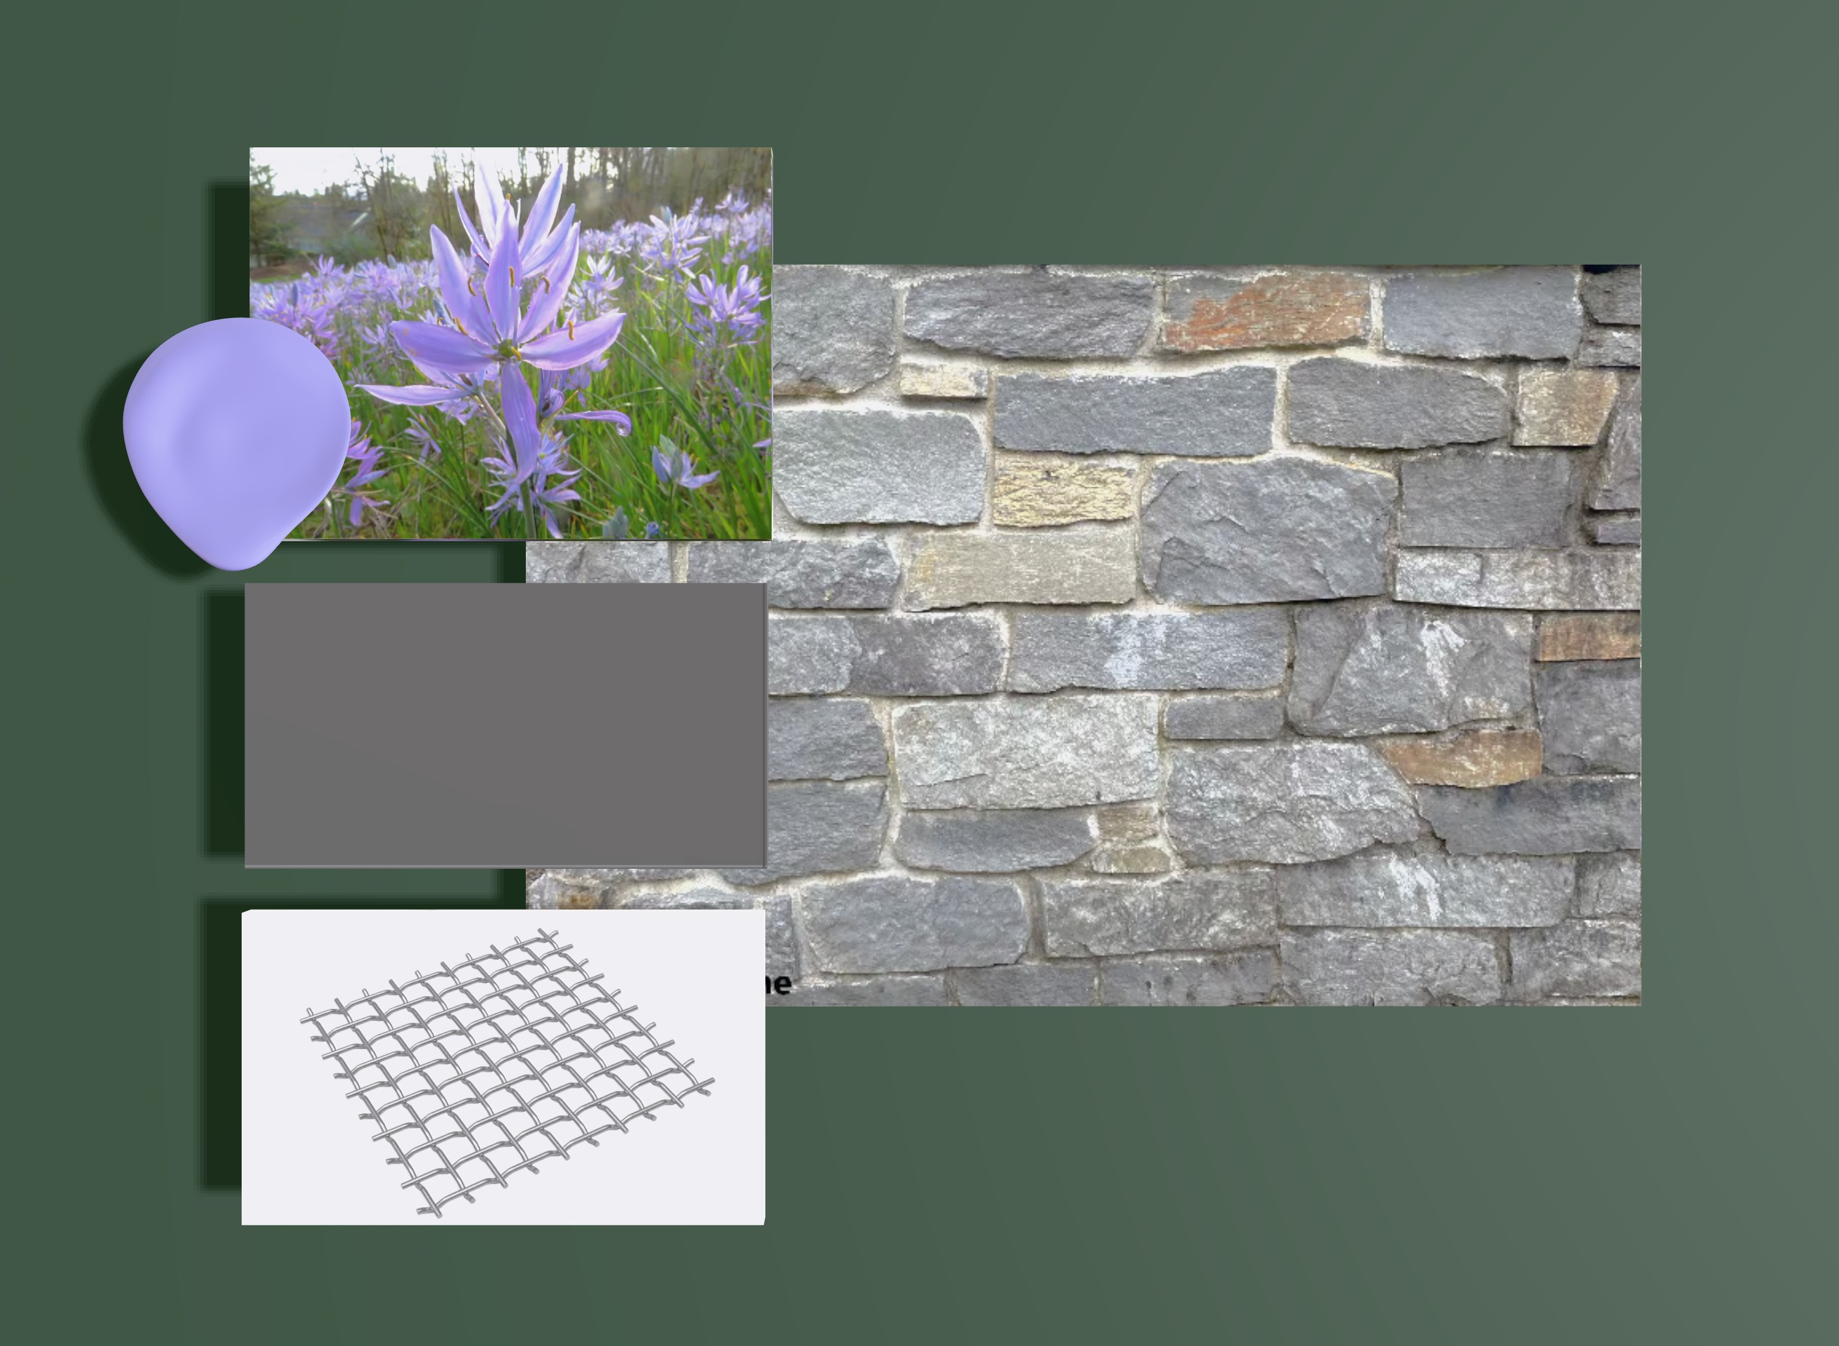
Camas Accent Color
Basalt Stone Veneer
Charcoal Grey Metal
Stainless Steel Mesh
Slide 4
Notes:
The new restroom utilizes a basalt stone veneer with a ribbed TPO roof that compliments the use of concrete structural roofing system while decreasing construction and maintenance costs. This allows the new restroom to complement but not compete with the other architecture in and around the park, while still maintaining the new park restroom identity. There will be one accent color on the restroom stalls, which is used as wayfinding for parkgoers to immediately recognize what the restroom is. Overall, there are 3 primary exterior materials; basalt, metal, and TPO roofing.

Slide 20
Staff commentary:
Visibility: the use of the shed-style roof system allows for the full visibility of the building from 4th Avenue as well as from the playground area. The stainless-steel mesh walls allow for clear sight lines to the stall doors - as well as for park rangers, neighbors and police to monitor the restroom “lobby” from the street.

Slide 21
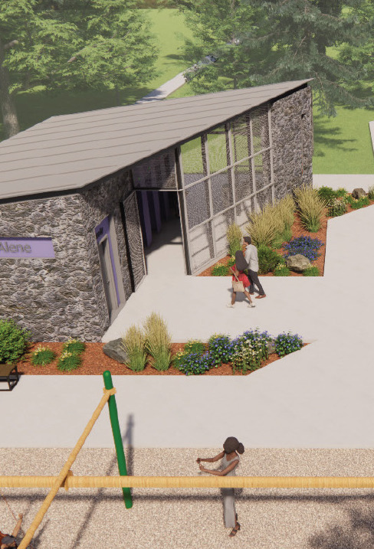
Staff commentary:
Accessibility: the proposed new restroom is fully ADA accessible with new pedestrian pathways. The design includes a conditioned family restroom that can be used longer into the season and allows for more use of the park.

Slide 22

Staff commentary:
Functionality: for the ease of cleaning and maintenance, the shed roof style and material choices make sense for the restroom to stay well-maintained and useable for the future.
Notes:
We trust that feedback from Parks staff who routinely maintain and clean these restrooms and support a product that works for their needs as well as the neighborhoods.

Slide 23
Staff recommends that the proposed new construction of the Coeur d’Alene Park Restroom is contemporary but compatible; follows the “invention within” design strategy from the Browne’s Addition Design Standards and Guidelines; meets the Secretary Standard #9; and should be approved.

