Slide 1
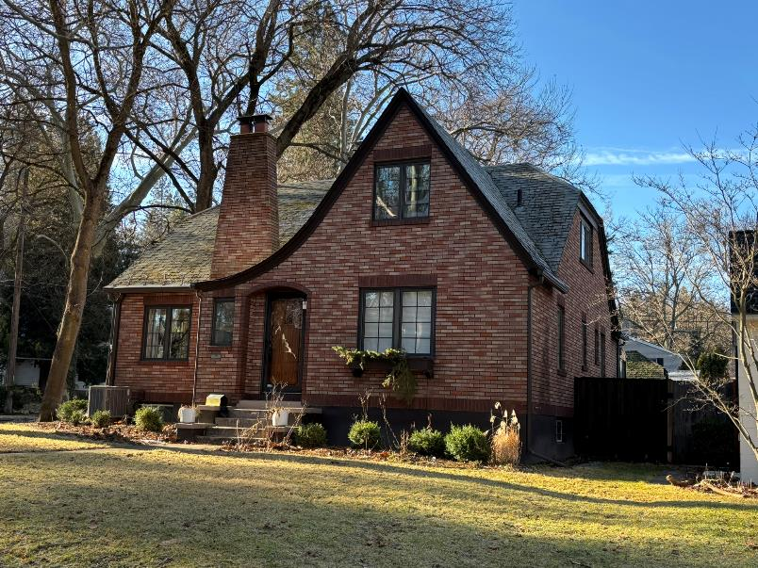
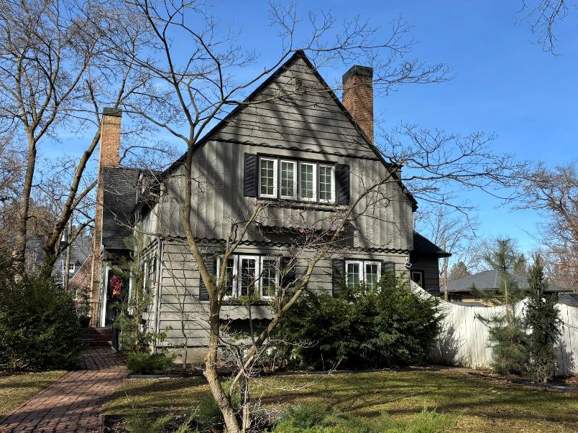
Spokane Plan Commission Hearing on the Cannon hill park Historic District
Spokane Historic Preservation Office

Slide 2
Spokane’s comprehensive Plan – Vision and values statement, chapter 8
“Urban design and historic preservation involves the city’s form and function, subdivision design, street character, and identification and preservation of historic resources, including buildings, sites, and districts.”

Slide 3
Spokane’s comprehensive Plan – Vision and values statement, chapter 8
Vision:
The qualities that make Spokane unique, including the historic and cultural fabric, neighborhoods, downtown area, parks and green spaces, and tree-lined streets, will be maintained and improved.
Values:
Preserving the historic buildings, historic fabric, and cultural heritage that provide Spokane with its character
Ensuring that new buildings in historic areas complement their surroundings

Slide 4
What is a local historic district?

Slide 5
What is a Local Historic district?
A nomination of a group of properties to be listed on the Spokane Register of Historic Places as a local historic district.
Requires an amendment to the Unified Development Code (UDC) since we are adding a section in chapter 17 of the SMC establishing the historic district overlay zone.
The formation of an overlay zone on the official zoning map and adoption of design standards and guidelines through reference within the proposed ordinance. The words “overlay zone” are only in the Comprehensive Plan four times, one of which is a reference to the use of overlay zones to protect historic districts.

Slide 6
Under What Authority are they formed
The City Council adopted Ordinance No. C-35580 on February 12, 2018 – this recodified the City’s Historic Preservation Ordinance. Part of that recodification included the process for the formation of local historic districts.
There are three main parts to the designation process in SMC 17D.100:
Submittal of the nomination documents (nomination and resource forms).
Property owner consent (balloting of affected property owners).
Final designation via the passage of an ordinance (SMC 17D.100.285) within the Historic Preservation section of our code that creates the overlay zone on the official City Zoning Map and adopts the Design Standards & Guidelines through reference.

Slide 7
Cannon hill park local historic district specifics

Slide 8
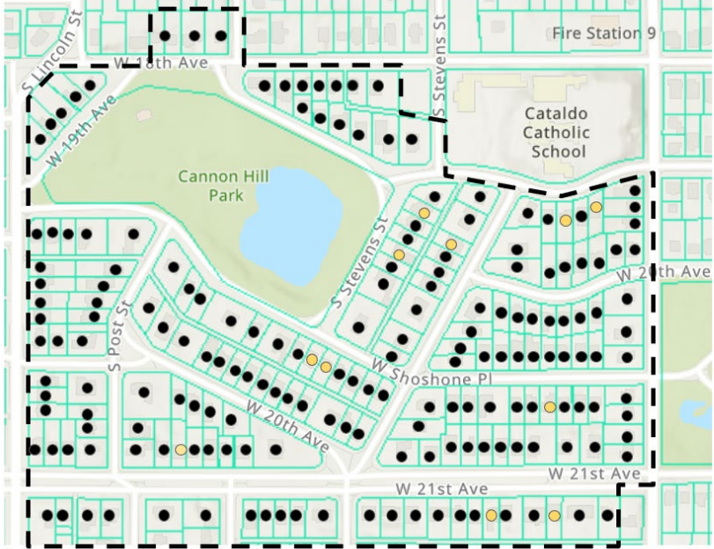
18th Avenue
The Cannon Hill Park Historic District Map
Bernard St.
Lincoln St.
21st Blvd.

Slide 9
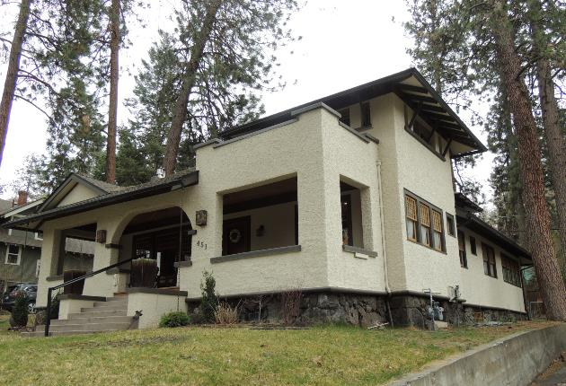
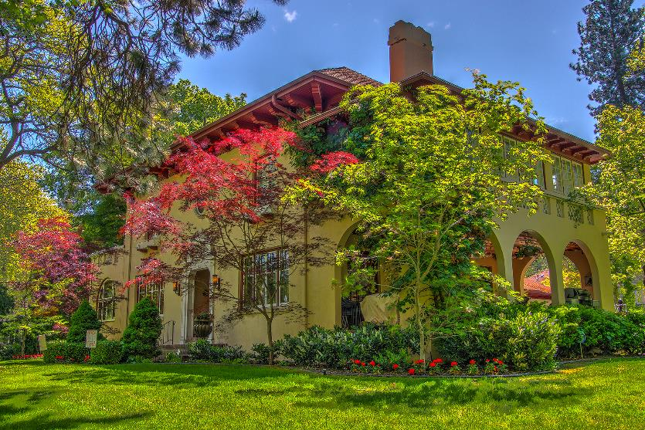
Why the cannon hill park neighborhood?
The Historic Preservation Office conducted grant funded survey work in this neighborhood in 2008 – survey is the foundation of preservation work and helps us identify where preservation makes sense.
Its significance is as a planned development platted in 1909-1910 by the Arthur Jones Company that included extensive landscape planting to create a “fine residential district.”
Neighborhood is largely intact as it was at the end of its build-out period in 1958.

Slide 10
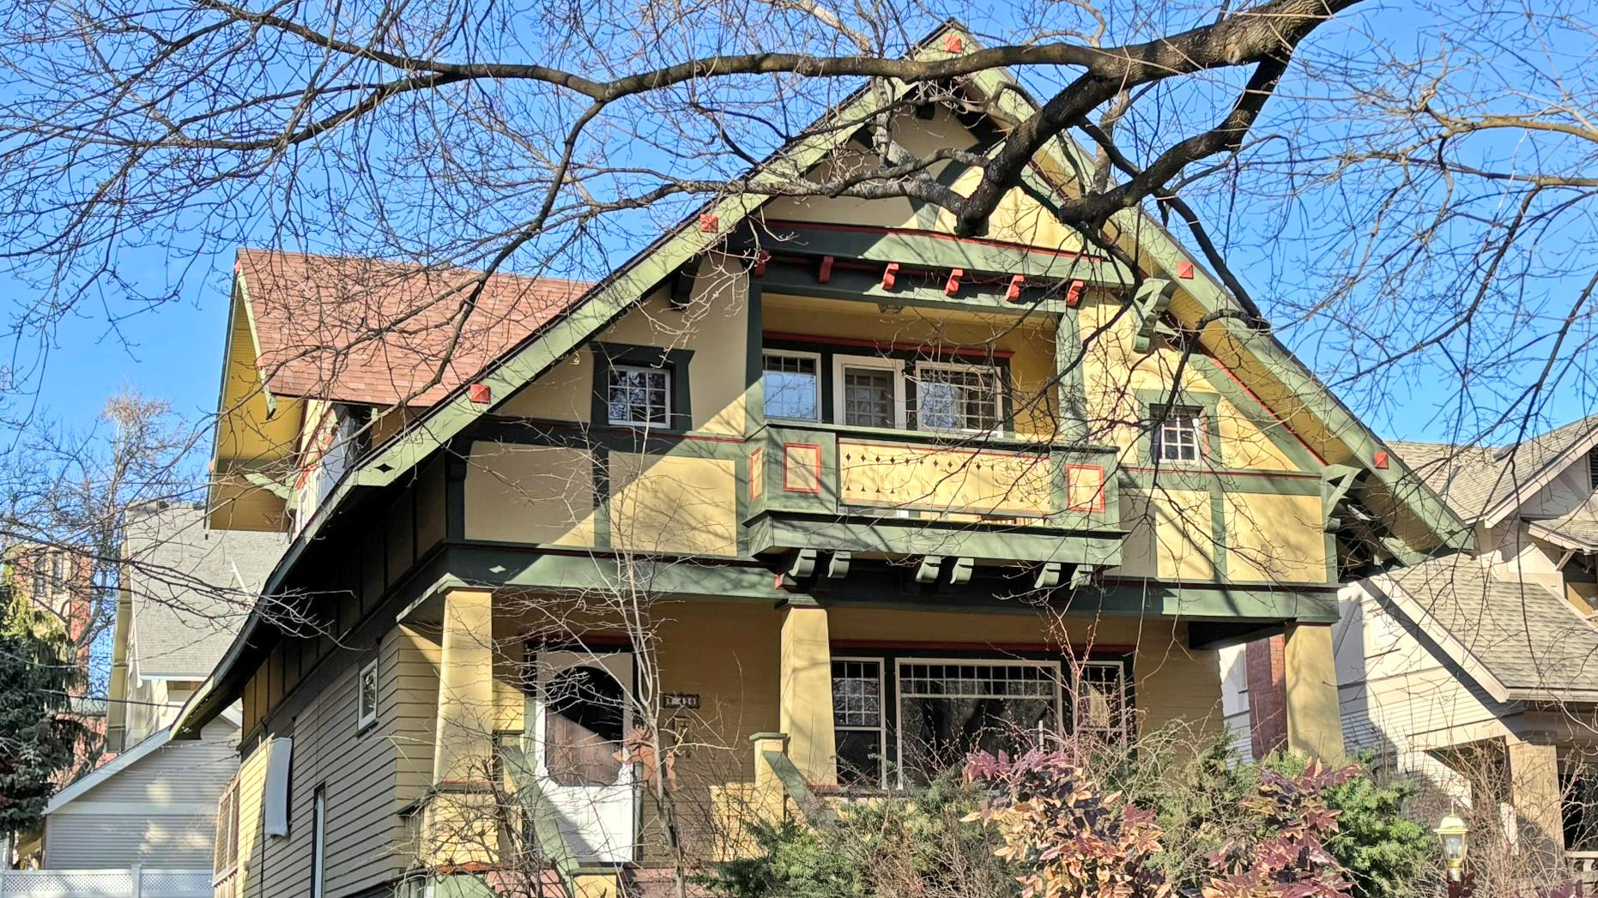
What makes up the district?
Properties:
191 Residential Properties (two properties include an extra parcel).
180 of the residences “contribute” to the district, only 11 are considered non-contributing.
Properties considered to be “contributing” were built between 1909 and 1958 and retain most of their original integrity.
Entire district is single-family homes with a few ADUs.
Notes:
The Olmsted plan included drawings of 3 parks – Cannon Hill Park, Liberty and Corbin Parks.

Slide 11
Types of properties

Slide 12
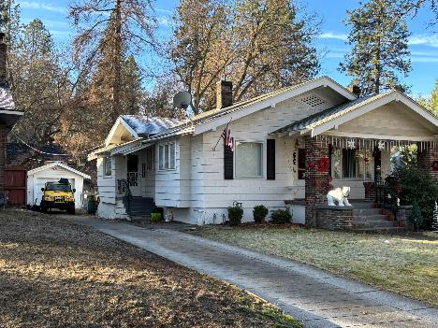
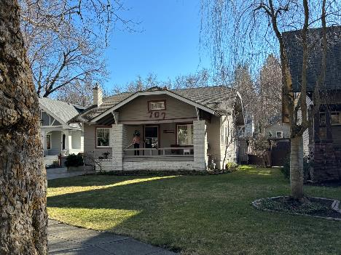
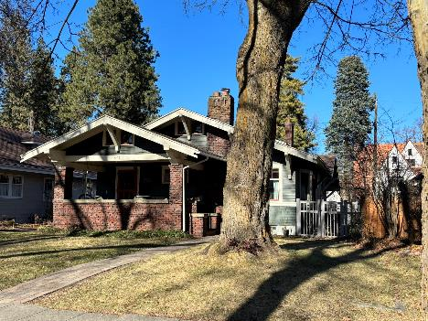
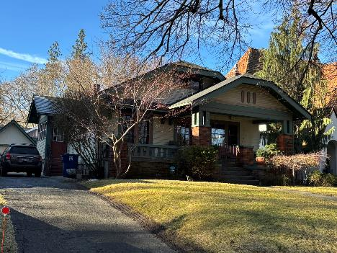
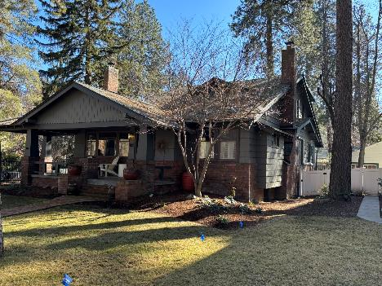
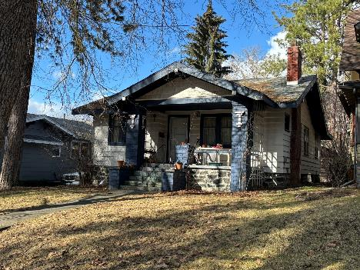
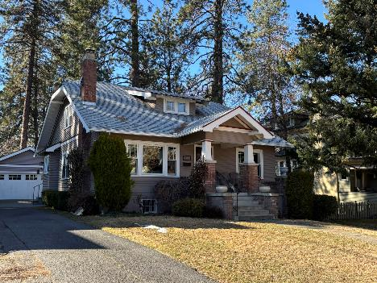
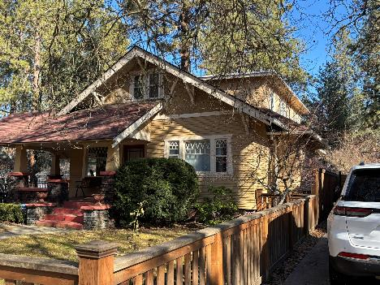
57 bungalow types of 191 properties(1909-1924)

Slide 13
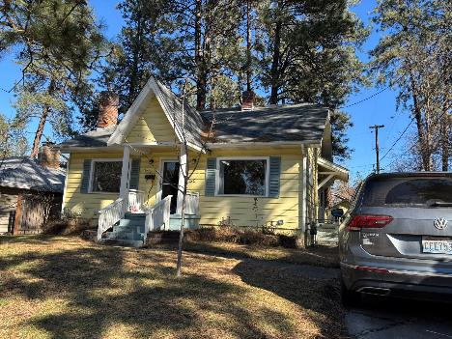
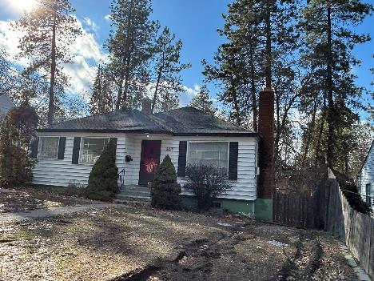
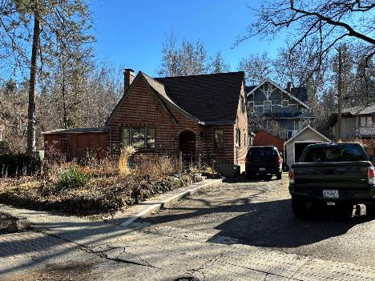
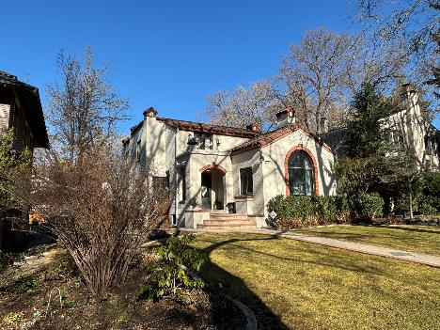
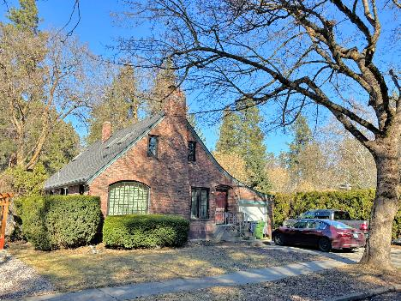
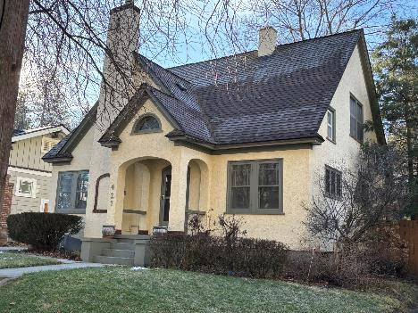
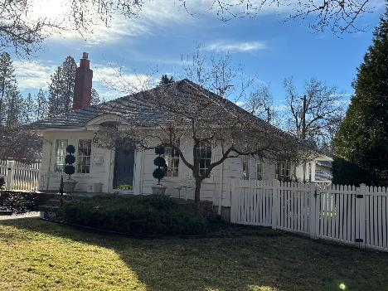
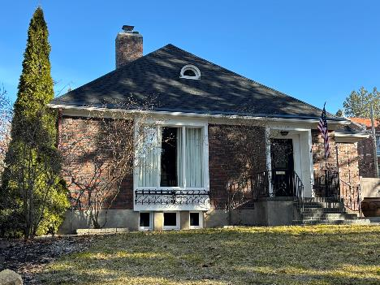
52 cottage Types of 191 properties (1921-1947)

Slide 14
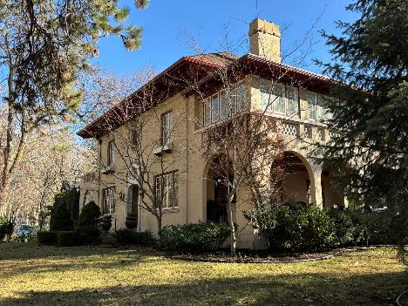
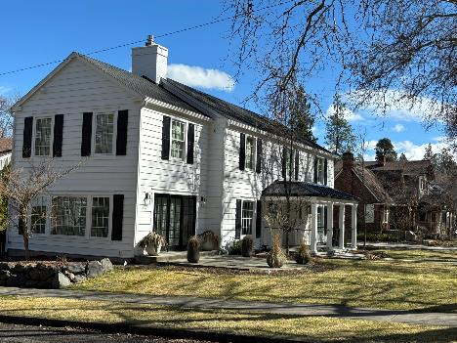
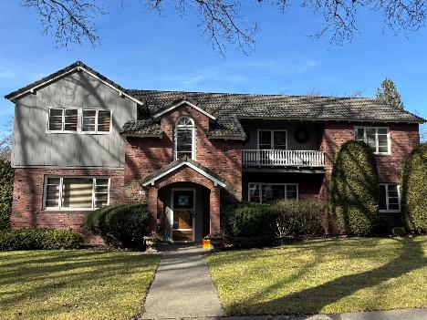
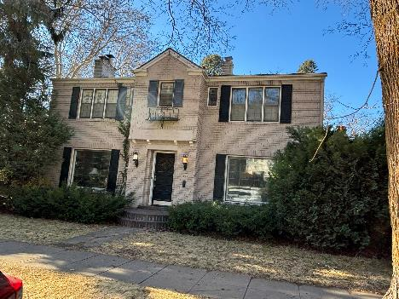
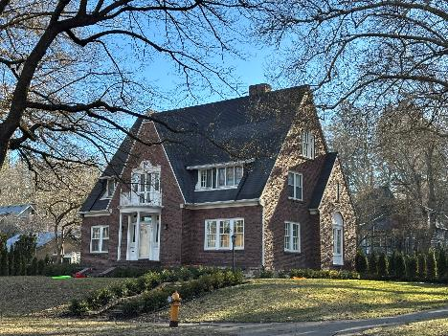
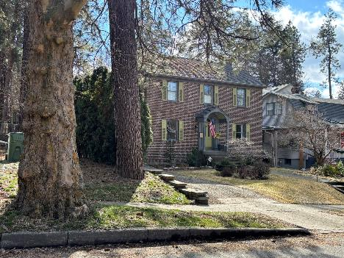
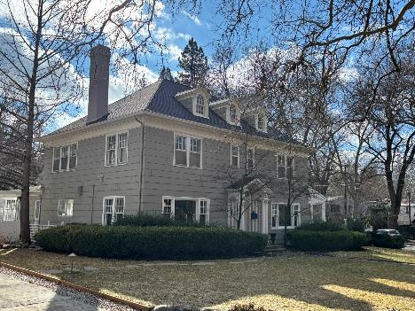
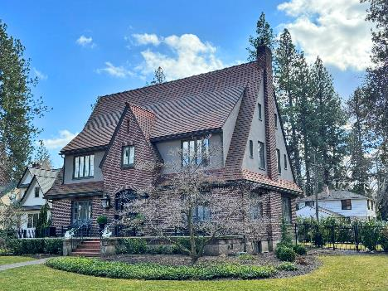
69 residence types of 191 properties (1909-1953)

Slide 15
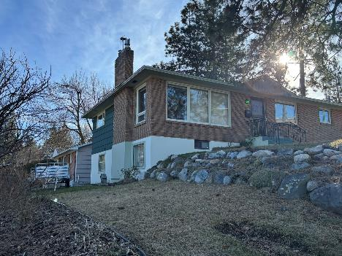
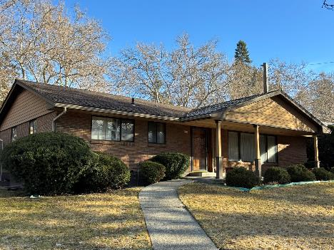
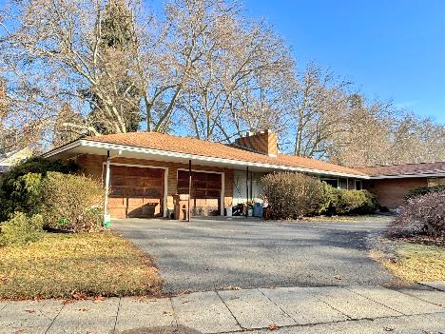
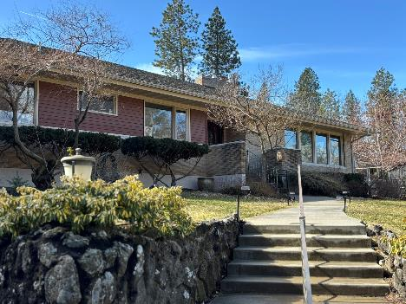
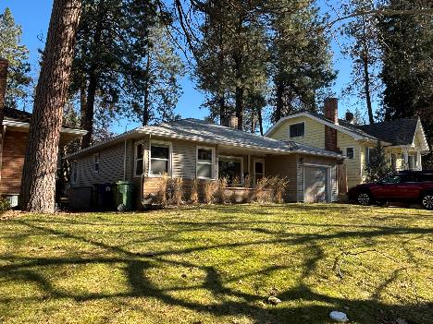
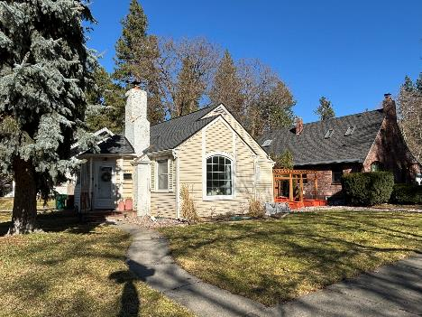
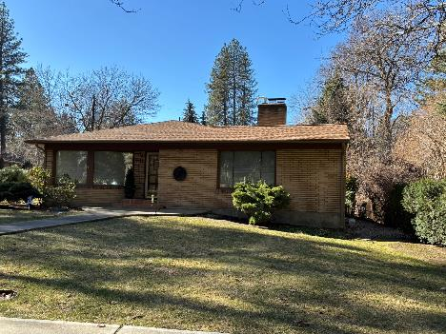
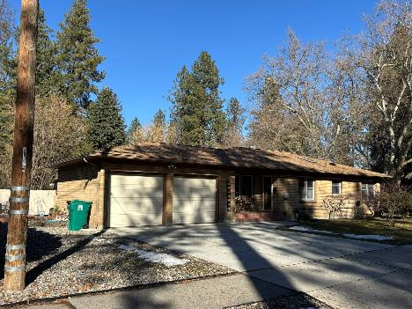
11 ranch Types of 191 properties (1948-1958)

Slide 16
Cannon hill park design standards and guidelines

Slide 17
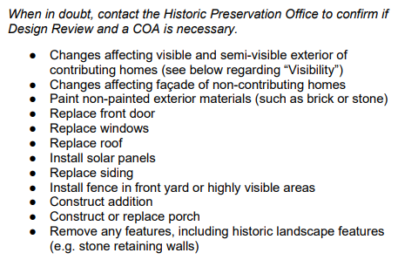
Design Standards & Guidelines
Each district formed in Spokane must have its own specific Design Standards and Guidelines created.
We use the Secretary of the Interior’s Standards for review of street-facing exteriors within Spokane’s Historic Districts as well as individually listed properties on the Spokane Register
10 broad standards – and then more descriptive guidance for home-owners and contractors, as well as the Spokane Historic Landmarks Commission and Staff to help interpret the standards
Design Standards and Guidelines are adopted by reference within the proposed ordinance in 17D.100.285

Slide 18
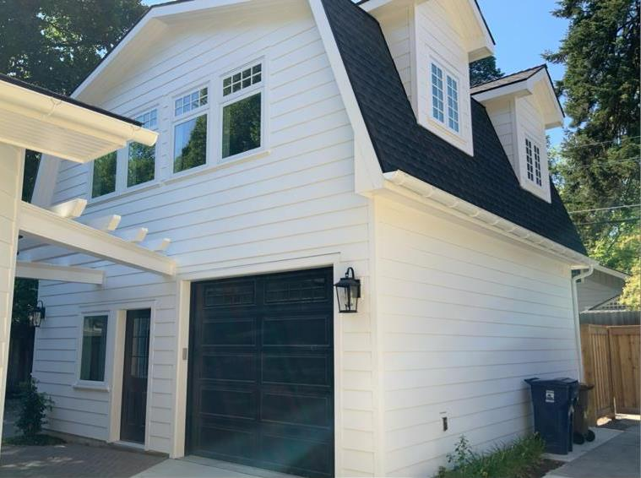
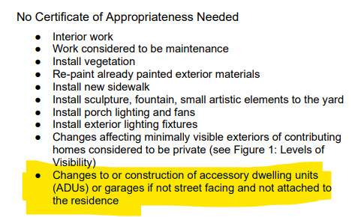
Design standards and guidelines - Adus

Slide 19

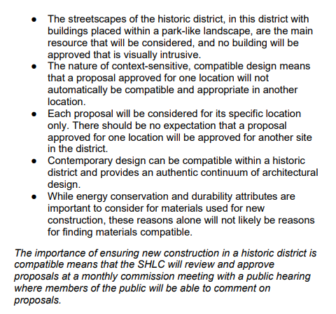
Design Standards & Guidelines: New construction
New construction (except detached ADUs and garages) in the district would require Landmarks Commission review
Since there are so few non-contributing properties and only one parcel without a building already on it, it would most likely require demolition or boundary line adjustments (creation of new lots) for new construction to occur in the district

Slide 20
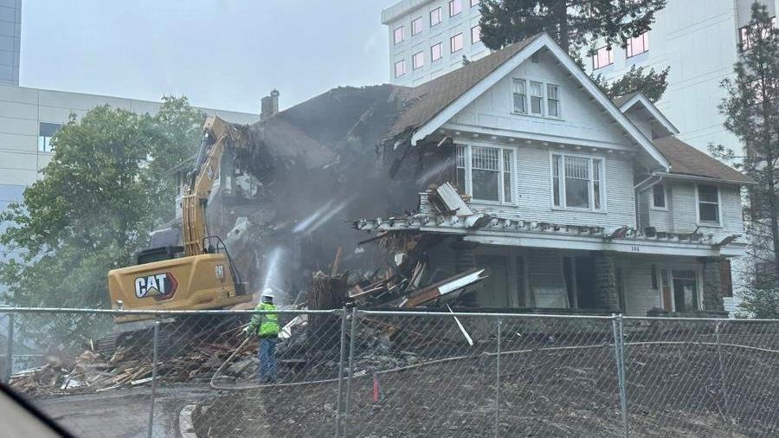
Design Standards & Guidelines: Demolition
The 11 properties considered non-contributing in the district due to age, or changes over time would be able to be demolished with a staff review
Any other demolitions would be reviewed by the full Landmarks Commission based on SMC 17D.100.220

Slide 21
Process pieces: property owner vote, outreach, regulatory processes

Slide 22
Final Voting results
We mailed 191 ballots covering 193 votes on May 8th, 2025.
Historic Preservation Office received 154 returned ballots (80% of ballots returned).
135 in favor of forming the Historic District (70% in favor)
Of those returning ballots, 88% were in favor of the district’s creation (135 of 154)
17 against forming the Historic District (9% against)
2 that are “neutral” and cannot come to a decision (1% neutral)
39 did not return ballots – these are counted as no votes (20%)
Per SMC 17D.100.100B, a simple majority of property owners is required to vote in favor to move the district through public process of Plan Commission, Spokane Historic Landmarks Commission and City Council.

Slide 23
Process followed by the Historic Preservation office
Date | Action | Code
10/16/2024 | Initial presentation to SHLC | SMC 17D.100.030
4/16/2025 | SHLC Meeting - Initial approval of documents to move forward with voting | SMC 17D.100.040
5/8 - 8/18/2025 | Ballots mailed to property owners in district boundaries - due to a noticing error that omitted 5 properties, due date for ballots was extended from 60 days to for everyone to 8/18/2025 | SMC 17D.100.100
6/23/2025 | SEPA/Notice sign posted in Cannon Hill Park | SMC 17D.100.040
7/3/2025 | SEPA Checklist request for comments | SMC 17G.025.010D
7/23/2025 | Plan Commission Workshop | SMC 17G.025.010
8/15/2025 | Commerce Notice to adopt an amendment to the UDC | SMC 17G.025.010I
8/20/2025 | SHLC Hearing on district | SMC 17D.100.040
8/27/2025 | Determination of Non-Significance Non-Project Action SEPA signed
9/24/2025 | Plan Commission Hearing | SMC 17G.025.010 F
10/20/2025 | Urban Experience Committee Briefing | SMC 17G.025.010 H
11/17/2025 | City Council Hearing | SMC 17G.025.010 H
TBD | Commerce Final Notification | Follows City Council action - 10 days

Slide 24
Outreach conducted
Date | Action
10/16/2024 | Initial presentation to SHLC
2/26/2025 | Public Workshop with presentation by HPO Staff at Wilson Elementary
3/12/2025 | Project proponent, Nathan South, and HPO Megan Duvall gave an introduction to Plan Commission about the project
4/1/2025 | SHLC Meeting (4/16/25) noticed in the Spokesman-Review as well as the Gazette and HP Website
4/23/2025 | Public Workshop with presentation by HPO Staff at Roosevelt Elementary
Ongoing | Neighborhood advocates have knocked on doors of neighbors to discuss the district, placed door hangers reminding neighbors to vote; and posted yard signs encouraging neighbor participation
5/8/2025 | Ballots mailed, letter included with more information and map to all property owners
6/18/2025 | Postcard mailed to all property owners advising the new due date for ballots as well as noting SHLC hearing date
6/23/2025 | SEPA Notice sign posted in Cannon Hill Park
Notes:
Fix the dates on this

Slide 25
Outreach conducted, Continued
Date | Action
7/23/2025 | Plan Commission Workshop Conducted – moved to hearing 9/24/2025
8/20/2025 | SHLC Hearing (newspaper & Gazette notice 2 weeks prior) - APPROVED
8/28/2025 | Notice of SEPA Determination and Plan Commission Hearing noticed in Spokesman Review and Gazette
8/29/2025 | Mailing to all property owners in proposed district with SEPA Determination and Plan Commission Hearing information
9/17/2025 | Notice of Plan Commission Hearing in Spokesman and Gazette
9/24/2025 | Plan Commission Hearing
10/20/2025 | City Council Briefing – Urban Experience Committee meeting
11/10/2025 | City Council First Reading – ordinance 17D.100.285 (notice will be done)
11/17/2025 | City Council Hearing – ordinance 17D.100.285 (notice will be done)
Notes:
Fix the dates on this

Slide 26
Agency and Public comment
The Historic Preservation Office has received 3 Agency comments and 3 Public comments to date.
All comments have been provided to the Plan Commission in your agenda packet.

Slide 27
Plan commission authority and decision making criteria

Slide 28
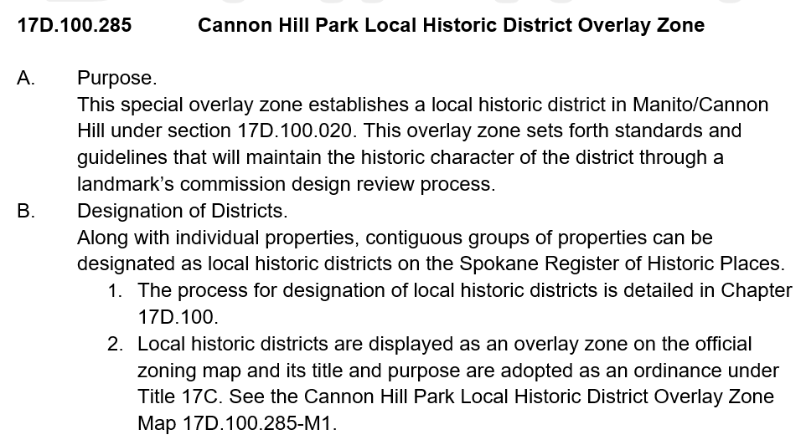
Overlay zone ordinance
The Historic Preservation code is located with Chapter 17 of the Spokane Municipal Code, therefore this proposal comes before the Plan Commission for a recommendation to City Council on whether this meets the City’s Comprehensive Plan goals. The Spokane Historic Landmarks Commission is tasked with providing expertise on matters of historic preservation to the City Council and has recommended approval.
Historic Districts in Spokane are created through an Overlay Zone Ordinance which includes the map; the Certificate of Appropriateness process; codifies the Design Standards & Guidelines; and includes the Secretary of the Interior’s Standards.

Slide 29
When Is a UDC Amendment appropriate?
Chapter 17G.025 Unified Development Code Amendment Procedure
Approval Criteria. The City may approve amendments to this code if it finds that:
The proposed amendment is consistent with the applicable provisions of the comprehensive plan; and
The proposed amendment bears a substantial relation to public health, safety, welfare, and protection of the environment.

Slide 30
The City of Spokane's Comprehensive Plan
1) Encourages the recognition and preservation of unique or outstanding landmark structures, buildings, and sites. (Goal DP 1.1) 2) Establishes historic preservation as a high priority within city programs. (Goal DP 3.1) 3) Requires that the city identify historic resources to guide decision making in planning. (Goal DP 3.3) 4) Seeks to maintain and utilize the expertise of the Landmarks Commission in decision making by the City Council, City Plan Commission, City Parks Board, and other city agencies in matters of historic preservation. (Goal DP 3.5)

Slide 31
The City of Spokane's Comprehensive Plan
The Comprehensive Plan also requires that the City utilize design guidelines and criteria for sub-areas and historic districts that are based on local community participation and the particular character and development issues of each subarea or historic district. (Goal DP 2.7)
The City's Comprehensive Plan recognizes our neighborhoods as one of our City's finest assets, and therefore requires that the City assist neighborhoods and other potential historic districts to identify, recognize, and highlight their social and economic origins and promote the preservation of their historic heritage, cultural resources, and built environment. (Goal DP 3.13)

Slide 32
The City of Spokane's Comprehensive Plan
To accomplish this, the City's Comprehensive Plan states as a goal to “provide incentives to property owners to encourage historic preservation" (Goal DP 3.9) and assist and cooperate with owners of historic properties to identify, recognize, and plan for the use of their property to ensure compatibility with preservation objectives (Goal DP 3.11) as well as encourage the deconstruction and reuse of historic materials and features when historic buildings are demolished. (Goal DP 3.12)

Slide 33
1) Which Comprehensive Plan Goals are met?
The Comprehensive Plan recognizes the high value that citizens place on historic resources in Spokane. Policies express public desires regarding their preservation and how to manage changes to these resources as they are impacted by new development. Historic properties can range from individually listed commercial, governmental, or residential buildings to historic districts in both neighborhood and commercial areas.
Chapter 3: Land Use
LU 2.2 Performance Standards.
LU 5.5 Compatible Development
LU 7.3 Historic Reuse
Chapter 6: Housing
H 2.3 Housing Preservation
Chapter 8: Urban Design and Historic Preservation
DP 1.1 Landmark Structures, Buildings, and Sites
DP 1.2 New Development in Established Neighborhoods
DP 2.8 Design Review Process
DP 2.12 Infill Development
DP 3.1 Historic Preservation
DP 3.3 Identification and Protection of Resources
DP 3.4 Reflect Spokane’s Diversity
DP 3.5 Landmarks Commission
DP 3.9 Redevelopment Incentives
DP 3.13 Historic Districts and Neighborhoods
DP 5.1 Neighborhood Participation
Chapter 11: Neighborhoods
N 2.4 Neighborhood Improvement
N 6.1 Environmental Planning
Chapter 13: Local Government and Citizenship
N 2.4 Neighborhood Improvement

Slide 34
2) The environment And Historic Preservation
The proposed UDC amendment bears a substantial relation to…the protection of the environment – in this case, the historic character of a neighborhood or district would fall under the environment. Historic and Cultural Preservation is included as one of the “Environmental Elements” in the SEPA Checklist – in this case, question #13.
Additionally, in SMC 17E.050.220 we adopt Washington State’s definition of “environment.” The code provides a reference to the state code WAC 197-11-740 which directs you to WAC 197-11-444 for a list of elements that make up the environment. One of those elements is (2)(b)(vi) “historic and cultural preservation.”

Slide 35
Action Requested
We respectfully request that the Plan Commission:
Recommend to City Council that the proposed adoption of SMC 17D.100.285, Cannon Hill Park Local Historic District Overlay Zone and Design Standards and Guidelines is fully consistent with applicable provisions of the City of Spokane Comprehensive Plan and bears a substantial relation to the public health, safety, welfare, and protection of the environment

