Slide 1
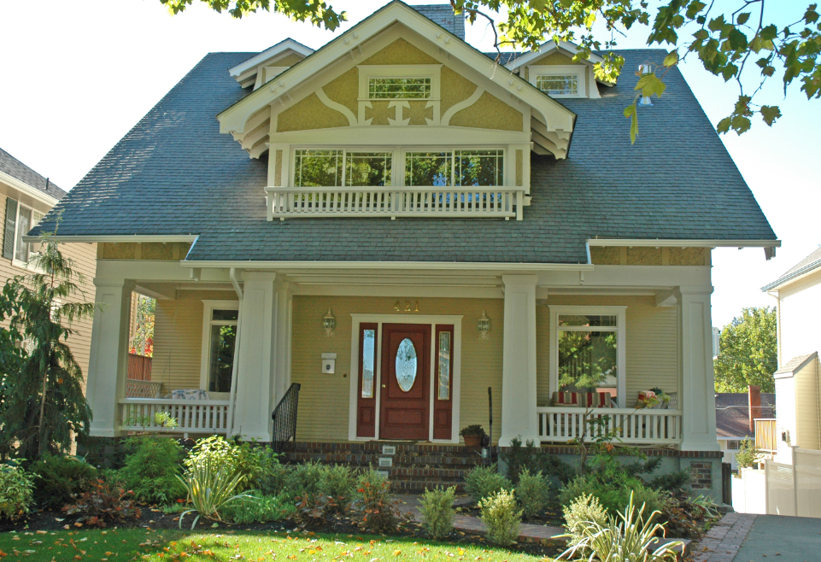
Cannon Hill Park Historic District

Slide 2
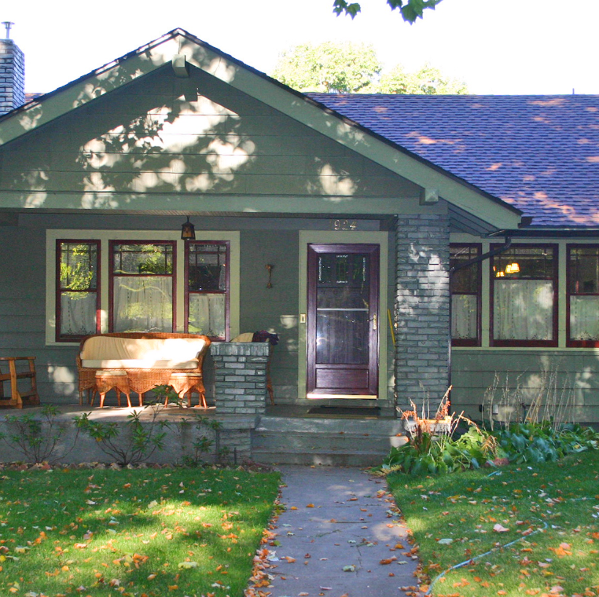
Spokane Historic Landmarks Commission Hearing:
Approval and recommendation to City Council for:
Nomination
Resource forms for each house
Design Standards and Guidelines
Overlay Zone Ordinance

Slide 3
The Role of the Historic Preservation Office in District Creation
Assist with City processes such as:
Sending out ballots to property owners and keeping track of responses
Spokane Historic Landmarks Commission Review & Recommendation
Plan Commission Review and Recommendation
City Council Review and Decision

Slide 4
Ballots
Ballots were sent to all property owners on May 8, 2025 – each “developable” parcel gets a vote, so if a property owner owns more than one parcel, they may have multiple votes.
60-day voting period – originally ballots were due 7/10/25, extended to 8/18/25 due to a noticing mistake that inadvertently left off 4 properties.
A non-returned ballot is counted as a “NO” vote – so we start with all “NO” votes and must get 50% + 1 “YES” votes to move the effort forward.
Engaged neighbors have contacted property owners about returning their ballots and encouraged participation. The Historic Preservation Office is the regulatory office, so we do not advocate for/against the district. We have provided advocates for the district periodic updates of returned ballots throughout the process – not the voting record, just the return of ballots.

Slide 5
Balloting Results
191 Ballots mailed represented 193 votes/parcels
152 Ballots returned (79% return rate)
133 YES Votes (69% in favor)
17 NO Votes (9% against)
2 Neutral Votes (1% count as NO votes)
41 unreturned ballots (21% count as NO votes)
Of those returning ballots, 88% were in favor of the district’s creation
In order to move forward (to SHLC, Plan Commission and City Council), the district needed 97 YES votes – they have exceeded that number and “owner consent” for listing has been achieved.

Slide 6
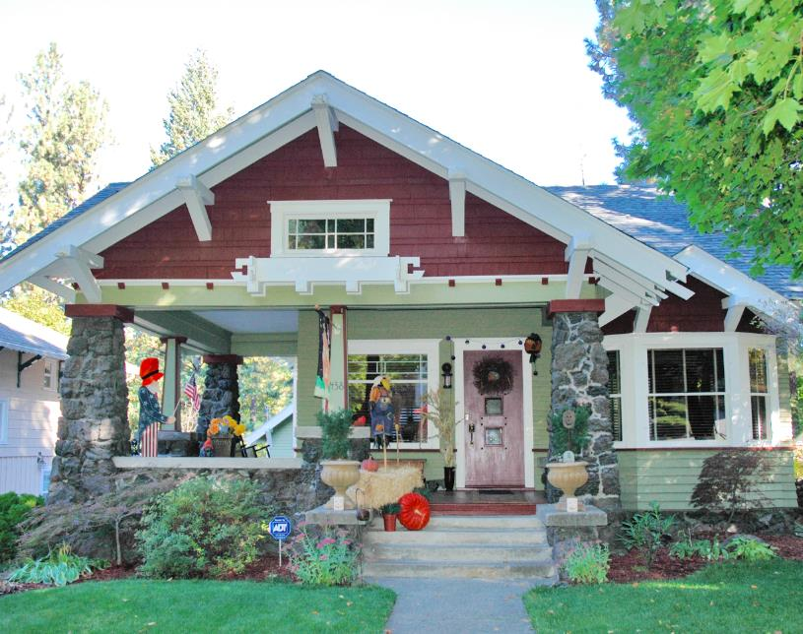
Additional Process after today:
Plan Commission Public Hearing – September 24
City Council Urban Experience Committee Meeting – September 8 or October 6
City Council will hold a Public Hearing on the proposal and make a decision October 2025.
Mayor then signs and 30 days later, district is in effect.

Slide 7
Cannon Hill Park Historic District
The Cannon Hill Park Addition Historic District is eligible for the Spokane Historic Register under Category A.
It is eligible under Category A for its association with the broad patterns of Spokane history in the area of a planned residential development as a designed and developer-shaped residential neighborhood.
The Period of Significance for the Cannon Hill Park Historic District is from 1909 when the district was first platted to 1958 with the conclusion of the post-WWII building boom; and 96 percent of the residential lots already built on.

Slide 8
Resources
Contributing Resources of the Cannon Hill Park Historic District
Contributing | Non-Contributing (alteration) | Out of Period/Age
180 (94%) | 4 (2%) | 7 (4%)

Slide 9
Map of the Cannon Hill Park Historic District

Slide 10
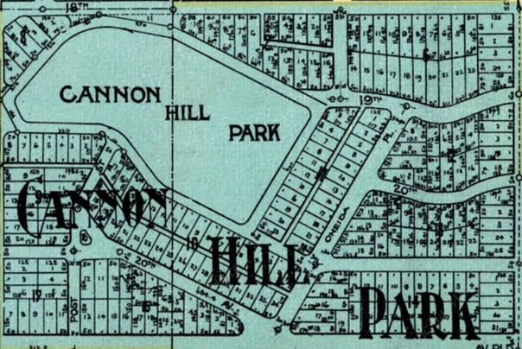
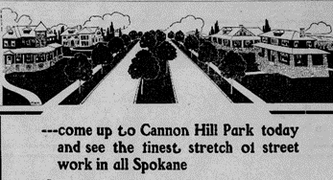
SIGNIFICANCE OF THE NEIGHBORHOOD
Convergence of the following:
Cannon Hill Park as a City Park
Olmsted Brothers Park & Boulevard Plan (included CHP along with Corbin and Liberty Parks)
Arthur D. Jones & Company and the Cannon Hill Co. platted the Cannon Hill Park Addition and offered lots for sale: 1909-1910
Notes:
The Olmsted plan included drawings of 3 parks – Cannon Hill Park, Liberty and Corbin Parks.

Slide 11
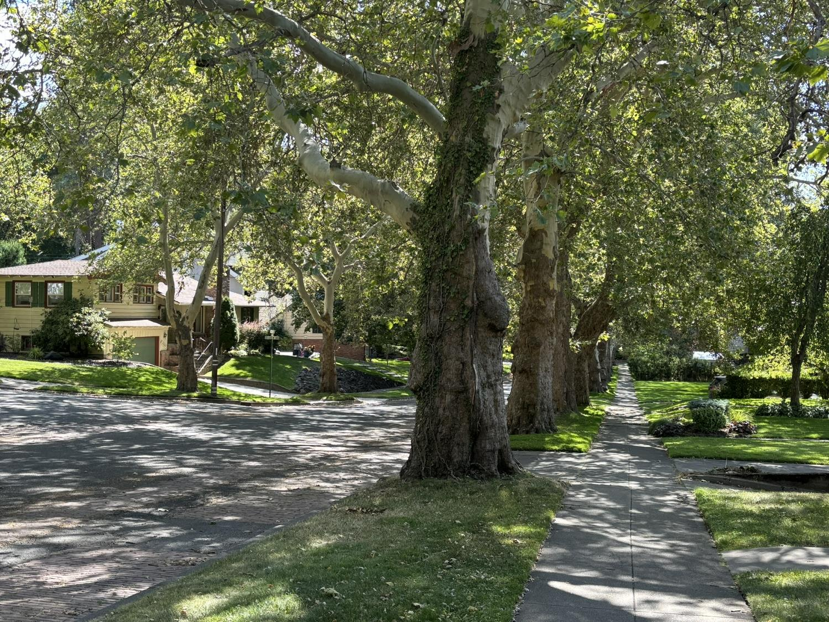
SIGNIFICANCE OF THE NEIGHBORHOOD
Park-like Setting
Landscape grading
Curvilinear streets to follow the park
Street trees planted
Boulevard
Views to the park and out over the City (not anymore!)
Notes:
The Olmsted plan included drawings of 3 parks – Cannon Hill Park, Liberty and Corbin Parks.

Slide 12
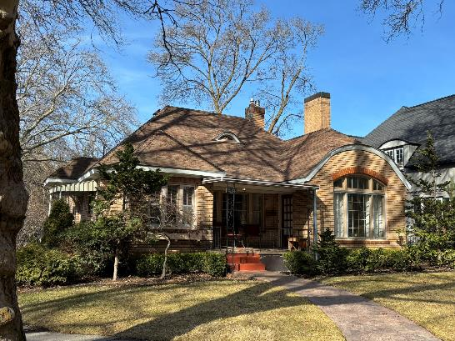
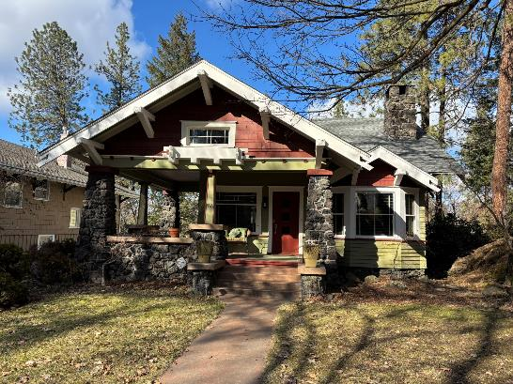
DISTRICT SIGNIFICANCE
The Cannon Hill Park District is nominated under Category A as a designed landscape with both the framework and many elements designed and implemented by two related development companies: the Arthur D. Jones & Company and the Cannon Hill Company (both entities listed Arthur Jones as president).
The dwellings within the district vary in size, building type, use of building materials, and style, even as they adhere to similar set-backs and scales of building mass to lot size. The use of a limited range of building materials and a similar quality of design and materials unites them in streetscapes that express both cohesion and variety.
However, many builders ignored the deed restrictions for size of houses. This pattern led to greater residential density in the CHPA, as numerous small houses, built with consistent quality design and materials, edged the park and boulevard and lined the tree-shaded streets.

Slide 13
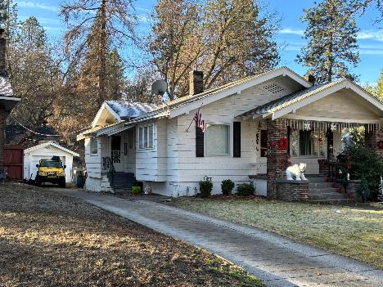
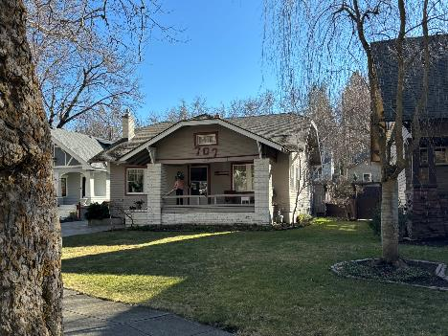
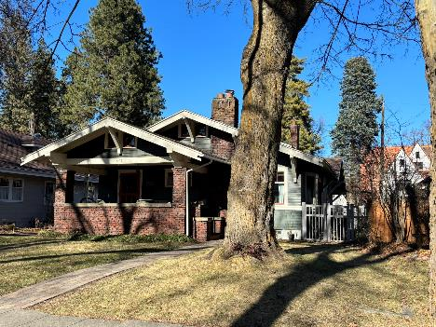
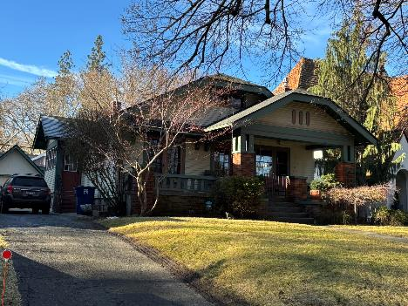
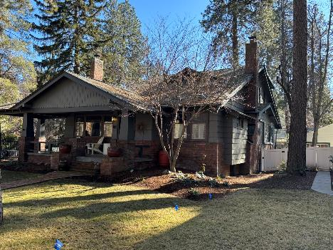
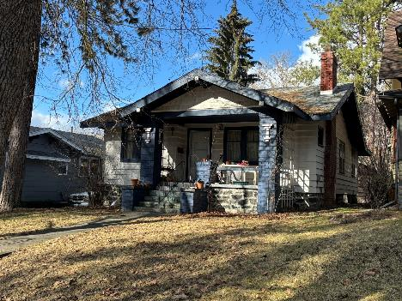
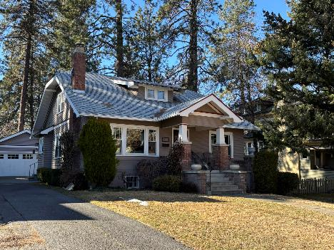
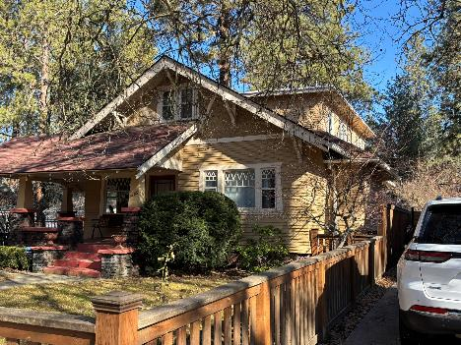
57 bungalow types of 191 properties (1909-1924)

Slide 14
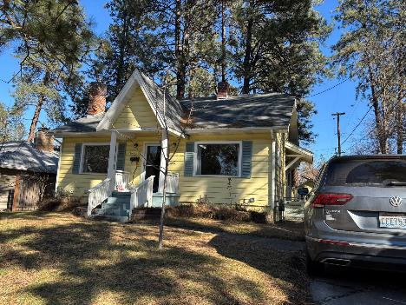
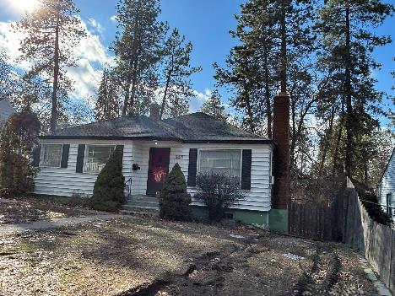
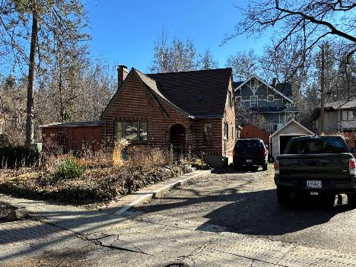
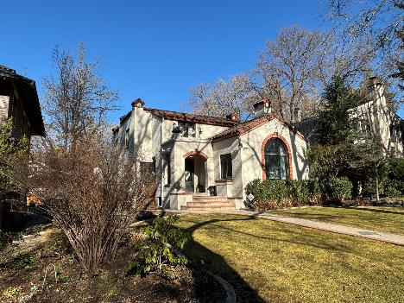
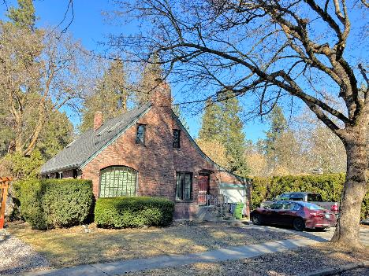
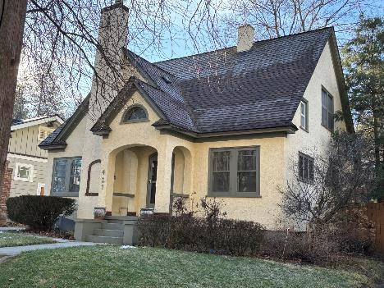
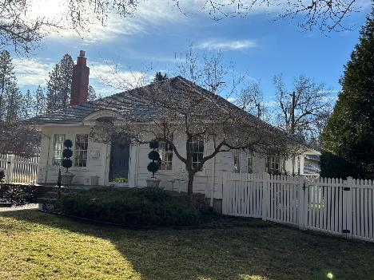
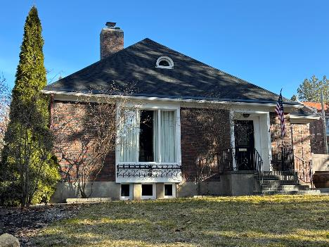
52 cottage Types of 191 properties (1921-1947)

Slide 15
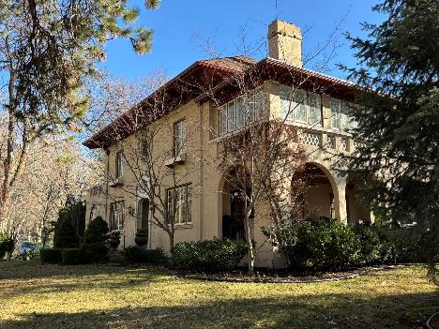
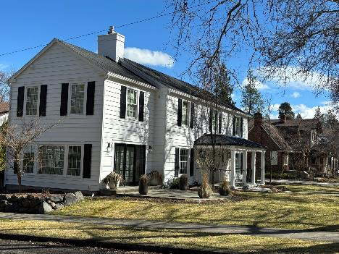
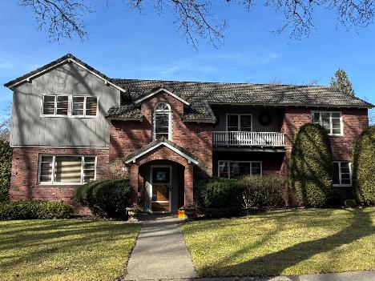
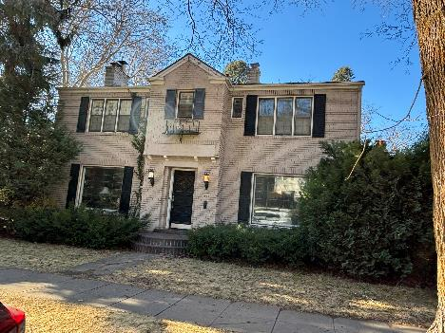
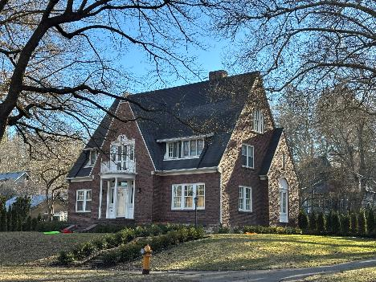
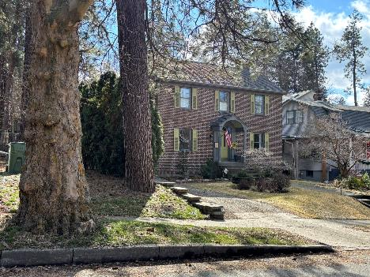
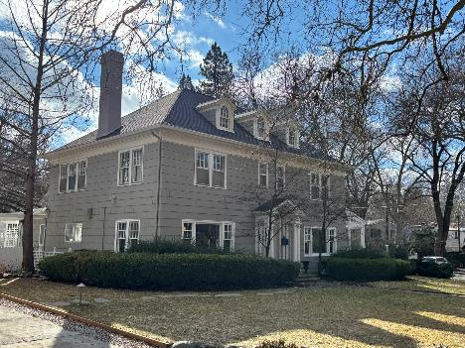
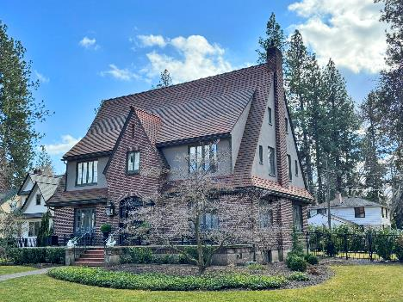
69 residence types of 191 properties (1909-1953)

Slide 16
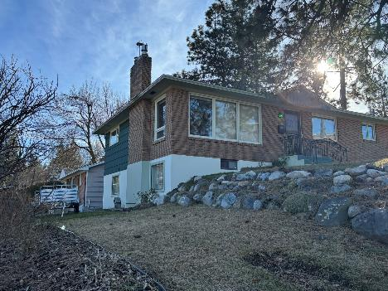
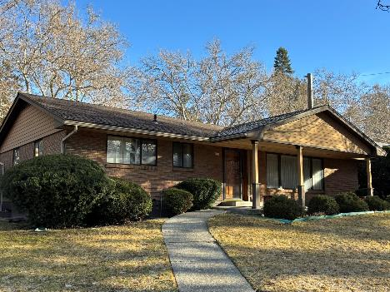
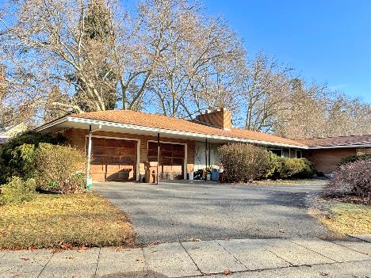
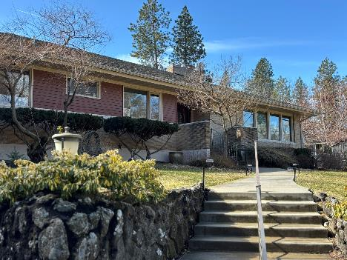
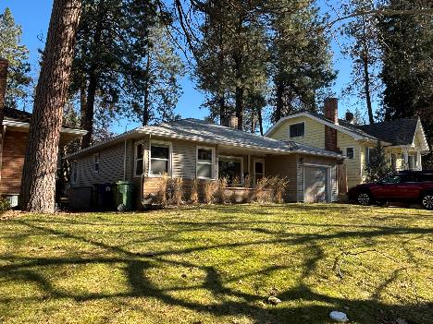
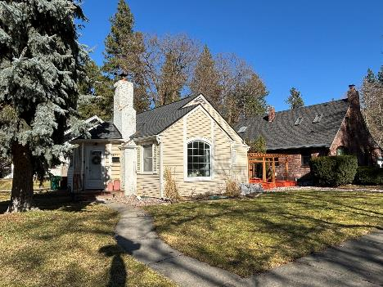
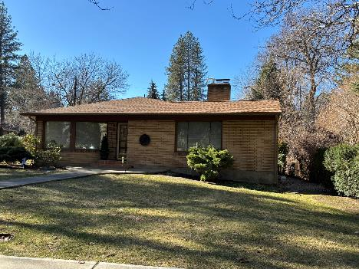
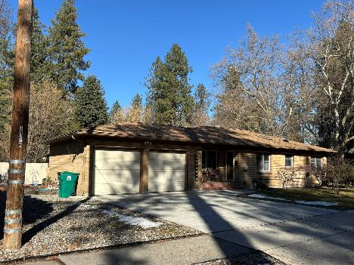
11 ranch Types of 191 properties (1948-1958)

Slide 17
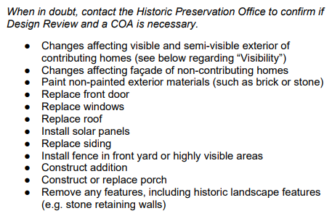
DESIGN STANDARDS & GUIDELINES
We use the Secretary of the Interior’s Standards for review of street-facing exteriors within Spokane’s Historic Districts as well as individually listed properties on the Spokane Register
10 broad standards – and then more descriptive guidance for home-owners and contractors, as well as the Spokane Historic Landmarks Commission and Staff to help interpret the standards

Slide 18
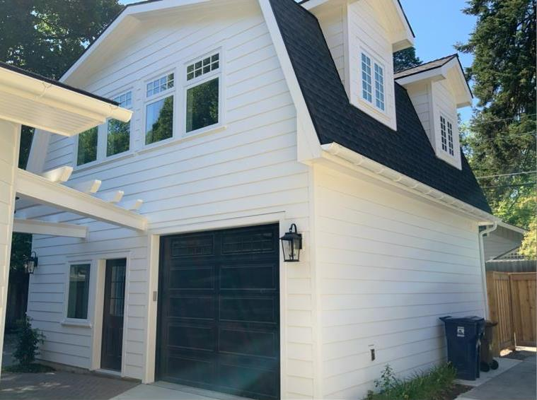
DESIGN STANDARDS AND GUIDELINES - ADUS

Slide 19
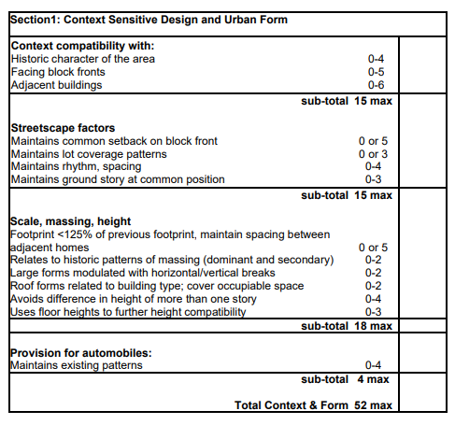
DESIGN STANDARDS & GUIDELINES: NEW CONSTRUCTION
New construction in the district would require Landmarks Commission review
Since there are so few non-contributing properties and only one parcel without a building already on it, it would most likely require demolition or boundary line adjustments (creation of new lots) for new construction to occur in the district

Slide 20
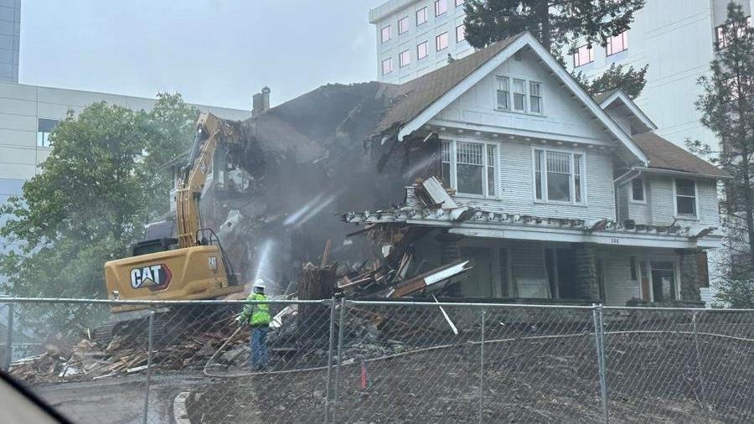
DESIGN STANDARDS & GUIDELINES: DEMOLITION
The 11 properties considered non-contributing in the district due to age, or changes over time would be able to be demolished with a staff review
Any other demolitions would be reviewed by the full Commission based on SMC 17D.100.220

Slide 21
PROCESS FOLLOWED BY THE HISTORIC PRESERVATION OFFICE
Date | Action | Code
10/16/2024 | Initial presentation to SHLC | SMC 17D.100.030
4/16/2025 | SHLC Meeting - Initial approval of documents to move forward with voting | SMC 17D.100.040
5/8 - 8/18/2025 | Ballots mailed to property owners in district boundaries - due to a noticing error that omitted 5 properties, due date for ballots was extended from 60 days to for everyone to 8/18/2025 | SMC 17D.100.100
6/23/2025 | SEPA/Notice sign posted in Cannon Hill Park | SMC 17D.100.040
7/3/2025 | SEPA Checklist request for comments | SMC 17G.025.010D
7/3/2025 | Commerce Notice to adopt an amendment to the UDC | SMC 17G.025.010I
7/23/2025 | Plan Commission Workshop | SMC 17G.025.010
8/20/2025 | SHLC Hearing on district | SMC 17D.100.040
9/8/2025 | Urban Experience Committee Briefing | SMC 17G.025.010 H
9/24/2025 | Plan Commission Hearing | SMC 17G.025.010 F
TBD | City Council Hearing | SMC 17G.025.010 H
TBD | Commerce Final Notification | Follows City Council action - 10 days

Slide 22
OUTREACH CONDUCTED
Date | Action
10/16/2024 | Initial presentation to SHLC
2/26/2025 | Public Workshop with presentation by HPO Staff at Wilson Elementary
3/12/2025 | Project proponent, Nathan South, and HPO Megan Duvall gave an introduction to Plan Commission about the project
4/1/2025 | SHLC Meeting (4/16/25) noticed in the Spokesman-Review as well as the Gazette and HP Website
4/23/2025 | Public Workshop with presentation by HPO Staff at Roosevelt Elementary
Ongoing | Neighborhood advocates have knocked on doors of neighbors to discuss the district, placed door hangers reminding neighbors to vote; and posted yard signs encouraging neighbor participation
5/8/2025 | Ballots mailed, letter included with more information and map to all property owners
6/18/2025 | Postcard mailed to all property owners advising the new due date for ballots as well as noting SHLC hearing date
6/23/2025 | SEPA Notice sign posted in Cannon Hill Park
TBD | *Notice will be done for all upcoming public hearings (SHLC, Plan Commission, City Council)
Notes:
Fix the dates on this

Slide 23
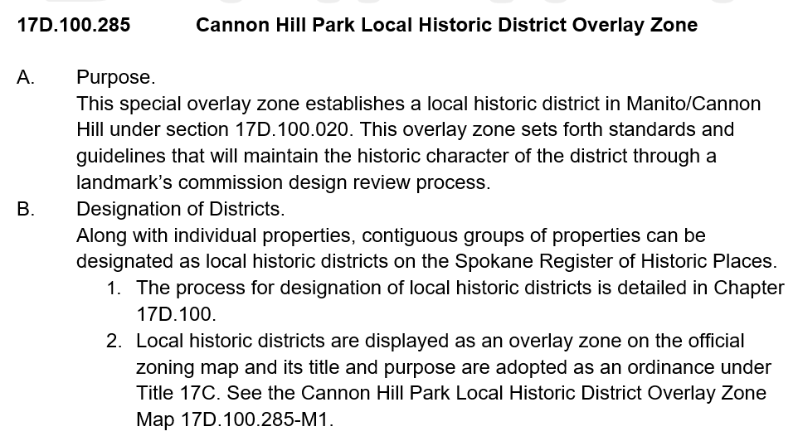
OVERLAY ZONE ORDINANCE
Historic Districts in Spokane are created through an Overlay Zone Ordinance which includes the map; the Certificate of Appropriateness process; codifies the Design Standards & Guidelines; and includes the Secretary of the Interior’s Standards.

Slide 24
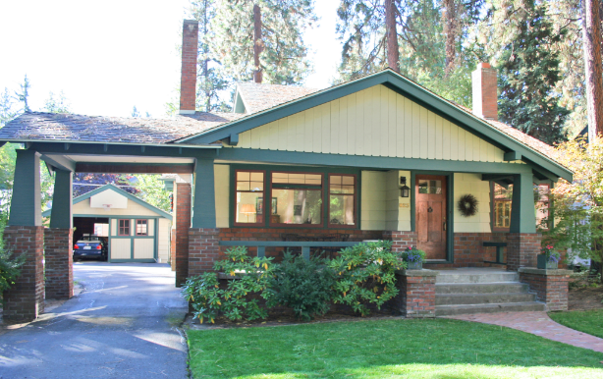
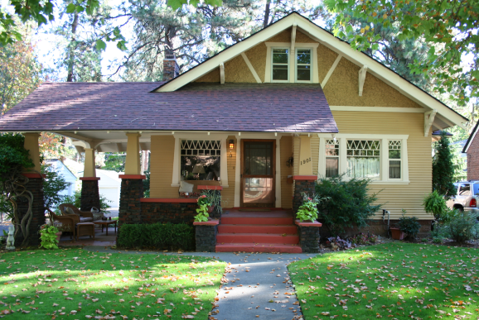
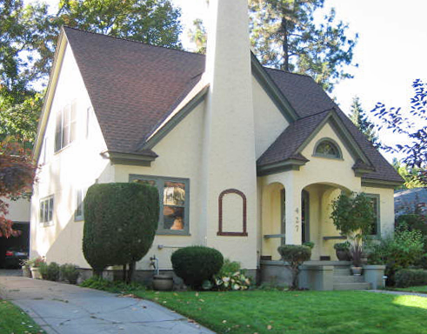
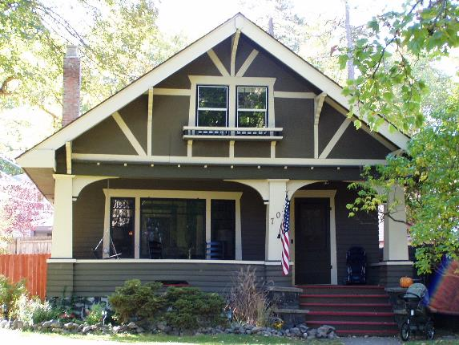
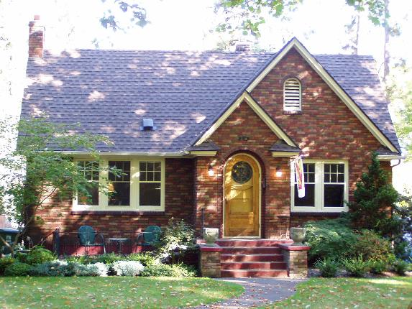

Questions?

