Slide 1
CP Thomas House
1212 N Summit Boulevard
Special Valuation Residential

Slide 2
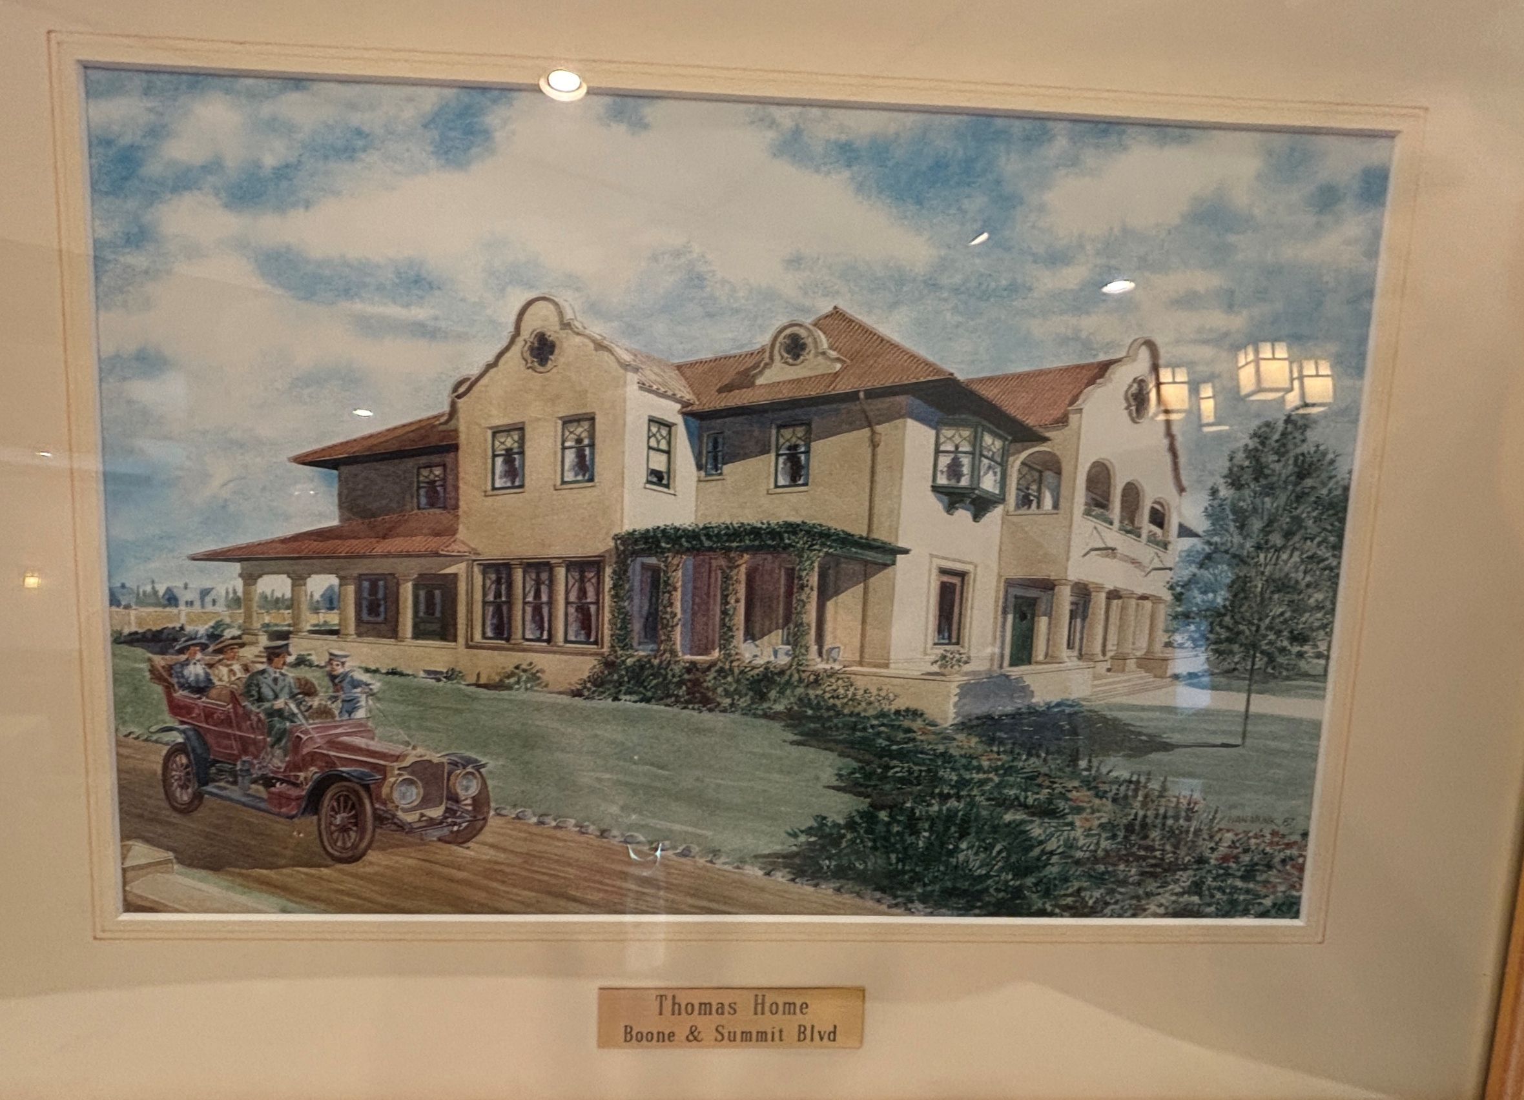

Slide 3
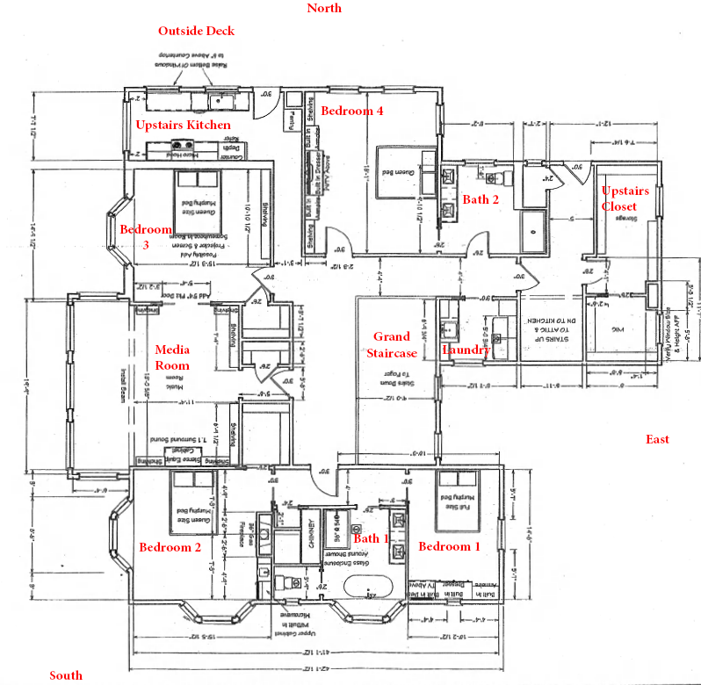

Slide 4
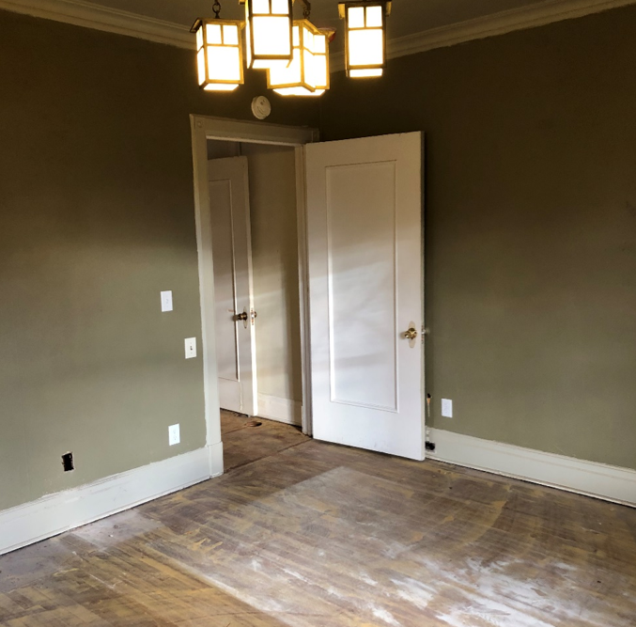
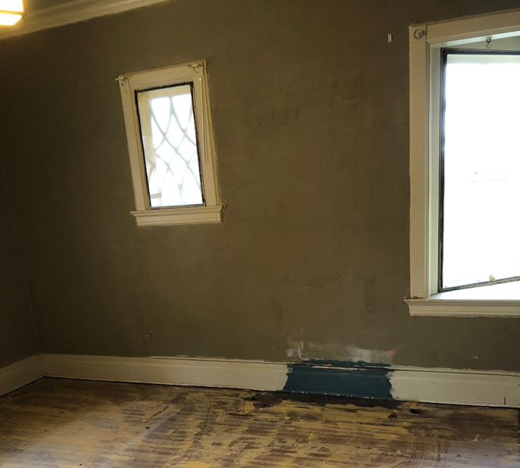
BEFORE: 2nd Floor - Bedroom 1

Slide 5
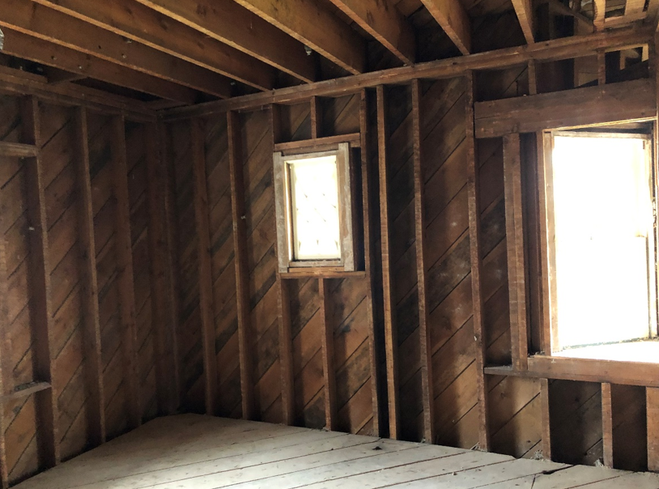
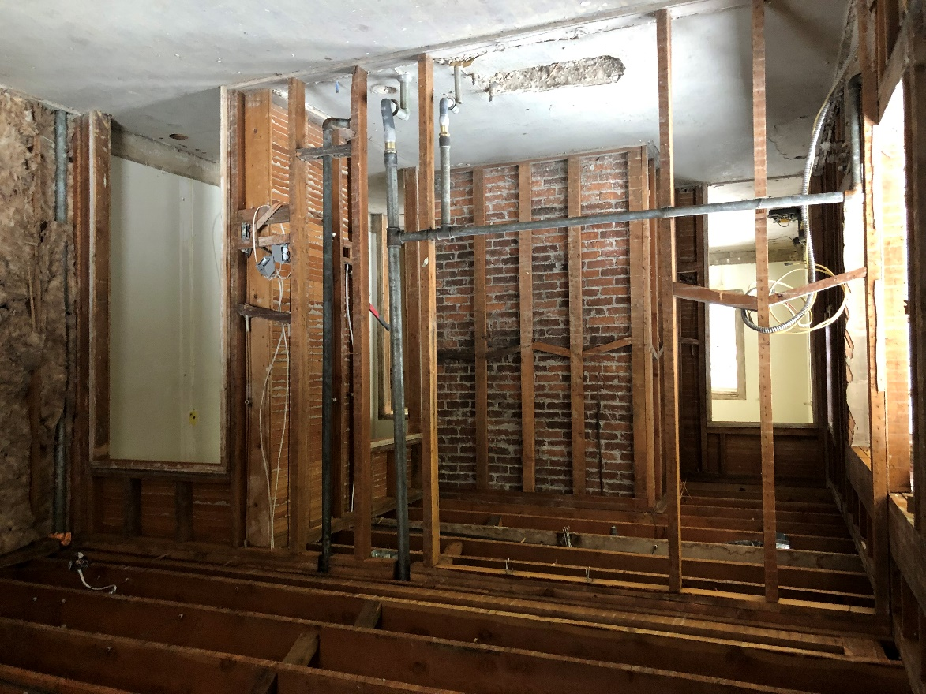
During construction: 2nd Floor - Bedroom 1

Slide 6
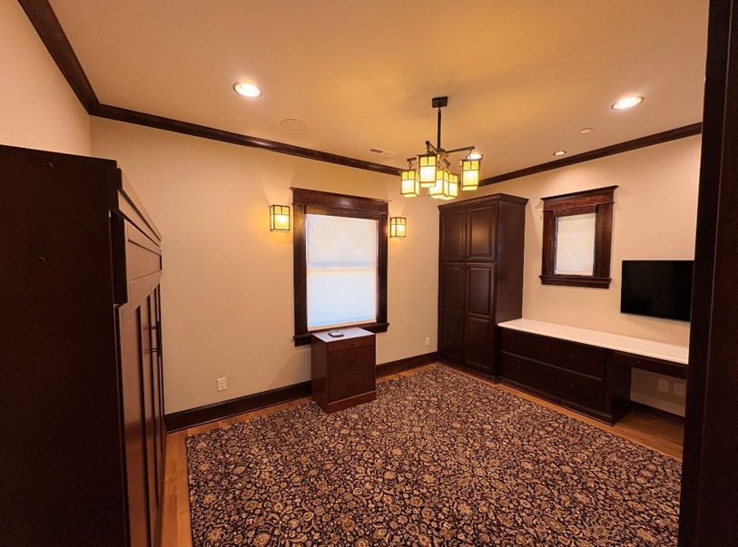
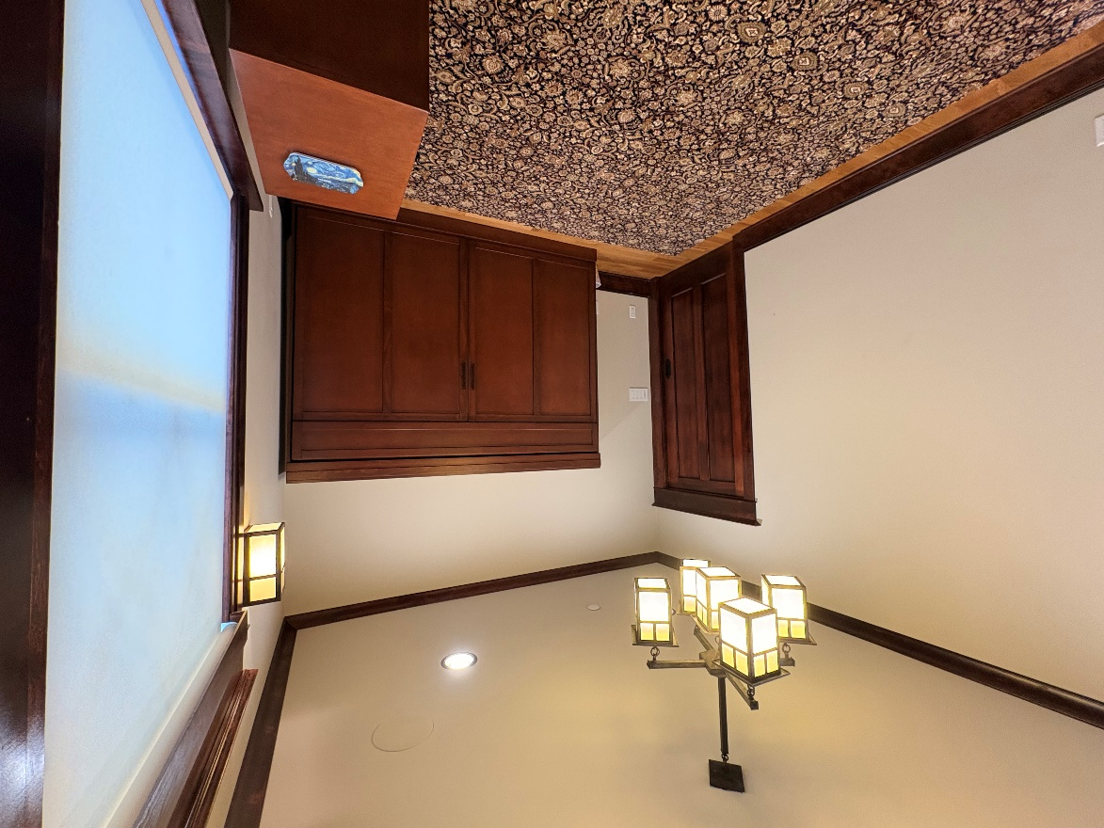
After: 2nd Floor - Bedroom 1

Slide 7
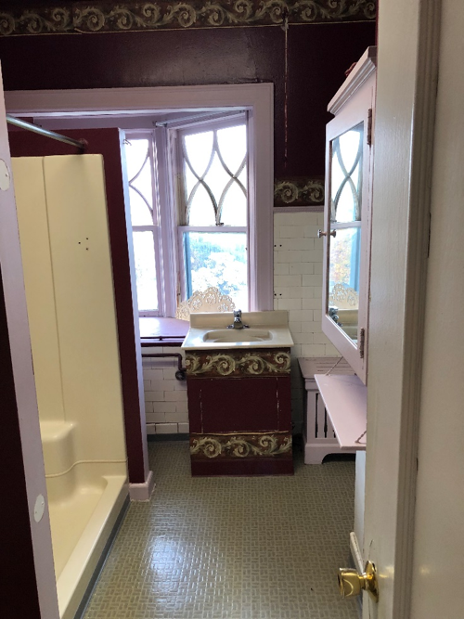
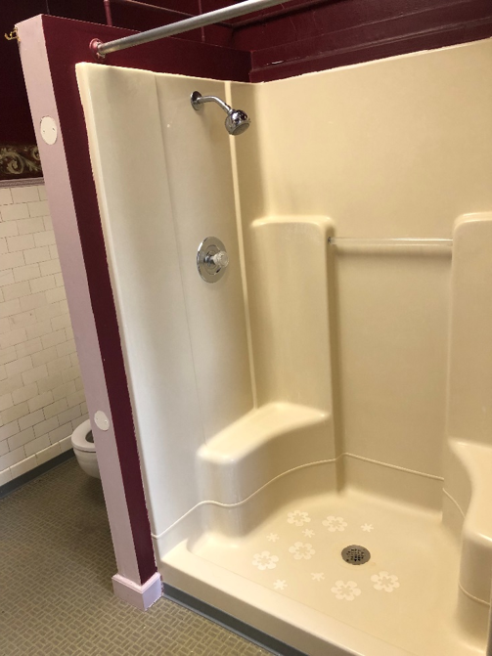
BEFORE: 2nd Floor - Bathroom 1

Slide 8
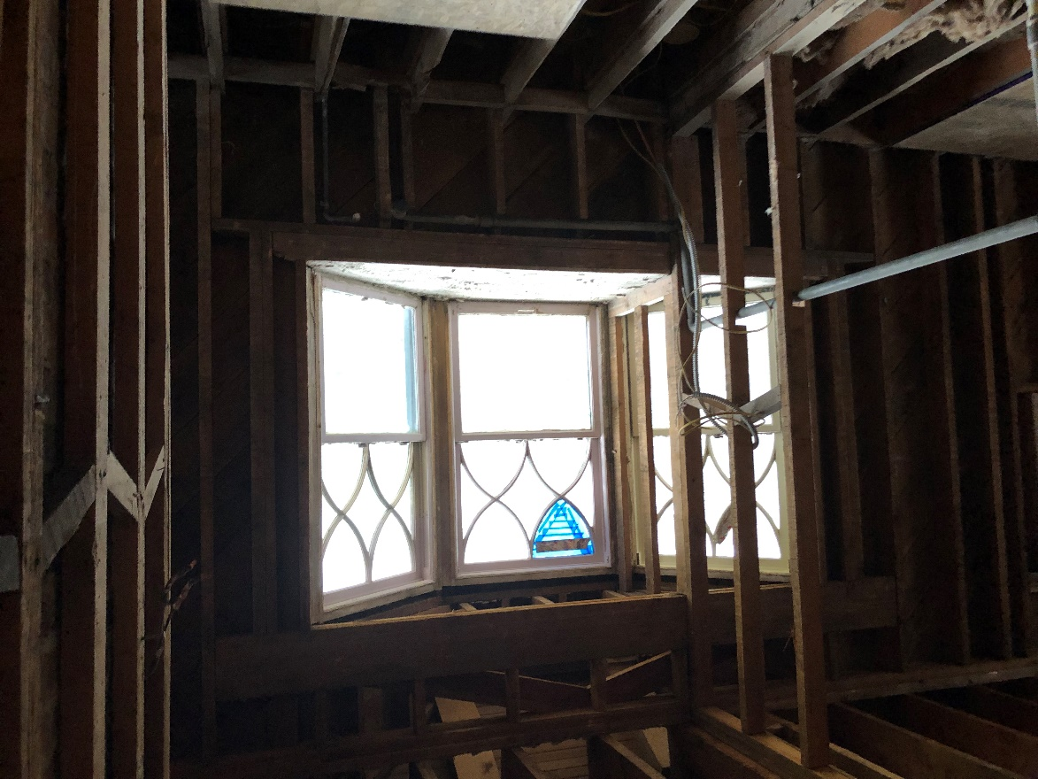
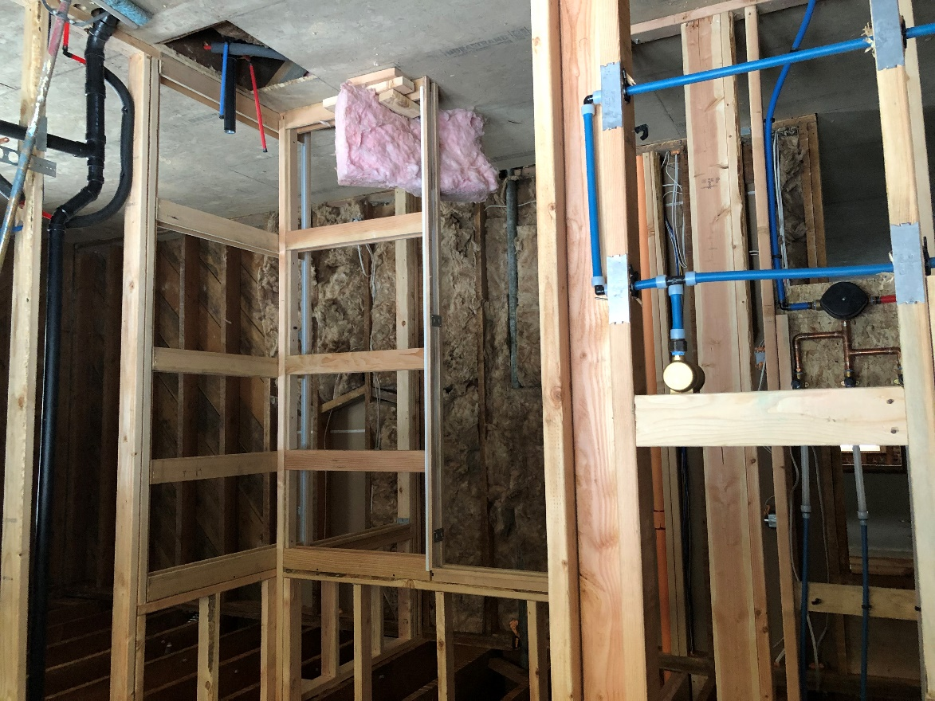
DURING: 2nd Floor - Bathroom 1

Slide 9
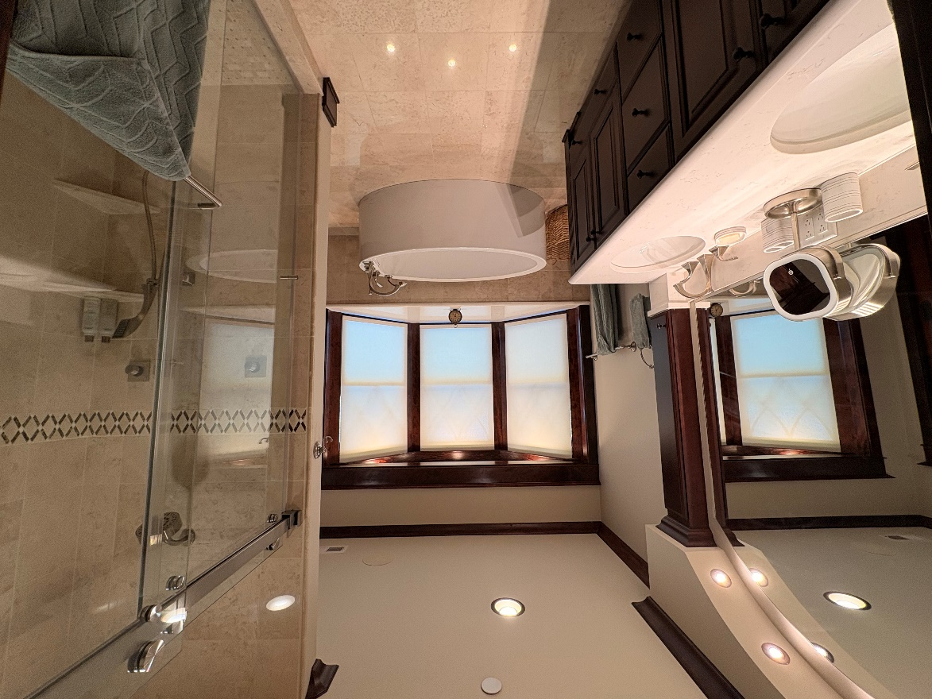
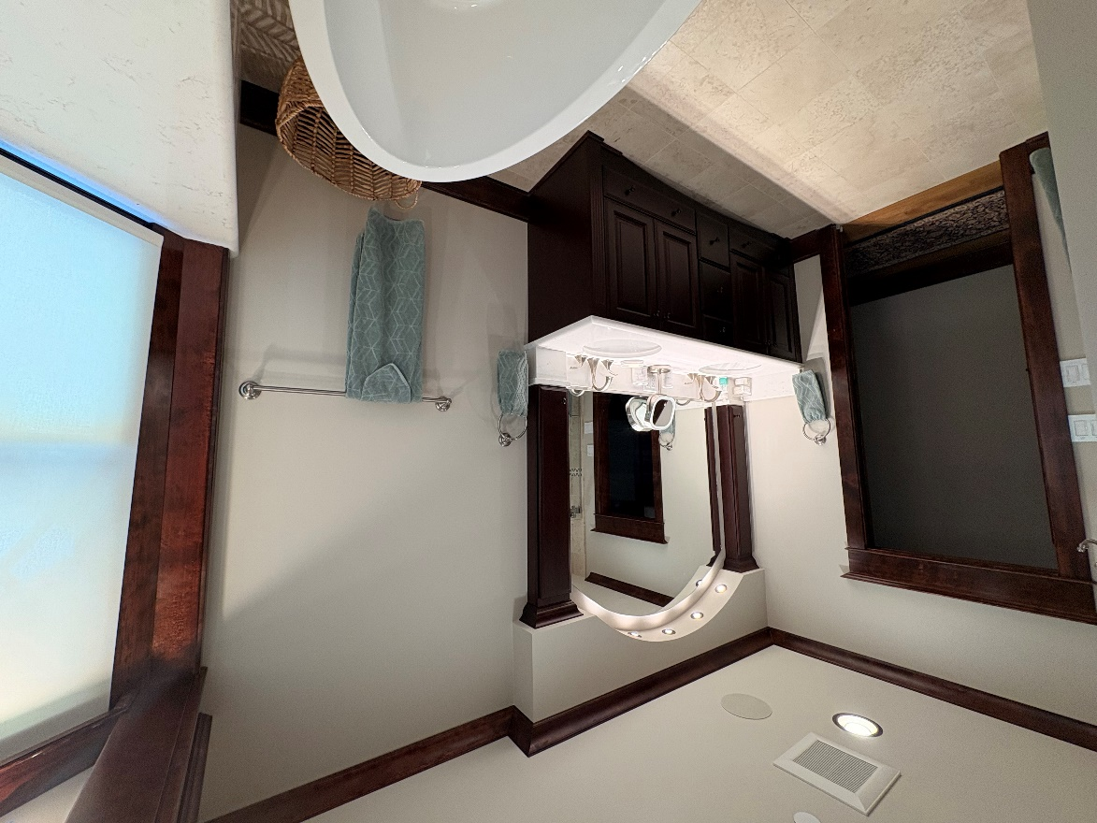
AFTER: 2nd Floor - Bathroom 1

Slide 10
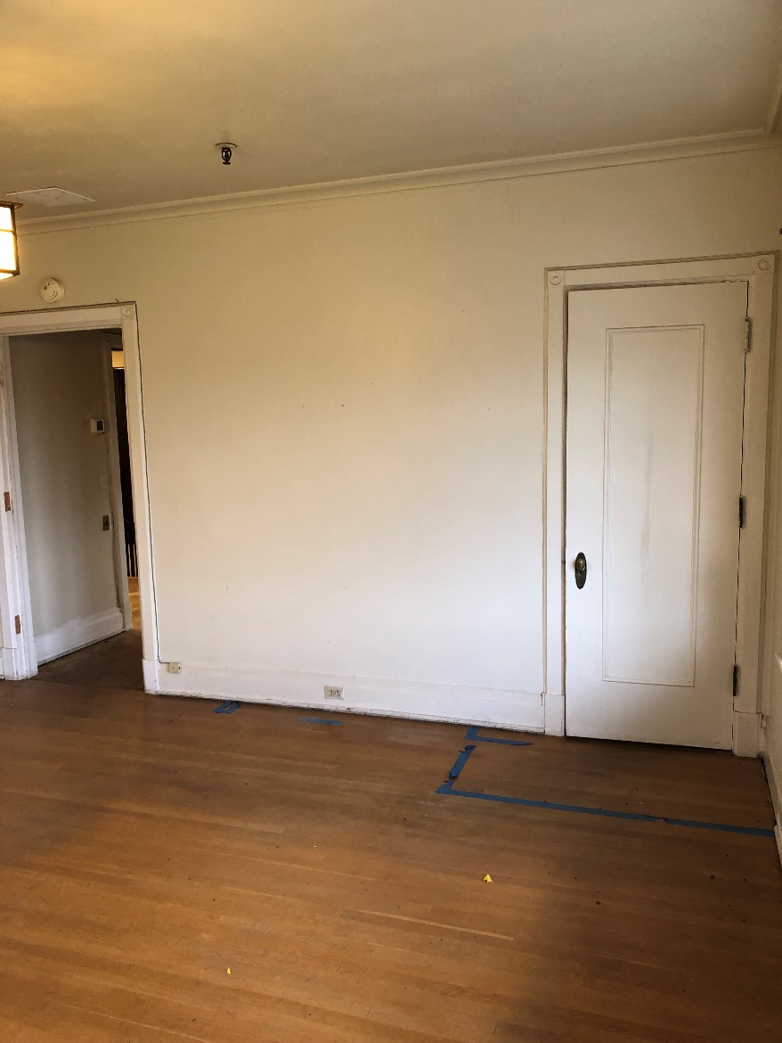
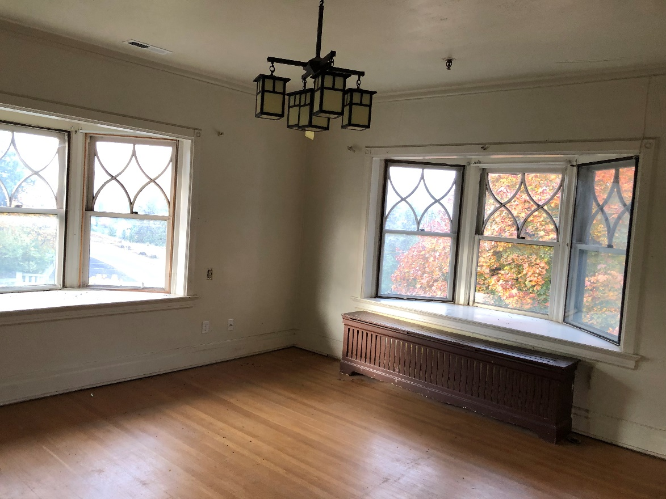
BEFORE: 2nd Floor – Bedroom 2

Slide 11
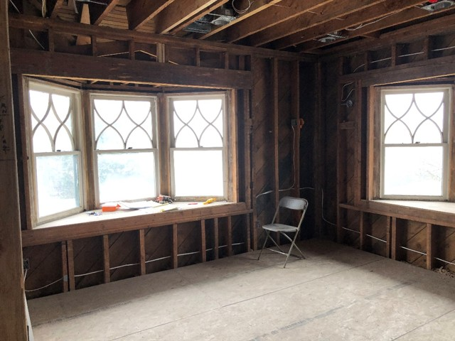
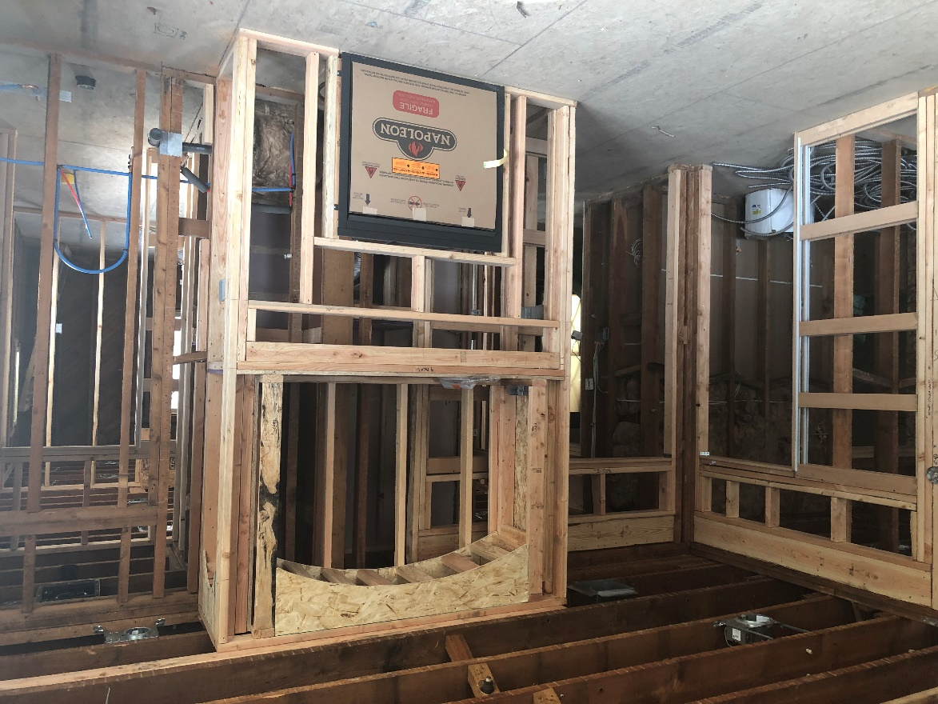
DURING: 2nd Floor – Bedroom 2

Slide 12
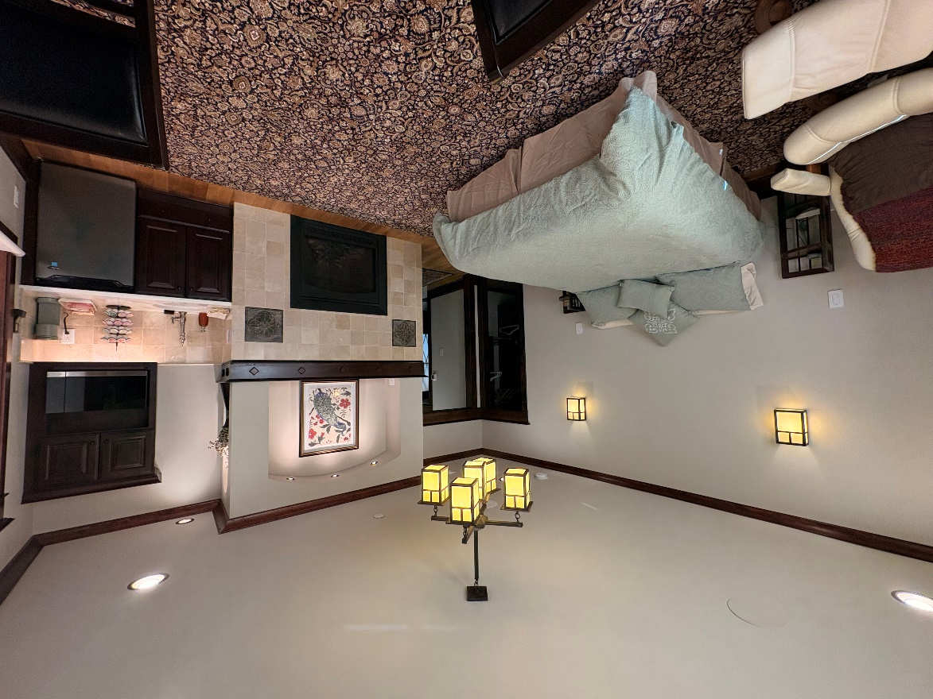
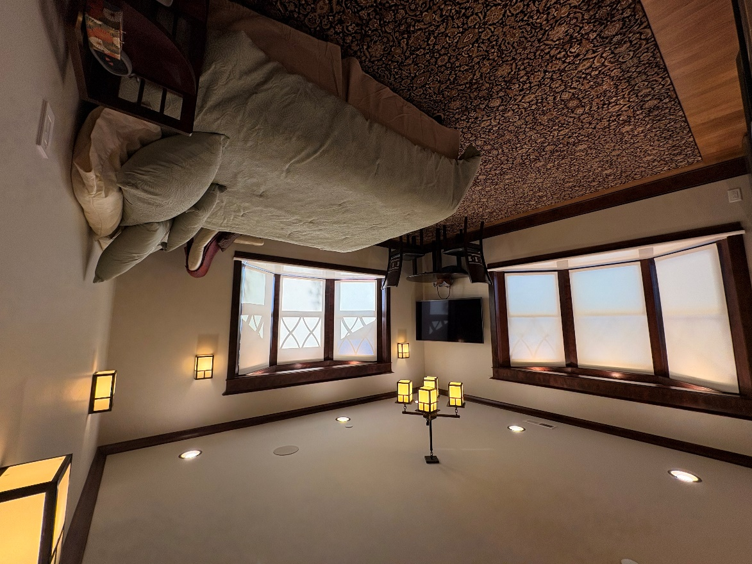
AFTER: 2nd Floor – Bedroom 2

Slide 13
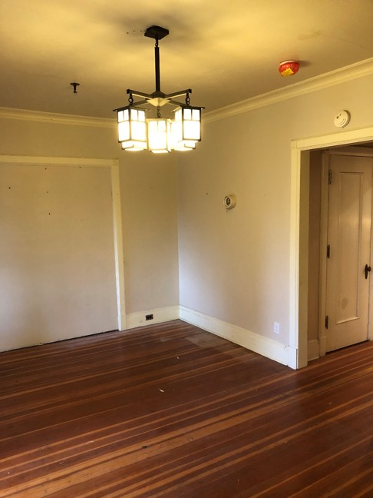
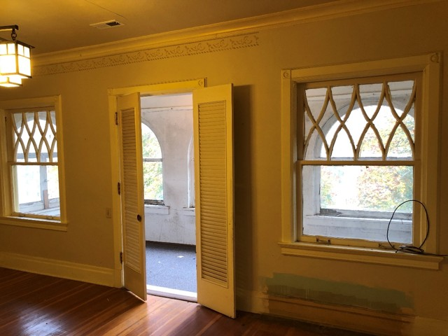
BEFORE: 2nd Floor – Media Room

Slide 14
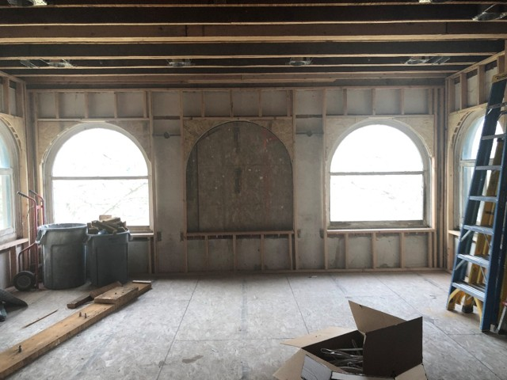
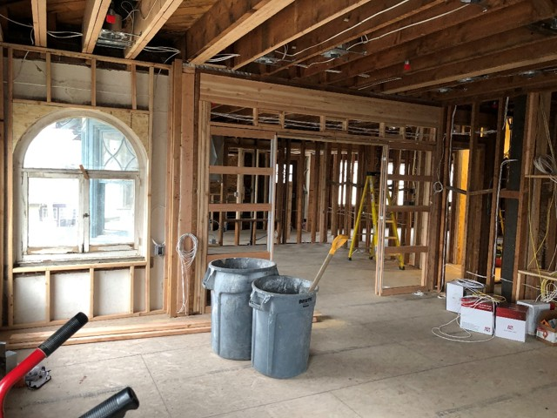
DURING: 2nd Floor – Media Room

Slide 15
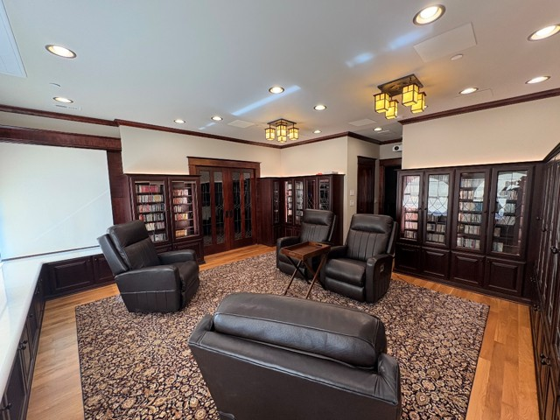
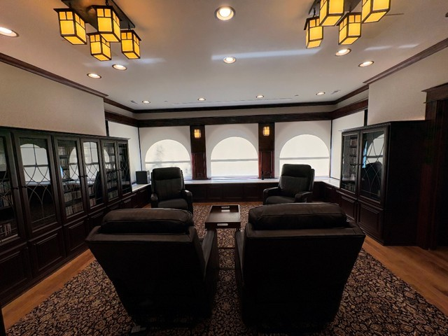
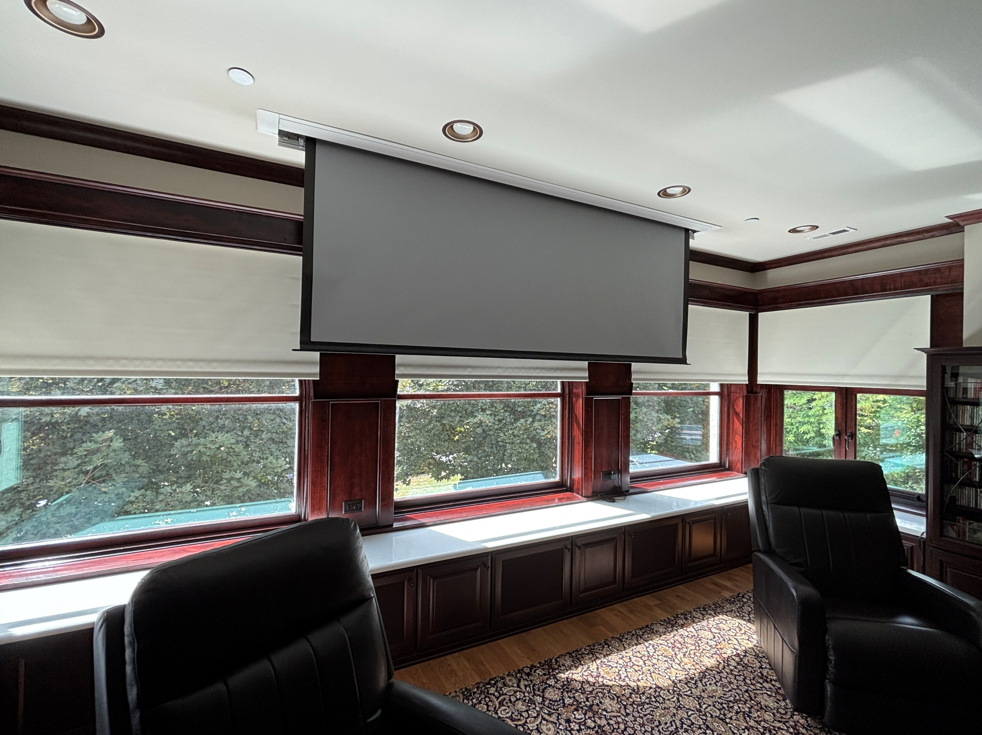
AFTER: 2nd Floor – Media Room

Slide 16
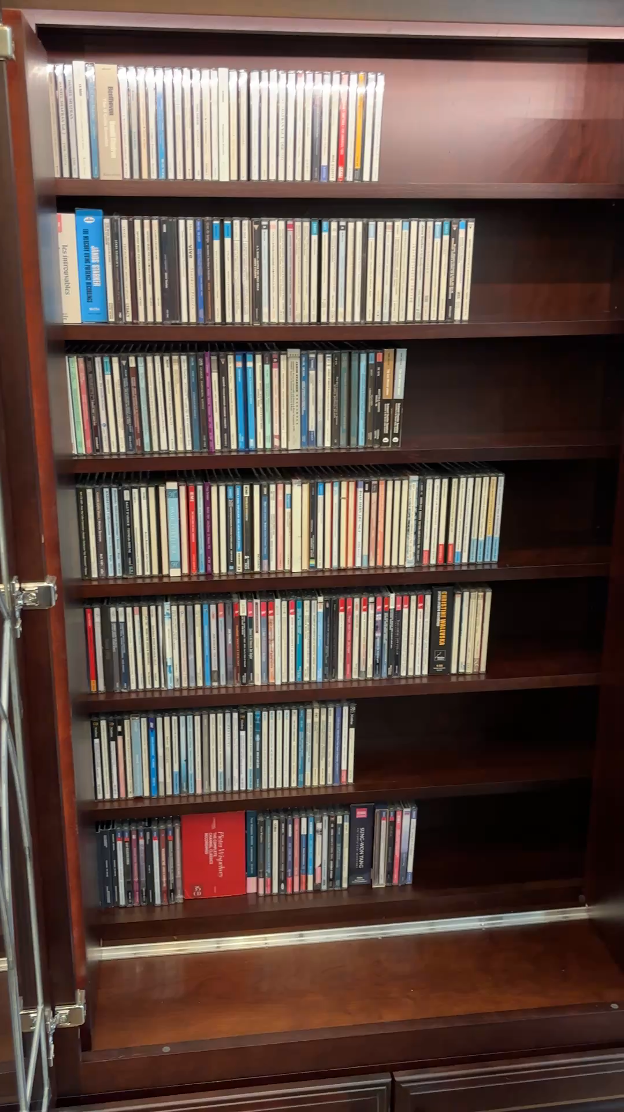
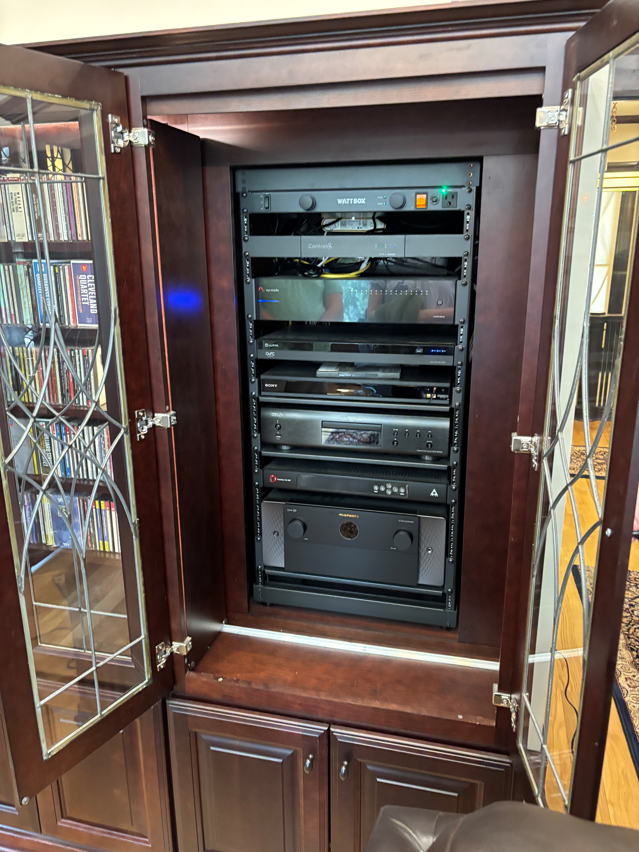
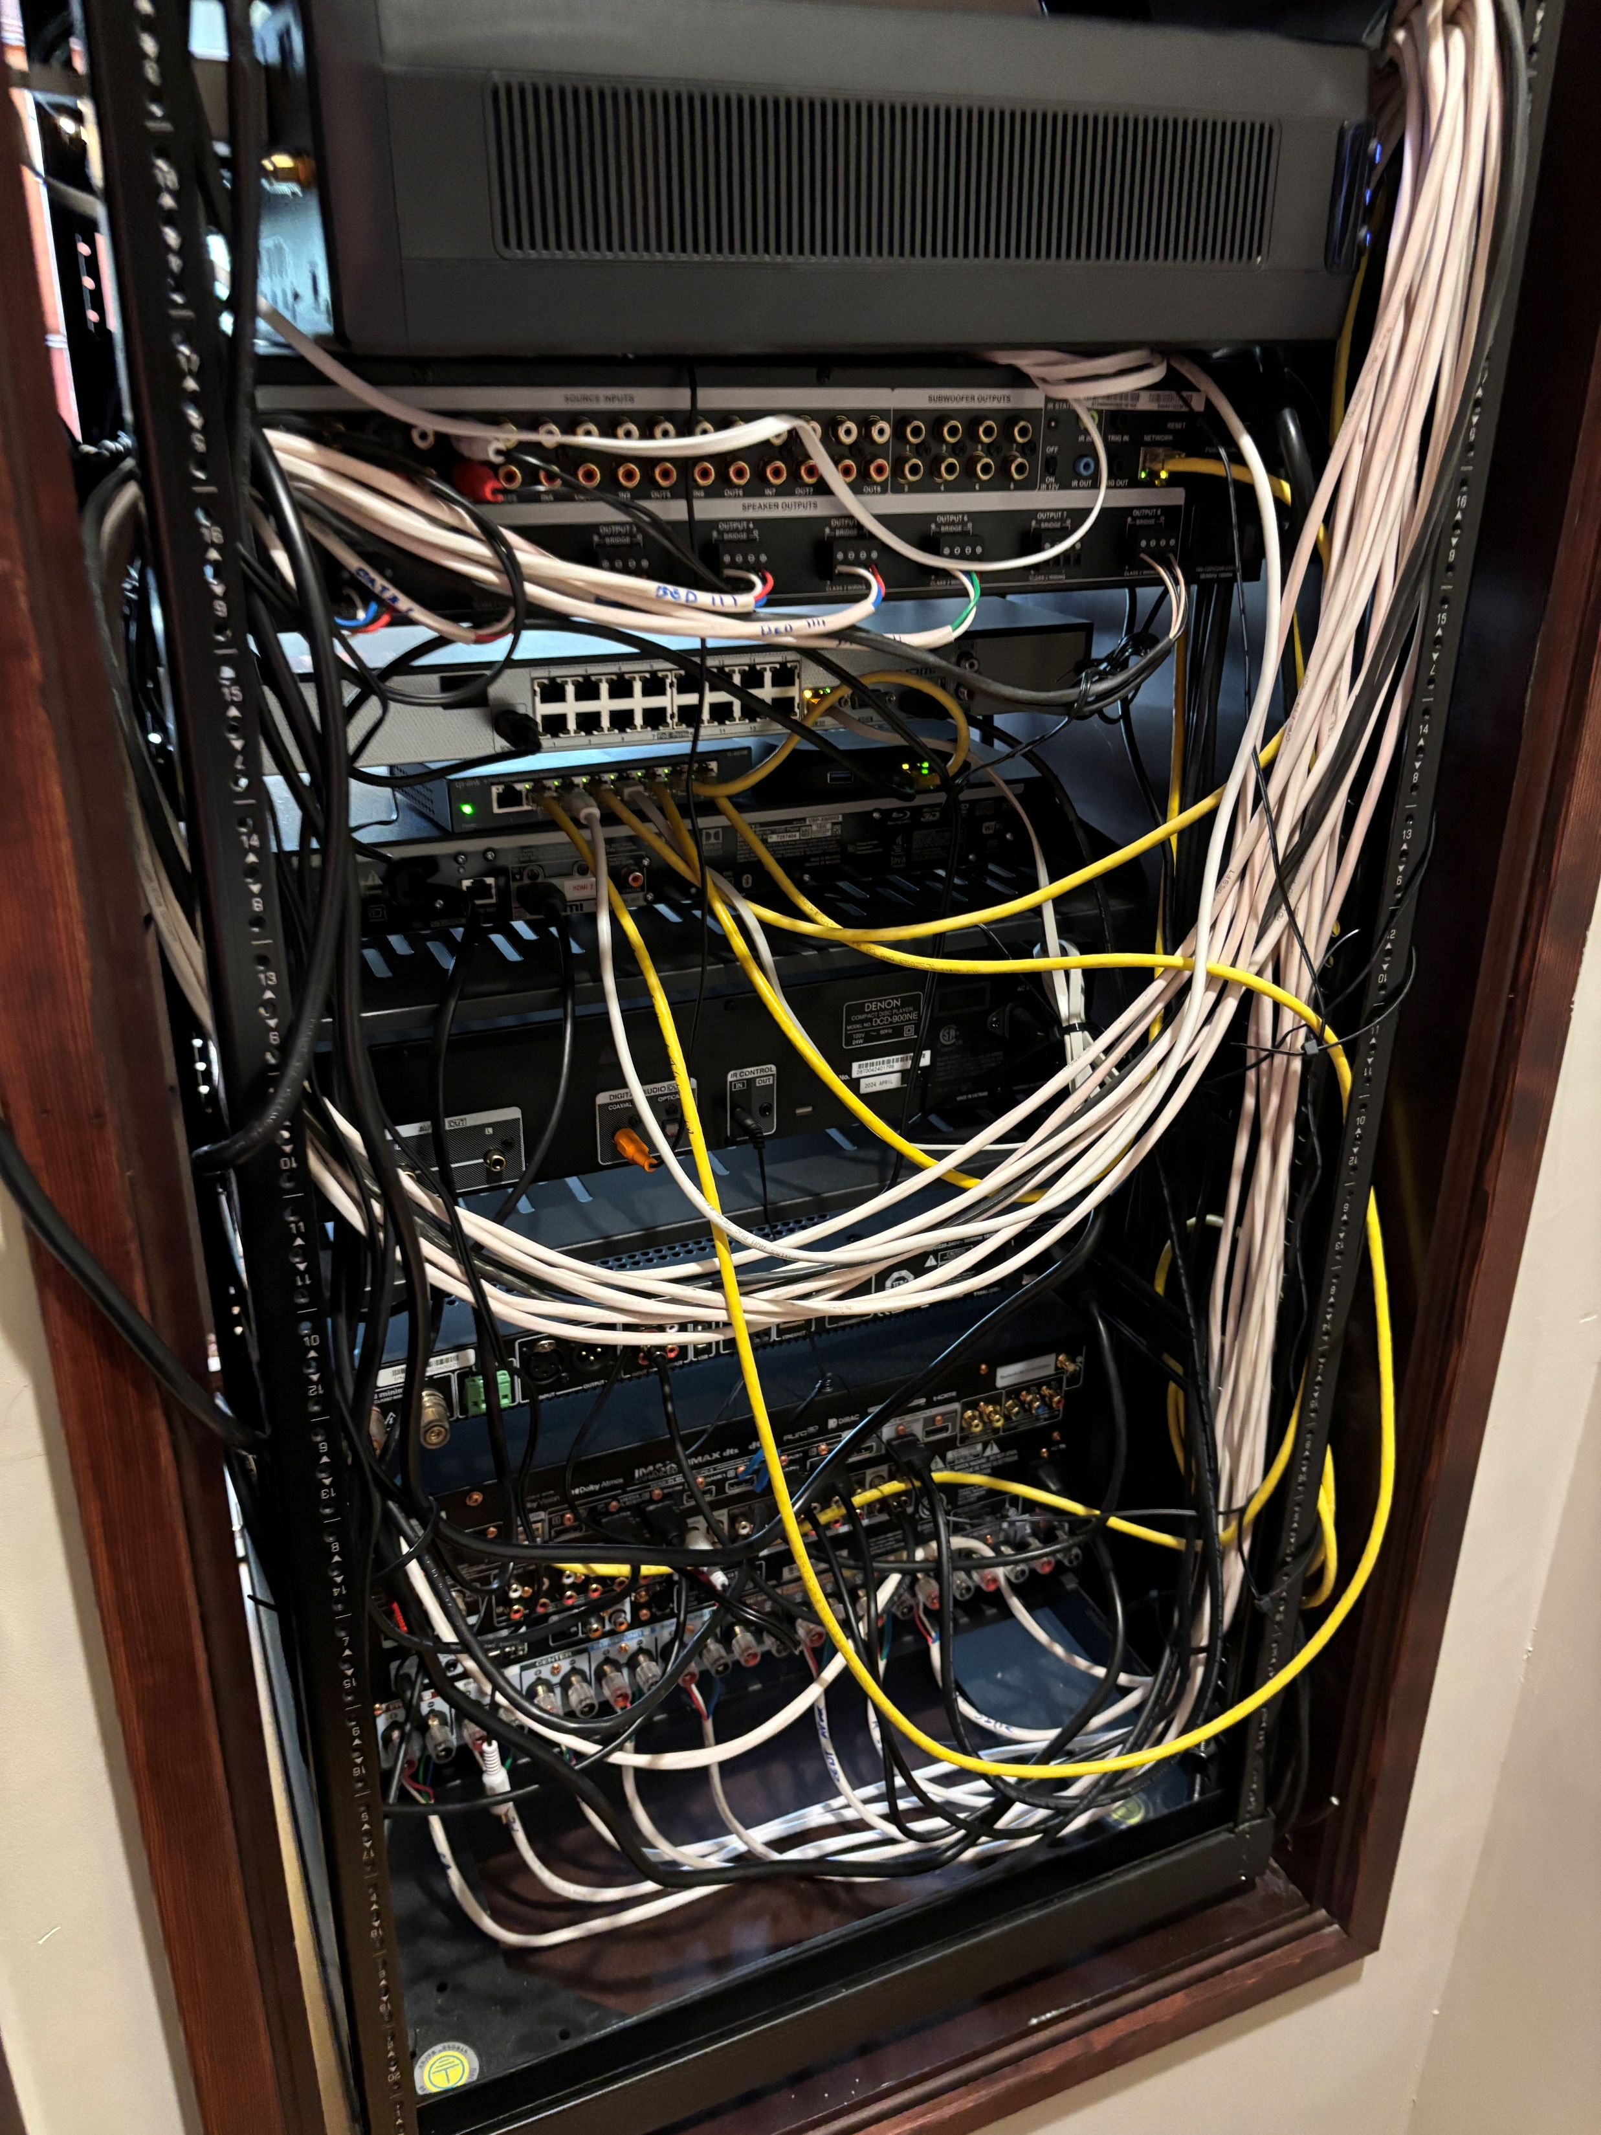

Slide 17
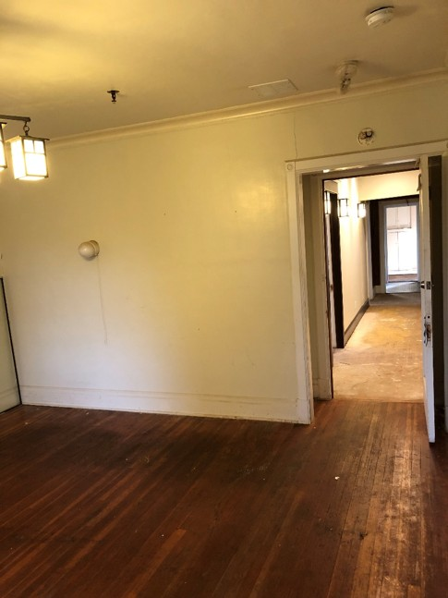
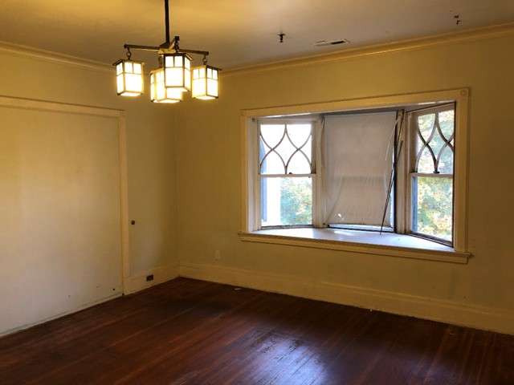
BEFORE: 2nd Floor – Bedroom 3

Slide 18
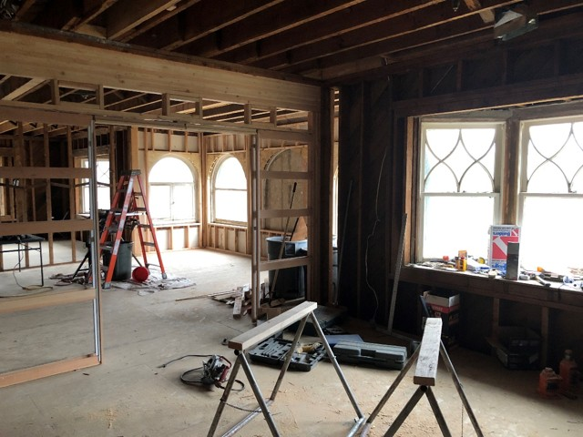
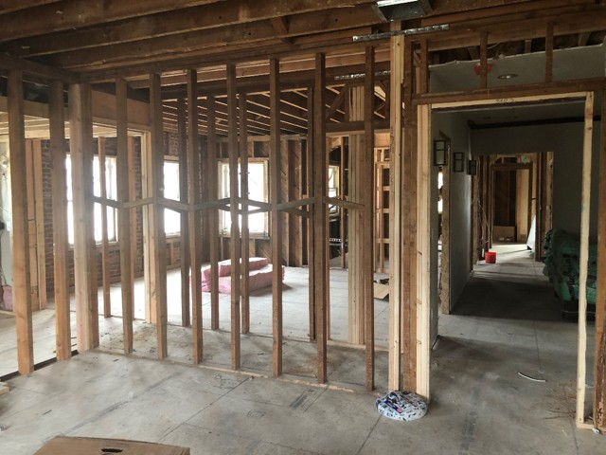
DURING: 2nd Floor – Bedroom 3

Slide 19
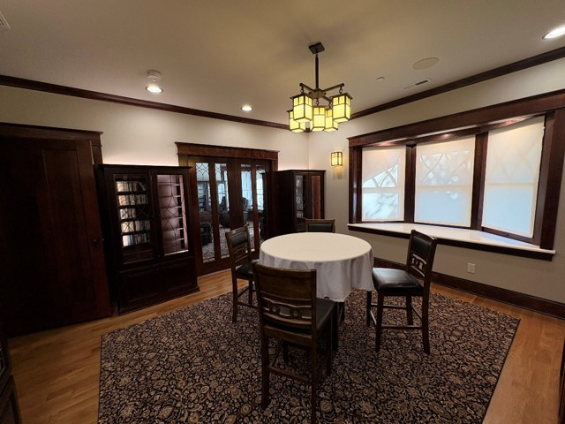
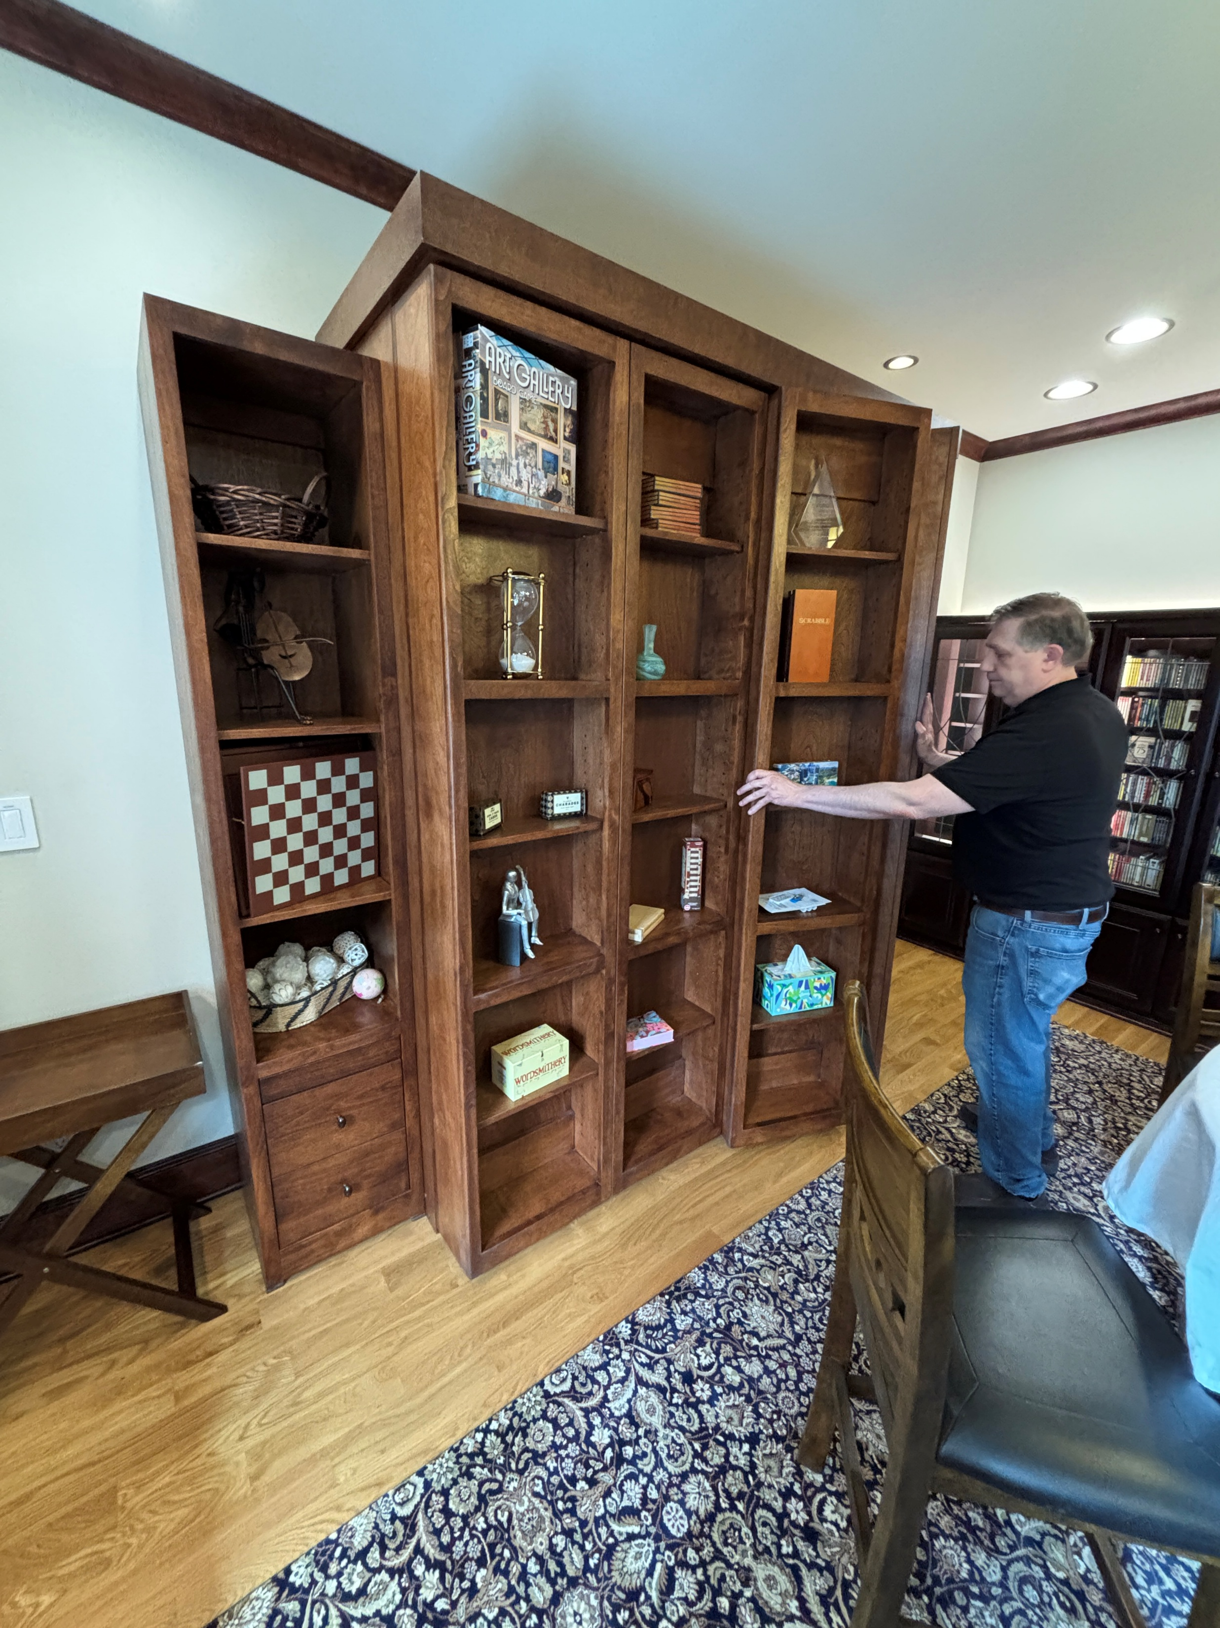
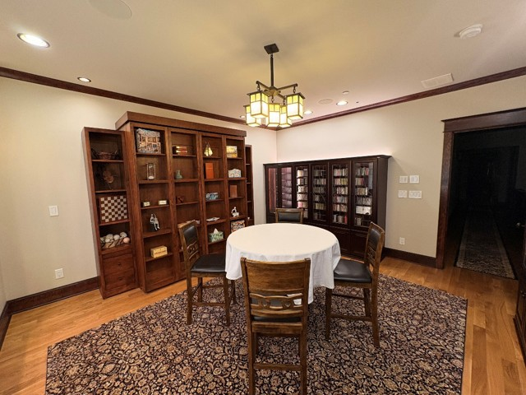
AFTER: 2nd Floor – Bedroom 3

Slide 20
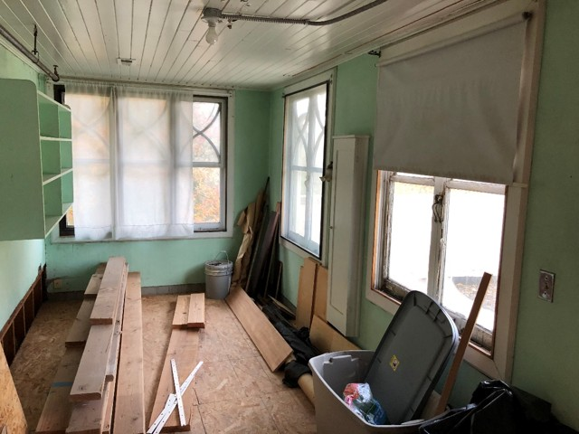
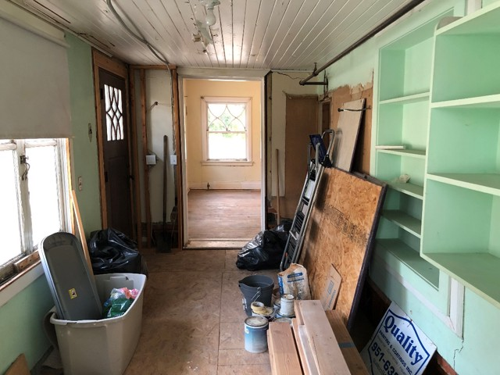
BEFORE: 2nd Floor – Upstairs Kitchen

Slide 21
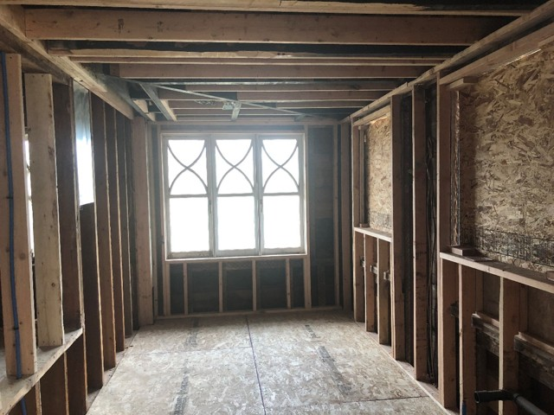
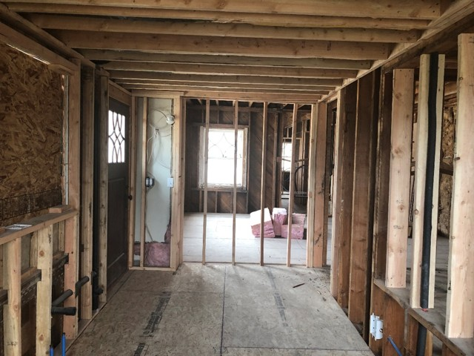
DURING: 2nd Floor – Upstairs Kitchen

Slide 22
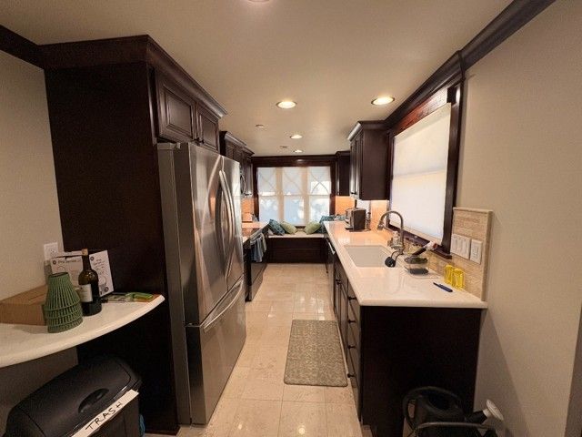
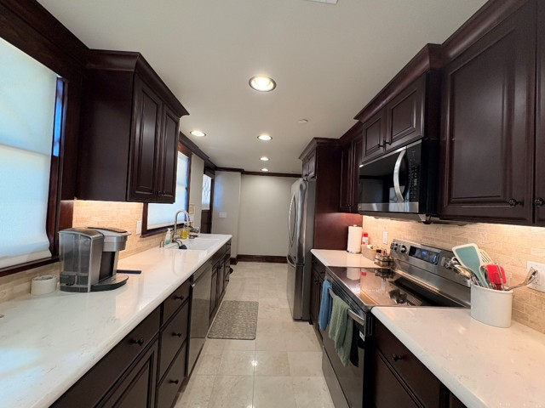
AFTER: 2nd Floor – Upstairs Kitchen

Slide 23
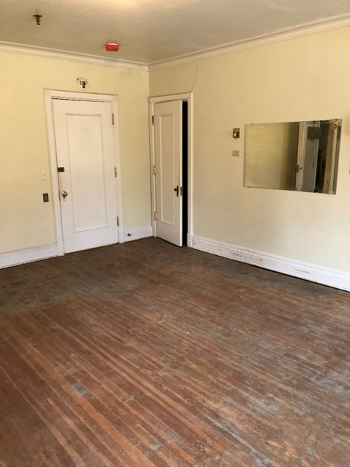
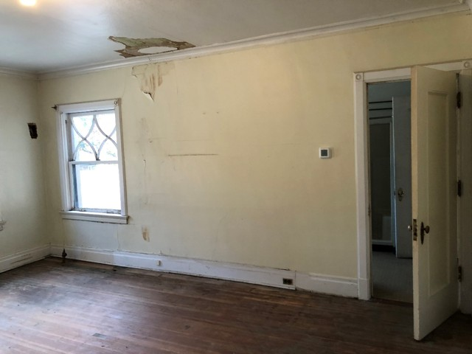
BEFORE: 2nd Floor – Bedroom 4

Slide 24
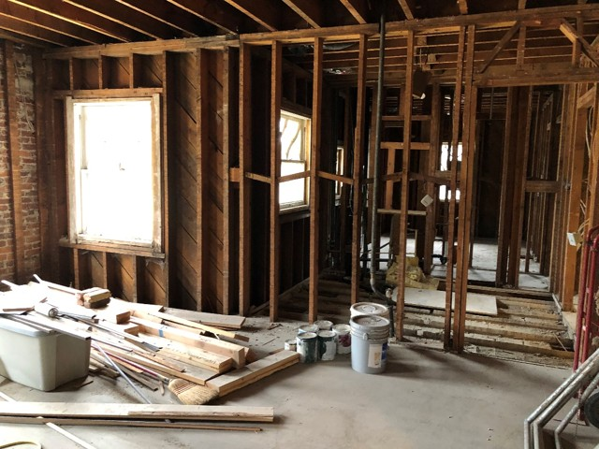
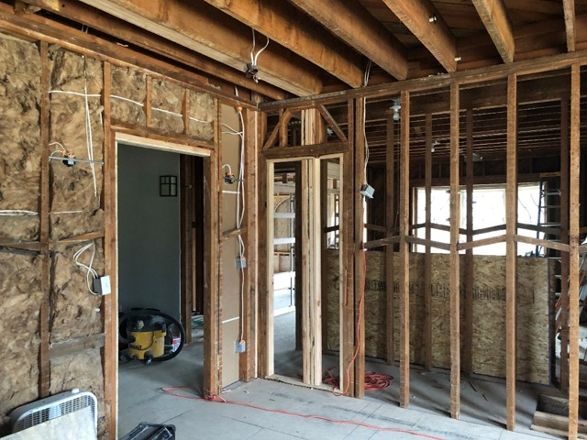
DURING: 2nd Floor – Bedroom 4

Slide 25
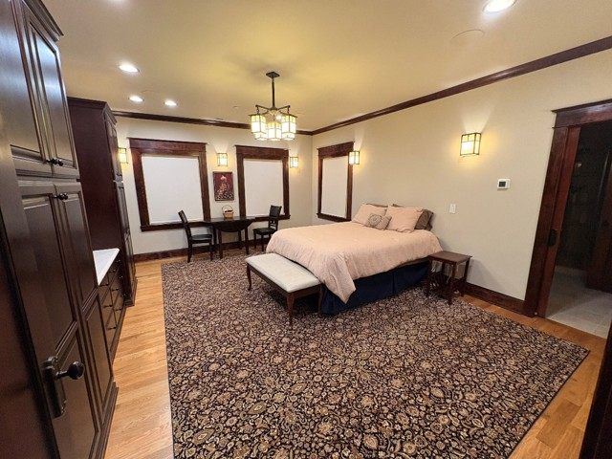
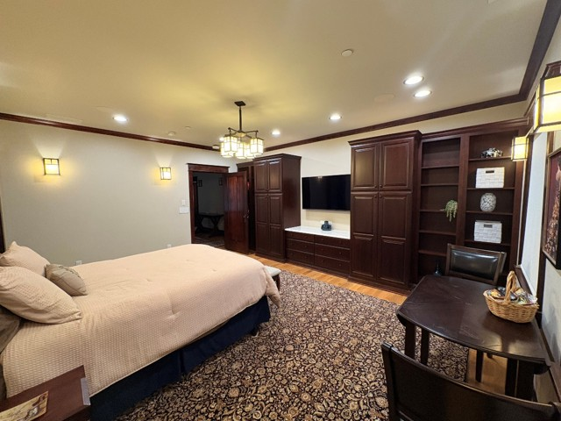
AFTER: 2nd Floor – Bedroom 4

Slide 26
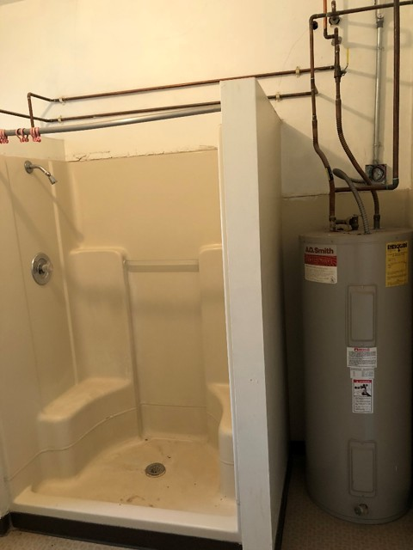

BEFORE: 2nd Floor – Bathroom 2

Slide 27


DURING: 2nd Floor – Bathroom 2

Slide 28


AFTER: 2nd Floor – Bathroom 2

Slide 29


BEFORE: 2nd Floor – Laundry Room

Slide 30


DURING: 2nd Floor – Laundry Room

Slide 31


AFTER: 2nd Floor – Laundry Room

Slide 32



BEFORE & AFTER: 2nd Floor – Upstairs Closet

Slide 33


BEFORE: Main Kitchen

Slide 34


DURING: Main Kitchen

Slide 35


AFTER: Main Kitchen

Slide 36




BEFORE & During Construction: Primary Suite

Slide 37


AFTER: Primary Suite

Slide 38


Before: 2nd floor deck

Slide 39


DURING: 2nd floor deck

Slide 40


AFTER: 2nd floor deck

Slide 41


