Slide 1
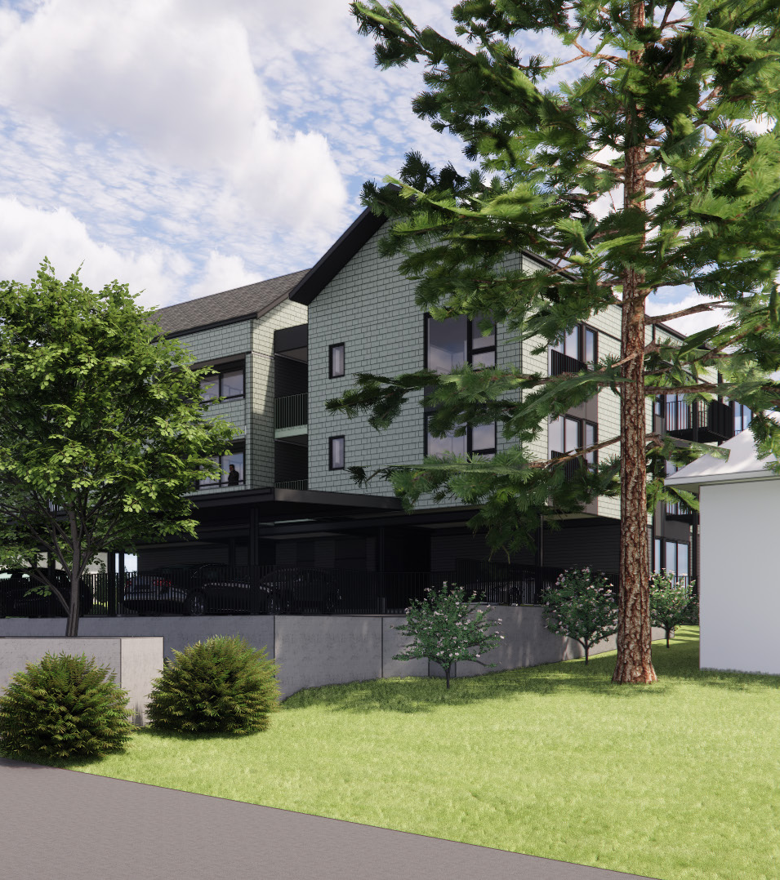
Commercial Certificate of Appropriateness
711-717 East 29th Avenue – New Construction

Slide 2
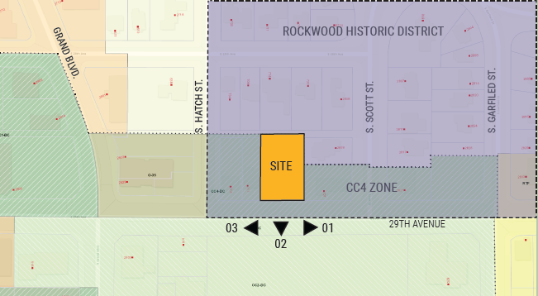

Slide 3



Looking West
Looking East
Looking South

Slide 4
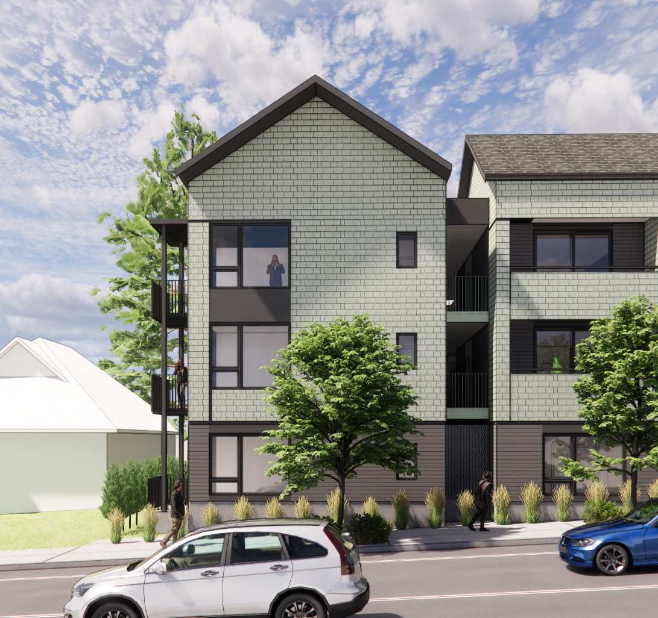
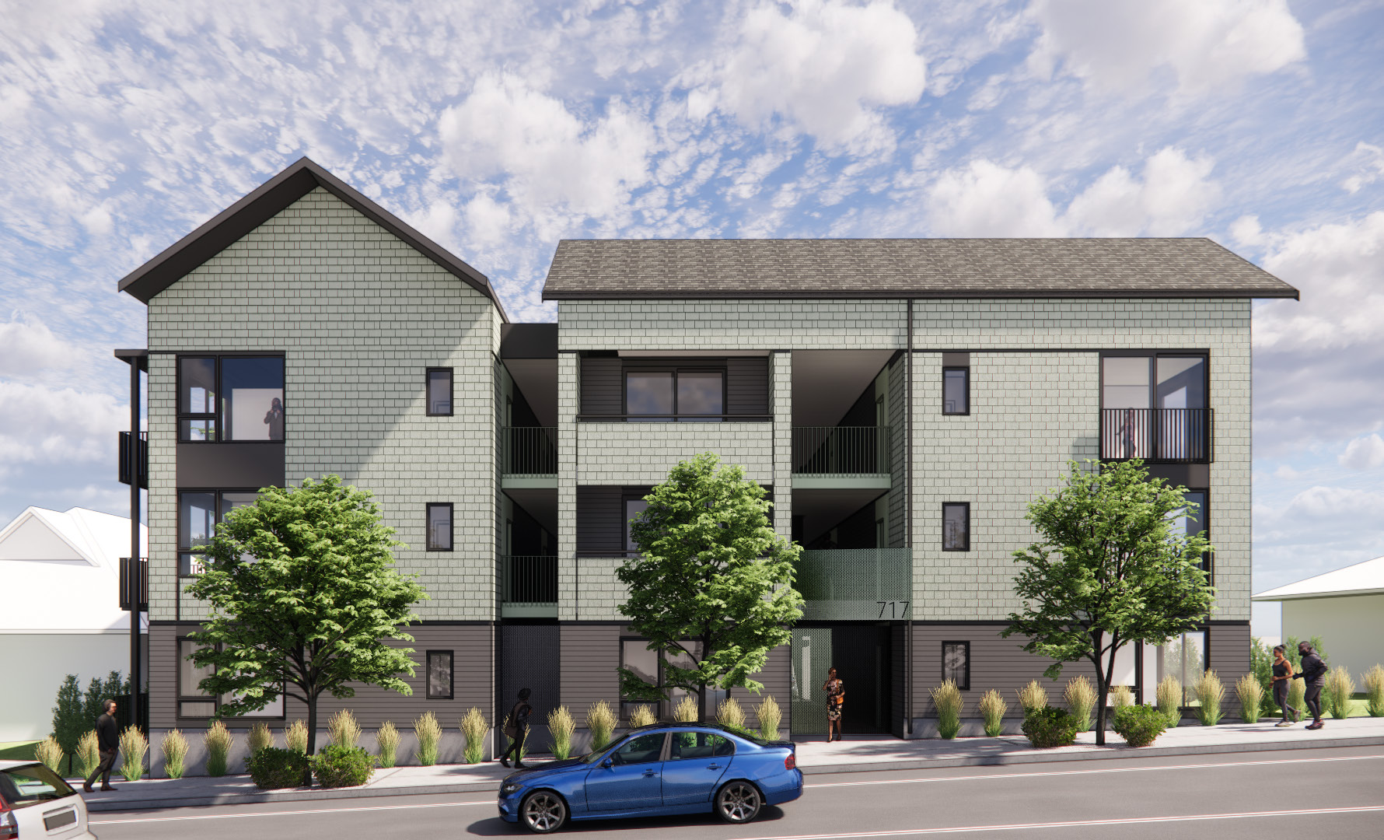
Primary Façade (South Facing)

Slide 5
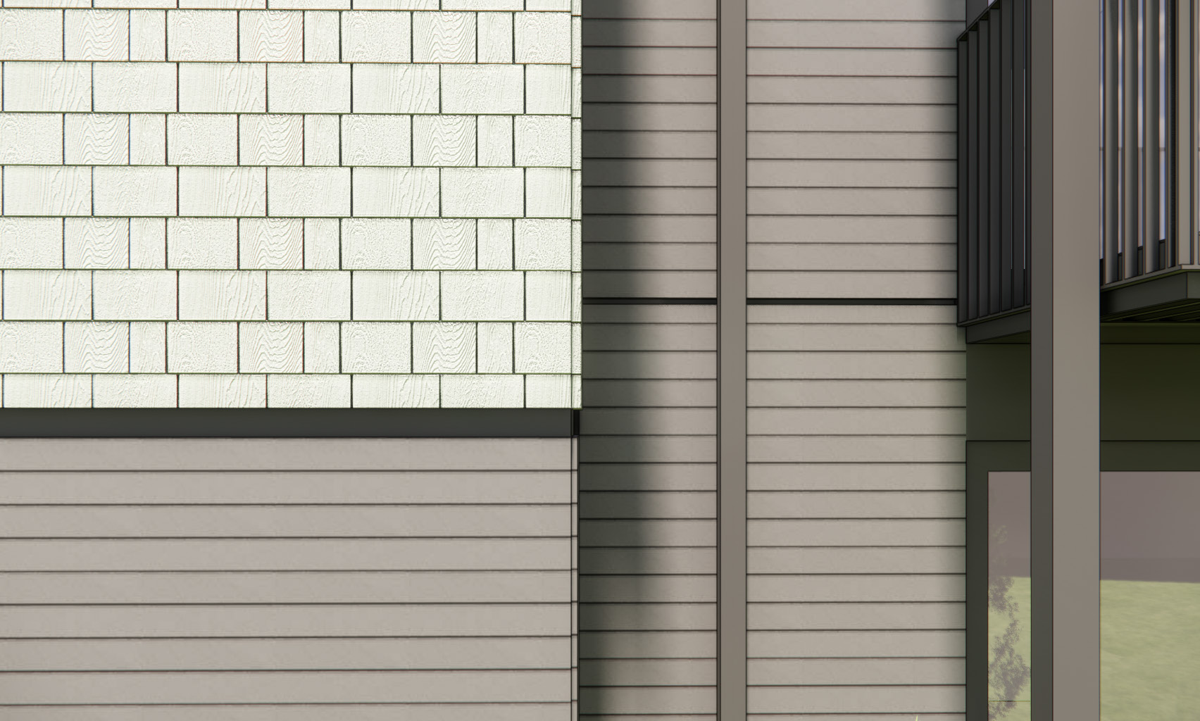
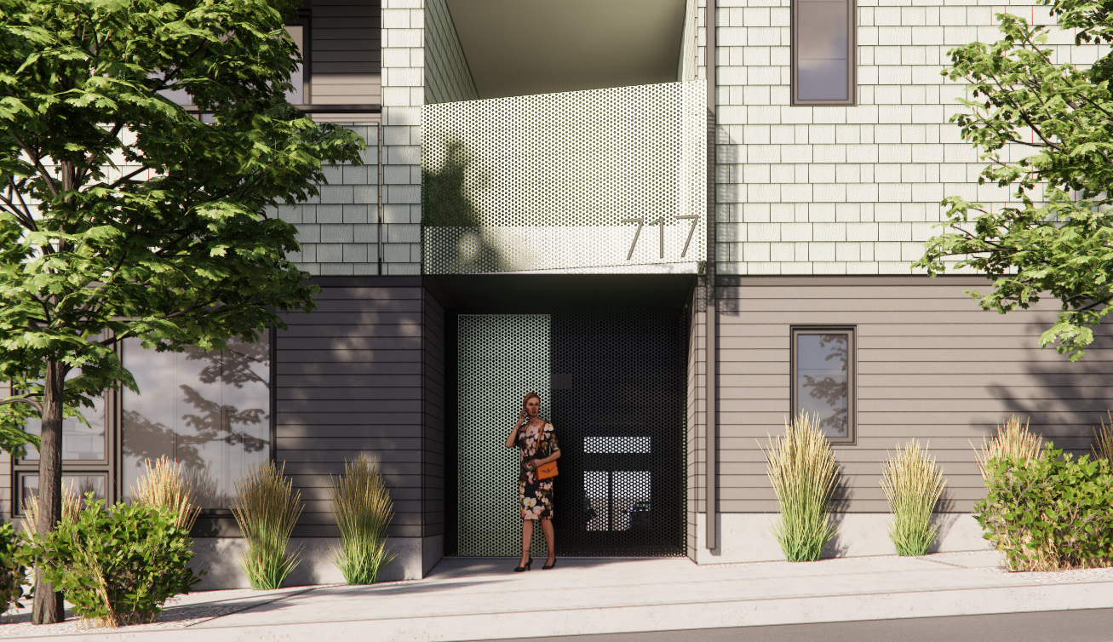
Façade Detail
Entrance Detail

Slide 6
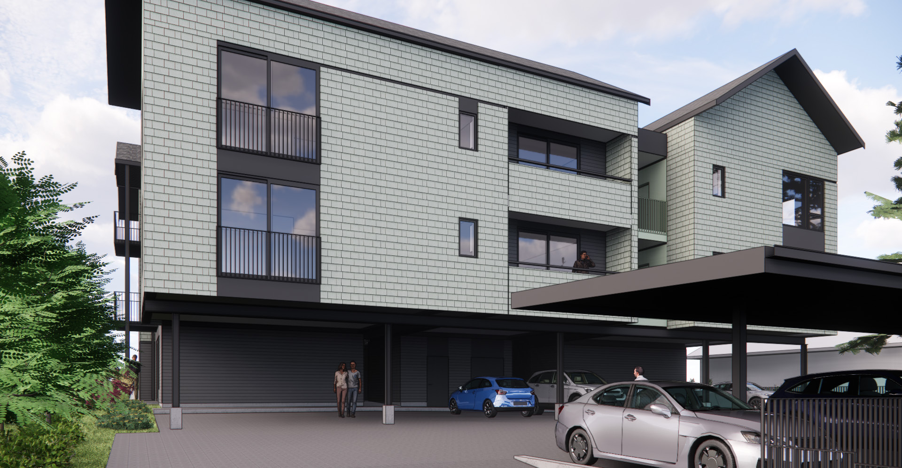
Rear Façade

Slide 7
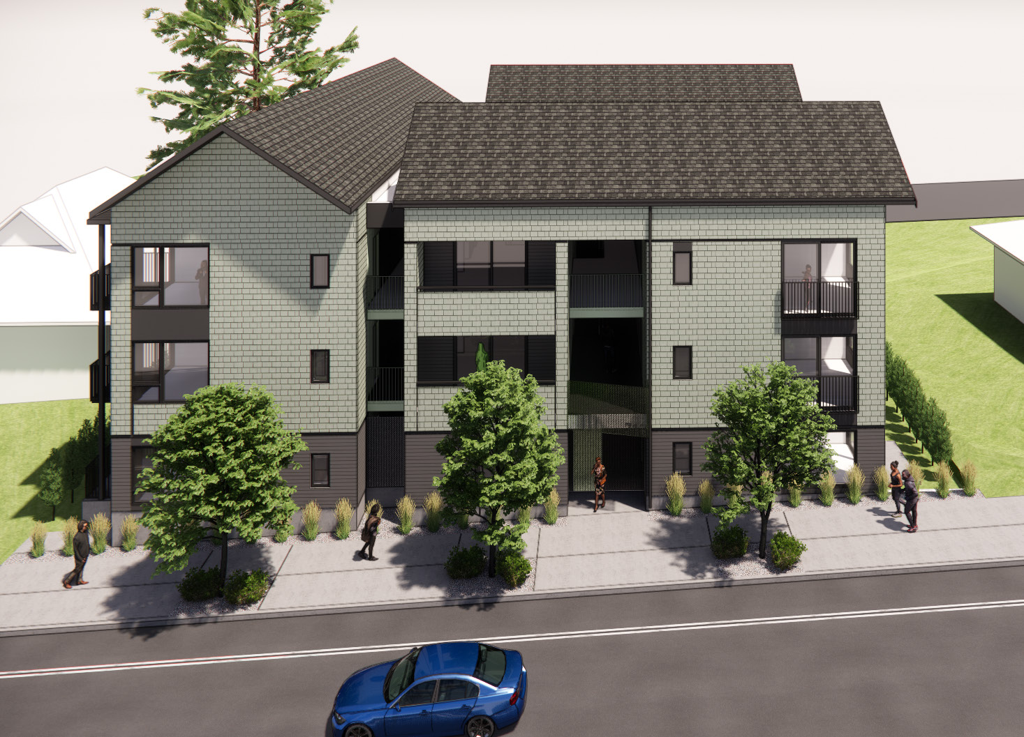
Oblique View (from south)

