Slide 1
Proposed Changes to 1204 West 11th Avenue Spokane, WA 99204
Proposed changes include:
Reroute of power line to avoid roof/line damage
Addition of shed roof dormer to utilize a closet as a room
Conversion of three small shed dormers into peaked “doghouse” dormers due to water damage
Addition of inset balcony to the upstairs bedroom

Slide 2
Power Line Problem

Slide 3
Avista’s recommendation
Avista recommended moving power supply line to this utility pole and connecting to a mast instead of under soffit to bring up to code.

Slide 4
Add required mast
Current power line tie-in is under soffit and is within arm’s reach while standing on back deck.

Slide 5
Bedroom Shed Dormer
Current roof above power line tie-in

Slide 6
Bedroom Shed Dormer
Proposed shed dormer attached to gable on left with new mast for power line tie-in; upstairs closet becomes bedroom.

Slide 7
Front Gable
Current

Slide 8
Front Gable Balcony
Proposed

Slide 9
Front Gable Balcony Comparison
818 West 14th Avenue

Slide 10
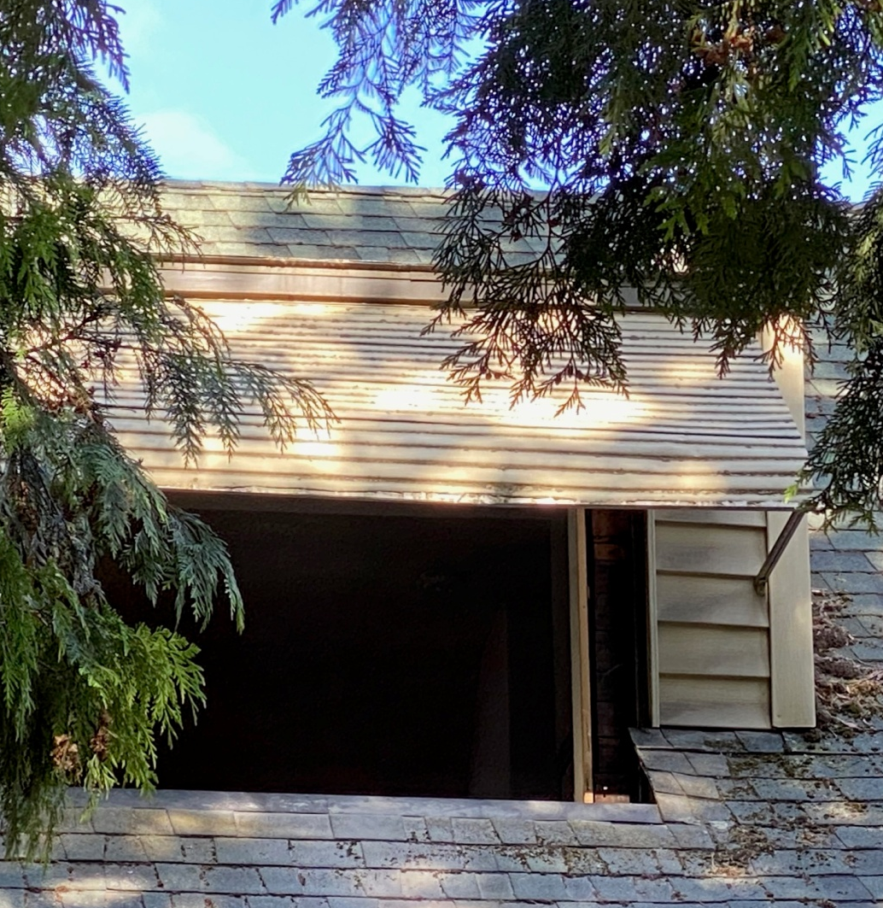
Leaking Dormer (East side)

Slide 11
Leaking Dormer (West side)

Slide 12
Bathroom Dormer
Upstairs bathroom dormer. Does not leak, but I would like to change to peaked dormer and replace window to match the other dormers.

Slide 13
Proposed Peaked Dormers (3)

