Slide 1
East facing dormer to utilize large 8’ x 18’ storage space as bedroom
Roof space originally contained chimney from kitchen

Slide 2
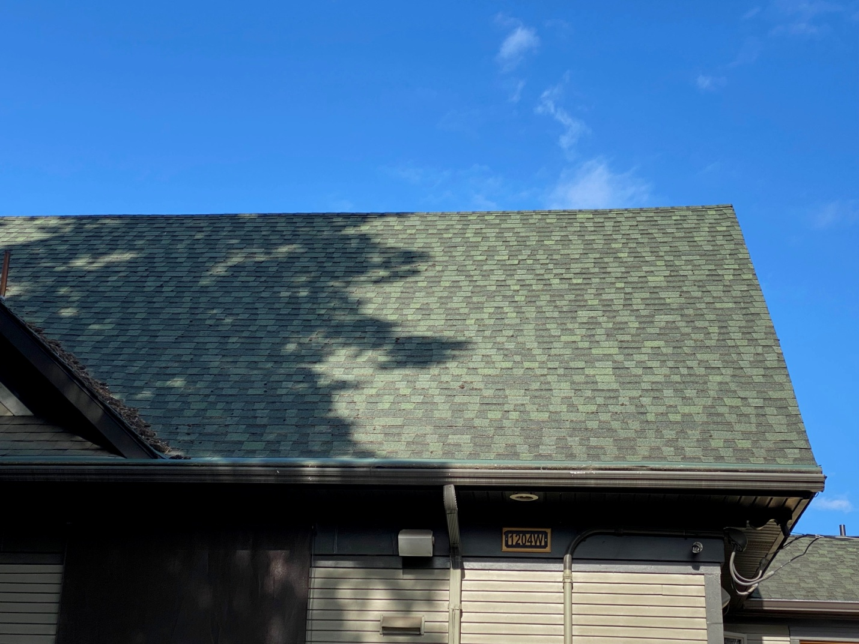
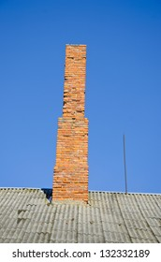
Original Roof

Slide 3
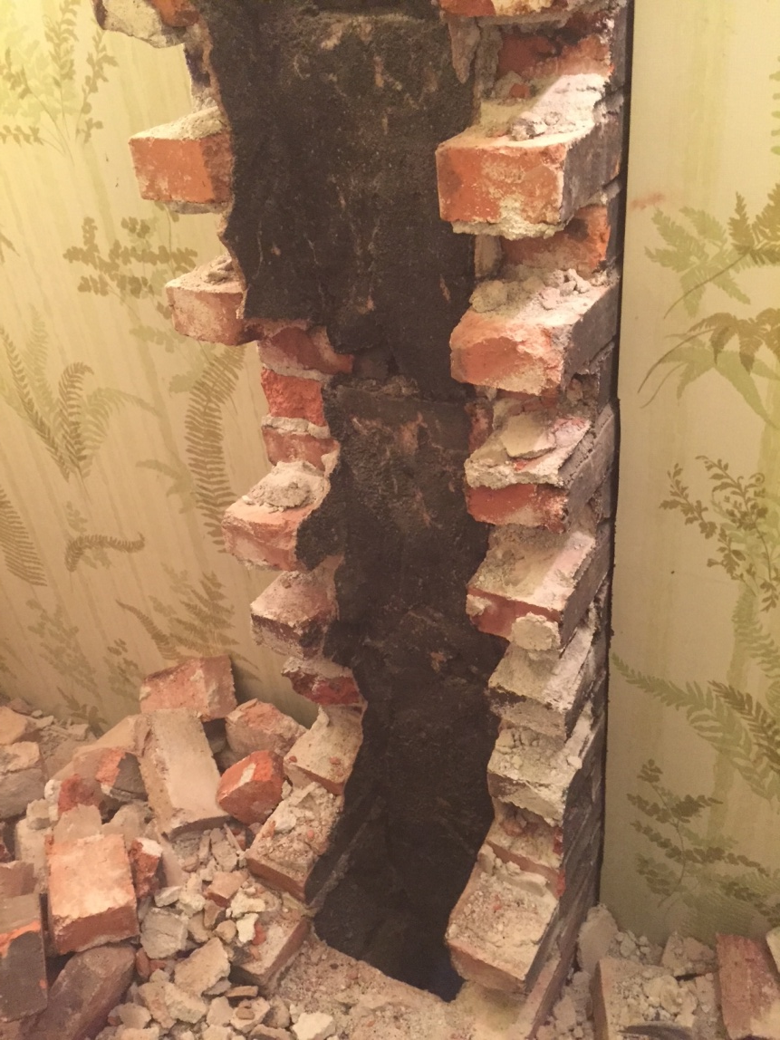
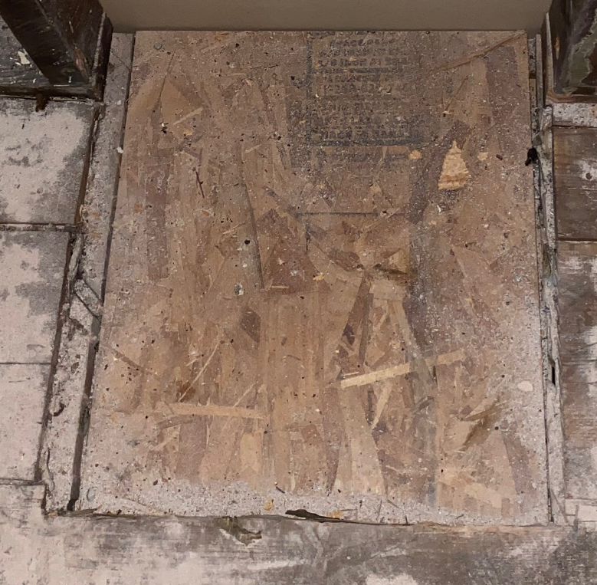
Chimney Removed 2014

Slide 4
Current Roof

Slide 5
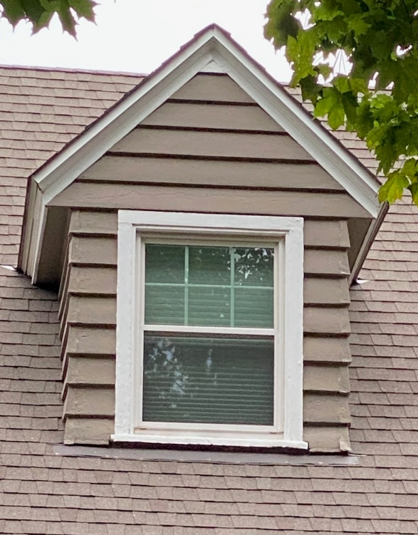
Proposed Modification #1
Three matching doghouse dormers

Slide 6

Doghouses
Look seems more appropriate to Colonial style home, but will go with HPO recommendation

Slide 7
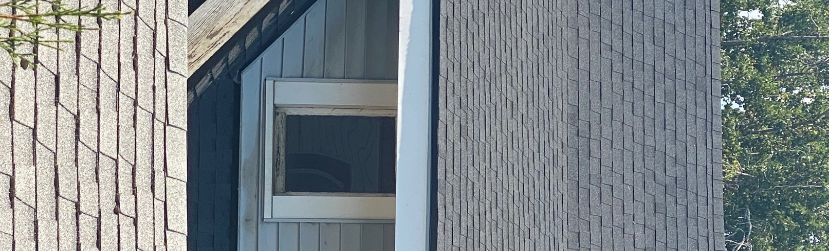
Proposed Modification #2
Dormer matches the 1908 home across the alley and avoids creating a false sense of historical development by mixing architectural features from other time periods

Slide 8
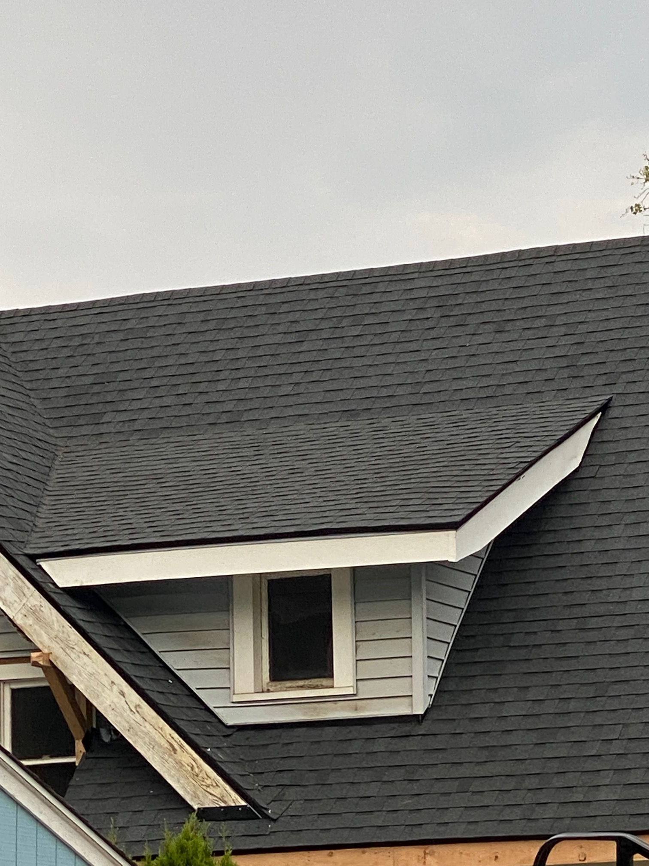
Appropriateness – this 1908 home is located at 1211 West 10th Avenue and is across the alley from our home

