Slide 1
SALVATION ARMY BUILDING
Retroactive Certificate of Appropriateness application
Chicago dogs awning
245 W Main Avenue

Slide 2
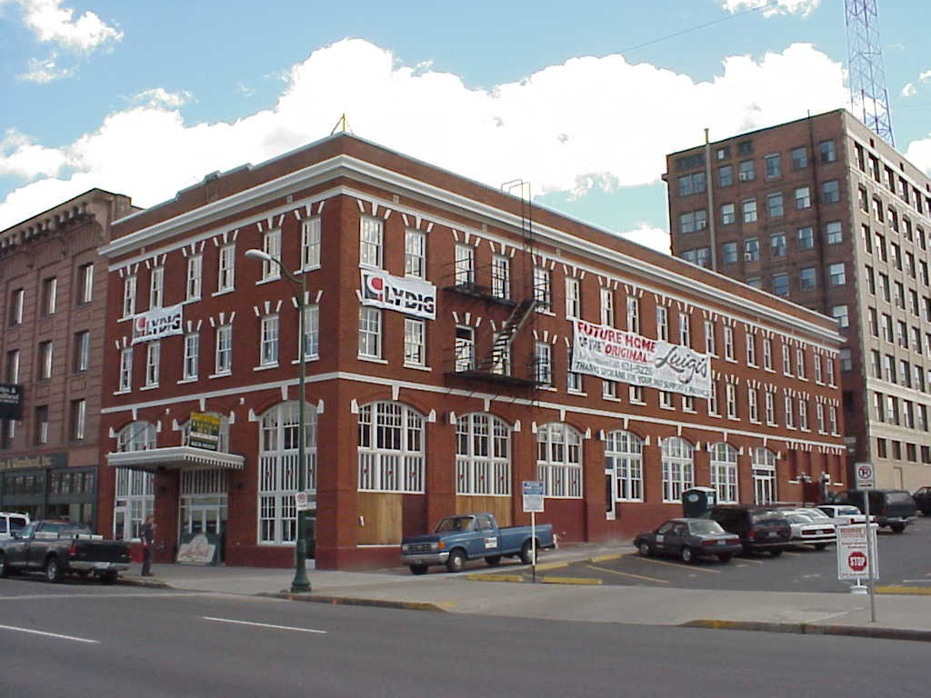
Salvation Army Building – 245 W Main

Slide 3
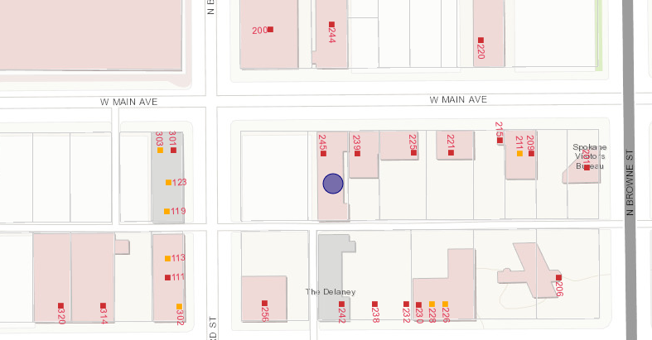
Salvation Army Building – 245 W Main

Slide 4
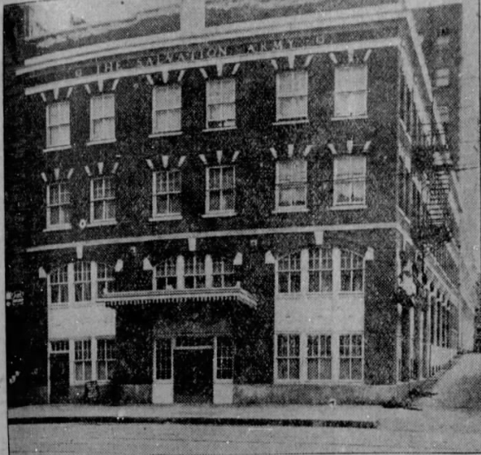
Salvation Army Building – 245 W Main
April 23, 1922:
1939

Slide 5
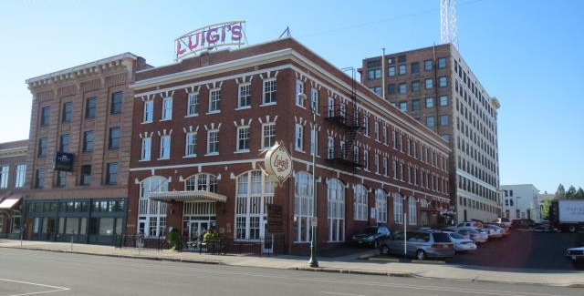
Salvation Army Building – 245 W Main

Slide 6
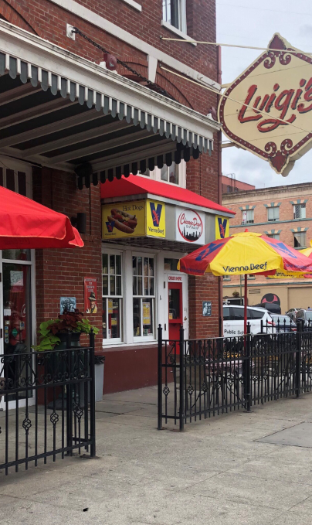
Salvation Army Building – 245 W Main
2019: Awning for Chicago Dog business was hung without a building permit so the SHLC was not afforded the ability for review of the proposed awning
July 2019: business owners came in for permit which kicked in the Certificate of Appropriateness process
The SHLC is reviewing a retroactive CoA application

Slide 7
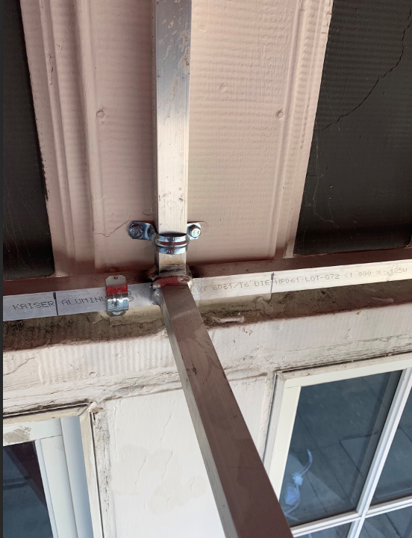
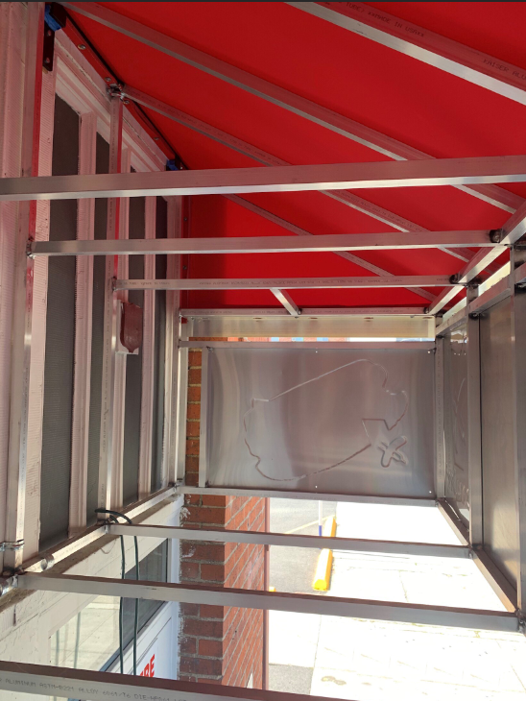
Salvation Army Building – 245 W Main

Slide 8
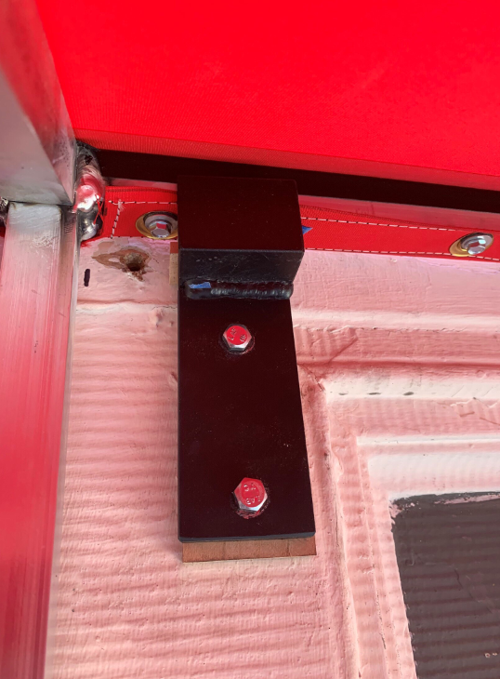
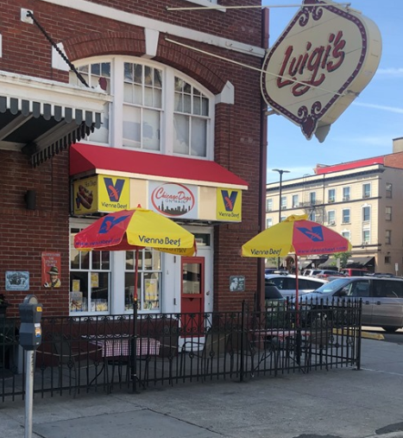
Salvation Army Building – 245 W Main

Slide 9
Salvation Army Building – 245 W Main
Secretary of the Interior Standards:
Standard #2: The historic character of a property will be retained and preserved. The removal of distinctive materials or alteration of features, spaces and spatial relationships that characterize a property will be avoided.
Standard #9: New additions, exterior alterations or related new construction will not destroy historic materials, features and spatial relationships that characterize the property. The new work will be differentiated from the old and will be compatible with the historic materials, features, size, scale and proportion, and massing to protect the integrity of the property and its environment.

Slide 10
Salvation Army Building – 245 W Main
The Salvation Army building is a study in symmetry
The awning detracts from the symmetry of the building
The awning is incompatible with the building’s historic character – according to historic photos, the building never had awnings
Not recommended:
Using inappropriately scaled signs and logos or other types of signs that obscure, damage, or destroy remaining character-defining features of the historic building.

Slide 11
Staff Recommendation
Because the awning was placed on the building without a building permit, staff recommends a denial of a Certificate of Appropriateness
However, because the awning is ultimately removable without damaging historic features of the building, staff does not recommend forcing the business owners to remove the awning/sign
Staff recommends placing a denial of CoA with the building permit so that it is on record that the SHLC did not approve the awning’s installation or design and this is not precedent setting

