Slide 1
Clinkerdagger Spokane Flour Mill 621 W Mallon
Commercial
Certificate of Appropriateness

Slide 2
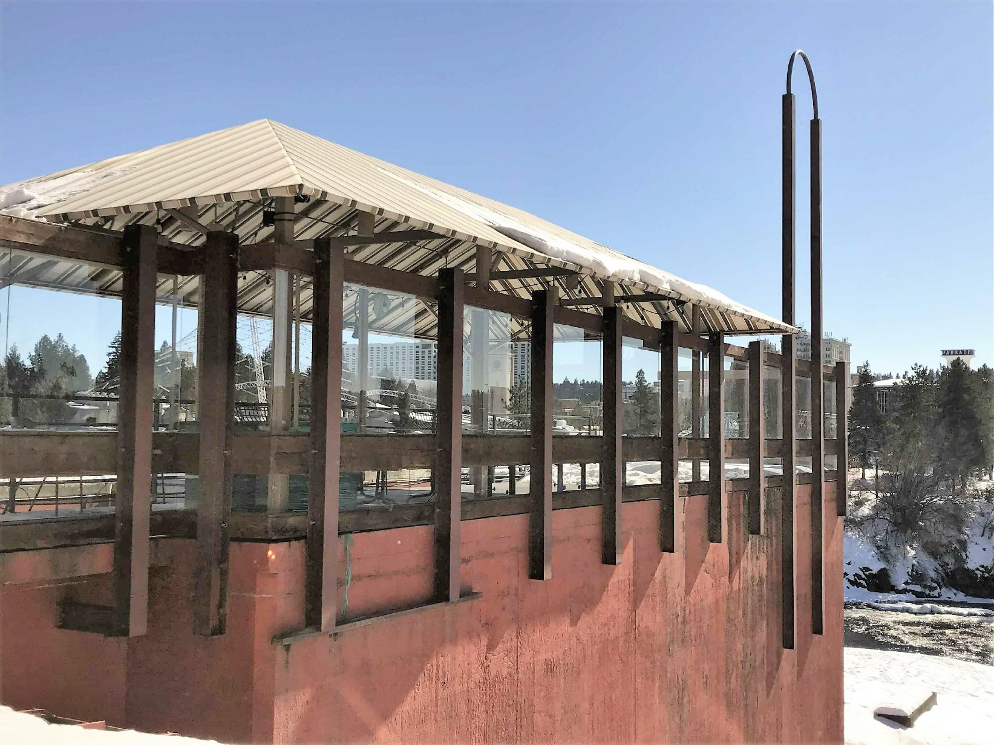
Clinkerdagger Patio 621 W Mallon

Slide 3
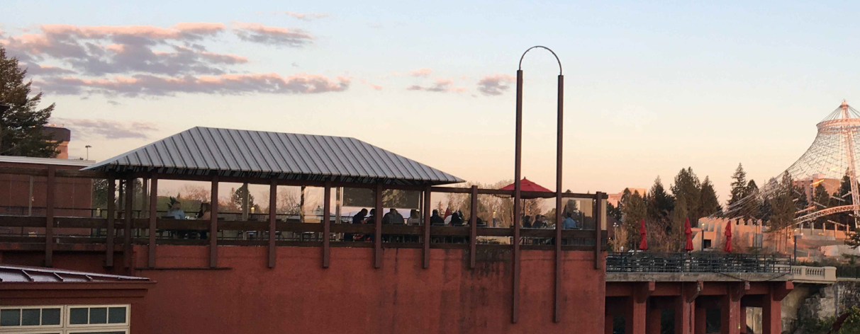
Clinkerdagger Patio 621 W Mallon
Reconstruction of existing exterior patio:
Replacement of glazing
Adding additional glazing for year-round use
Providing a roof enclosure
Adding interior overhead heaters

Slide 4
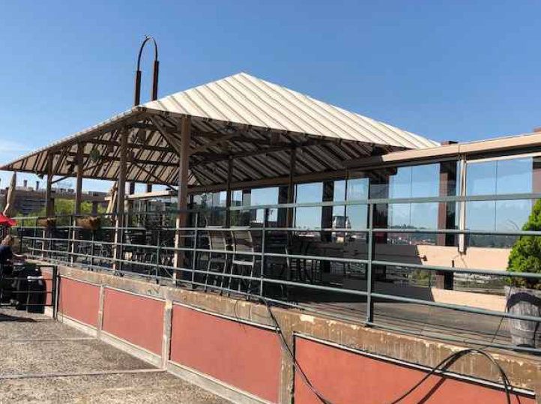
Clinkerdagger Patio 621 W Mallon
Existing conditions:
Level 2 Plan

Slide 5
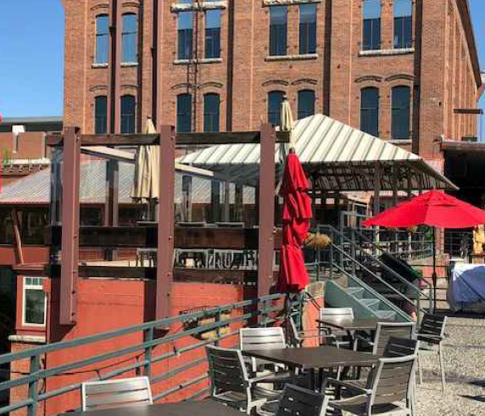
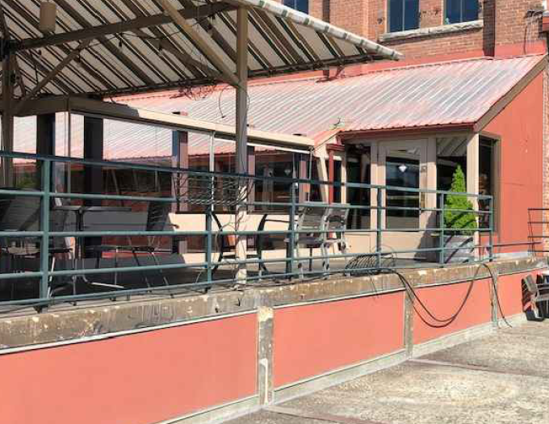
Clinkerdagger Patio 621 W Mallon

Slide 6
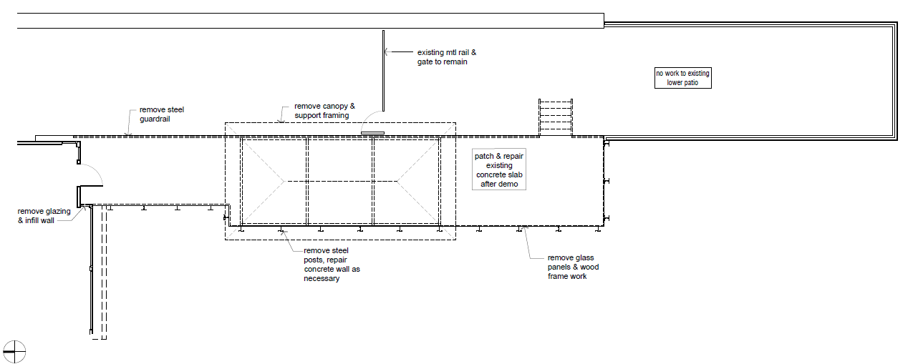
Clinkerdagger Patio 621 W Mallon
Proposed Plans:

Slide 7
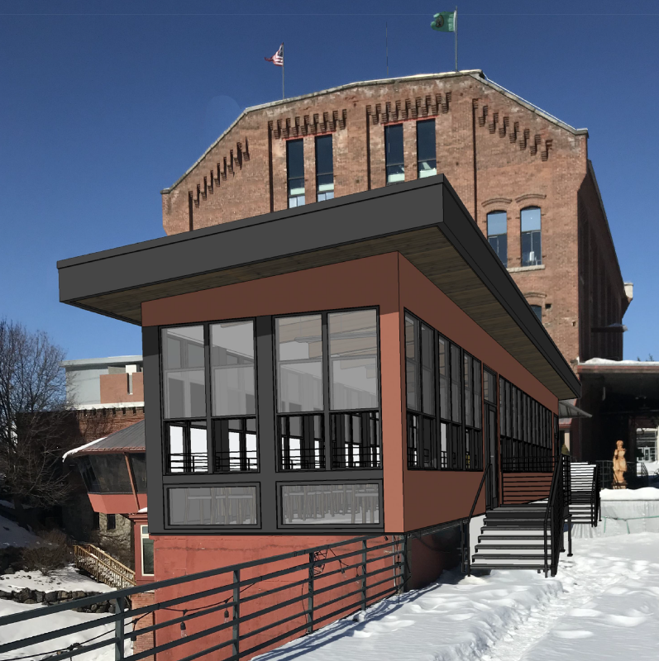
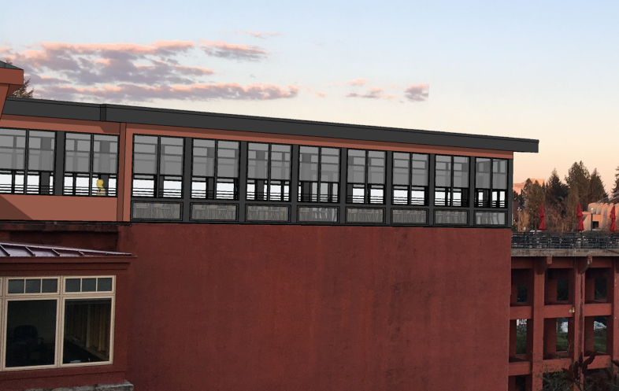
Clinkerdagger Patio 621 W Mallon

Slide 8
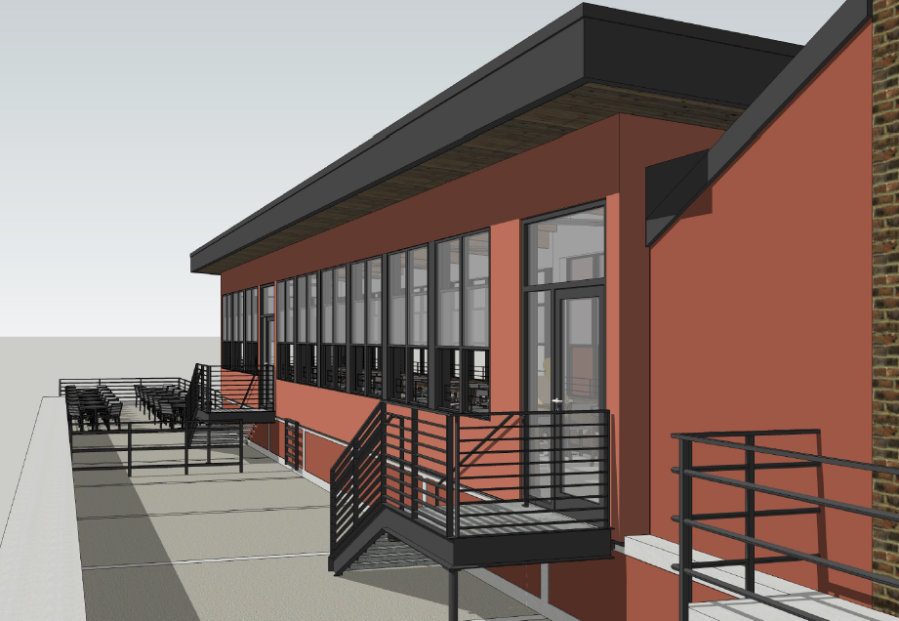
Clinkerdagger Patio 621 W Mallon

Slide 9
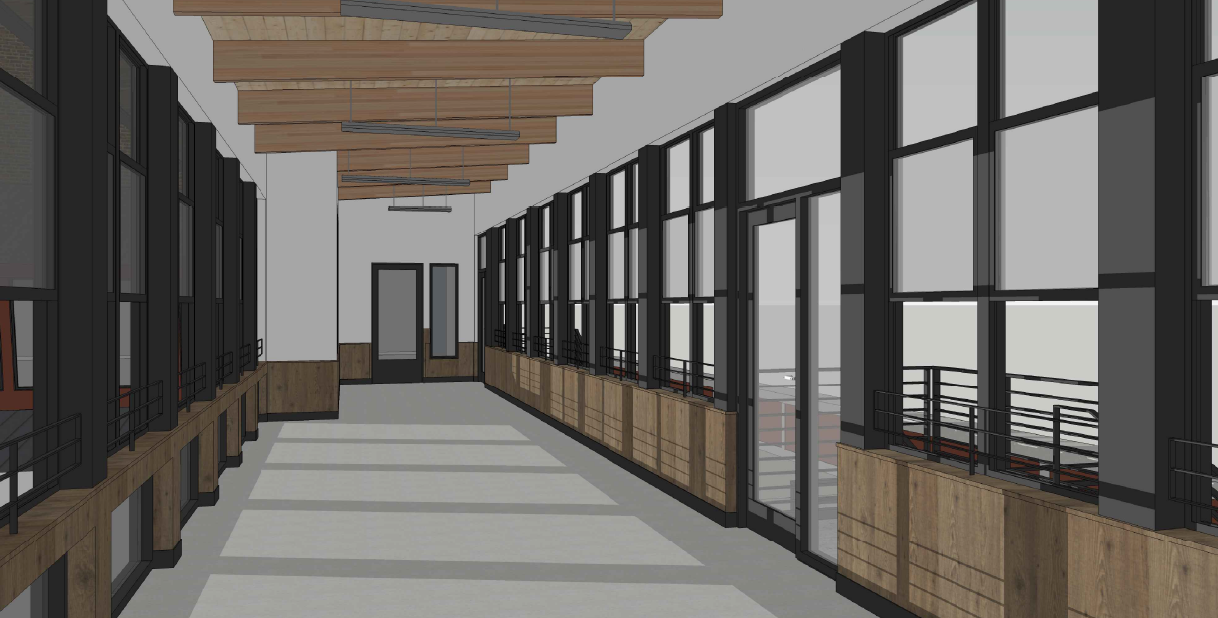
Clinkerdagger Patio 621 W Mallon

Slide 10
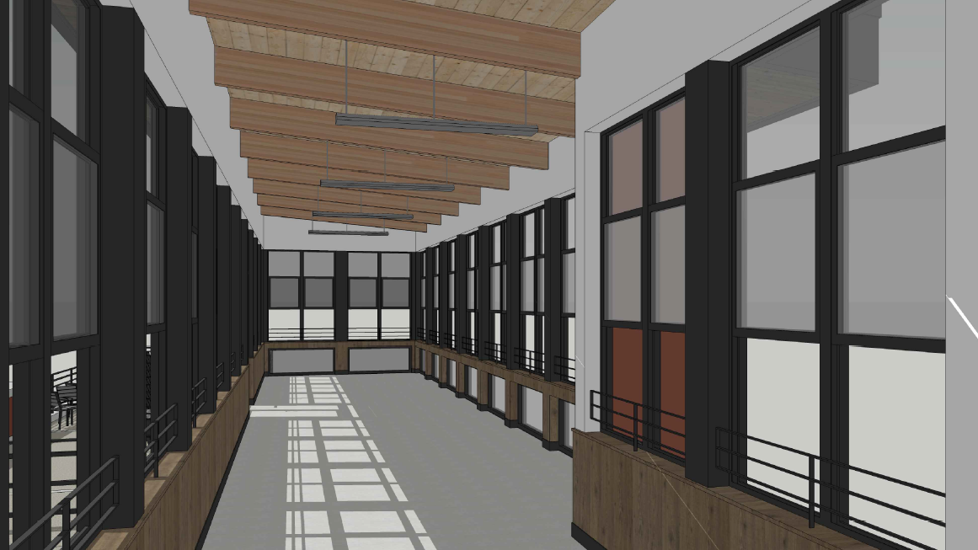
Clinkerdagger Patio 621 W Mallon

Slide 11
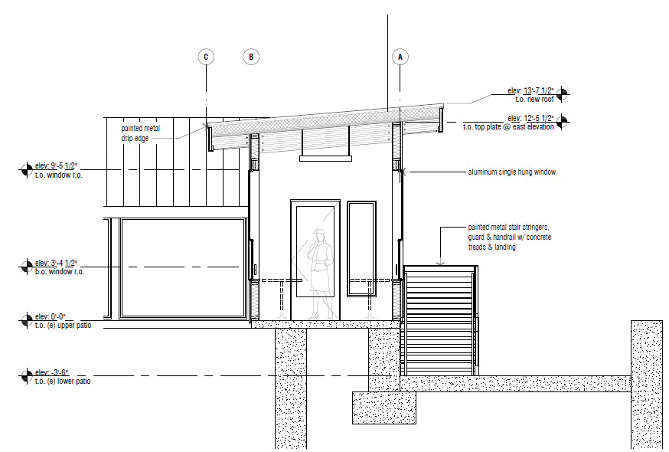
Clinkerdagger Patio 621 W Mallon

Slide 12
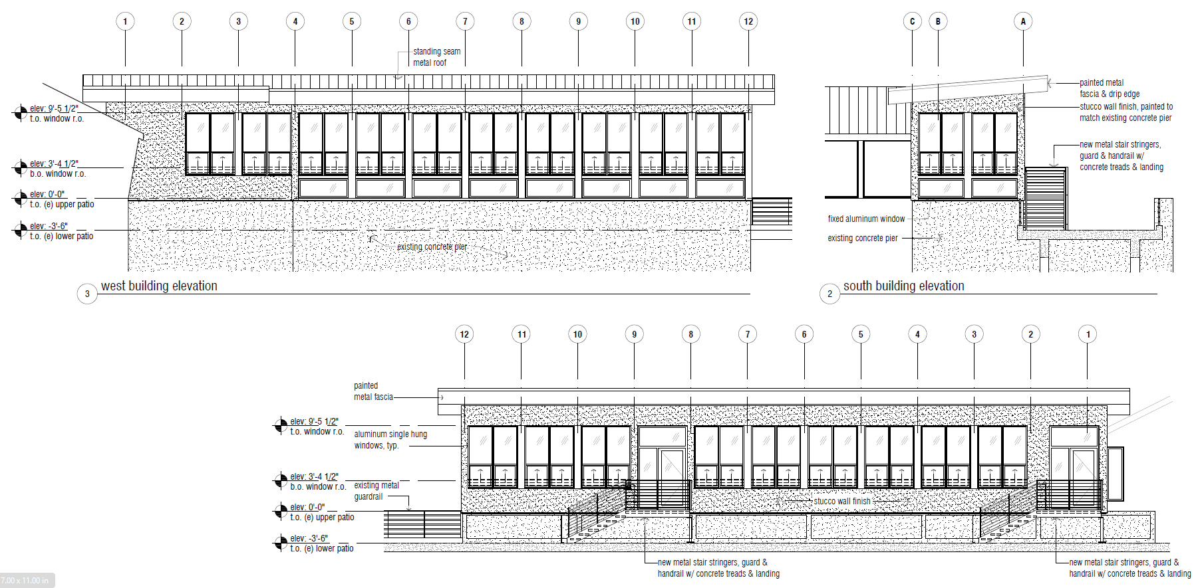
Clinkerdagger Patio 621 W Mallon

