Slide 1
Forming a Local Historic District in Cliff-Cannon
Spokane Historic Preservation Office
February 2020

Slide 2
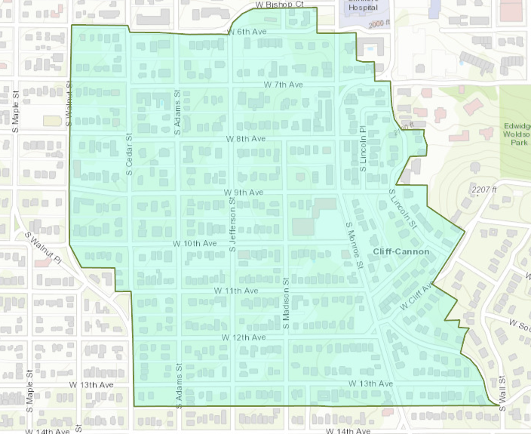
Proposed Boundary

Slide 3
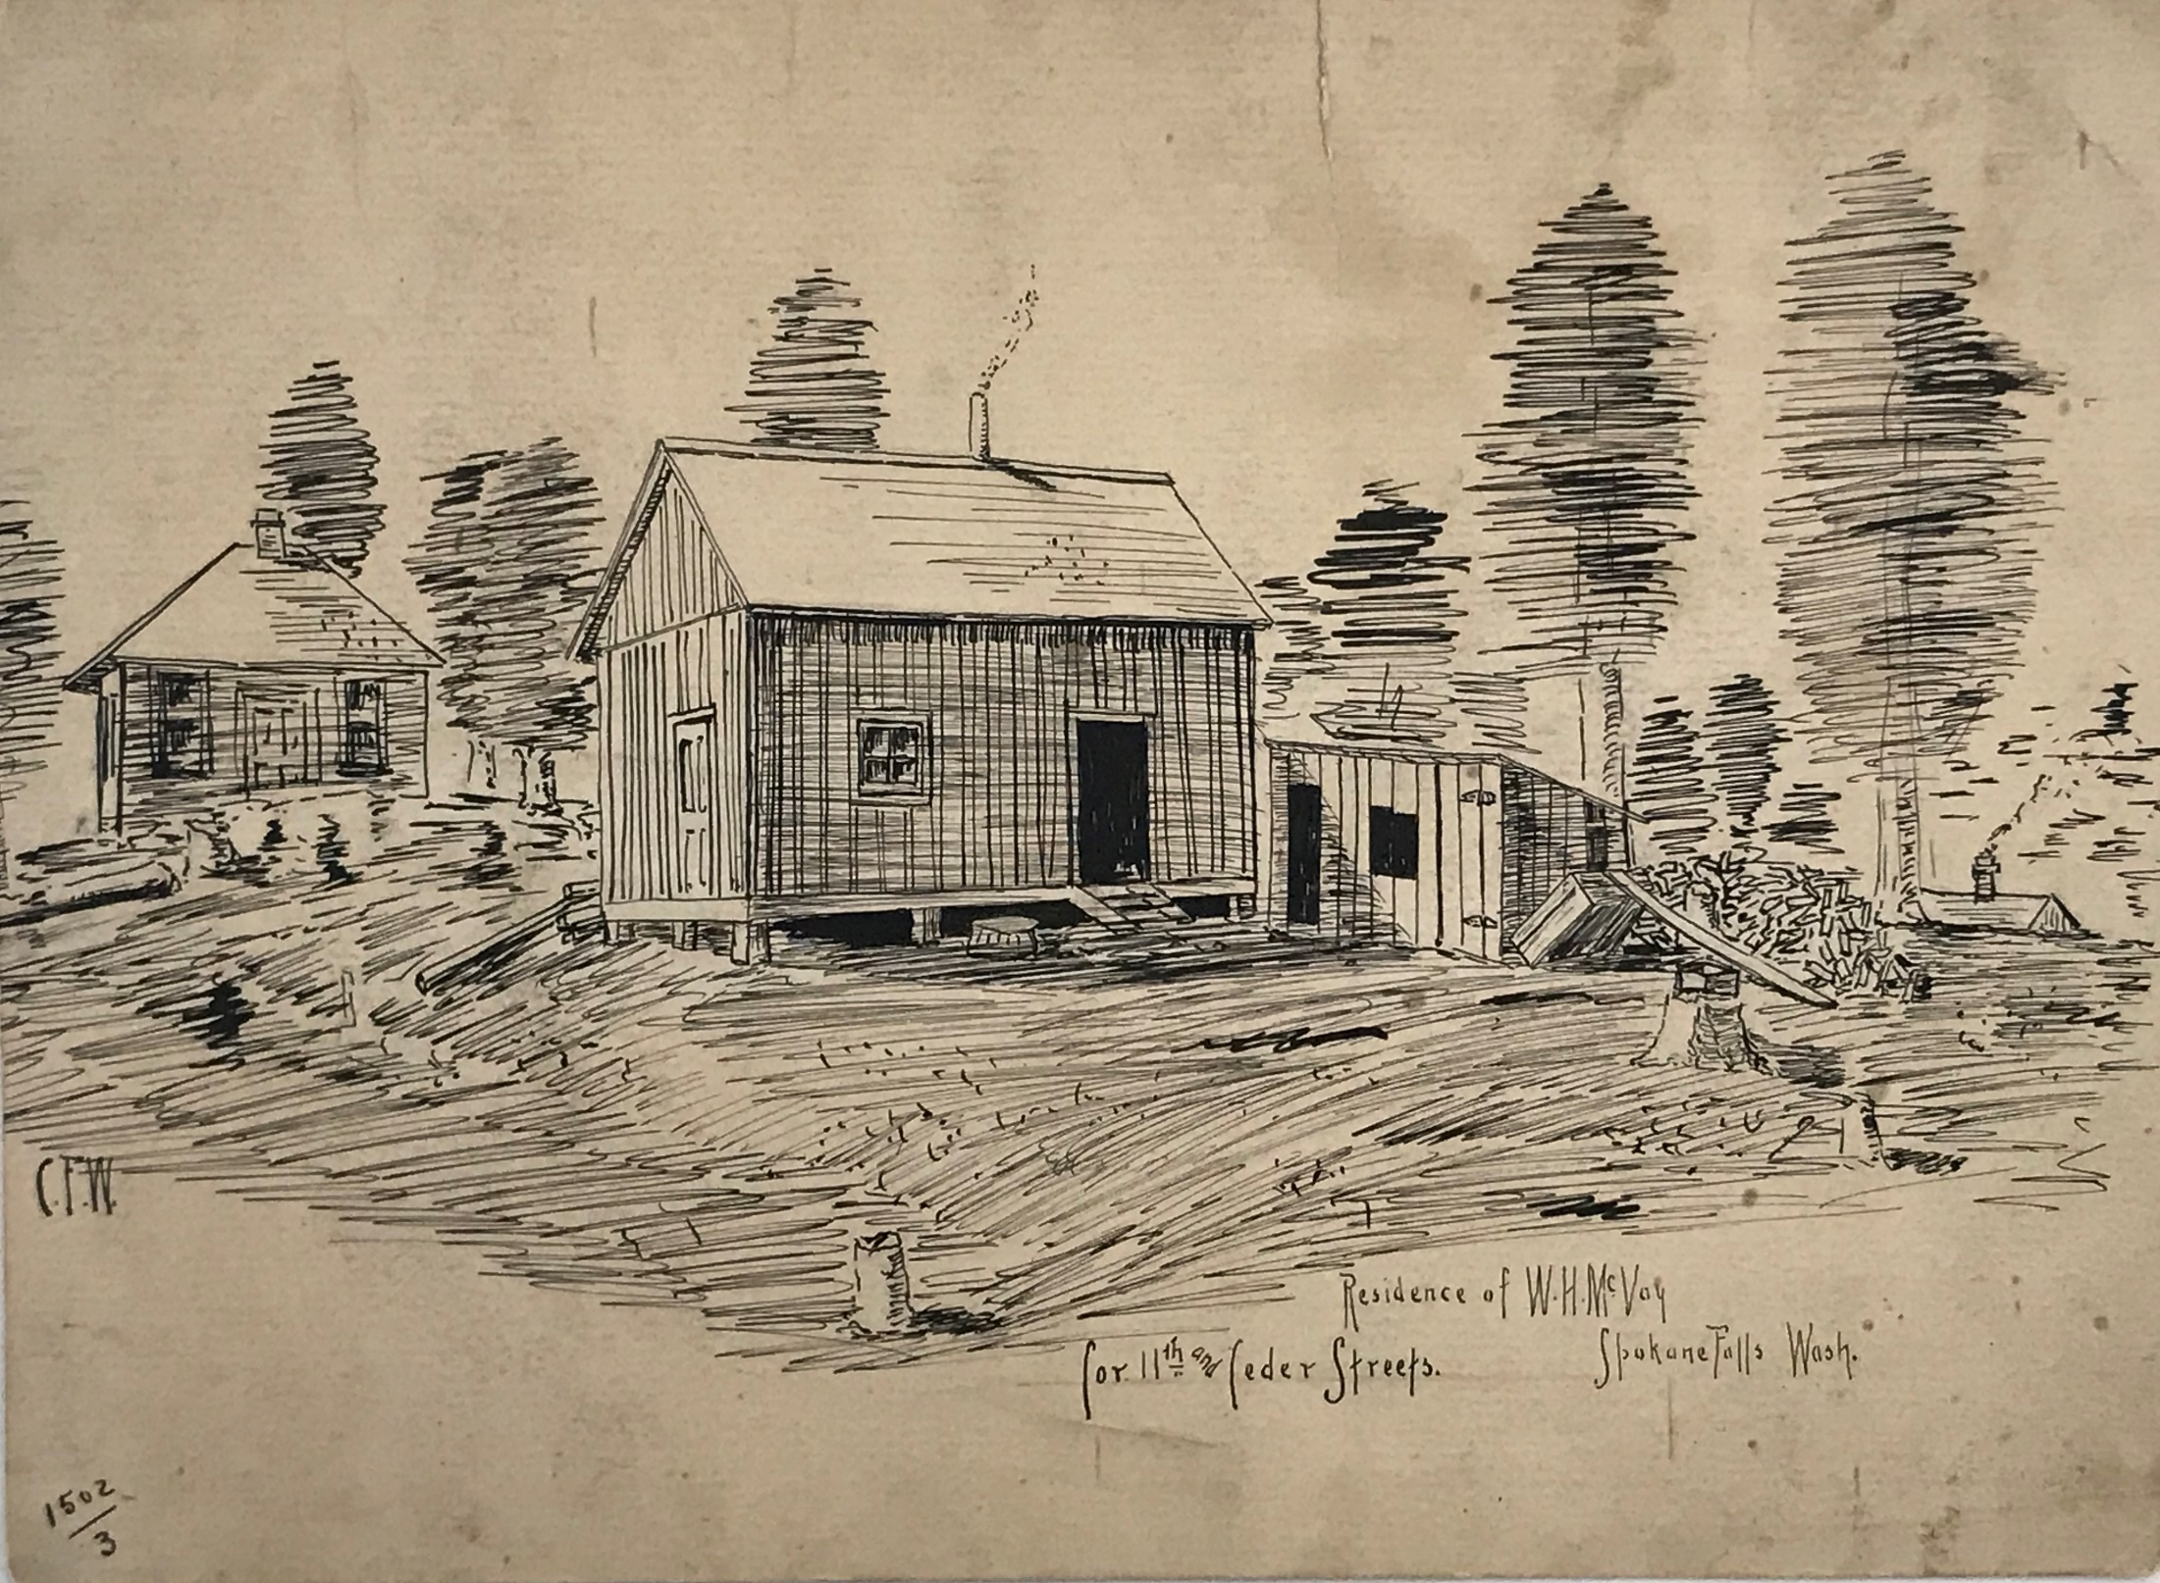
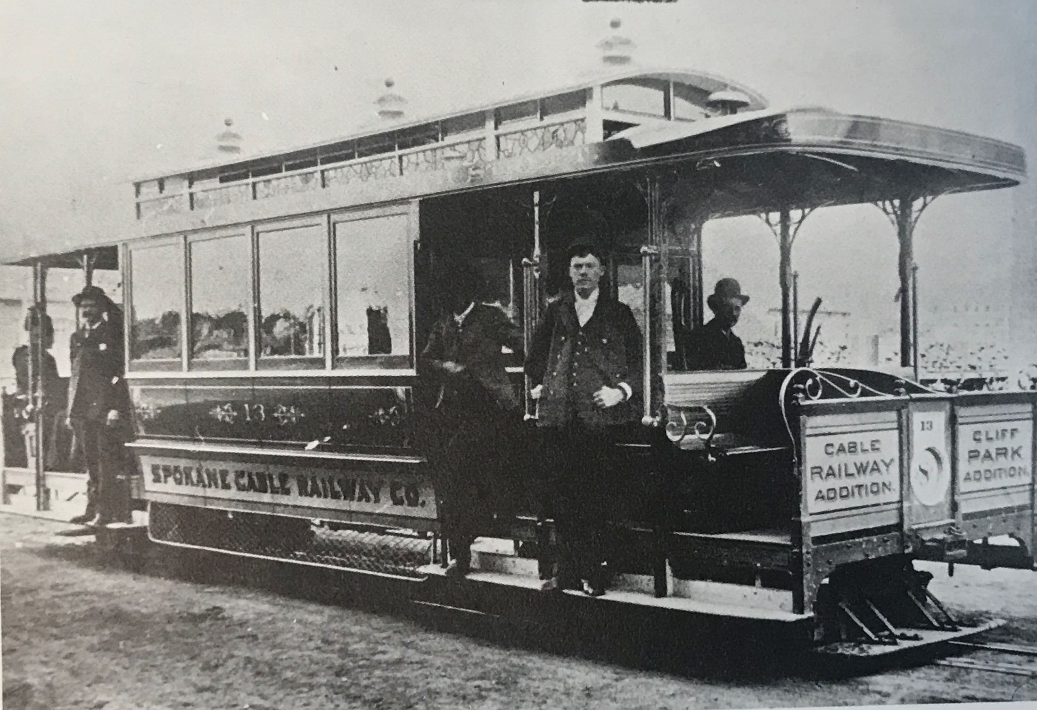
Cannon History in a nutshell
The district was platted from 1883-1902 as part of 8 different additions
District’s oldest home built in 1888
Monroe Cable Car Line 1890-1894
Only 18 homes in the district were constructed before 1899 (92 in BA)
In 1899, the Cannon Hill Car Line began operation
220 homes were built in the district from 1899 through 1909

Slide 4
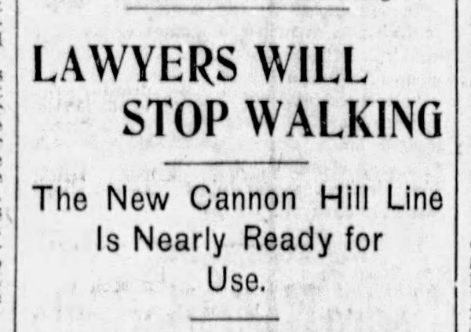
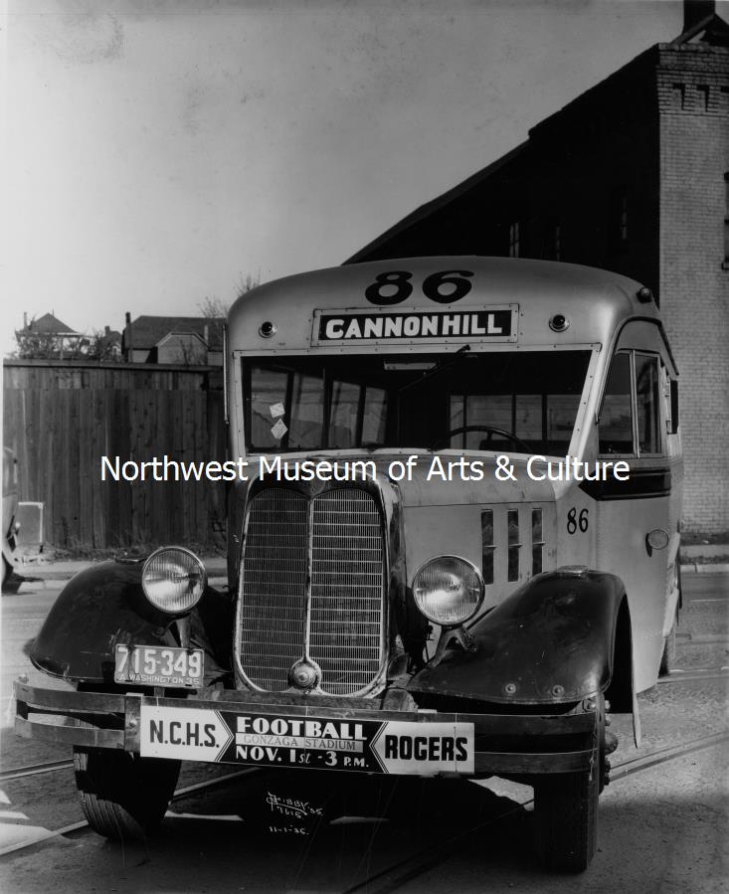
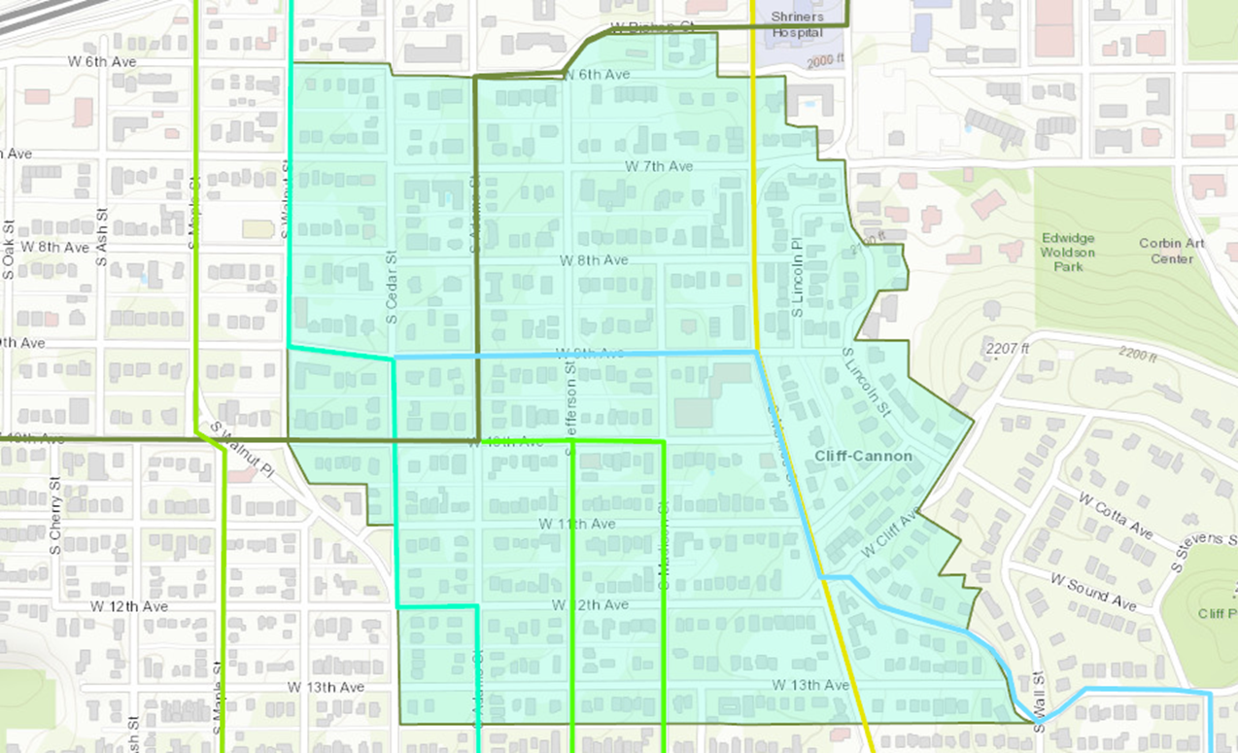
A District Defined by Public transportation

Slide 5
Period of significance 1888-1955
432 before 1955
478 total resources

Slide 6
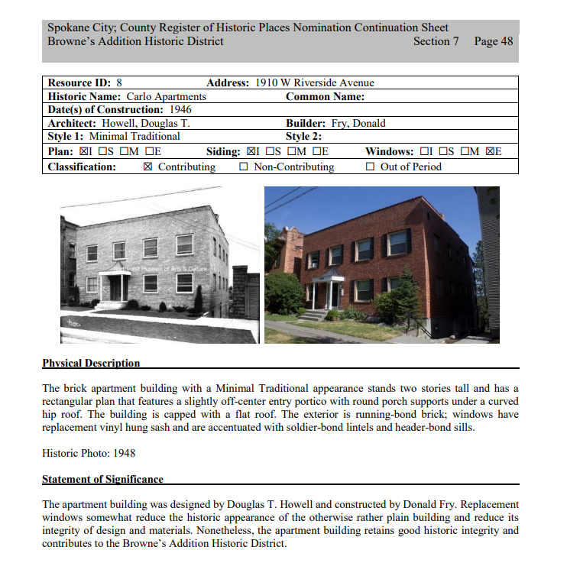
Resource Forms
Contributing
versus
Non-contributing
Age and Integrity
Plan Porch Siding Windows

Slide 7
Timeline
February 4: Attend C-C Neighborhood Council Meeting to present
March 3: Attend C-C NC Meeting
March 23-27: Host district workshop
April 1: Ensure all SEPA and Commerce requirements are met.
April 7: Attend C-C NC Meeting
Early April-Early May: Survey neighborhood for customization of Guidelines
April 21-23: Host district workshop
May 13-14, 18-19: Host district workshop
Late May: Plan Commission Hearing
June 2: Attend C-C Neighborhood Park Potluck to provide update
June 17: Present the district documents to the SHLC for pre-approval
June 18-20: Send ballots and post neighborhood notice signs
Late June-Late August: Voting period
August 26: Special SHLC Meeting to report results of voting period
September 1: Attend C-C NC Meeting to provide voting update
September 21: Bring action to Spokane City Council

Slide 8
Workshops
What it Means to Live in a Historic District: March 23-27, 6:30-8:00, Women’s Club, 1428 W 9th Ave
Tailoring Design Guidelines for Cannon Historic District: April 21-23, 6:30-8:00, Women’s Club, 1428 W 9th Ave
Overview and Discussion of the Completed Documents: May 13-14, 18-19, 6:30-8:00, Women’s Club, 1428 W 9th Ave

Slide 9
What Does it Mean?
Must be widely supported by property owners: a vote of 50%+1 of property owners required to form the district
Local districts protect the investments of owners and residents through a fair design review process
There is some control over how the district deals with changing times/circumstances/development pressures
Special Valuation tax incentive available for contributing properties when a substantial rehabilitation happens – 10 year property tax reduction based on $ amount of rehab
Historic Preservation Incentive Fund – Façade Improvement Grants up to $5000 for both commercial or residential properties on the Spokane Register or contributing to a district

Slide 10
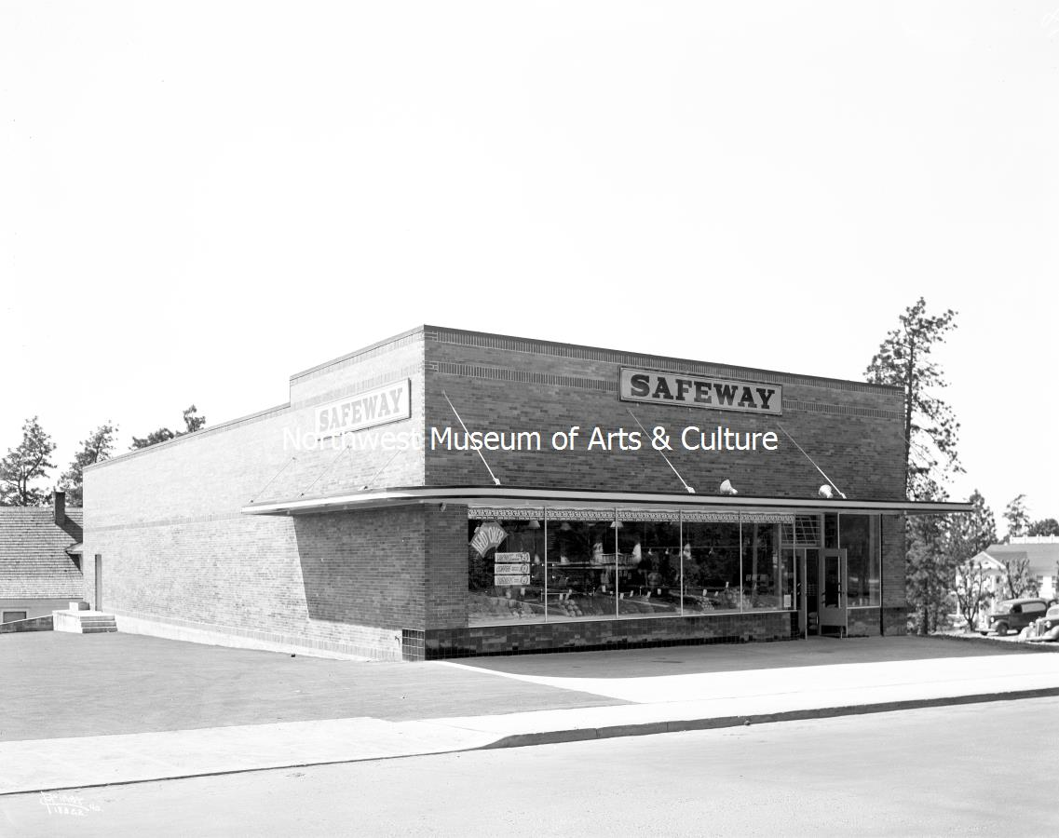
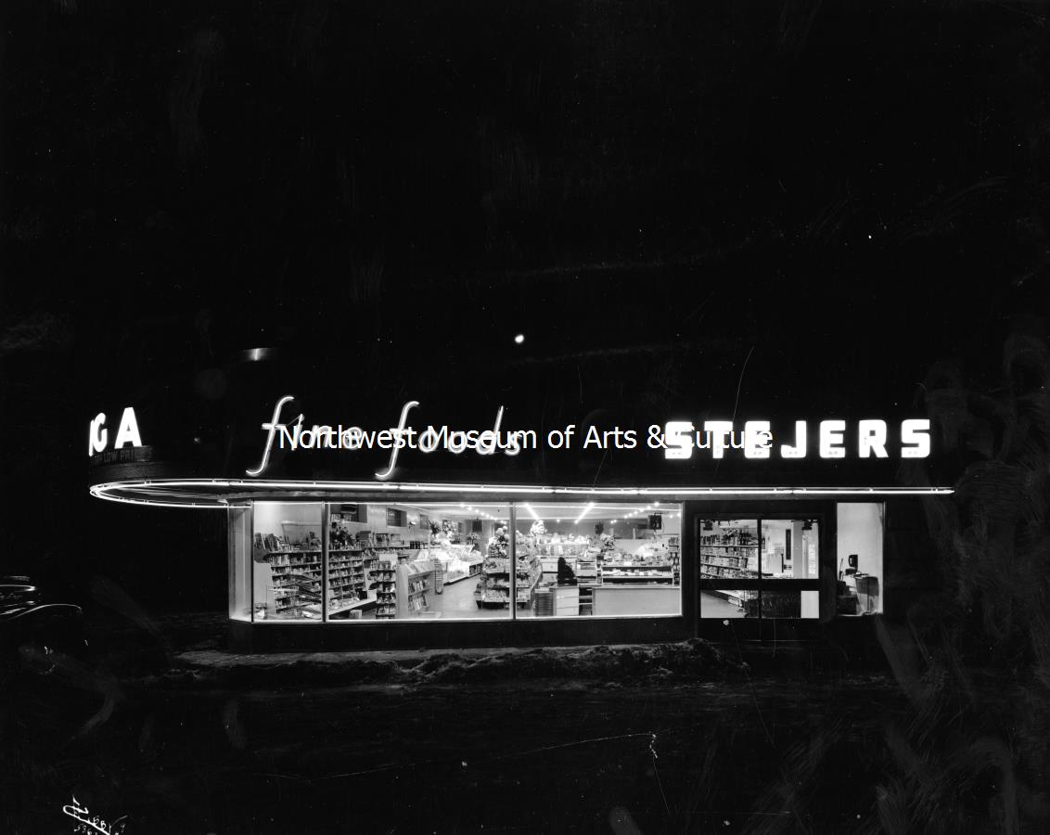
QUESTIONS?

