Slide 1
BROWNE’S ADDITION
HISTORIC DISTRICT
Preliminary Approval of Nomination, Resource Pages & Design Standards

Slide 2
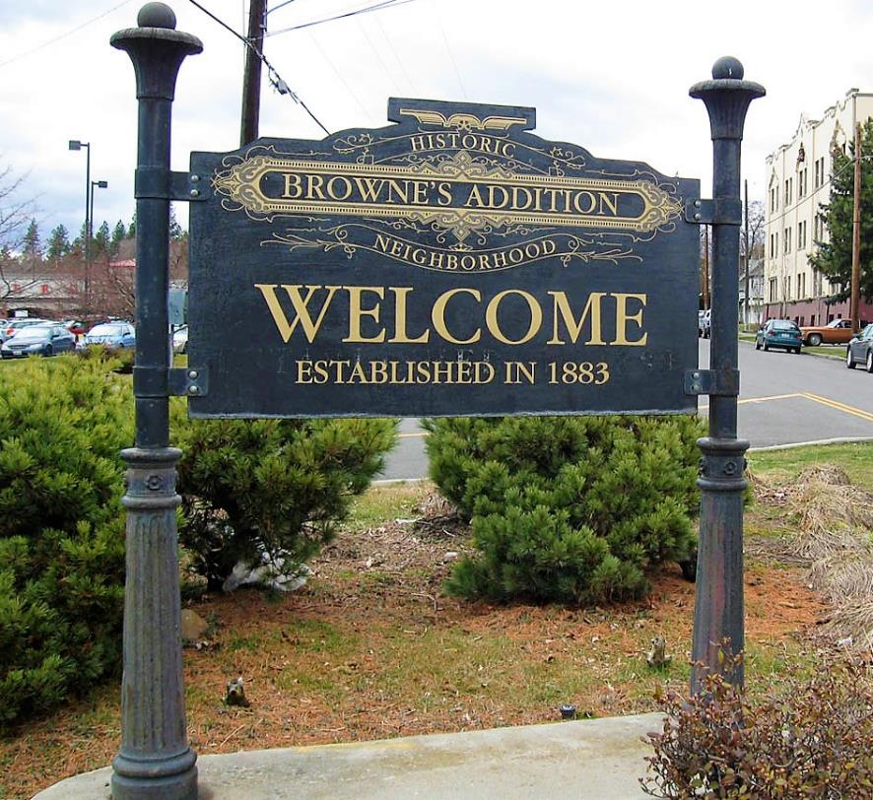
Browne’s Addition Historic District

Slide 3
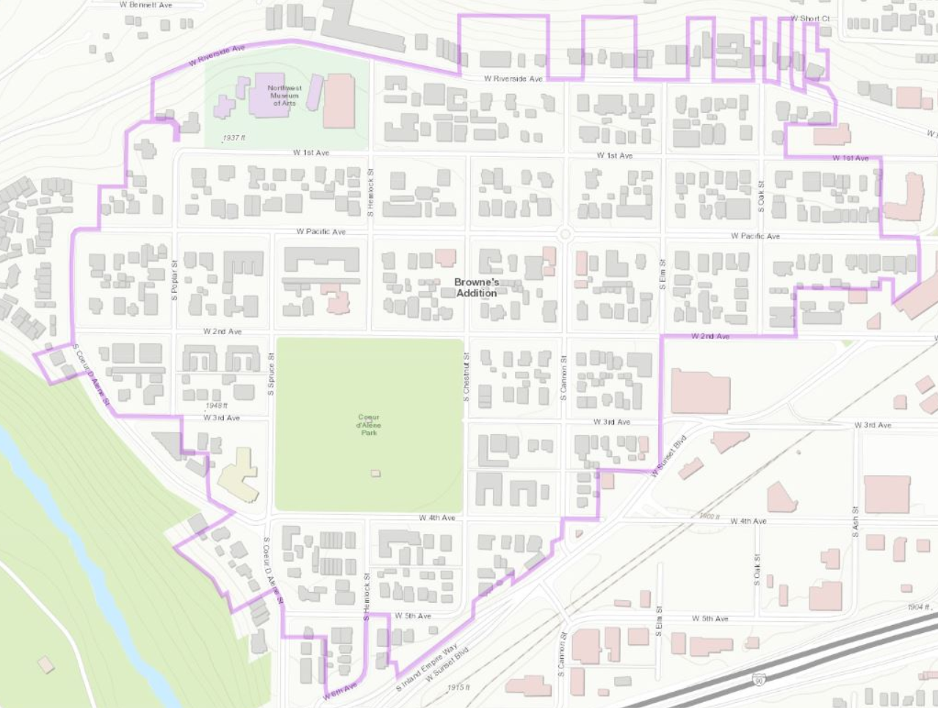
Browne’s Addition Historic District

Slide 4
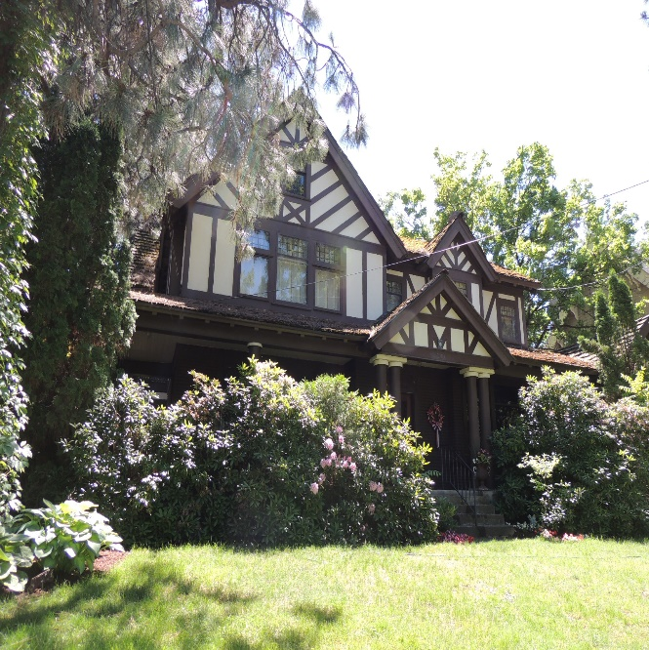
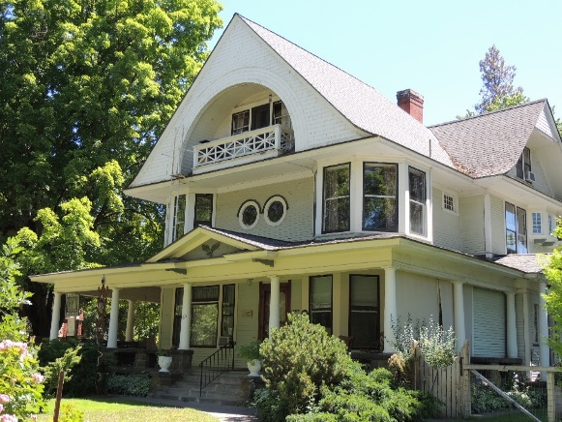
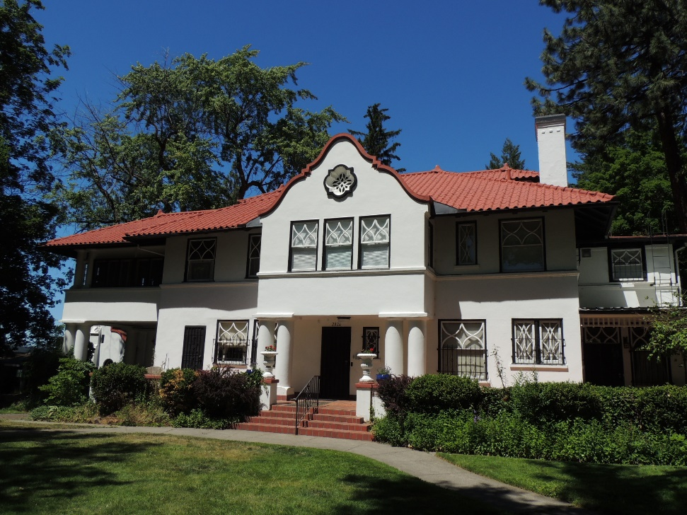
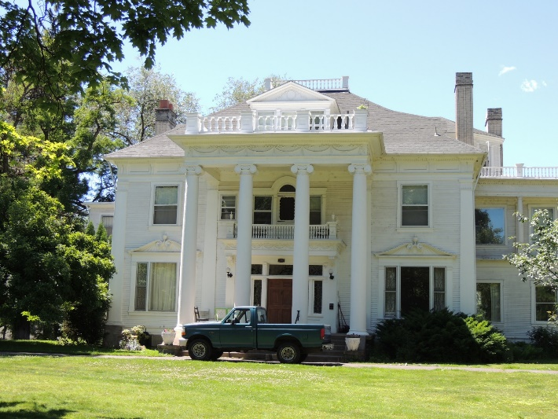
Browne’s Addition Historic District
1st Avenue

Slide 5
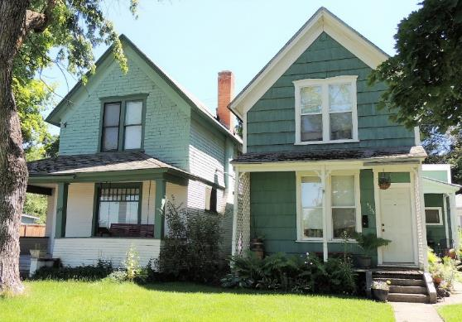
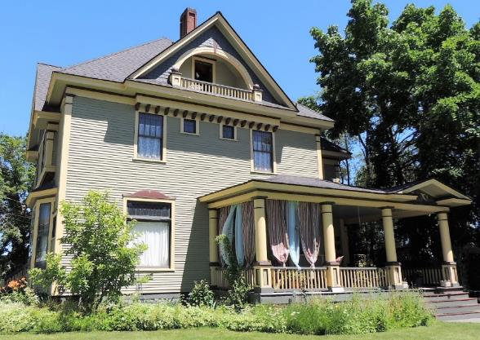
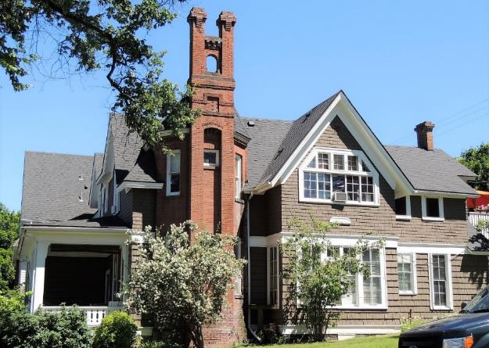
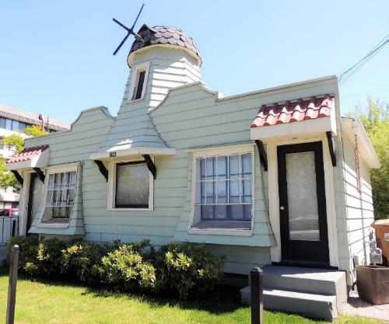
Browne’s Addition Historic District
1st Avenue

Slide 6
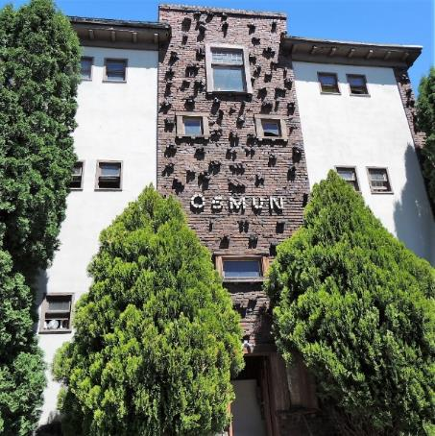
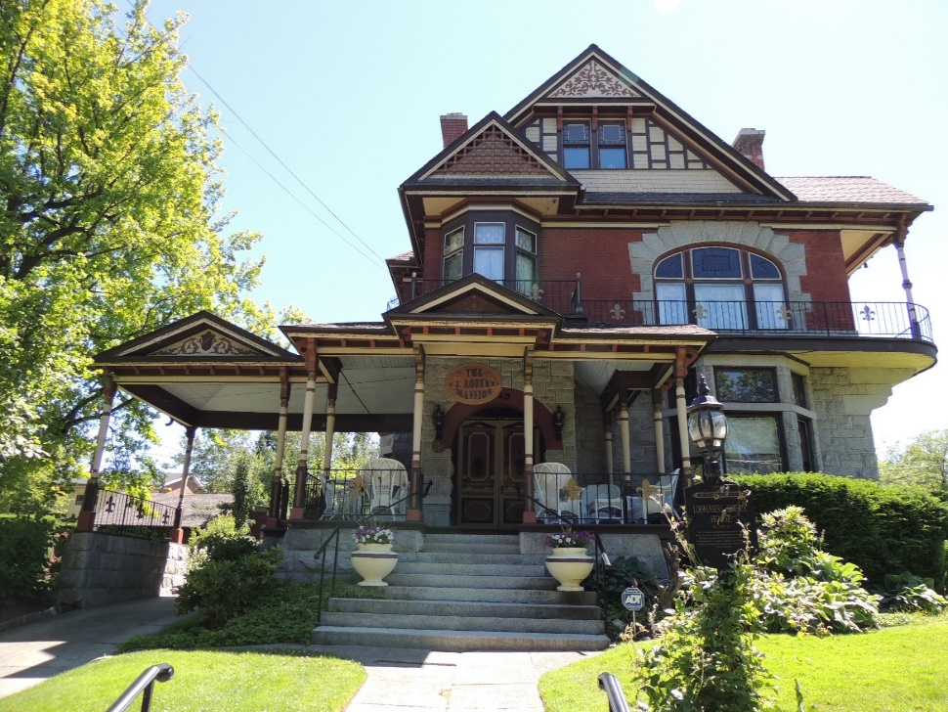
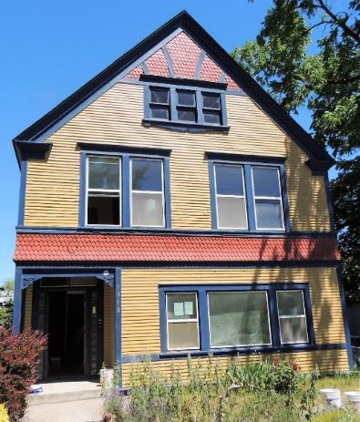
Browne’s Addition Historic District
1st Avenue

Slide 7
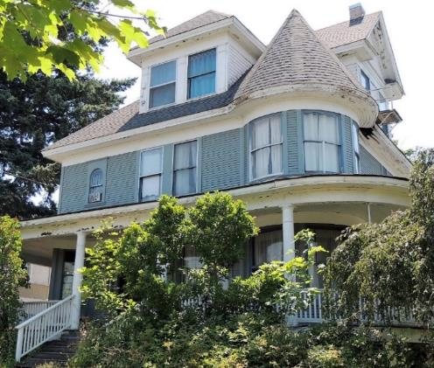
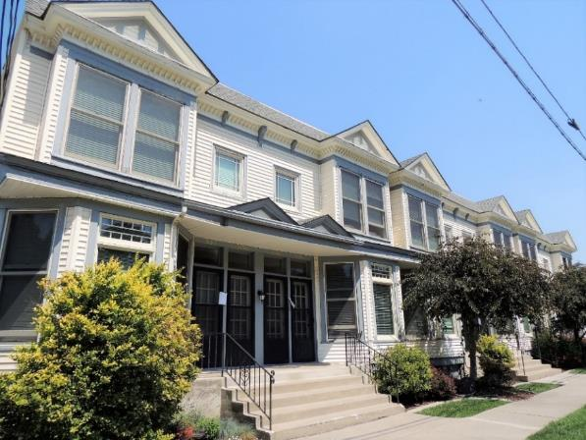
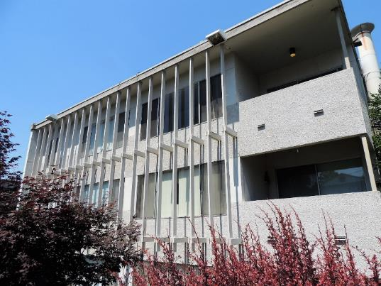
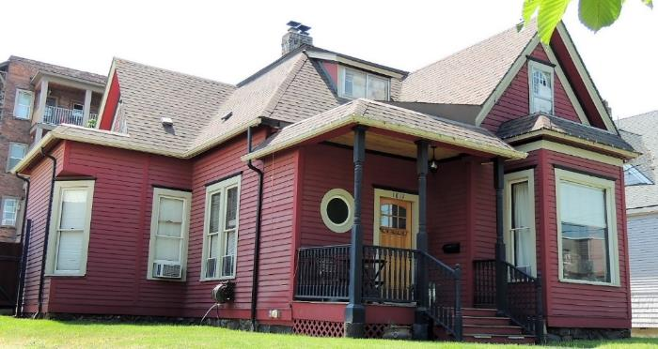
Browne’s Addition Historic District
Riverside Avenue

Slide 8
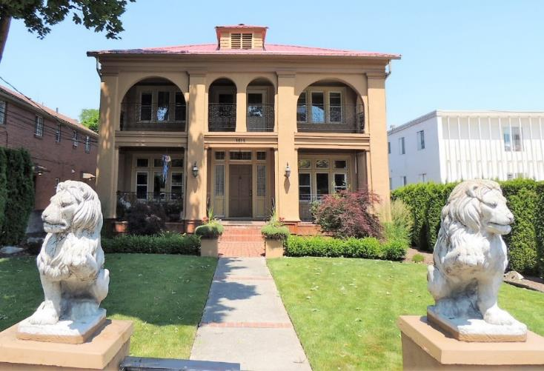
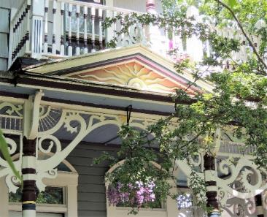
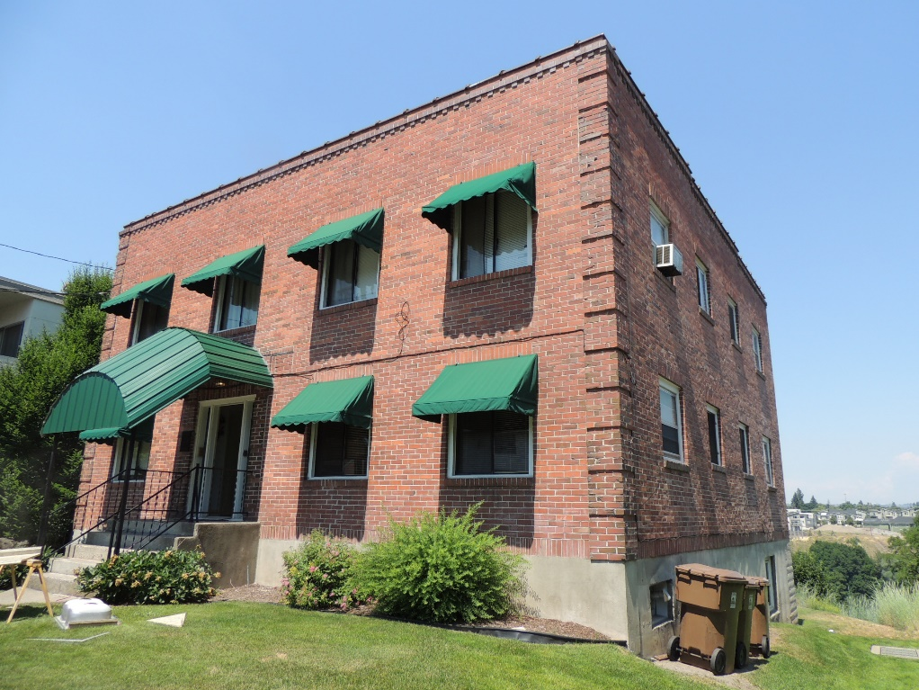
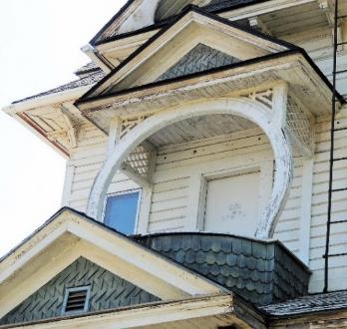
Browne’s Addition Historic District
Riverside Avenue

Slide 9
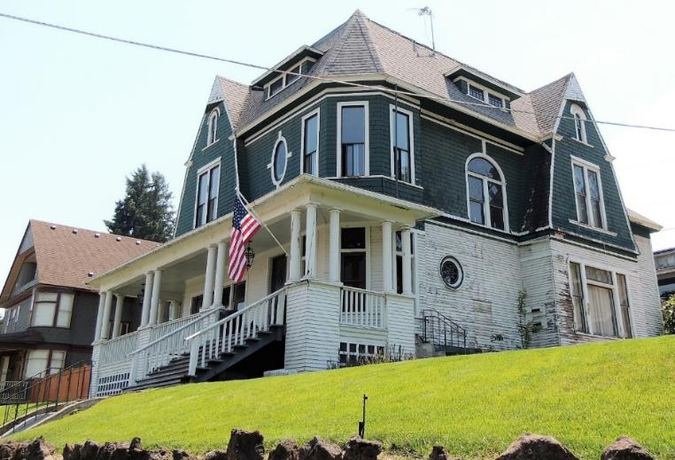
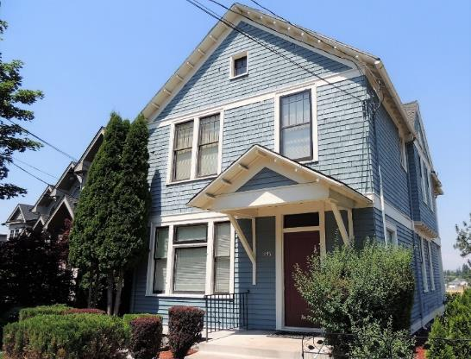
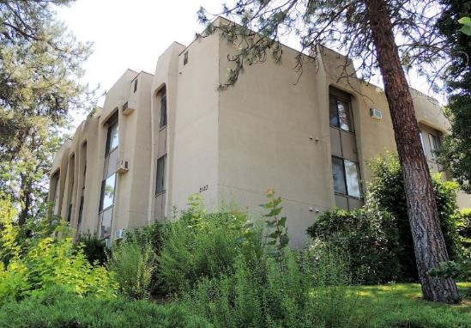
Browne’s Addition Historic District
Riverside Avenue

Slide 10
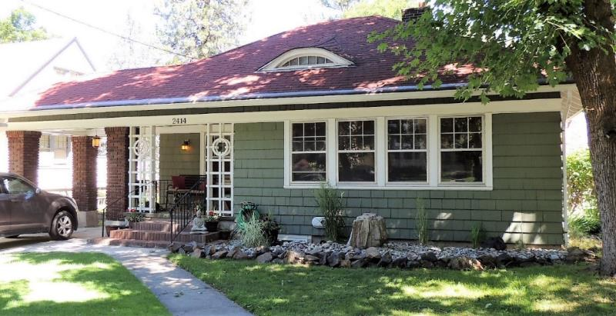
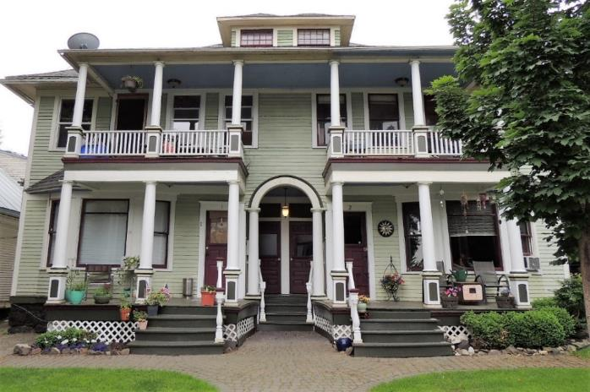
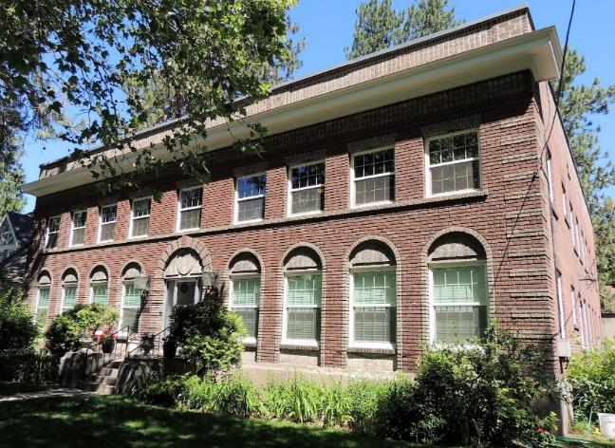
Browne’s Addition Historic District
Pacific Avenue

Slide 11
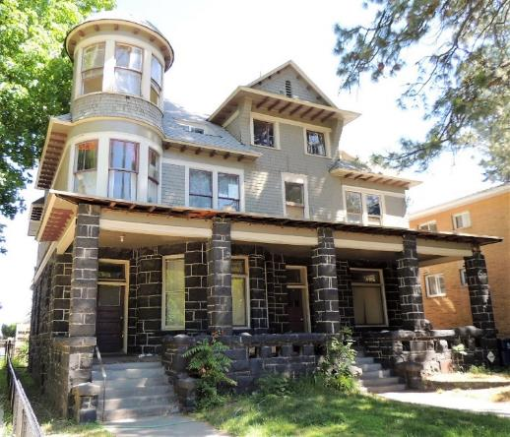
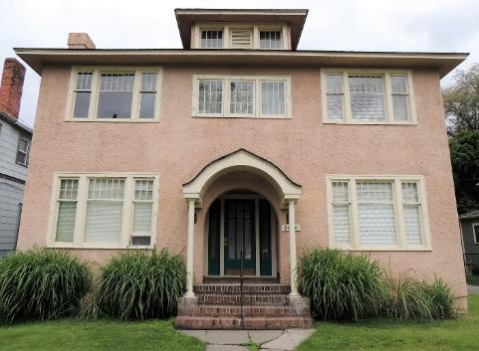
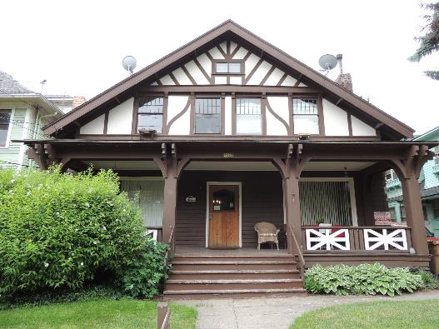
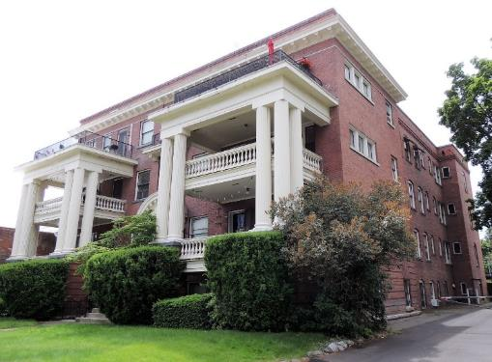
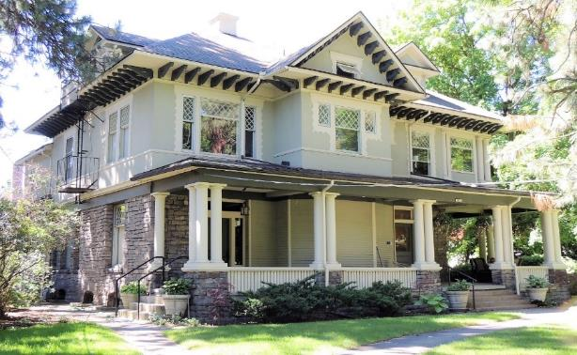
Browne’s Addition Historic District
Pacific Avenue

Slide 12
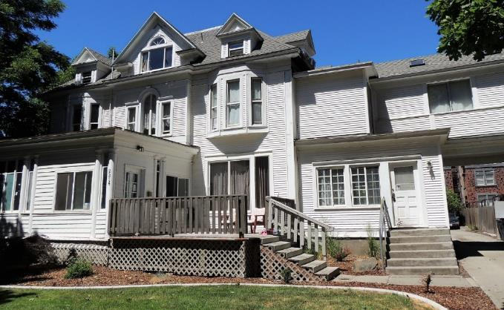
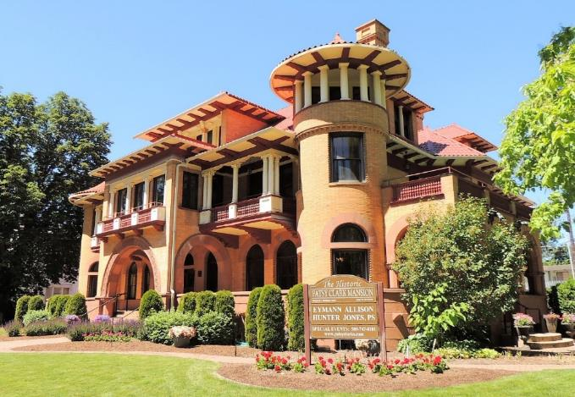
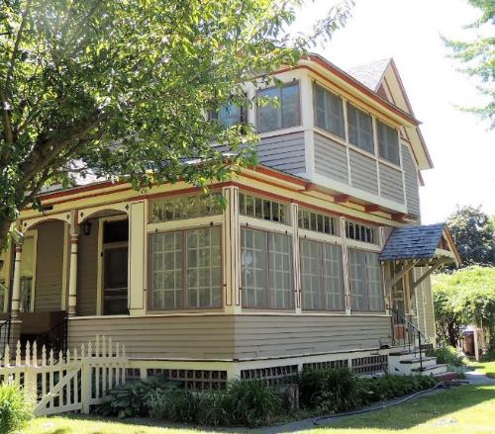
Browne’s Addition Historic District
2nd Avenue

Slide 13
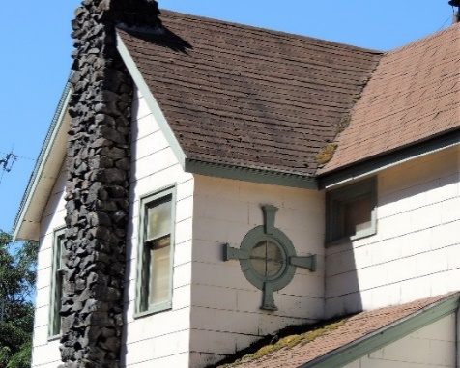
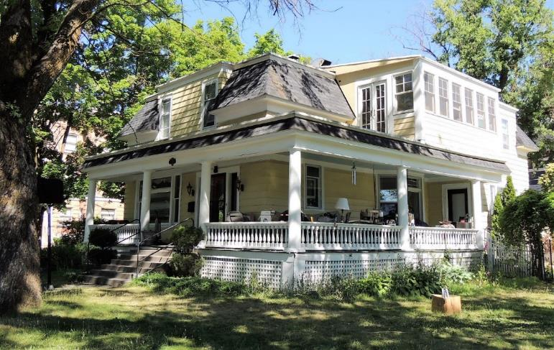
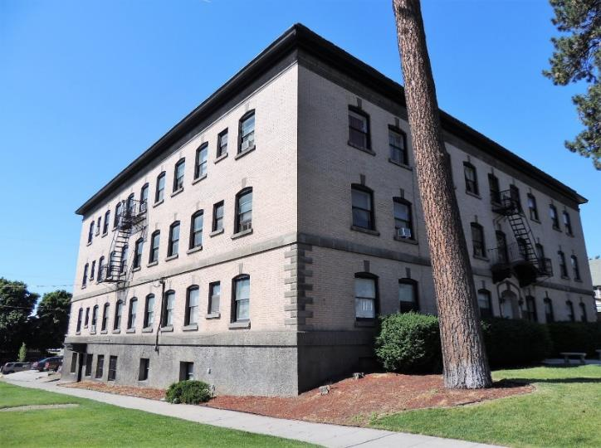
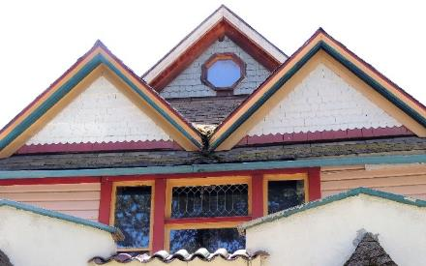
Browne’s Addition Historic District
2nd Avenue

Slide 14
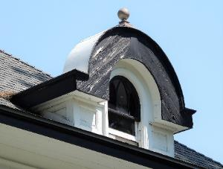
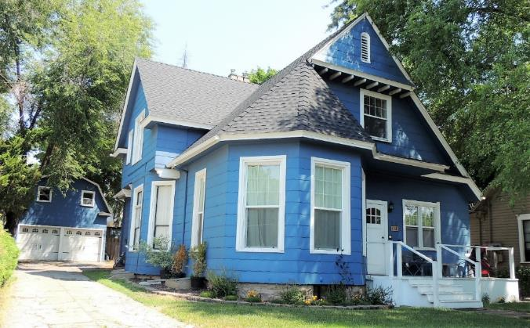
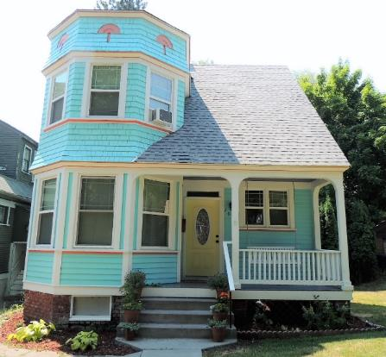
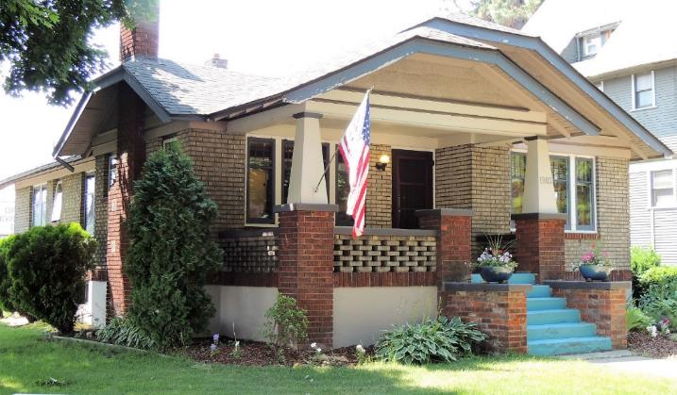
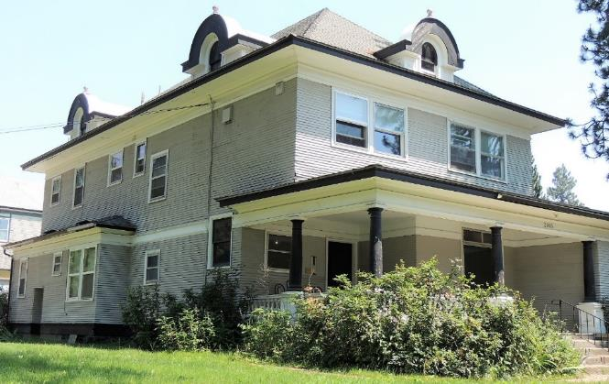
Browne’s Addition Historic District
3rd Avenue

Slide 15
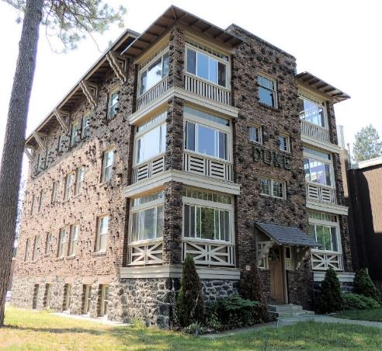
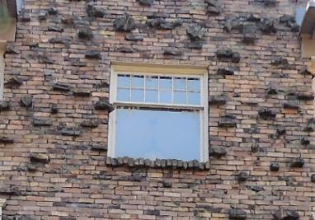
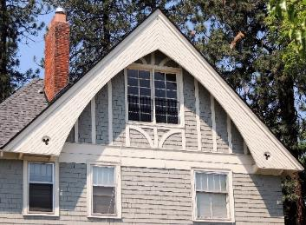
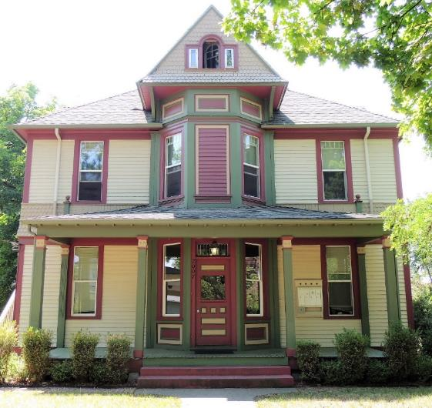
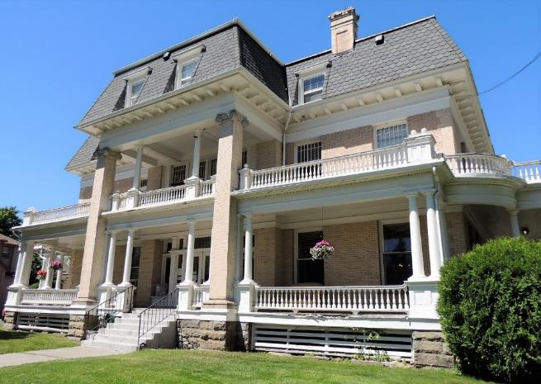
Browne’s Addition Historic District
3rd Avenue

Slide 16
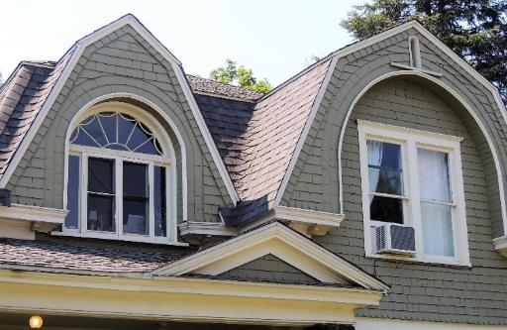




Browne’s Addition Historic District
4th Avenue

Slide 17





Browne’s Addition Historic District
4th Avenue

Slide 18





Browne’s Addition Historic District
5th Avenue

Slide 19




Browne’s Addition Historic District
5th Avenue

Slide 20


Browne’s Addition Historic District
Sunset Boulevard

Slide 21




Browne’s Addition Historic District
Oak Street

Slide 22




Browne’s Addition Historic District
Elm Street

Slide 23



Browne’s Addition Historic District
Cannon Street

Slide 24



Browne’s Addition Historic District
Cannon Street

Slide 25



Browne’s Addition Historic District
Coeur d’Alene Park

Slide 26



Browne’s Addition Historic District
Chestnut Street

Slide 27



Browne’s Addition Historic District
Chestnut Street

Slide 28



Browne’s Addition Historic District
Hemlock Street

Slide 29




Browne’s Addition Historic District
Hemlock Street

Slide 30




Browne’s Addition Historic District
Spruce Street

Slide 31


Browne’s Addition Historic District
Poplar Street

Slide 32



Browne’s Addition Historic District
Coeur d’Alene Street

Slide 33



Browne’s Addition Historic District
Coeur d’Alene Street

Slide 34

Browne’s Addition Historic District
Modifications/Integrity
INTACT
The Queen Anne house was designed by Loren L. Rand in 1899 as a single-family residence, and was
converted to multi-family use in 1954. No visible modifications have occurred to the exterior of the house;
it retains excellent historic integrity and contributes to the Browne’s Addition Historic District.

Slide 35

Browne’s Addition Historic District
Modifications/Integrity
SLIGHT
Changes to plan are not entirely visible from the street and in-kind window replacement = slight

Slide 36

Browne’s Addition Historic District
Modifications/Integrity
MODERATE
The exterior is clad with stucco that appears
to have been added over other siding due to the shallow relief of the window frames. The windows on the
north façade are original wood fixed sash, and the windows on the west elevation have been replaced with
anodized aluminum sliding sash. Even so, the cottage has an intact porch and plan, and overall retains
good historic integrity.

Slide 37

Browne’s Addition Historic District
Modifications/Integrity
EXTENSIVE
The first and second stories are clad with stucco applied over the original siding,
and the third story is clad with wood shingle siding on the north façade. The windows have been replaced
with vinyl hung and sliding sash. Plan has been extensively changed with front porch enclosure and second story addition at rear.

Slide 38

Browne’s Addition Historic District
Levels of Integrity
EXCELLENT
No visible modifications have occurred to the exterior of the Colonial Revival house since it was
constructed in 1896; it retains excellent historic integrity and contributes to the Browne’s Addition Historic
District.

Slide 39

Browne’s Addition Historic District
Modifications/Integrity
GOOD
The Stick style house was constructed in 1889. Modifications to a small number of
windows only slightly reduce its historic appearance and integrity of design and materials. Overall, the
house retains good historic integrity, and contributes to the Browne’s Addition Historic District.

Slide 40

Browne’s Addition Historic District
Modifications/Integrity
FAIR
Constructed circa 1890, as depicted on the 1890 Sanborn Fire Insurance Map, as one of the earlier multifamily
residences in Browne’s Addition, replacement siding and windows reduce its historic appearance
and integrity of design and materials. Even so, with the intact plan and lively Queen Anne massing of
projecting bays and intact entrances, the apartment building retains enough historic integrity to still
contribute to the Browne’s Addition Historic District.

Slide 41

Browne’s Addition Historic District
Modifications/Integrity
POOR
Constructed in 1889, modifications to the plan, siding, and windows of the cottage have removed all evidence of its historic appearance and completely diminish its integrity of design, materials, workmanship, and association. The house does not retain historic integrity and does not contribute to the Browne’s Addition
Historic District.

Slide 42

Browne’s Addition Historic District
Modifications/Integrity
Changes over time
The Queen Anne house was designed by Cutter and Malmgren in 1898 as a single-family residence, and it was converted to a multi-family residence in 1925. Modifications to the plan with the partial enclosure of the porch in 1948 and presence of replacement siding and changes to windows somewhat reduce its historic appearance and integrity of design and materials. Even so, with the plan and massing otherwise intact, the dwelling retains good historic integrity and contributes to the Browne’s Addition Historic District.

Slide 43

Browne’s Addition Historic District
Contributing/Non-contributing

Slide 44
Browne’s Addition Historic District
Design Standards
historicspokane.org/pro-brownes

Slide 45
Browne’s Addition Historic District
Actions concluded:
SHLC gave a preliminary approval to three documents:
  Browne’s Addition Spokane Register District Nomination
  Resource forms for Browne’s – gives determination of contributing and non-contributing
  Design Standards document
When will the final action be taken?
We are planning to have SHLC final meeting on the district at our June 19th meeting
Then City Council will approve district through the overlay zone ordinance

Slide 46


Browne’s Addition Historic District
Property owner vote
Ballots mailed out mid-April to all property owners
We will have 60-days for the ballots to be returned
Major changes may be made to the documents before ballots mailed, small changes may continue to be made until final action by SHLC

Slide 47
Browne’s Addition Historic District
What is next?
Logan is developing the overlay zone ordinance for Plan Commission and City Council
Instead of a Management Agreement, the overlay ordinance will be the action that City Council takes after the recommendation is given from the SHLC
Other HPO Duties:
We are developing a notice sign for the district and zoning ordinance
We will have to do a non-project SEPA for the district
The ordinance will have to go to the State Department of Commerce
It has to be reviewed by Plan Commission (first workshop April 24th) we will follow up soon after for a final recommendation from them to City Council
We will workshop it to City Council at an Urban Advantage Committee meeting – first in May

Slide 48
Browne’s Addition Historic District
What can you do?
VOTE! Please return your ballots promptly after receiving them.
Encourage neighbors to vote as well!
Are you a tenant? Encourage your landlord to vote.
Email HPO with comments on the documents – big items before ballots are mailed, small changes can be made up until June.
Attend Plan Commission and City Council meetings when the Historic District Overlay Zone ordinance is up for discussion or vote.

Slide 49
Questions…
General:
1. What surprised you about the documents?
2. What questions do you have about the documents?
3. Was there something missing from the documents that you expected to see?
4. Is there anything in the documents that you would like to see changed?

Slide 50
Questions…
Nomination:
Did the nomination do a good job capturing the history, culture, and built environment that make Browne’s Addition worth protecting? If not, what was missing?
Do you feel the boundary accurately reflects the district? If not, what would you change?

Slide 51
Questions…
Design Review Standards:
Were the Design Review Standards confusing? If so, which part could be clearer?
Do you want paint colors to be included in the design review process?
Do you want landscaping to be included in the design review process? What about garages?

Slide 52
Questions…
Resource Forms:
Much of the physical descriptions in the property forms were based on observations taken from the sidewalk. Did you see any errors in the description of your property?

