Slide 1
Browne’s Addition
Local Historic District
Plan Commission Workshop #2
May 8, 2019

Slide 2
SPOKANE HISTORIC LANDMARKS COMMISSION
Spokane Historic Landmarks Commission:
Section 04.35.010 Findings and Purpose
Findings.
The City and Spokane County find that the establishment of a landmarks commission with specific duties to recognize, protect, enhance and preserve those buildings, districts, objects, sites and structures which serve as visible reminders of the historical, archaeological, architectural, educational and cultural heritage of the City and County is a public necessity.
Purpose.
Initiate and maintain the Spokane register of historic places to encourage efforts by owners to maintain, rehabilitate and preserve properties. This official register compiles buildings, districts, objects, sites and structures identified by the commission as having historic significance worthy of recognition by the council or board

Slide 3
SPOKANE HISTORIC LANDMARKS COMMISSION
Review proposals (as provided in SMC 17D.100.200) to construct, change, alter, modify, remodel, move, demolish and significantly affect properties or districts on the register.
In making a decision on an application, the commission uses the Secretary of the Interior’s Standards for Rehabilitation, historic district design standards and other general guidelines established and adopted by the commission. In adopting and using standards, the commission does not limit new construction to any one architectural style but seeks to preserve the character and integrity of the landmark or the historic district through contemporary compatible designs.

Slide 4
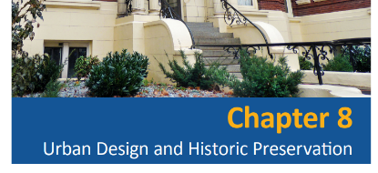
IMPLEMENTING THE COMPREHENSIVE PLAN
Comprehensive Plan Chapter 8: Urban Design and Historic Preservation
DP 1.1: Landmark Structures, Buildings, and Sites
  Recognize and preserve unique or outstanding landmark structures, buildings, and sites.
DP 1.2: New Development in Established Neighborhoods
  Encourage new development that is of a type, scale, orientation, and design that maintains or improves the character, aesthetic quality, and livability of the neighborhood.
DP 2.7: Historic District and Sub-Area Design Guidelines
  Utilize design guidelines and criteria for sub-areas and historic districts that are based on local community participation and the particular character and development issues of each sub-area or historic district.

Slide 5
IMPLEMENTING THE COMPREHENSIVE PLAN
DP 3.10 Zoning Provisions and Building Regulations
Utilize zoning provisions, building regulations, and design standards that are appropriate for historic districts, sites, and structures.
Discussion: Regulations are tools that can and should be used to promote preservation and renovation rather than demolition. Examples include retaining favorable zoning options (Historic Conditional Use Permits and Historic District Overlay Zones), and encouraging the use of form based codes and special building codes like the historic building sections of the International Building Code (IBC) and International Existing Building Code.
DP 3.13 Historic Districts and Neighborhoods
Assist neighborhoods and other potential historic districts to identify, recognize, and highlight their social and economic origins and promote the preservation of their historic heritage, cultural resources, and built environment.

Slide 6
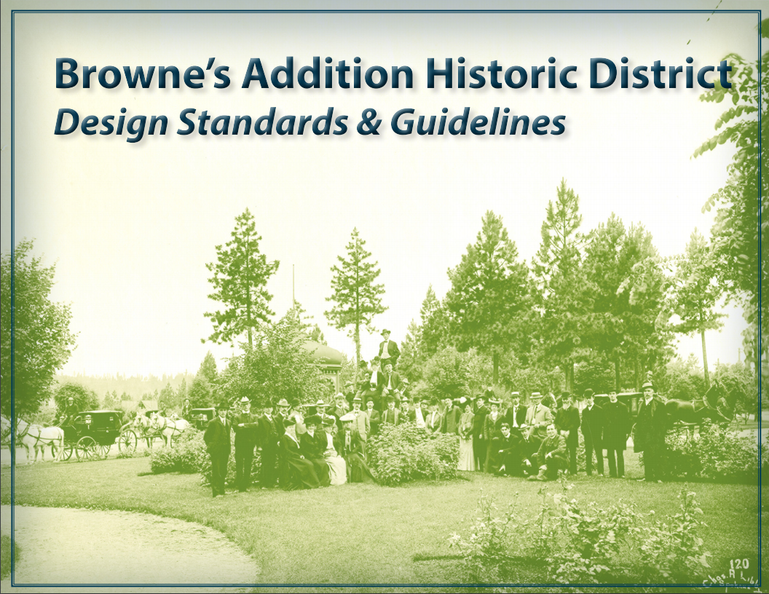
Browne’s Addition Design Standards & Guidelines

Slide 7
Browne’s Addition Design Standards & Guidelines
The Secretary of the Interior’s Standards for Rehabilitating Historic Buildings was published in 1983.
The Secretary of the Interior's Standards for the Treatment of Historic Properties (36 CFR Part 68, 1995) consists of four treatment standards — Preservation, Rehabilitation, Restoration and Reconstruction — and are regulatory for NPS Grants–in–Aid programs. The Secretary of the Interior's Standards for Rehabilitation (36 CFR Part 67, 1990), which are included in the treatment standards, are regulatory for the Federal Historic Preservation Tax Incentives program and used as the criteria to determine if a project qualifies as “a certified rehabilitation.”
The Secretary of the Interior's Standards for the Treatment of Historic Properties, in particular the Standards for Rehabilitation, are intended as general guidance for work on all historic properties and are widely used and have been adopted at the Federal, State and local levels.

Slide 8
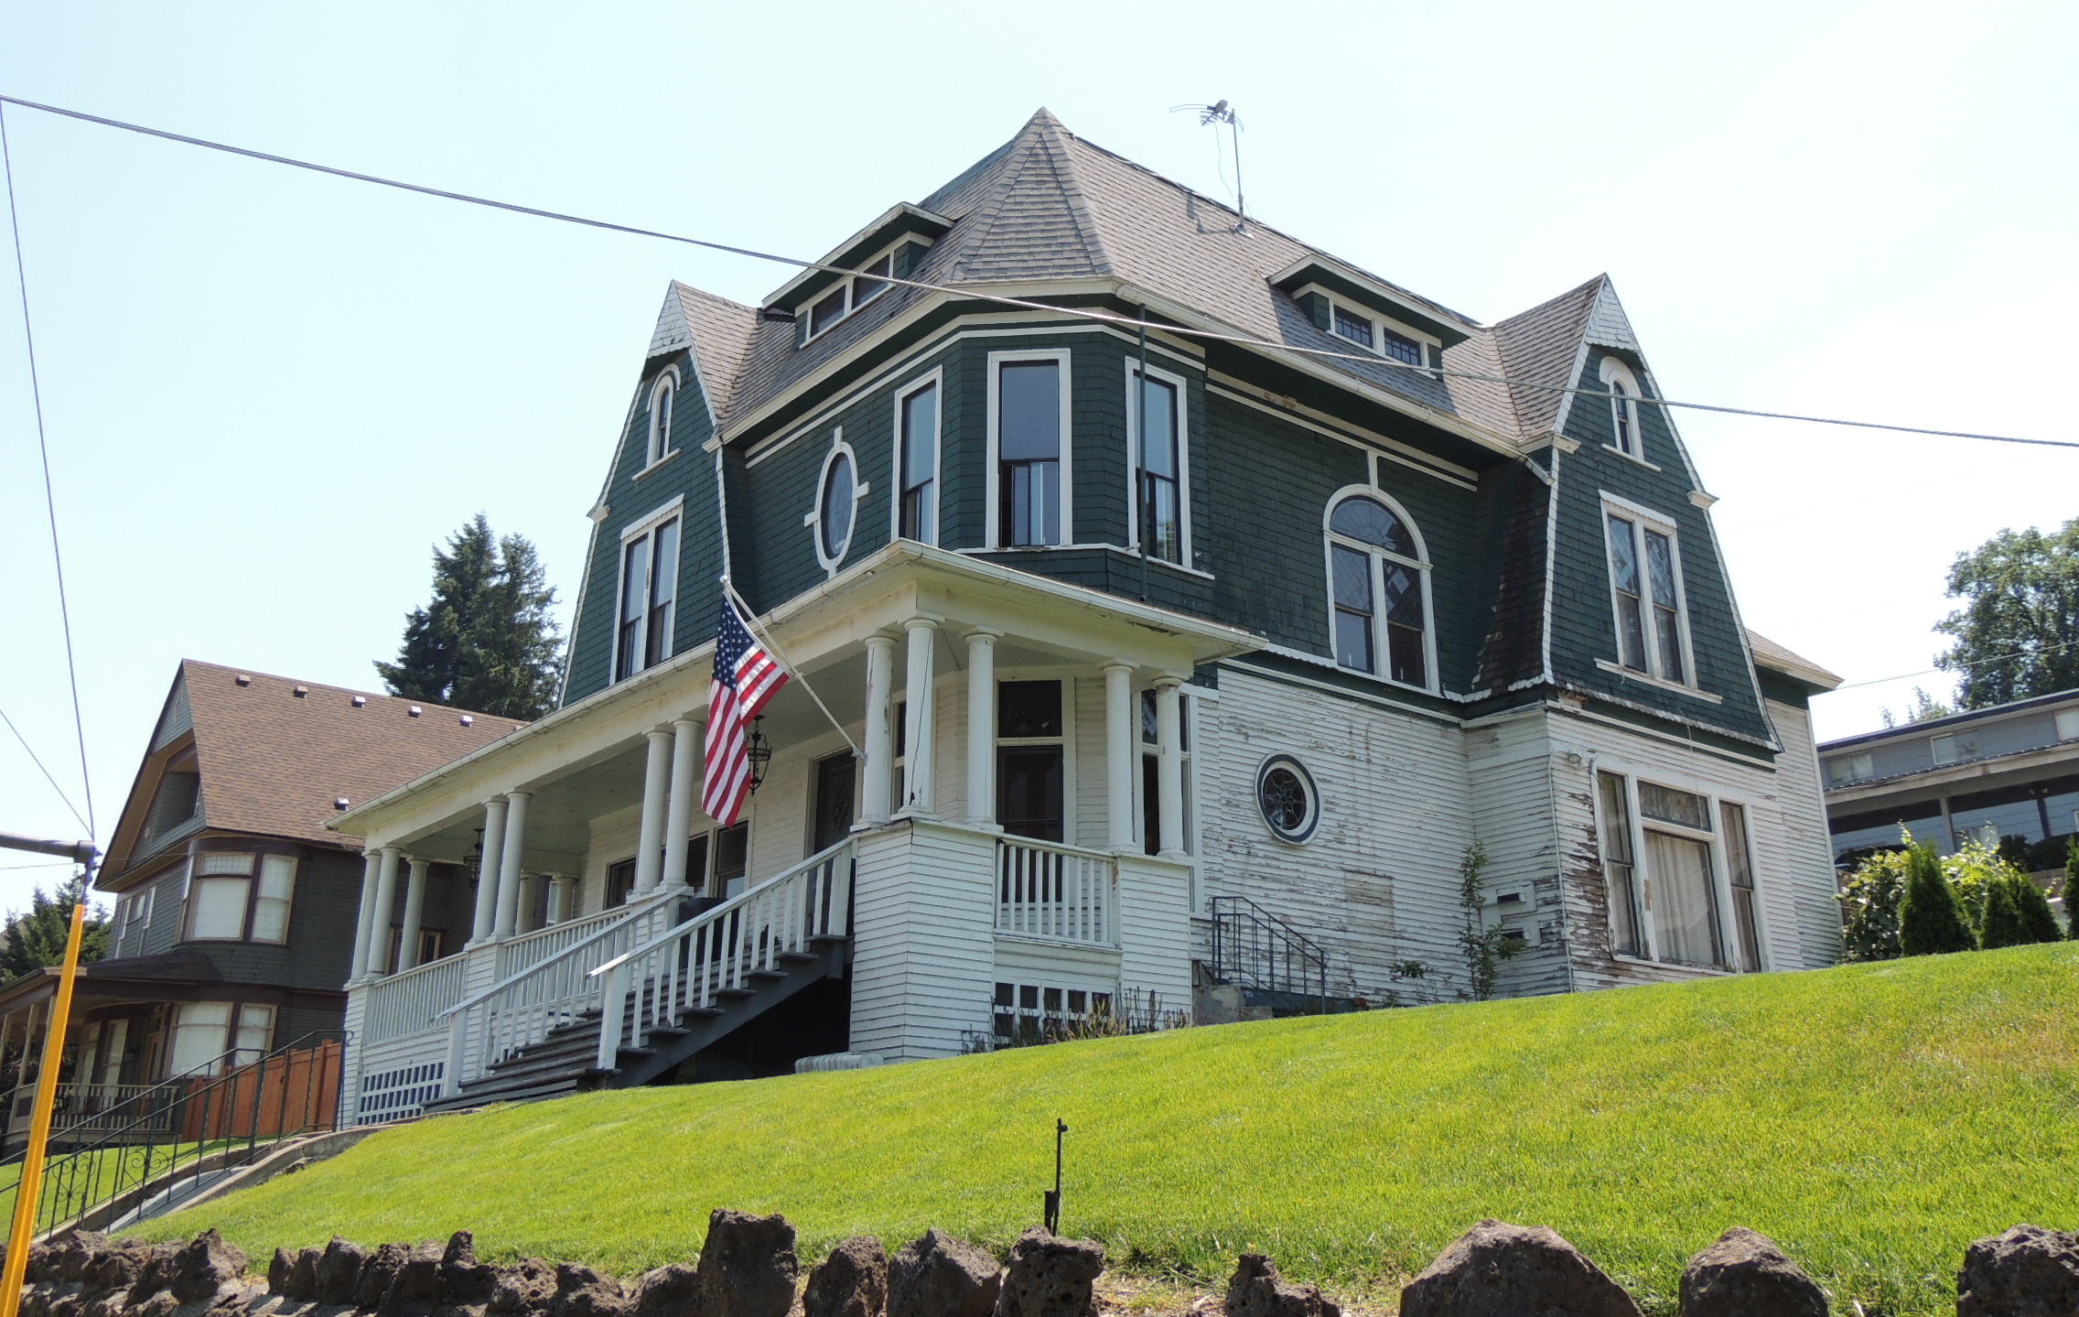
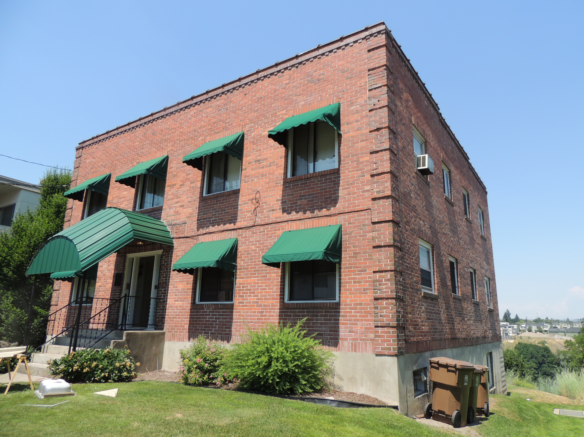
Secretary’s Standards & Browne’s Guidelines
The Standards are a series of concepts about maintaining, repairing, and replacing historic materials, as well as designing new additions or making alterations.
The Guidelines offer general design and technical recommendations to assist in applying the Standards to a specific property.
Together, they provide a framework and guidance for decision-making about work or changes to a historic property.

Slide 9
Secretary of the Interior’s Standards for Rehabilitation constitute the “standards” in this document, while the additional guidance represents the “guidelines” for decision making both by property owners when undertaking how to complete work within the district and the HPO and SHLC when issuing COAs in the district.
The Browne’s Addition Historic District Standards & Guidelines document expands and customizes these more general standards. The guidelines are the basis for evaluating applications for COAs, and assist applicants in understanding the Commission’s decision-making process.

Slide 10
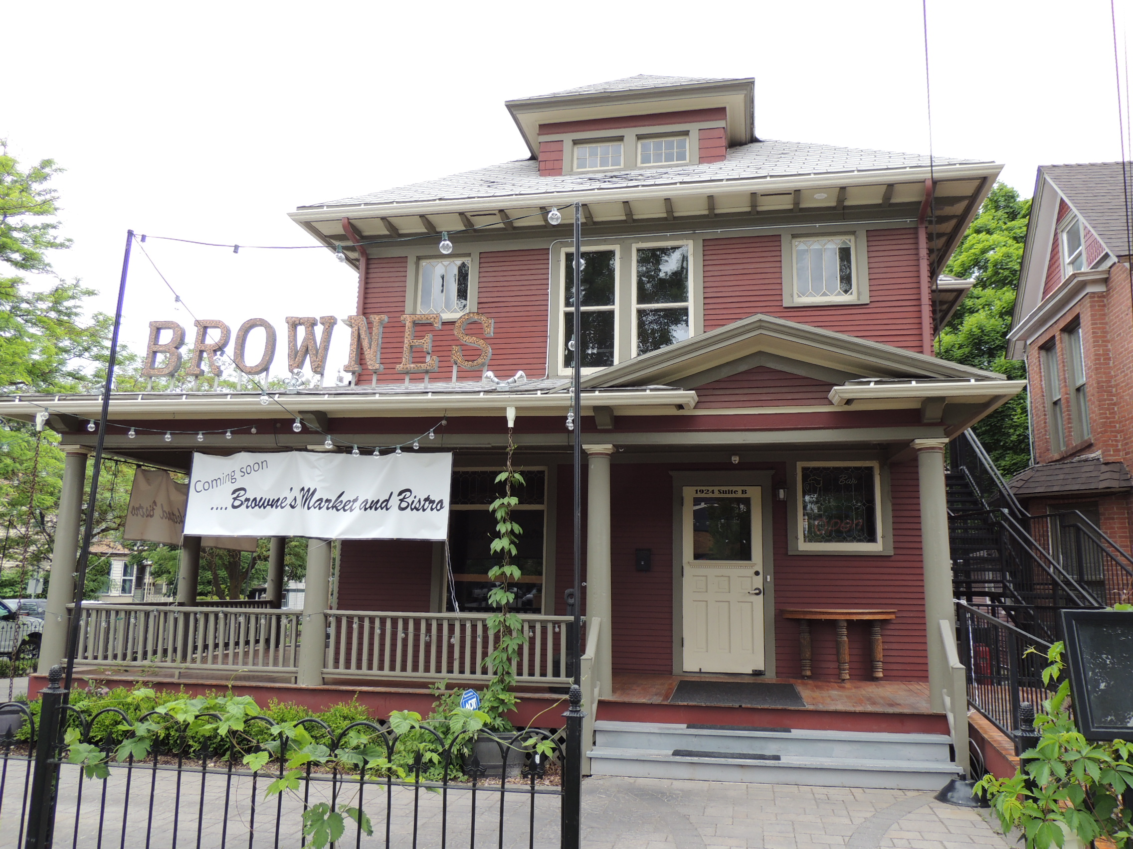
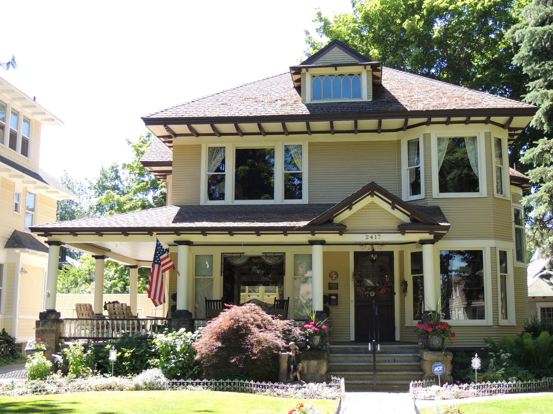
A property shall be used for its historic purpose or be placed in a new use that requires minimal change to the defining characteristics of the building and its site and environment.
1

Slide 11
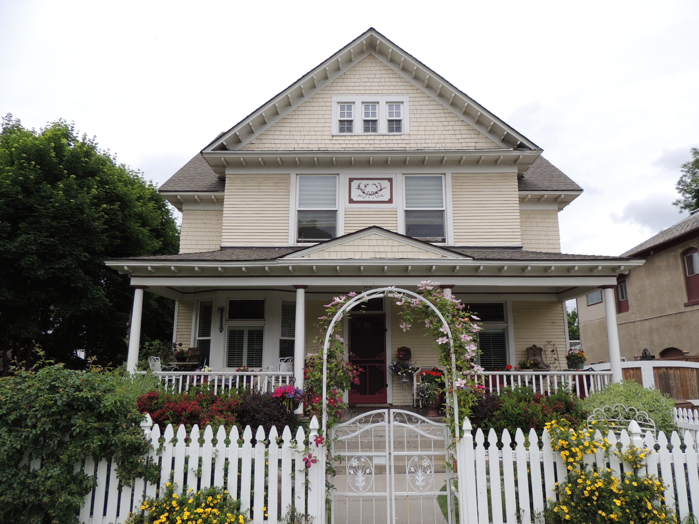
The historic character of a property shall be retained and preserved. The removal of historic materials or alteration of features and spaces that characterize a property shall be avoided.
2

Slide 12
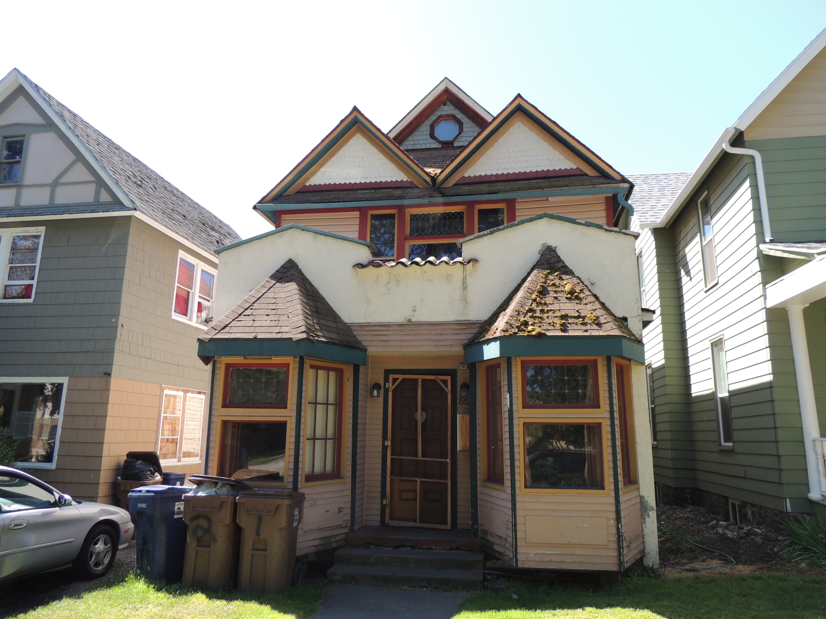
Each property shall be recognized as a physical record of its time, place, and use. Changes that create a false sense of historical development, such as adding conjectural features or architectural elements from other buildings, shall not be undertaken.
3

Slide 13
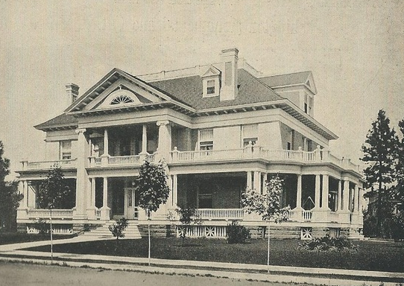
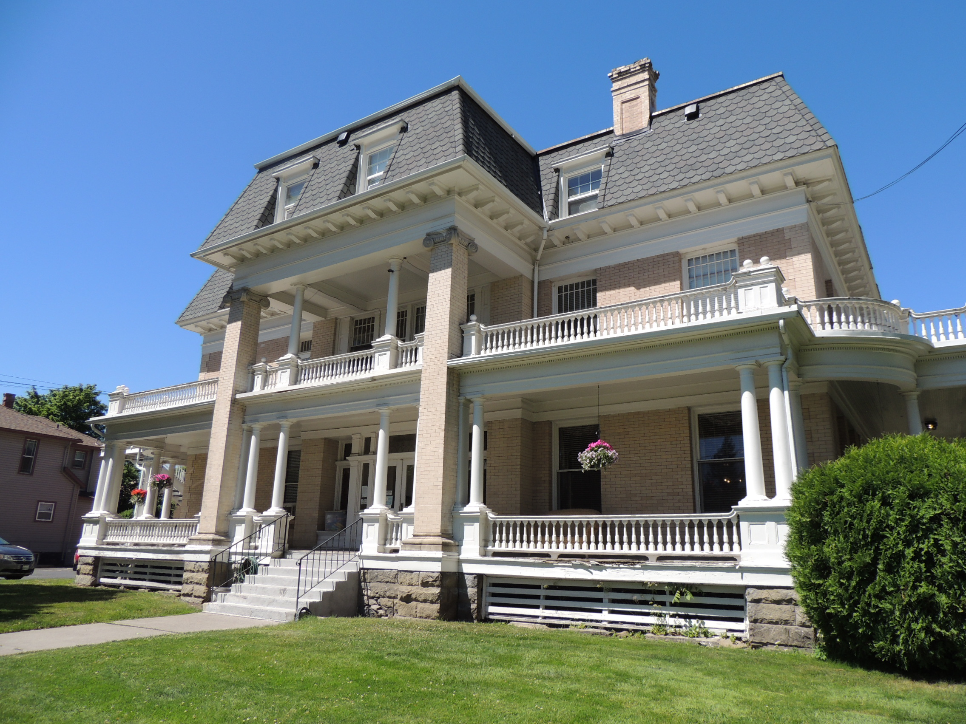
Most properties change over time; those changes that have acquired historic significance in their own right shall be retained and preserved.
4

Slide 14
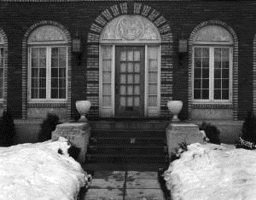
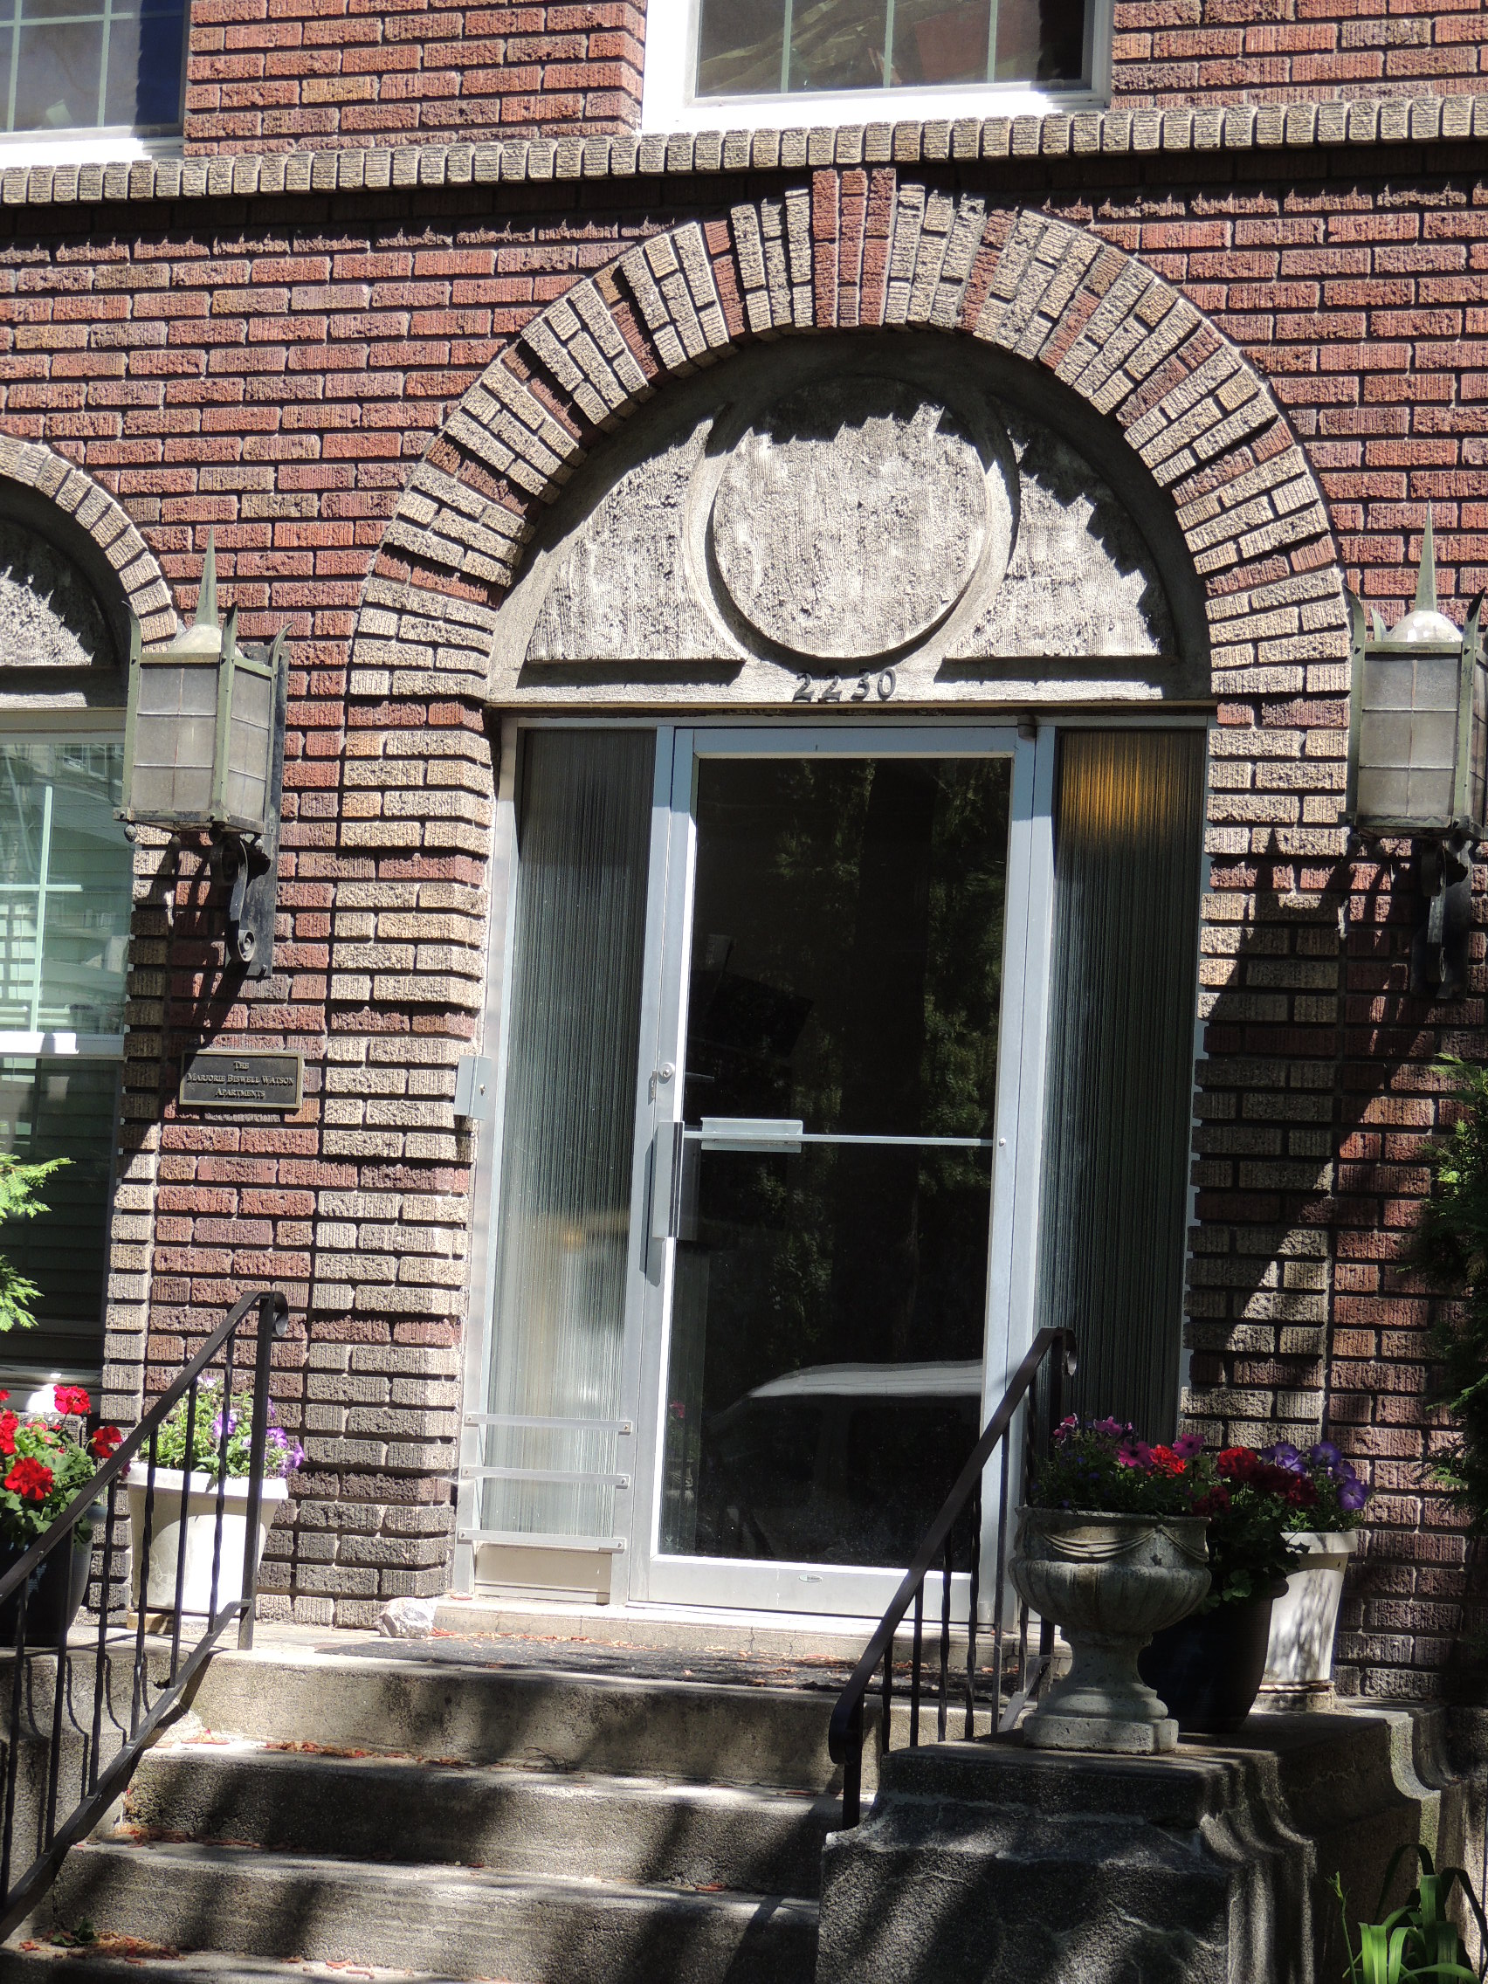
Distinctive features, finishes, and construction techniques or examples of craftsmanship that characterize a property shall be preserved.
5

Slide 15
Deteriorated historic features shall be repaired rather than replaced. Where the severity of deterioration requires replacement of a distinctive feature, the new feature shall match the old in design, color, texture, and other visual qualities and, where possible, materials. Replacement of missing features shall be substantiated by documentary, physical, or pictorial evidence.
6

Slide 16
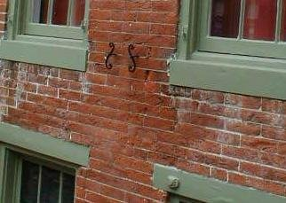
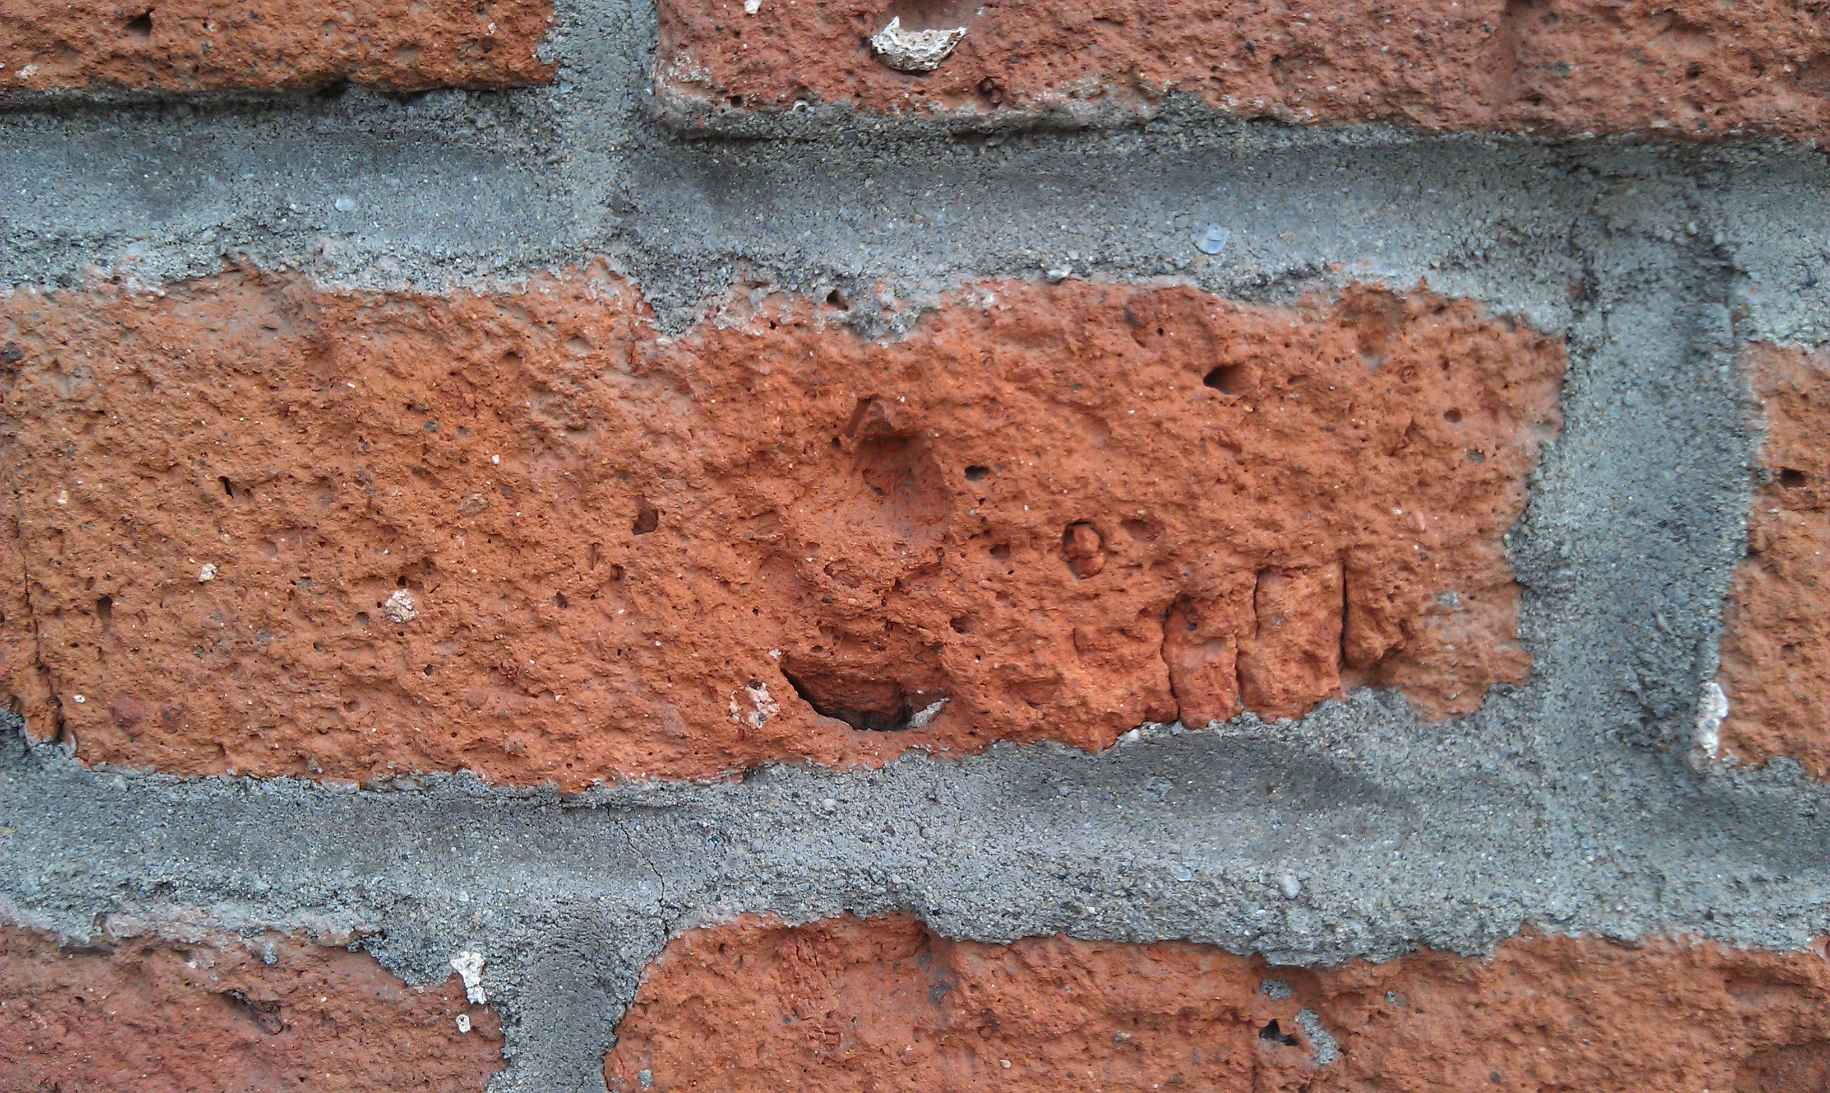
Chemical or physical treatments, such as sandblasting, that cause damage to historic materials shall not be used. The surface cleaning of structures, if appropriate, shall be undertaken using the gentlest means possible.
7

Slide 17
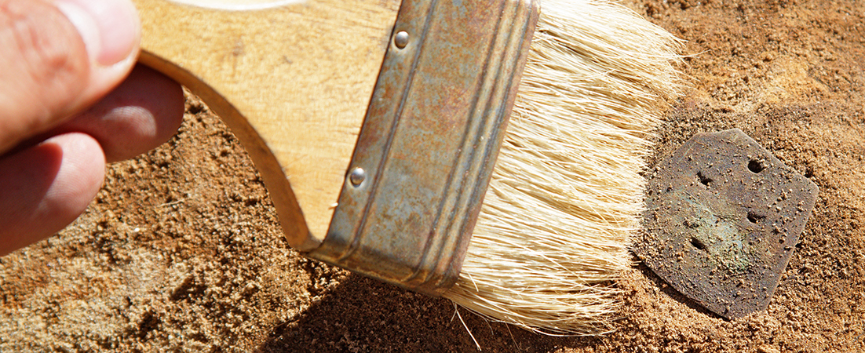
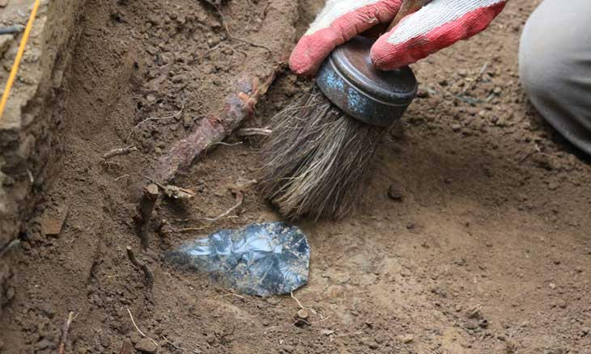
Significant archeological resources affected by a project shall be protected and preserved. If such resources must be disturbed, mitigation measures shall be undertaken.
8

Slide 18
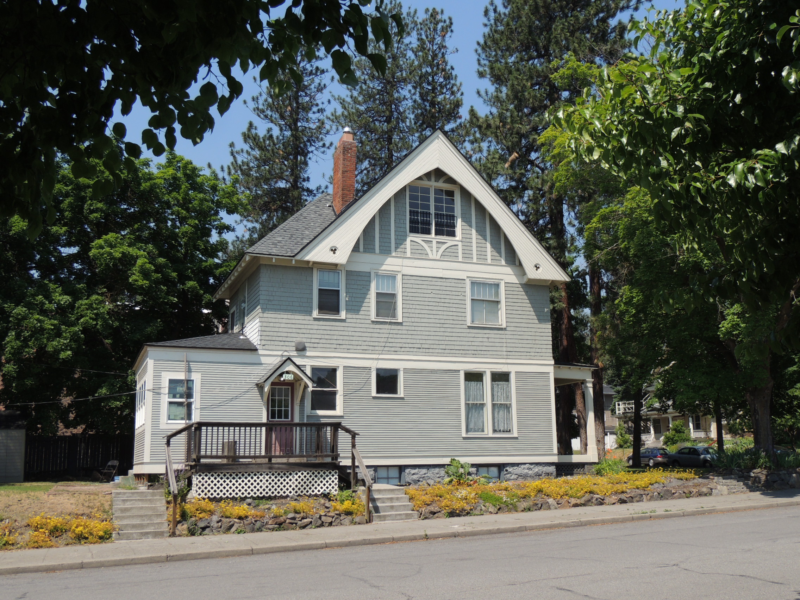
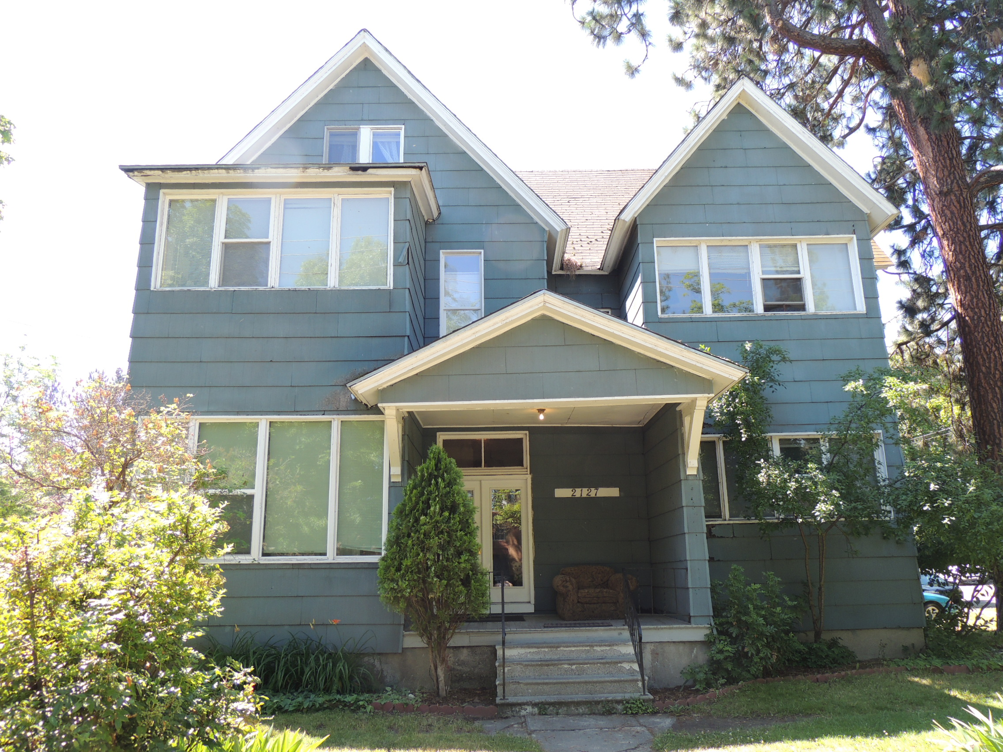
New additions, exterior alterations, or related new construction shall not destroy historic materials that characterize the property. The new work shall be differentiated from the old and shall be compatible with the massing, size, scale, and architectural features to protect the historic integrity of the property and its environment.
9

Slide 19
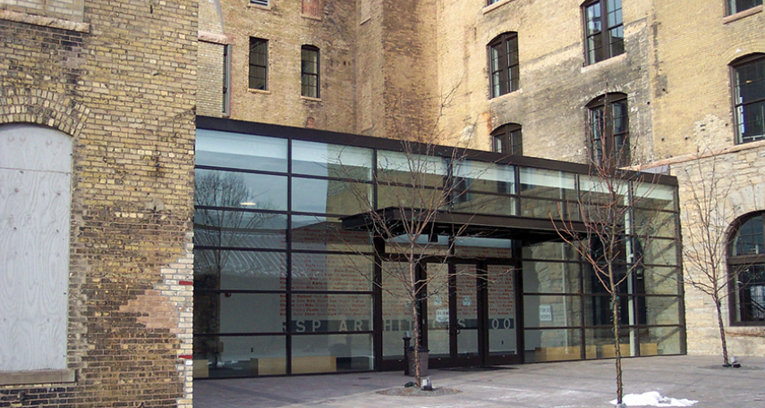
New additions and adjacent or related new construction shall be undertaken in such a manner that if removed in the future, the essential form and integrity of the historic property and its environment would be unimpaired.
10

Slide 20
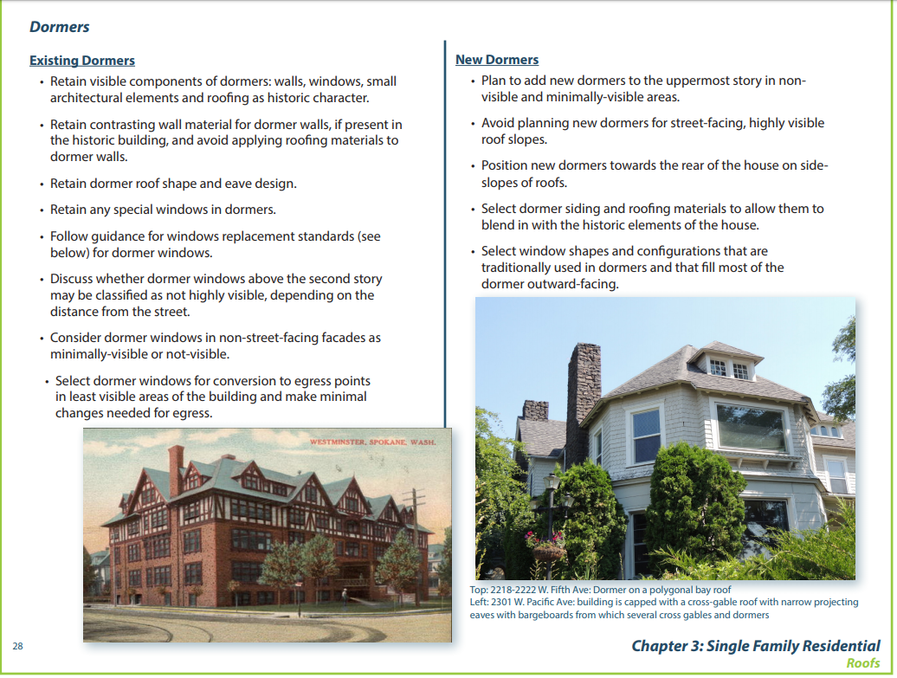
Examples of Guidelines for Browne’s

Slide 21
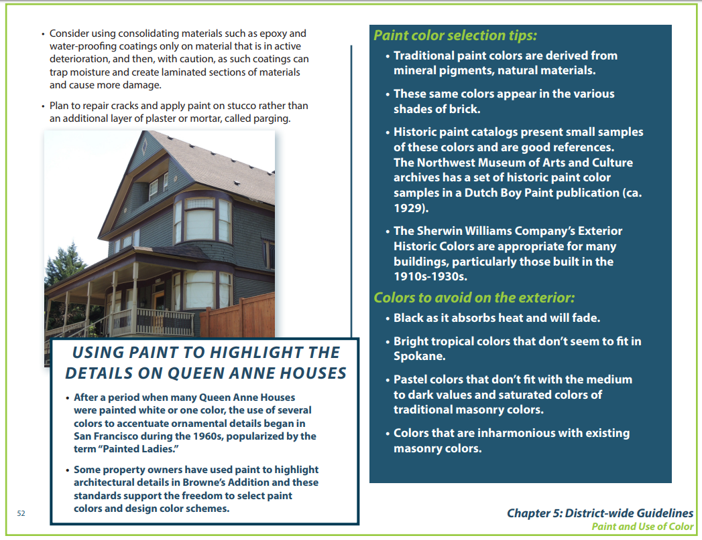
Examples of Guidelines for Browne’s

Slide 22
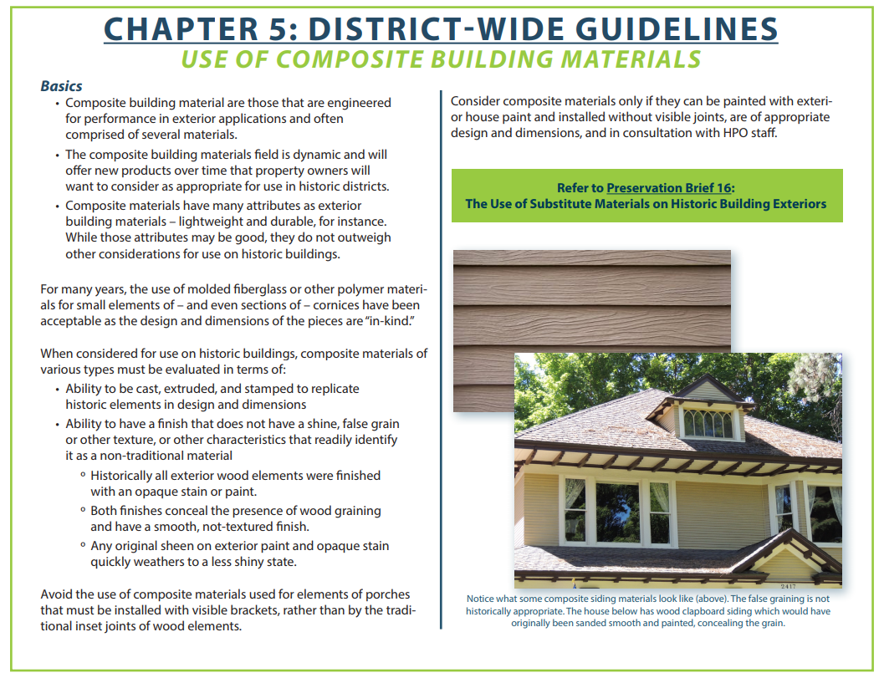
Examples of Guidelines for Browne’s

Slide 23
Flowchart for Design Review…Non-contributing
Owner Applies for Building Permit for street-facing side of building
Applicant completes a Certificate of Appropriateness application (can be done online)
HPO makes administrative decision
(admin review fee $25)
Administrative reviews can be completed within 24-48 hours
Property flagged as in Browne’s – referred to HPO

Slide 24
Flowchart for Design Review…Contributing
Owner Applies for Building Permit
Property flagged in Browne’s – referred to HPO for next step
Applicant completes online Certificate of Appropriateness Application
HPO decides if review is ADMINISTRATIVE or FULL SHLC
If full review required, public hearing scheduled on next SHLC agenda (3rd Wednesday of each month)
Administrative: Decision made and COA given within 48 hours
Staff report is submitted to the applicant and SHLC 10 days prior to meeting
Decision made at meeting, CoA approval or denial issued following day

Slide 25
Flowchart for Design Review…Appeals
Owner’s request for a CoA is denied
Appeals may be made to the Hearings Examiner within 10 days of the decision. The appeal is heard on a “closed record” of the SHLC meeting.
Hearings Examiner may either affirm the Commission’s decision or remand the matter back to the Commission for further proceedings
Decisions are appealed based on SMC 17D.100.080 and the Findings of Fact
*A negative recommendation or a non-acceptance of an application by the SHLC is not irrevocable. If new information becomes available or if the applicant wishes, the application may be resubmitted to the SHLC. In such a case, the entire procedure must begin anew.

Slide 26
Most decisions on Certificates of Appropriateness Applications are within 1-2 days of receipt of a completed application.
  2019 - 5 admin, 5 SHLC
  2018 – 10 admin, 4 SHLC
  2017 – 15 admin, 6 SHLC
  2016 - 23 admin, 7 SHLC
  2015 – 9 admin, 8 SHLC
In 4.5 years, we have completed:
  62 Administrative reviews (review takes < 48 hours)
  30 Full SHLC reviews (review generally takes < 30 days)
We have never continued a CoA application, decisions are made at the next SHLC meeting

Slide 27



New Construction:
Compatible vs Comparable
Comparable
Compatible new design is not imitative or meant to be indistinguishable from old

Slide 28
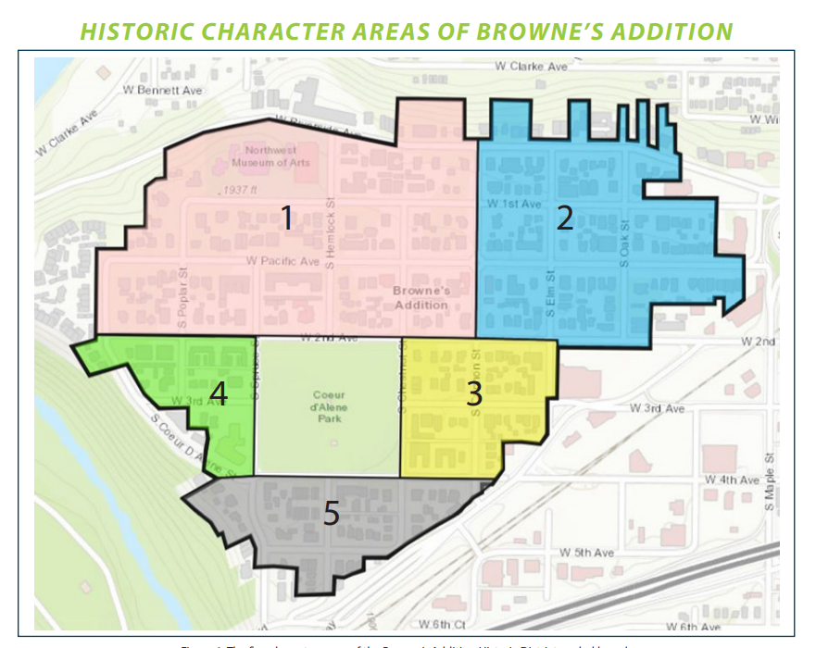
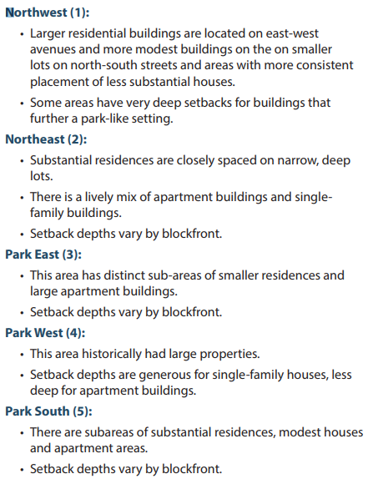

Slide 29
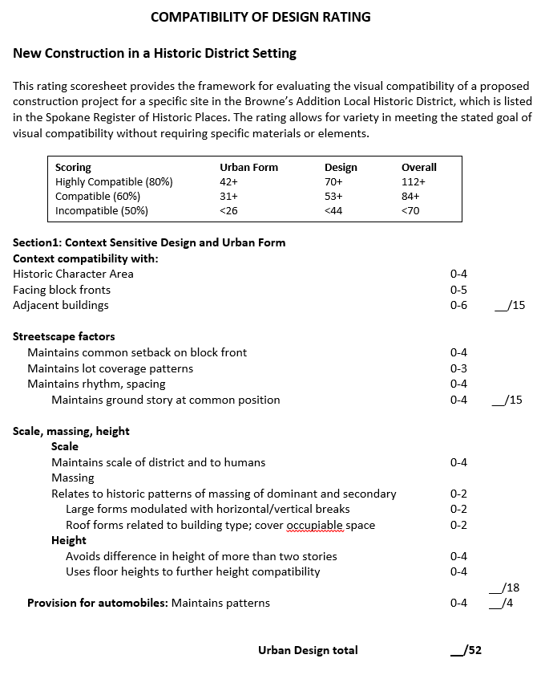
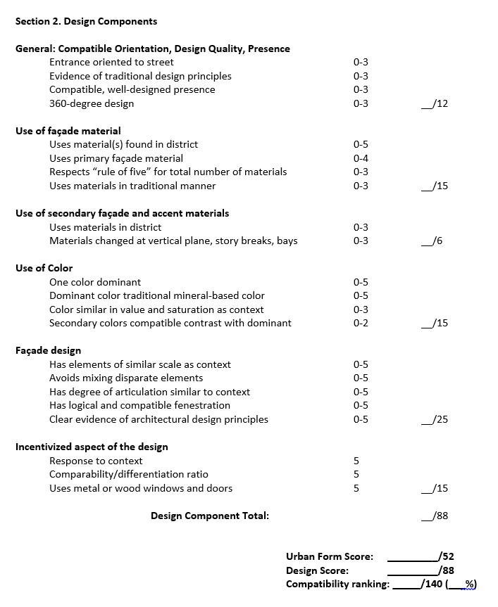

Slide 30
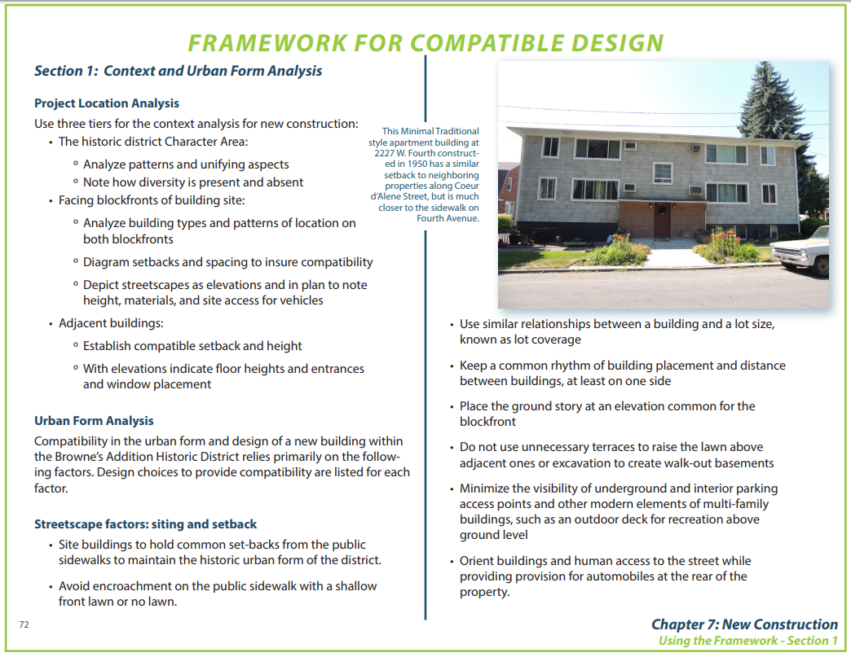
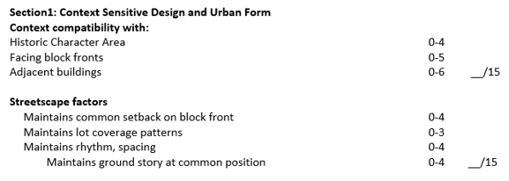
New Construction Framework for Compatibility

Slide 31
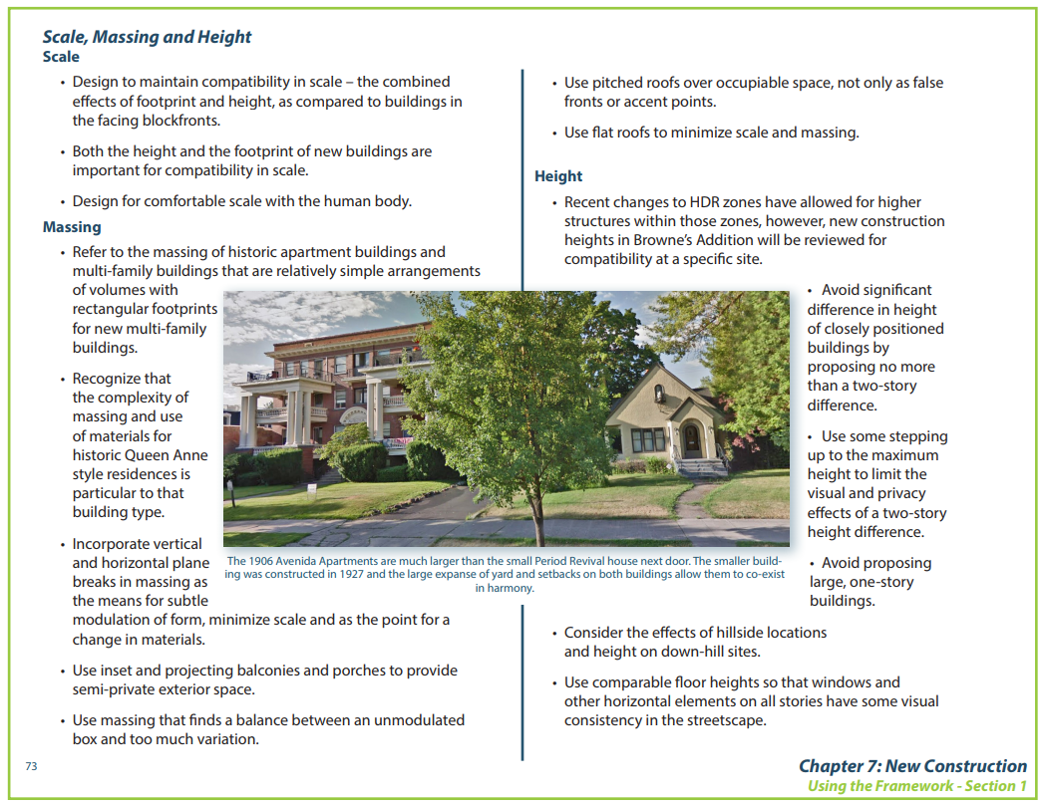
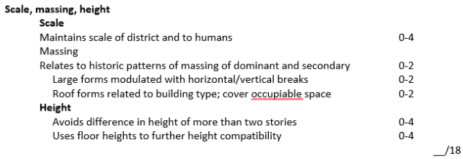
New Construction Framework for Compatibility

Slide 32
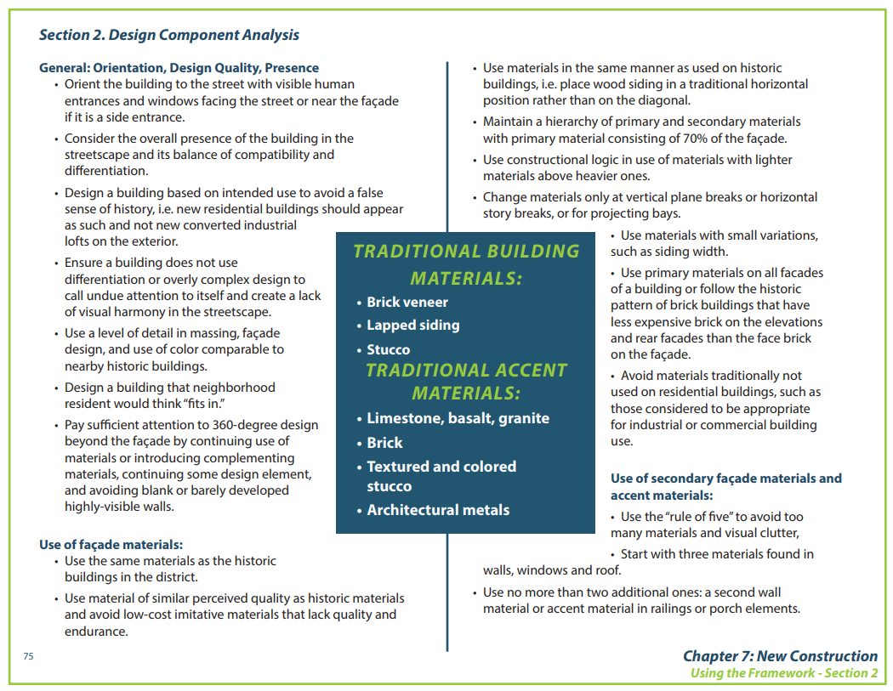
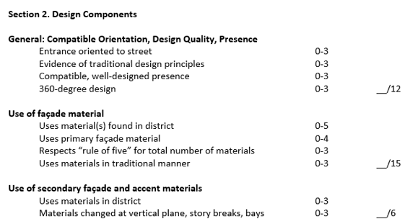
New Construction Framework for Compatibility

Slide 33
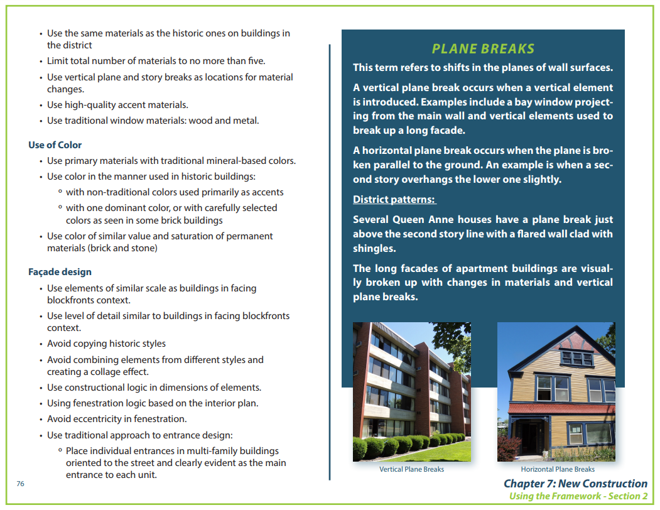
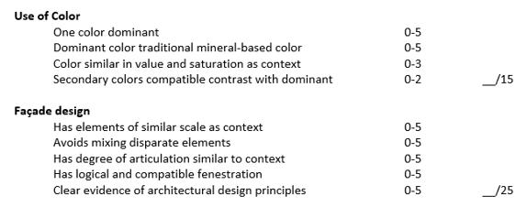
New Construction Framework for Compatibility

Slide 34
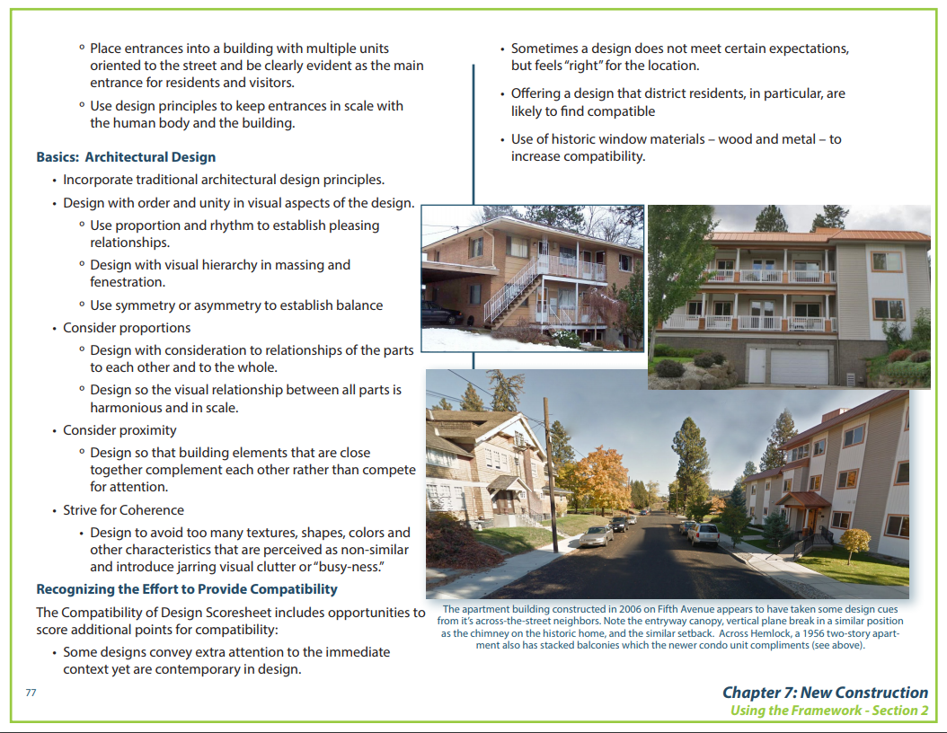
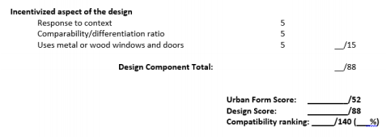
New Construction Framework for Compatibility

Slide 35
Flowchart for Design Review…New Construction
Proponent contacts HPO for preliminary plan review with Design Review Committee
Project is scored for compatibility by the DRC/staff using the “Compatibility of Design Rating” sheet
Depending upon score, a conversation can begin about the appropriateness of that design for a specific site in
the historic district
Architect may revise plans (or not) and submit for full SHLC review
Public hearing scheduled on next SHLC agenda (3rd Wednesday of each month)
Staff report is submitted to the applicant and SHLC 10 days prior to meeting
Appeal of decision same as any other CoA
Decision made at meeting, CoA approval or denial issued following day

Slide 36
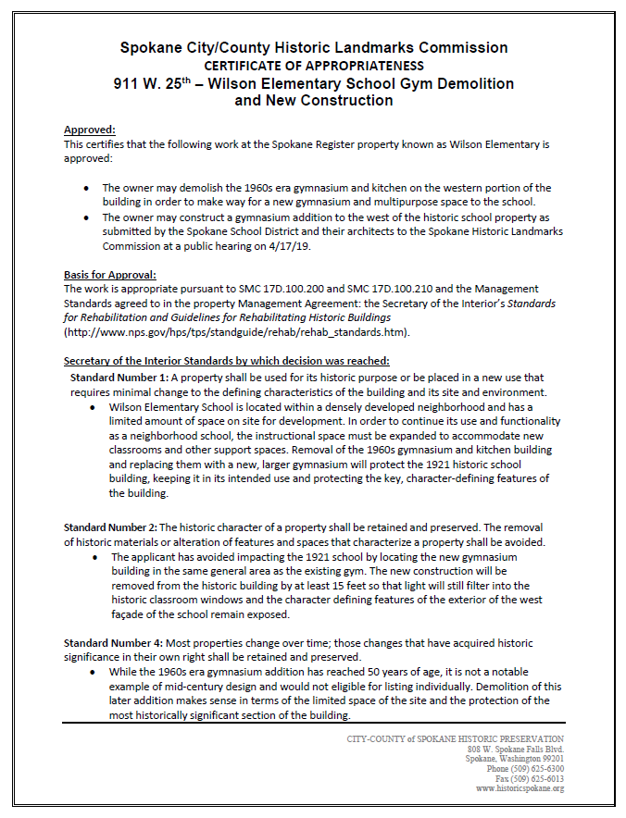
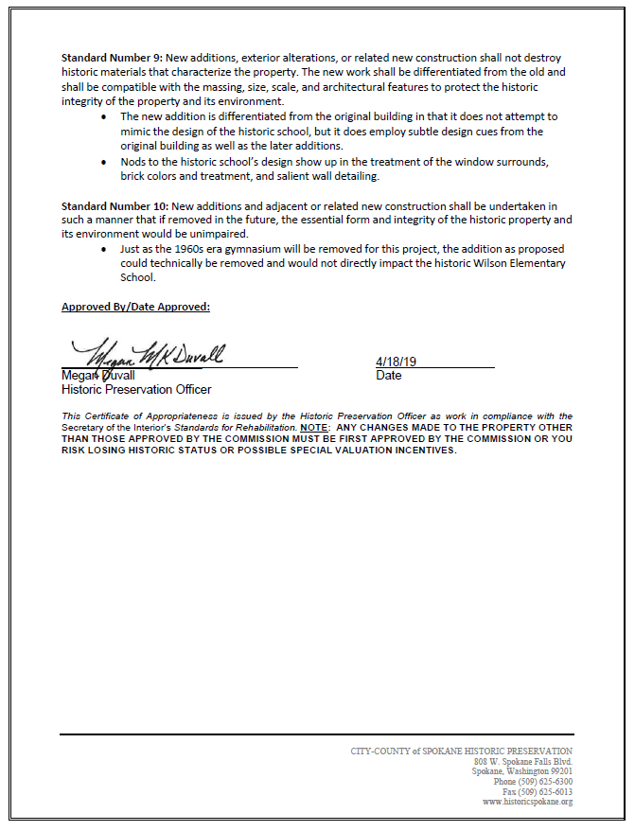

Slide 37
Creation of an historic district in Browne’s Addition is not intended to curtail development or stop new construction. The neighborhood’s underlying zoning of High Density Residential would not be changed as a result of the overlay zone. Rather, a district designation could protect housing stock that has historically been reserved for some of the lowest income residents in our community.
The neighborhood’s intention for new construction is to have review of the proposed development for compatibility with the surrounding historic resources through an open public hearing process.

Slide 38
Next Steps…
We continue to update resource forms, design standards as we receive comments from the neighborhood and/or internal stakeholders
We are on the Plan Commission agenda for a June 12 public hearing
  Landmarks Commission will review suggested changes by Plan Commission before property owner vote begins
  In order to bring the historic district overlay zone to City Council, there needs to be a 50% +1 return of ballots in the affirmative (approximately 185 “yes” ballots returned)
  Ballots not returned are considered a “no”
Final approval of the documents and recommendation to City Council will occur by the Spokane Historic Landmarks Commission
City Council will have the final action with the consideration of the Browne’s Addition Historic District Overlay Zone ordinance

Slide 39
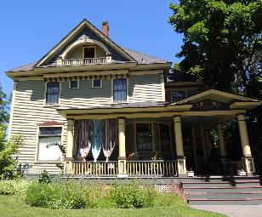
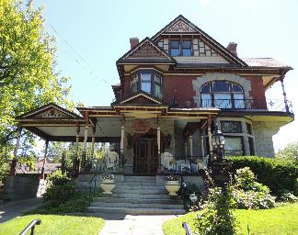
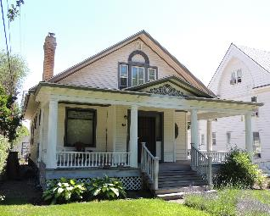
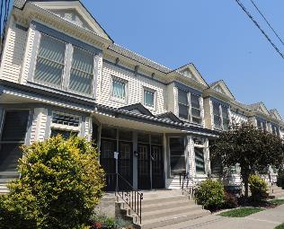
Questions?

