Slide 1
Browne’s Addition
Local Historic District Overlay Zone
Plan Commission Hearing
June 12, 2019

Slide 2
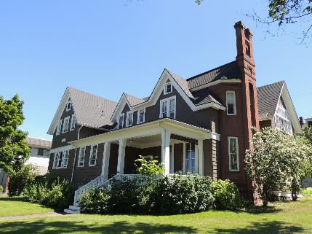
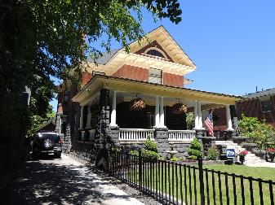
Basics of Browne’s Addition
The neighborhood has been a National Register Historic District since 1976
  The only “protection” in a NR District in Spokane is a review of demolition
  In the past, as long as there was a replacement structure, HPO had to sign off on the demolition – without design review of the replacement structure
After several demolitions in the neighborhood in 2015, the BANC asked the HPO and City Council for some additional protections for the historic neighborhood

Slide 3
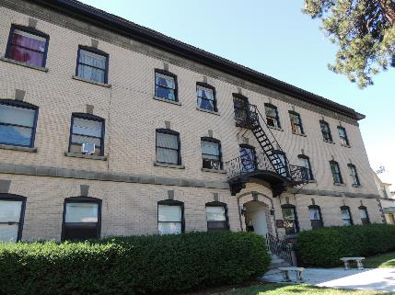
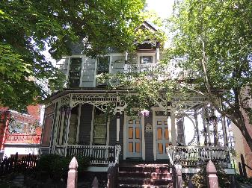
Basics of Browne’s Addition
In June 2015, Browne’s Addition Neighborhood Council (BANC) was presented with options to give them more protection/control of the changes in the neighborhood
  Neighborhood opted to have a local historic district created
A revision of SMC 17D.040 (Historic Preservation) was undertaken to allow for the creation of large-scale historic districts in Spokane (17D.100)
  CM Kinnear implemented a moratorium on demolition in Browne’s in 2016-17
  Revision passed City Council in February of 2018
Notes:
Moratorium on demolition to give time to revise the HP ordinance

Slide 4
History of Historic Preservation in BA
BANC requested the local historic district in order to:
  Give more protection to the neighborhood’s historic resources through design review of existing and new construction
  Offer incentives to “contributing properties” within the district (Special Valuation and Façade Improvement Grants, amongst others)
  Review of demolitions within Browne’s
  Maintain the historic nature of the district
In July of 2017, HPO received grant funding from the DAHP for $22,000 for the project ($17,000 from Federal pass-through, $5,000 cash match) to hire Historic Preservation Consulting firm to complete the documents. Project was completed in March of 2019 and HPO has continued to revise docs.

Slide 5
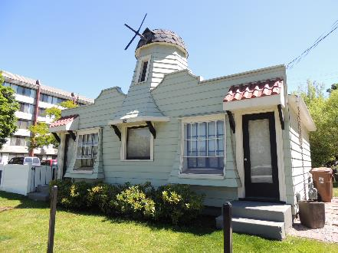
Local Historic District Basics
Made up of:
Spokane Register Nomination Document:
  Includes description of property types in the district;
  architectural styles;
  period of significance;
  boundary;
  discussion of contributing/non-contributing evaluations;
  historic context for the district;
  a statement of significance
Resource Forms - Each building within the district boundary has a separate form that details:
  architectural style
  year built
  integrity and evaluations of each property (contributing/non-contributing status)
Design Standards and Guidelines: Gives property owners and developers direction concerning existing buildings (both contributing and non-contributing); new construction; demolition and how to receive approval for a Certificate of Appropriateness. Includes a framework for scoring compatibility for new construction.

Slide 6
Local Historic District Boundaries
District boundaries were drawn to include the highest concentration of “contributing” resources – those that were built within the period of significance and retain original historic fabric – and excludes “non-contributing” resources on the edges of the district. This decision was made alongside the Historic Preservation Office and the neighborhood.
“Period of Significance” is from 1881 when Browne’s Addition was first platted to 1950 when the last single family residence was constructed (until 1992).
Notes:
The boundary of the historic district roughly echoes that of the neighborhood boundaries. However, the historic district boundaries are slightly smaller than the neighborhood boundaries (see map) in order to exclude buildings on the edge of the boundary that do not contribute to the eligibility of the district due to age or integrity.
Parcels contained within the boundaries of the historic district total 373 (made up of 291 regular and 82 condominium parcels).
The total number of parcels (buildings, condos, and/or vacant lots) that were excluded on the edges of the boundary, but are within the neighborhood council boundary, were 205 (53 regular and 152 condo parcels).
Consideration was also given to the fact that the Historic Preservation Office has one full-time employee and currently has one full-time project employee. Tying up limited administrative resources for reviews of non-contributing properties on the edges of the district does not make sense. Nor does it make sense to add additional building permit review time to non-contributing resources on the edge of the historic district.

Slide 7
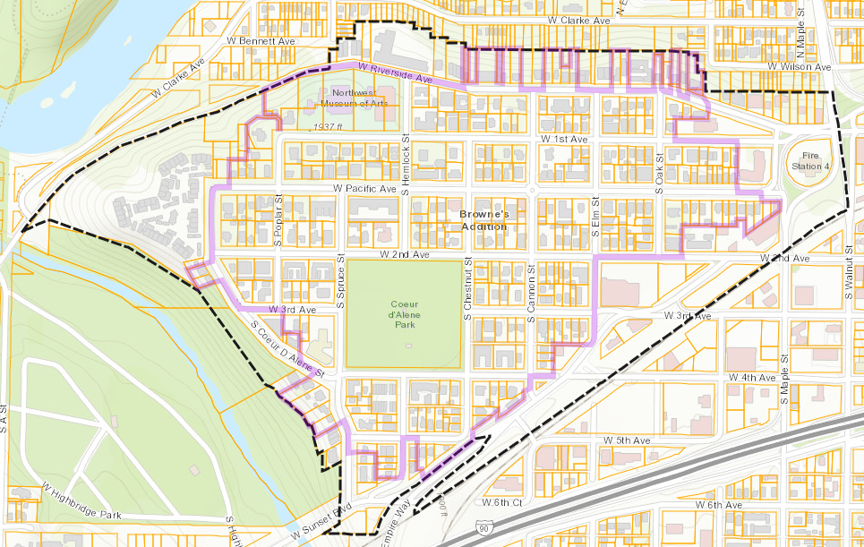
Local Historic District Boundaries
Boundaries were drawn with input from the technical professionals hired to create the district; the HPO; SHLC and neighborhood residents
Excludes “non-contributing” properties and vacant parcels on the edge
Notes:
The boundary of the historic district roughly echoes that of the neighborhood boundaries. However, the historic district boundaries are slightly smaller than the neighborhood boundaries (see map) in order to exclude buildings on the edge of the boundary that do not contribute to the eligibility of the district due to age or integrity.
Parcels contained within the boundaries of the historic district total 373 (made up of 291 regular and 82 condominium parcels).
The total number of parcels (buildings, condos, and/or vacant lots) that were excluded on the edges of the boundary, but are within the neighborhood council boundary, were 205 (53 regular and 152 condo parcels).
Consideration was also given to the fact that the Historic Preservation Office has one full-time employee and currently has one full-time project employee. Tying up limited administrative resources for reviews of non-contributing properties on the edges of the district does not make sense. Nor does it make sense to add additional building permit review time to non-contributing resources on the edge of the historic district.

Slide 8
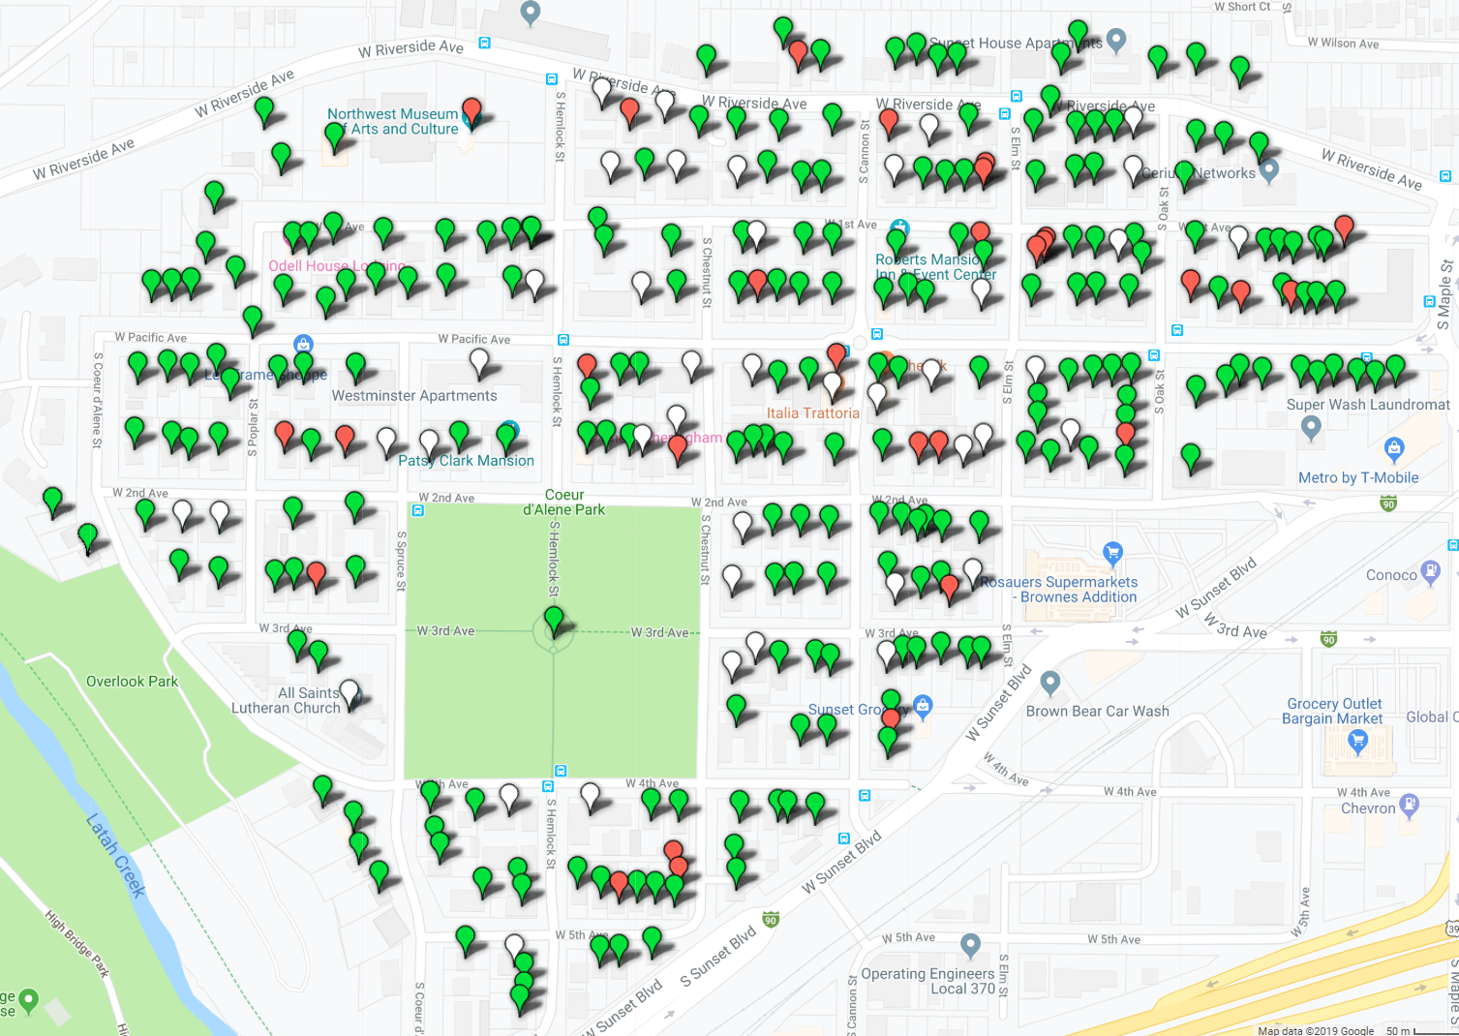
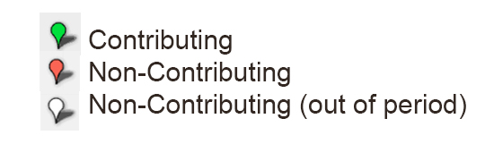
Proposing a Local Historic District in BA
Map shows “contributing” and “non-contributing” designations within the district
Notes:
Parcels contained within the boundaries of the historic district total 375 (made up of 293 regular and 82 condominium parcels).
The total number of parcels (buildings, condos, and/or vacant lots) that were excluded on the edges of the boundary, but are within the neighborhood council boundary, were 203 (51 regular and 152 condo parcels).

Slide 9
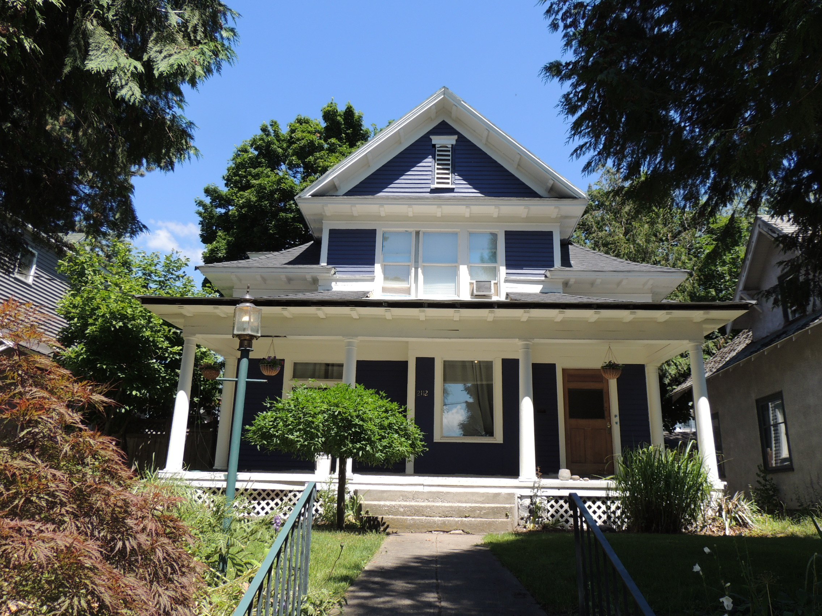
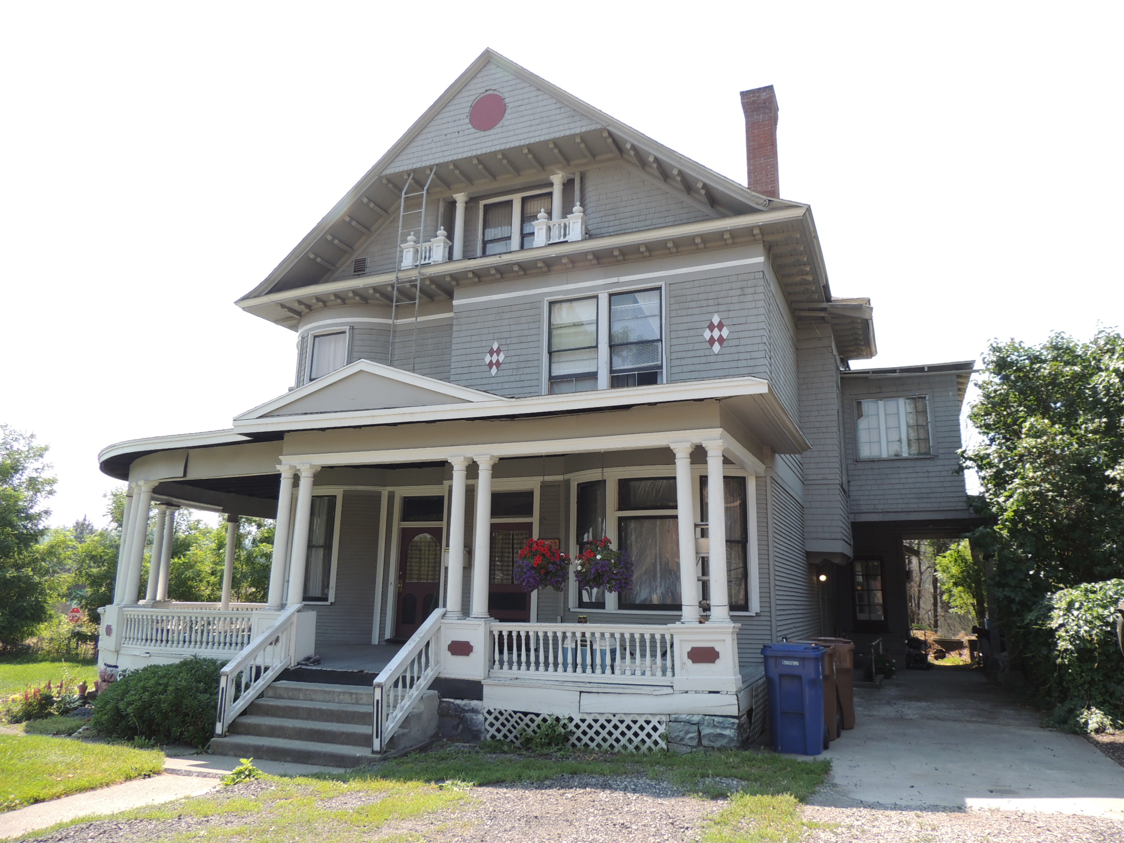
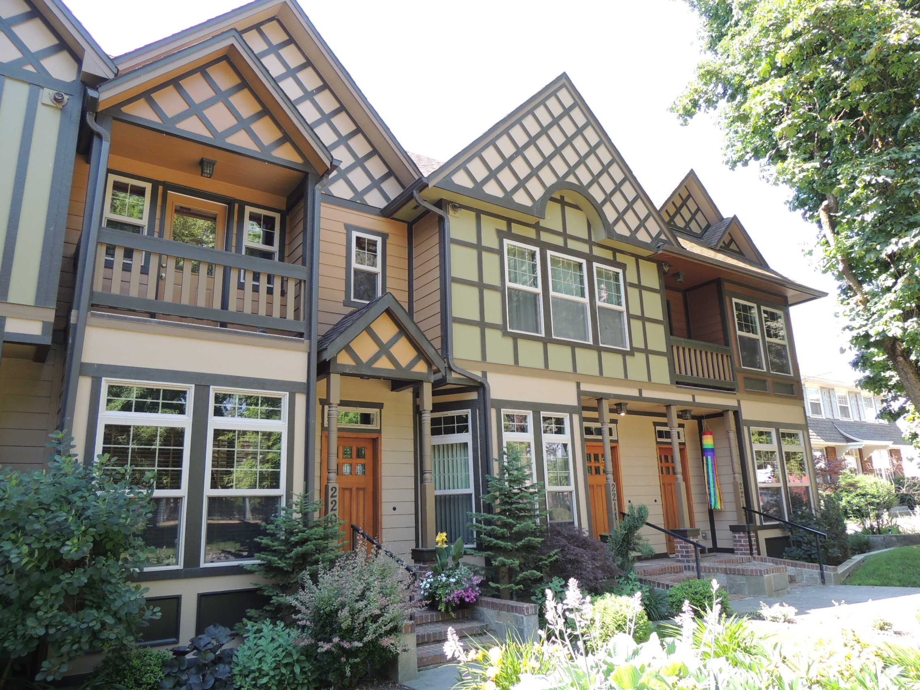
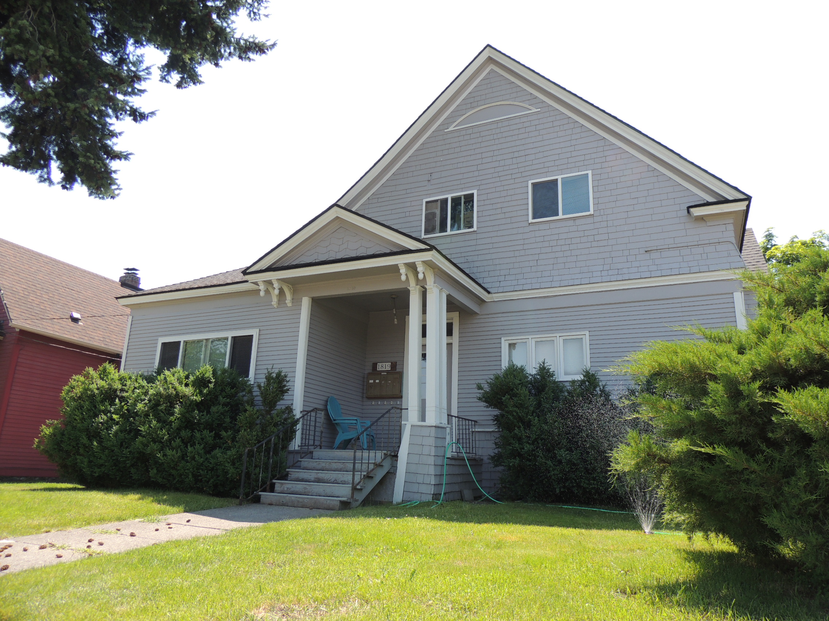
Contributing vs. Non-contributing
Contributing properties (76% of properties – 230 properties)
Non-contributing properties (24% of properties – 73 properties)
  29 are non-contributing due to changes over time
  44 are non-contributing based on age of construction (after 1950)

Slide 10
Process for Creation of the District
Ballots will be mailed on June 20th to property owners
60-day period for ballots to be returned (August 20)
Sign will be hung in district at least 30 days prior to SHLC Meeting of August 21 (will probably be up longer than that)
50% +1 of the property owners must return their ballots in the affirmative in order for the district overlay to move to City Council for final vote
Not returning a ballot counts as a “no” vote

Slide 11
Once a district is formed:
All contributing properties are eligible for Special Tax Valuation – a property tax incentive for ‘significantly’ improved historic properties
Building permits for exterior changes to properties within the boundaries of the district require a Certificate of Appropriateness
  Most CoAs can be done administratively by the Historic Preservation Office
  Some permits must go before the whole SHLC
Demolition permits of contributing buildings need a CoA
New construction within the historic district requires SHLC review

Slide 12
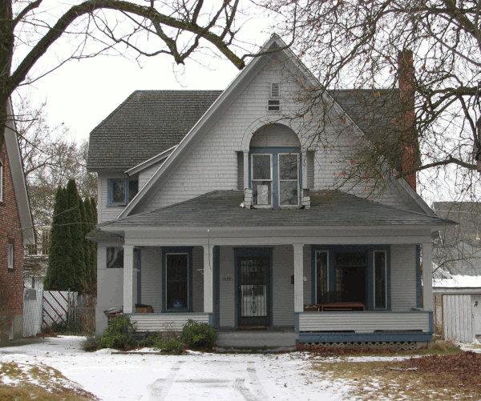
Special Tax Valuation
State passed enabling legislation in the late 1980s
City/County Governments pass it locally
In Spokane, only properties individually listed on the Spokane Register or ‘contributing’ in a local register historic district are eligible
“Substantial” rehabilitation = 25% of Assessed Value of building alone in a 24 month period
Eligible costs are reduced from Assessed Value for 10 years
Can be phased as long as investment reaches 25% again
EXAMPLE:
Assessed Value: $250,000 building $80,000 land $330,000 Total Value - Taxes = $3761
Receives Special Valuation of $200,000 for new roof, paint, new kitchen & bathrooms, floor refinishing, porch repair, lighting, electrical, new furnace….
Assessed Value: $300,000 building $85,000 land $385,000 total value Taxes = $4388
Remove $200,000 SPECIAL VALUATION $185,000 TAXABLE value Taxes = $2108

Slide 13
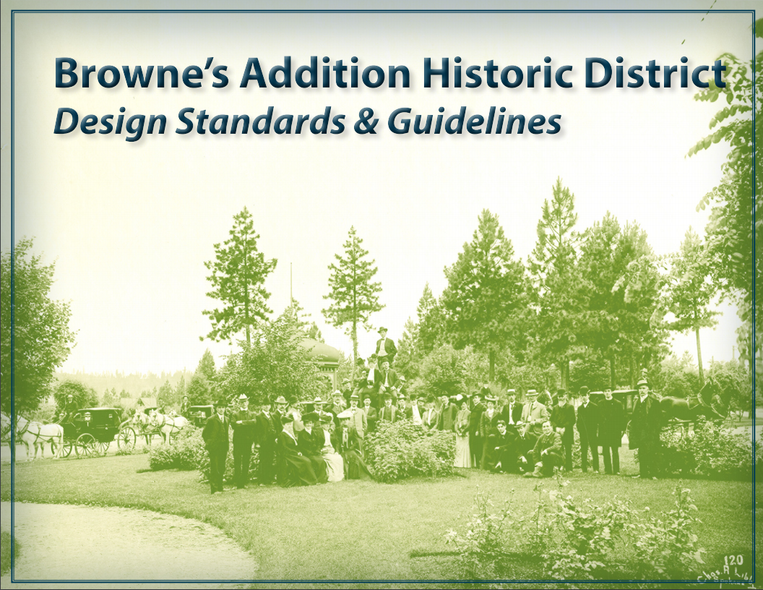
Browne’s Addition Design Standards & Guidelines
Notes:
How do we determine if a project should receive a CoA? Someone comes in for a building permit, if they are in the Brownes addition boundaries, permit tech directs them to HPO for next step. Most work can be reviewed administratively, but larger projects will go in front of the entire Landmarks Commission. All processes, guidance and standards are spelled out in the Browne’s Addition Historic District Design Standards and Guidelines.

Slide 14
Browne’s Addition Design Standards & Guidelines
The Secretary of the Interior’s Standards for Rehabilitating Historic Buildings was published in 1983.
The Secretary of the Interior's Standards for the Treatment of Historic Properties, in particular the Standards for Rehabilitation, are intended as general guidance for work on all historic properties and are widely used and have been adopted at the Federal, State and local levels.
The Standards have been added to the code in SMC 17D.100.100 E and listed in 17D.100.280 D (Browne’s Addition Historic District Overlay Section).

Slide 15
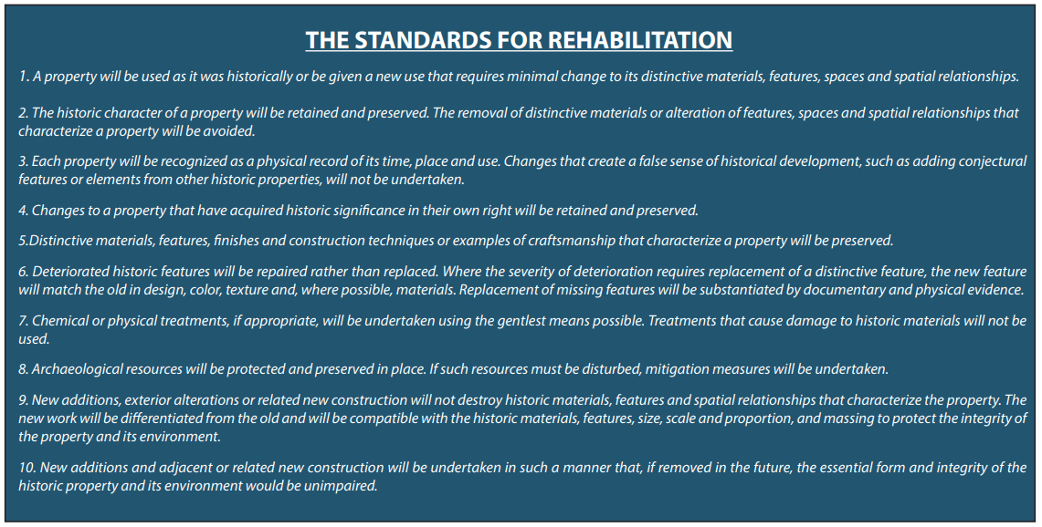

Slide 16
Secretary of the Interior’s Standards for Rehabilitation constitute the “standards” in this document, while the additional guidance represents the “guidelines” for decision making both by property owners when undertaking how to complete work within the district and the HPO and SHLC when issuing COAs in the district.
The Browne’s Addition Historic District Standards & Guidelines document expands and customizes these more general standards. The guidelines are the basis for evaluating applications for COAs, and assist applicants in understanding the Commission’s decision-making process.

Slide 17
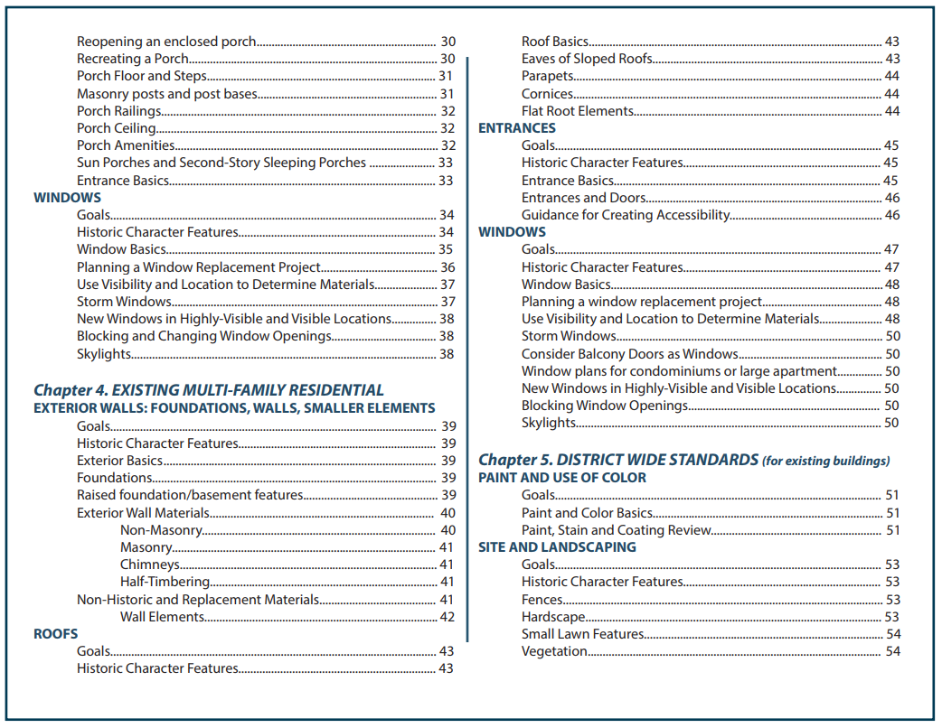
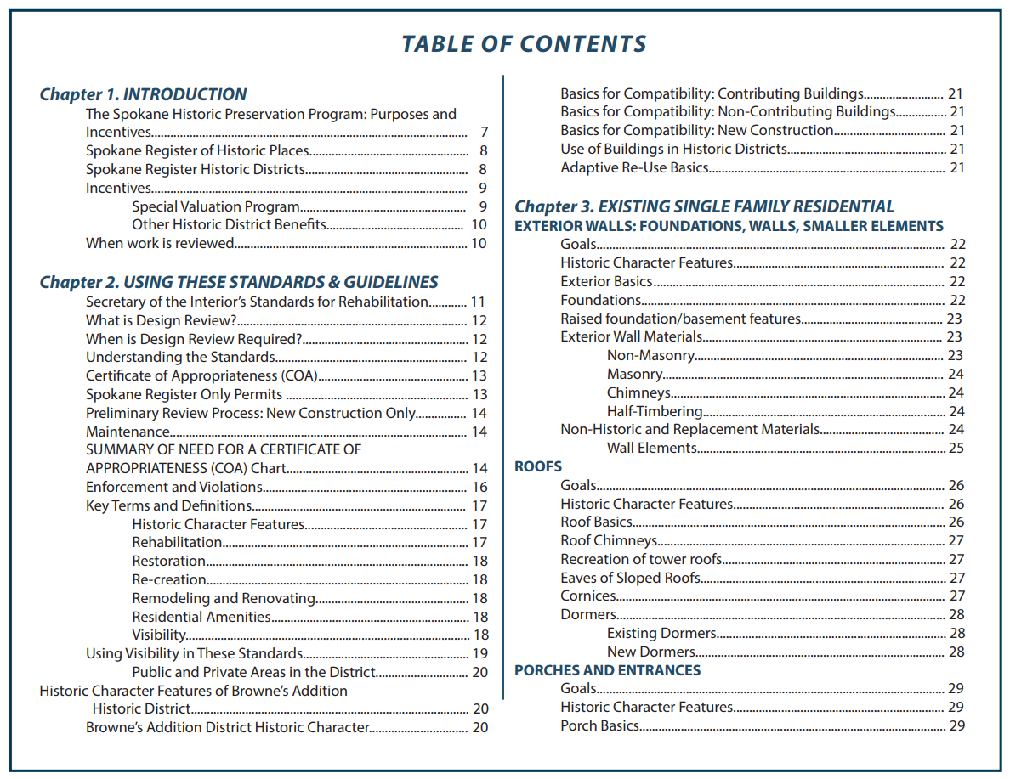
Standards & Guidelines
Notes:
How the Standards and Guidelines are arranged – by Existing Single Family and Multi family, District wide guidelines, and New Construction and demolition. Break down each resource type by different kinds of work that might be done.

Slide 18
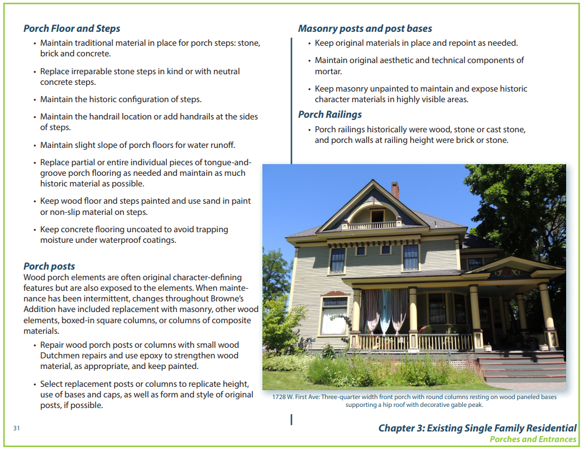
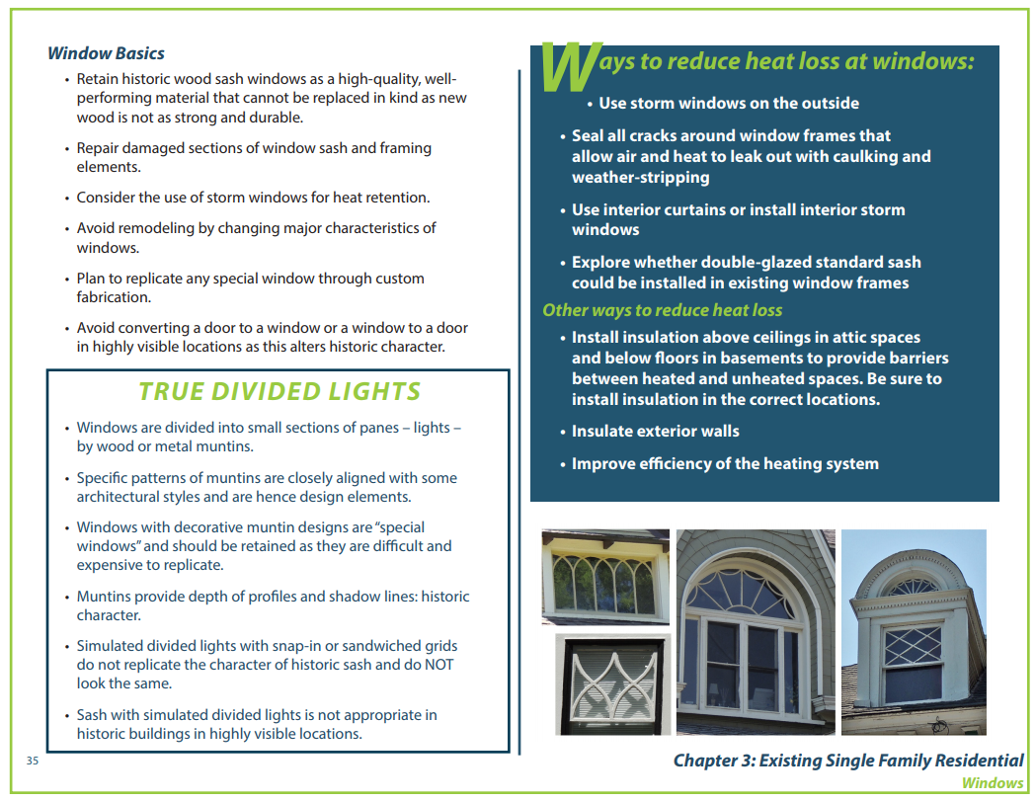
Notes:
Examples of guidelines within the Single Family Residential chapter – porches and windows. Attempts to educate on different important character defining features, gives hints about things like energy efficiency, and then gives guidance when changes or repairs are sought.

Slide 19
Spokane Historic Landmarks Commission
Spokane Historic Landmarks Commission:
Section 04.35.010 Findings and Purpose
Findings.
The City and Spokane County find that the establishment of a landmarks commission with specific duties to recognize, protect, enhance and preserve those buildings, districts, objects, sites and structures which serve as visible reminders of the historical, archaeological, architectural, educational and cultural heritage of the City and County is a public necessity.
Purpose.
Initiate and maintain the Spokane register of historic places to encourage efforts by owners to maintain, rehabilitate and preserve properties. This official register compiles buildings, districts, objects, sites and structures identified by the commission as having historic significance worthy of recognition by the council or board.
Notes:
Who will be doing these reviews? Many administrative, but more extensive projects require review by the Spokane Historic Landmarks Commission as a whole. They were established through the Spokane Municipal Code in the early 1980s and their job is to recognize, protect, enhance and preserve those buildings, districts, objects, sites and structures that are important to the history of Spokane. They “protect” buildings through design review when changes are proposed through the building permit process.

Slide 20
Spokane Historic Landmarks Commission
Review proposals (as provided in SMC 17D.100.200) to construct, change, alter, modify, remodel, move, demolish and significantly affect properties or districts on the register.
In making a decision on an application, the commission uses the Secretary of the Interior’s Standards for Rehabilitation, historic district design standards and other general guidelines established and adopted by the commission. In adopting and using standards, the commission does not limit new construction to any one architectural style but seeks to preserve the character and integrity of the landmark or the historic district through contemporary compatible designs.

Slide 21
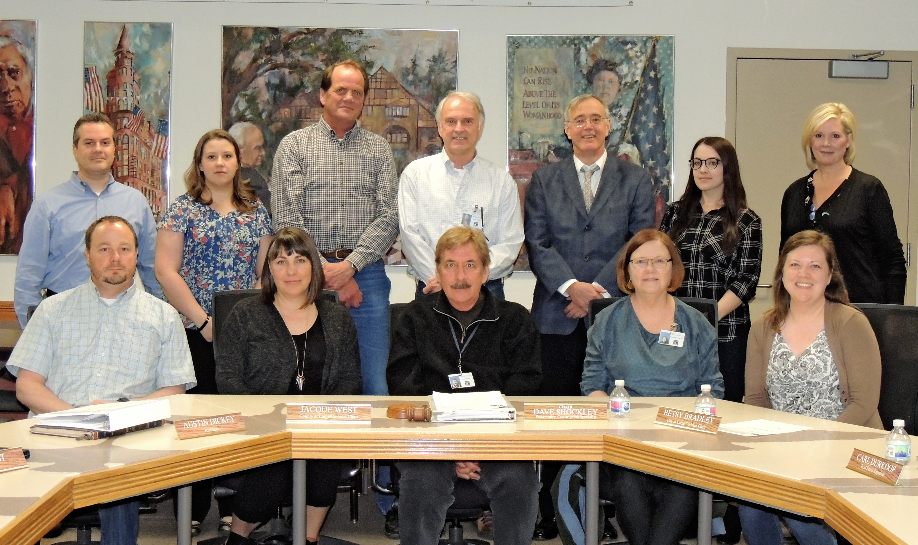
Spokane Historic Landmarks Commission
11 members strong made up of professionals and engaged citizens
Historians (2)
Archaeologist (1)
Appraiser (1)
Architects (2)
Construction Specialist (1)
City-at-Large (2)
County-at-Large (2)
Staff

Slide 22
Process for the creation of the district
Public Outreach/Internal Process:
June 3, 2015 – Initial BANC Meeting
October 24, 2016 – BANC Committee for Local District meeting
November 2, 2016 – Browne’s Addition Local District strategy meeting (Neighborhood Services/HP staff)
November 14, 2016 - BANC Committee for Local District meeting
November 30, 2016 -HPO published Browne’s Addition Historic District website
November 28, 2016 - BANC Committee for Local District meeting
December 7, 2016 - BANC Holiday Gathering, Brief update and discussion
April 2017 - Applied for DAHP Federal Pass-through funding for district project
June 2017 - Notice of receipt of grant – Project could not begin until October 1, 2017
February 2018 - Historic Preservation Ordinance Update passes City Council
February 2018 - RFP for district project advertised
March 2018 - Borth Preservation Consultant, LLC Hired for district nomination, resource forms, and design standards and guidelines document
May 10, 2018 - Browne’s Addition meetings/tour/kick-off with consultants and volunteers
June 7, 2018 - BANC Meeting Presentation to Neighborhood
July 24, 2018 - Browne’s Addition – training to volunteers for brochure distribution

Slide 23
Process for the creation of the district
Public Outreach/Internal Process:
August 8, 2018 - Consultant meets with BANC volunteers
August 29, 2018 - #1 Spokane Historic Landmarks Commission committee meeting on Design Standards
September 13, 2018 -BANC Meeting Presentation
October 3, 2018 - #2 Spokane Historic Landmarks Commission committee meeting on Design Standards
October 3, 2018 - Press Release on upcoming workshops/Browne’s progress
October 5, 2018 - Mailing sent to all property owners within the district boundaries
October 10, 2018 - Internal district adoption process – Planning, Legal & HP
October 12, 2018 - Local media interview with HPO on Browne’s Addition project
October 15, 2018 - Draft documents submitted to HPO
October 18, 2018 - #1 Browne’s Addition Workshop – Compatible New Construction in Browne’s
November 7, 2018 - #2 Browne’s Addition Workshop – Frequently Asked Questions
December 13, 2018- BANC Neighborhood Holiday Gathering – Update
February 18, 2019 - Final draft documents received from Consultant
March 1, 2019 - Draft documents added to Browne’s webpage on HPO website
March 14, 2019 - Postcard mailing to all property owners announcing availability of docs, workshop
March 20, 2019 - SHLC Preliminary Approval for Browne’s Addition documents
March 27, 2019 - #3 Browne’s Addition Workshop – Overview of Completed Documents/Discussion

Slide 24
Process for the creation of the district
Public Outreach/Internal Process:
March 29, 2019 - Survey to BANC for specific Design Standards and Guidelines questions
April 8, 2019 - Urban Experience City Council Committee update on BA District
April 24, 2019 - Plan Commission Workshop #1
May 8, 2019 - Plan Commission Workshop #2
May 16, 2019 - BANC Meeting – Process Update
May 21, 2019 - Submittal to Commerce of 60-day Notice to Adopt
May 22, 2019 - Plan Commission Workshop #3
May 28, 2019 - SEPA Non-project Determination of Non-significance
May 29, 2019 - Plan Commission Hearing Notice mailed to all residents, tax payers and property owners in Browne’s Addition
June 12, 2019 - Plan Commission Hearing
June 19, 2019 - SHLC Hearing
June 20, 2019 - Ballots to be mailed to all property owners in district for vote
Meetings with Planners, Legal and Current Planning: 4/11/19; 4/18/19; 5/2/19; 5/16/18; 5/31/18

Slide 25
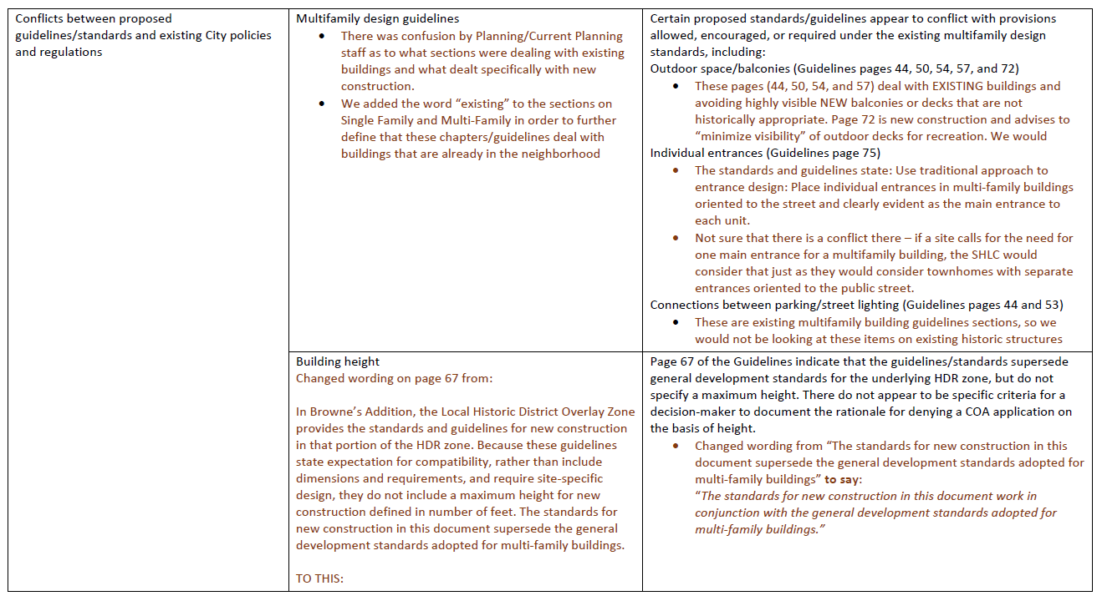
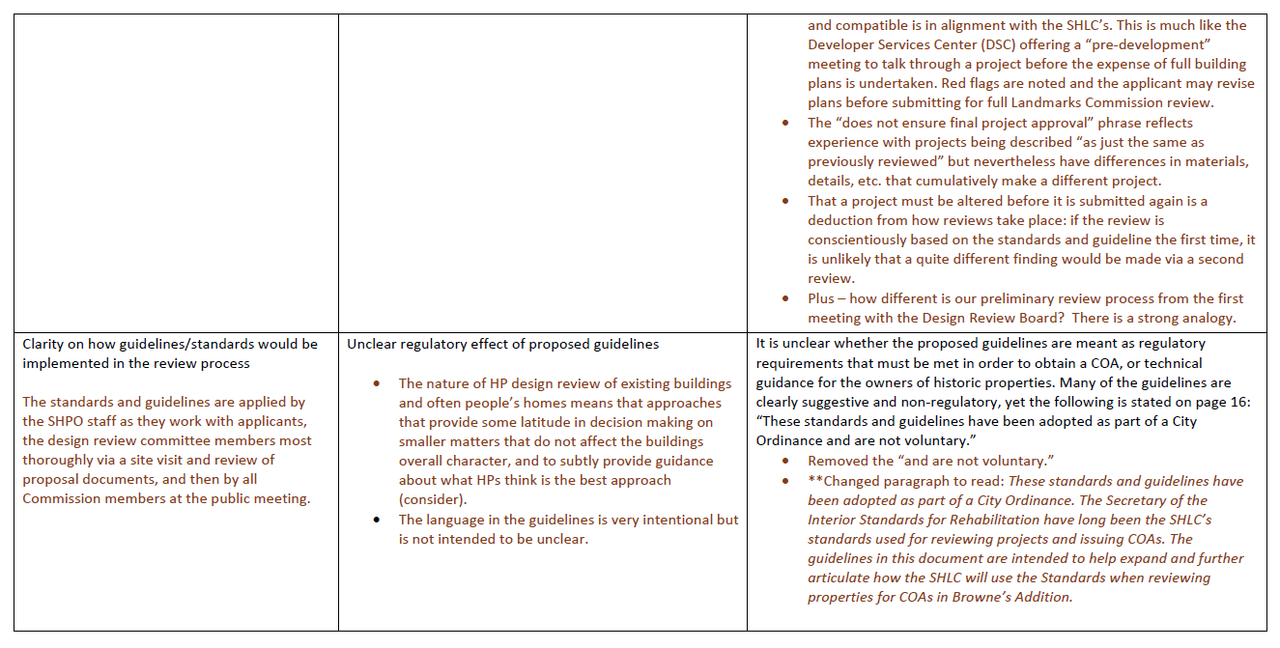
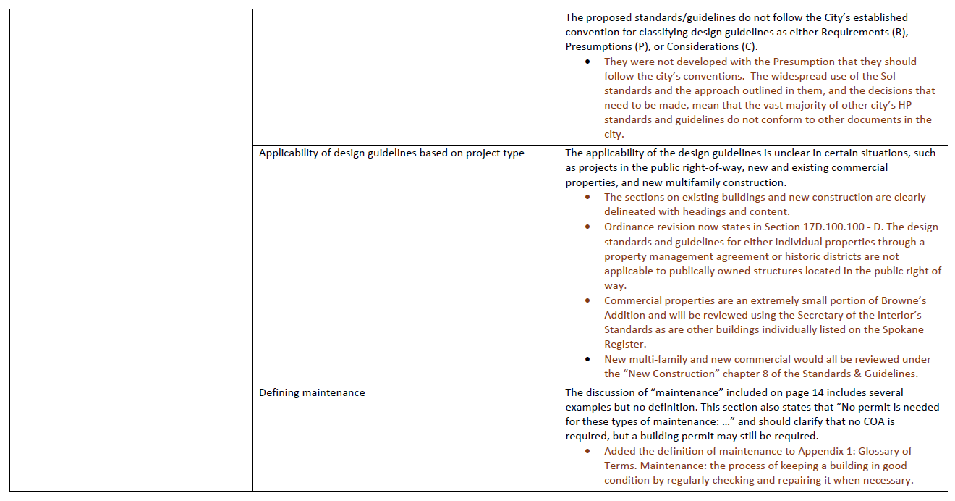
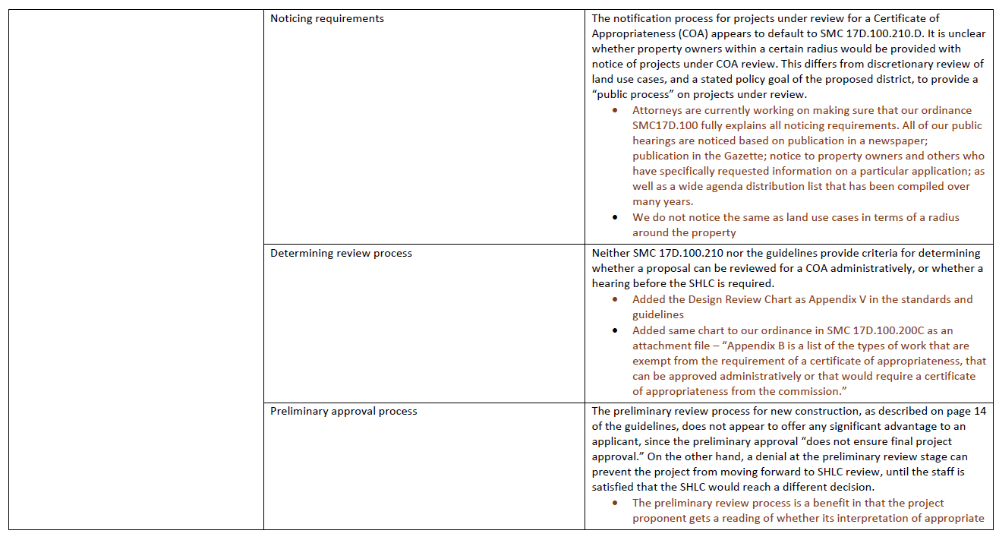
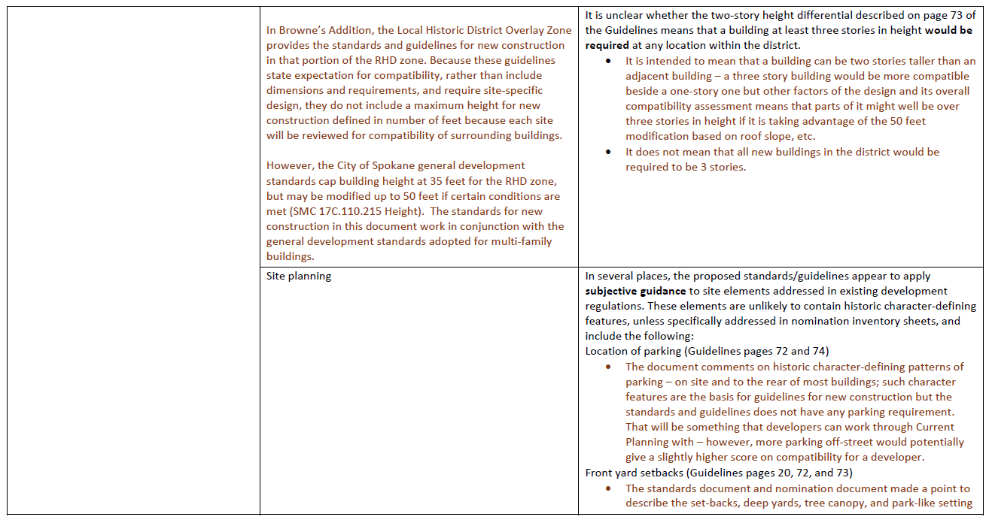
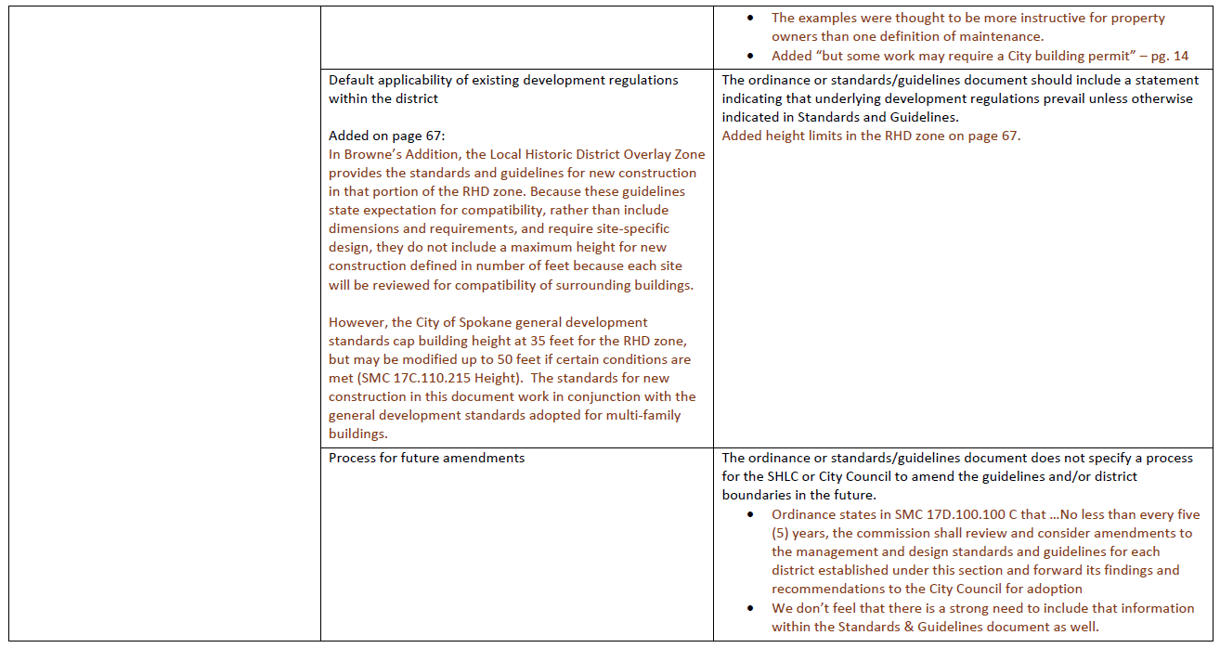
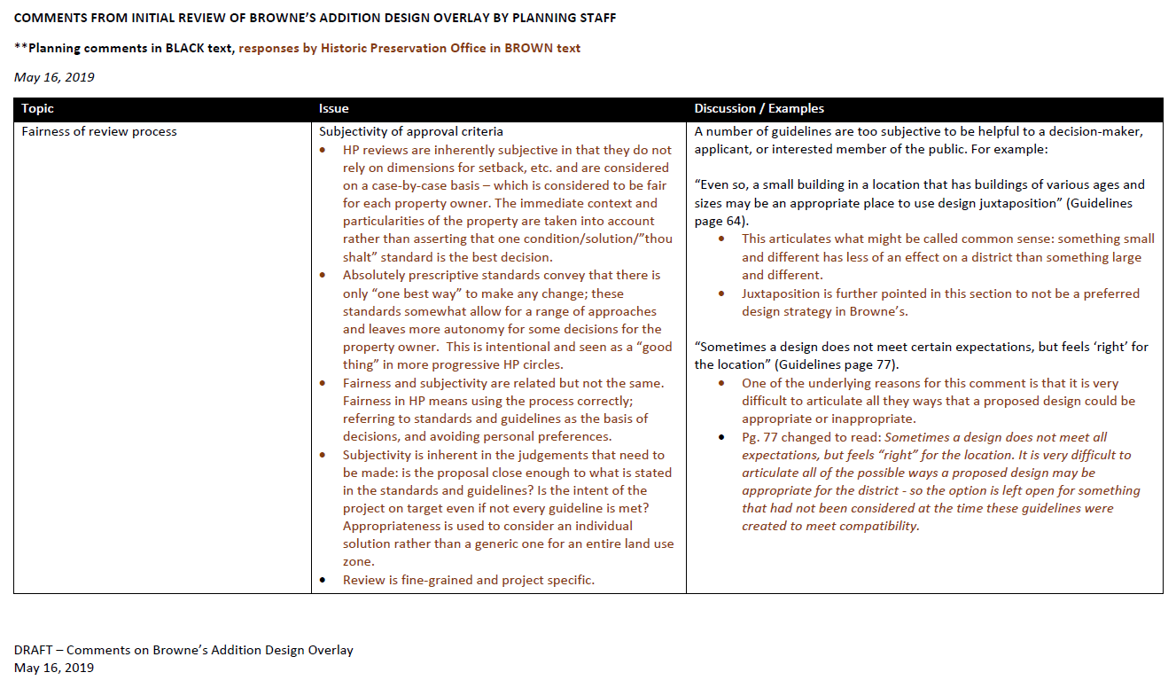

Slide 26
Ordinance Changes: SMC 17D.100
Housekeeping changes to the existing Historic Preservation Ordinance concerning noticing requirements to bring them into alignment with other City noticing requirements
Adds SMC 17D.100.280 which is the actual Browne’s Addition Historic District Overlay Zone ordinance and includes the Standards and Guidelines as “Appendix A”
Codifies the Secretary of the Interior Standards as the rehabilitation standards used by the SHLC and HPO for Certificates of Appropriateness
Added neighborhood council notification for CoA reviews
Added 14-day turnaround for Administrative reviews of CoAs
Added section that gives vesting to a project when it comes in for a CoA

Slide 27
Ordinance Changes: SMC 17D.100
Specifies the Hearings Examiner appeal process for actions of the SHLC
Adds the requirement for a CoA under SMC 17G.060.070 for building permits (when buildings are listed on the Spokane Register or within an historic district)
Adds SMC 17D.100.330 to allow City Council to find that CoA applications should be exempted from state law requiring all permits to be reviewed under one action.
Clarified what types of work are exempted from a CoA (ordinary repair and maintenance, etc.)
Gives preference to design review by the SHLC over the underlying zoning when a conflict between development standards and historic standards arises – those conflicts are to be noted as exemptions in the CoA approval document

Slide 28
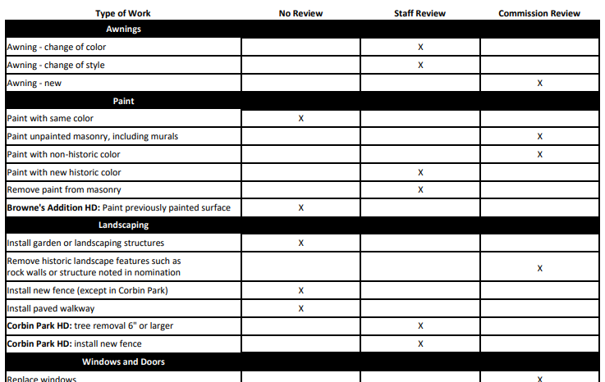
Ordinance Changes: SMC 17D.100
Adds Table 17D.100-1 which details types of work and the subsequent review required:

Slide 29
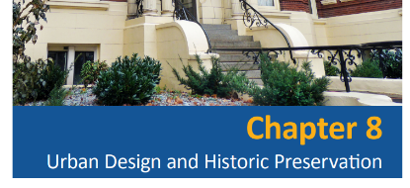
Implementing the Comprehensive Plan
Comprehensive Plan Chapter 8: Urban Design and Historic Preservation
DP 1.1: Landmark Structures, Buildings, and Sites
  Recognize and preserve unique or outstanding landmark structures, buildings, and sites.
DP 1.2: New Development in Established Neighborhoods
  Encourage new development that is of a type, scale, orientation, and design that maintains or improves the character, aesthetic quality, and livability of the neighborhood.
DP 2.7: Historic District and Sub-Area Design Guidelines
  Utilize design guidelines and criteria for sub-areas and historic districts that are based on local community participation and the particular character and development issues of each sub-area or historic district.
Notes:
Finally, it’s important to note that Chapter 8 of the City of Spokane’s Comprehensive Plan concerns Urban Design and Historic Preservation. These

Slide 30
Implementing the Comprehensive Plan
DP 3.10 Zoning Provisions and Building Regulations
Utilize zoning provisions, building regulations, and design standards that are appropriate for historic districts, sites, and structures.
DP 3.13 Historic Districts and Neighborhoods
Assist neighborhoods and other potential historic districts to identify, recognize, and highlight their social and economic origins and promote the preservation of their historic heritage, cultural resources, and built environment.

Slide 31
Plan Commission Action
We are seeking a recommendation by the Plan Commission for the passage by City Council of:
The Browne’s Addition Historic District Overlay Zone (SMC 17D.100.280) which includes the appendix of the Browne’s Addition Design Standards and Guidelines
Changes/additions/edits to the Historic Preservation Ordinance (SMC 17D.100) as shown in the track changes document

Slide 32
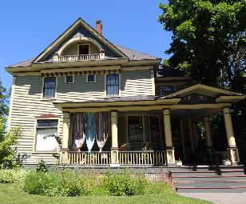
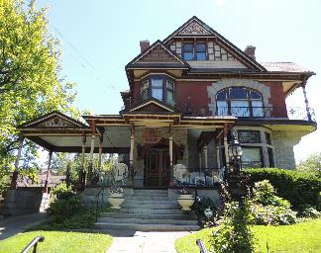
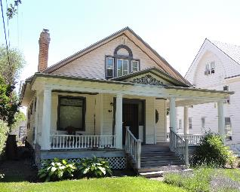
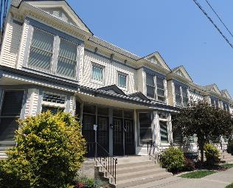
Questions?

