Slide 1
Browne’s Addition Local Historic District Plan Commission Workshop #1
April 24, 2019

Slide 2
SPOKANE HISTORIC LANDMARKS COMMISSION
Spokane Historic Landmarks Commission:
Section 04.35.010 Findings and Purpose Findings. The City and Spokane County find that the establishment of a landmarks commission with specific duties to recognize, protect, enhance and preserve those buildings, districts, objects, sites and structures which serve as visible reminders of the historical, archaeological, architectural, educational and cultural heritage of the City and County is a public necessity.
Purpose.
Initiate and maintain the Spokane register of historic places to encourage efforts by owners to maintain, rehabilitate and preserve properties. This official register compiles buildings, districts, objects, sites and structures identified by the commission as having historic significance worthy of recognition by the council or board

Slide 3
SPOKANE HISTORIC LANDMARKS COMMISSION
Review proposals (as provided in SMC 17D.100.200) to construct, change, alter, modify, remodel, move, demolish and significantly affect properties or districts on the register.
In making a decision on an application, the commission uses the Secretary of the Interior’s Standards for Rehabilitation, historic district design standards and other general guidelines established and adopted by the commission. In adopting and using standards, the commission does not limit new construction to any one architectural style but seeks to preserve the character and integrity of the landmark or the historic district through contemporary compatible designs.

Slide 4
IMPLEMENTING THE COMPREHENSIVE PLAN
Comprehensive Plan Chapter 8: Urban Design and Historic Preservation
DP 1.1: Landmark Structures, Buildings, and Sites
Recognize and preserve unique or outstanding landmark structures, buildings, and sites.
DP 1.2: New Development in Established Neighborhoods
Encourage new development that is of a type, scale, orientation, and design that maintains or improves the character, aesthetic quality, and livability of the neighborhood.
DP 2.7: Historic District and Sub-Area Design Guidelines
Utilize design guidelines and criteria for sub-areas and historic districts that are based on local community participation and the particular character and development issues of each sub-area or historic district.

Slide 5
IMPLEMENTING THE COMPREHENSIVE PLAN
DP 3.10 Zoning Provisions and Building Regulations
Utilize zoning provisions, building regulations, and design standards that are appropriate for historic districts, sites, and structures.
Discussion: Regulations are tools that can and should be used to promote preservation and renovation rather than demolition. Examples include retaining favorable zoning options (Historic Conditional Use Permits and Historic District Overlay Zones), and encouraging the use of form based codes and special building codes like the historic building sections of the International Building Code (IBC) and International Existing Building Code.
DP 3.13 Historic Districts and Neighborhoods
Assist neighborhoods and other potential historic districts to identify, recognize, and highlight their social and economic origins and promote the preservation of their historic heritage, cultural resources, and built environment.

Slide 6
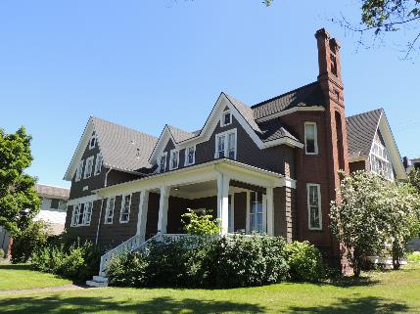
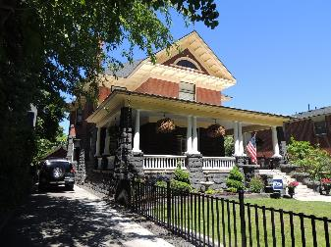
Basics of Browne’s Addition
The neighborhood has been a National Register Historic District since 1976
The only “protection” in a NR District in Spokane is a review of demolition
In the past, as long as there was a replacement structure, HPO had to sign off on the demolition – without design review of the replacement structure
After several demolitions in the neighborhood in 2015, the BANC asked the HPO and City Council for some additional protections for the historic neighborhood

Slide 7
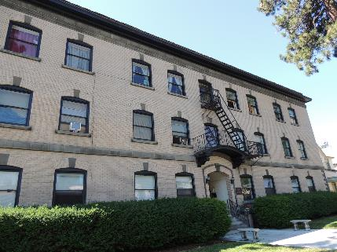
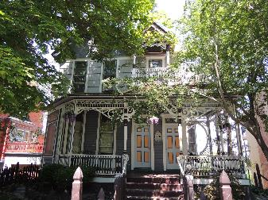
Basics of Browne’s Addition
In June 2015, Browne’s Addition Neighborhood Council (BANC) was presented with options to give them more protection/control of the changes in the neighborhood:
Options included an overlay zone or a local historic district
A revision of SMC 17D.040 (Historic Preservation) was undertaken to allow for the creation of large-scale historic districts in Spokane
CM Kinnear implemented a moratorium on demolition in Browne’s in 2016-17
Revision passed City Council in February of 2018

Slide 8
History of Historic Preservation in BA
BANC requested the local historic district in order to:
Give more protection to the neighborhood’s historic resources through design review of existing and new construction
Offer incentives to “contributing properties” within the district (Special Valuation and Façade Improvement Grants, amongst others)
Review of demolitions within Browne’s
Maintain the historic nature of the district
In July of 2017, HPO received grant funding from the DAHP for $22,000 for the project ($17,000 from Federal pass-through, $5,000 cash match).

Slide 9
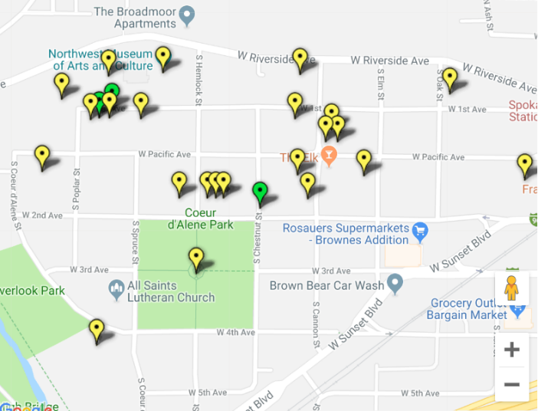
Individually listed properties on the SRHP
Browne’s Addition has 21 individually listed properties on the Spokane Register of Historic Places
These are the only properties that we can offer incentives for preservation activities, as well as protection from inappropriate changes or demolition

Slide 10
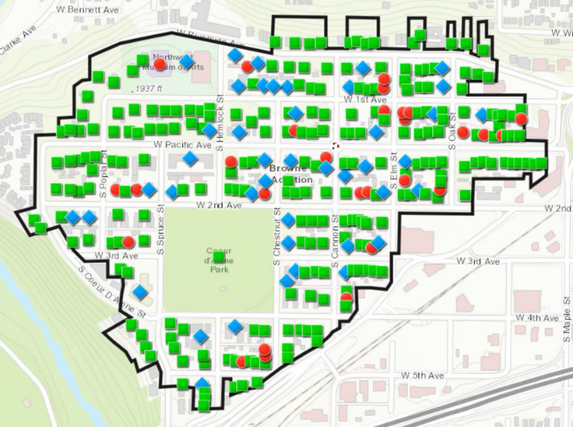
Proposing a Local Historic District in BA
As a result of the 2018 Historic Preservation Ordinance revision, we now have the ability to create an historic district through an overlay zone
Map shows the boundaries that would be created for the overlay along with “contributing” and “non-contributing” designations

Slide 11
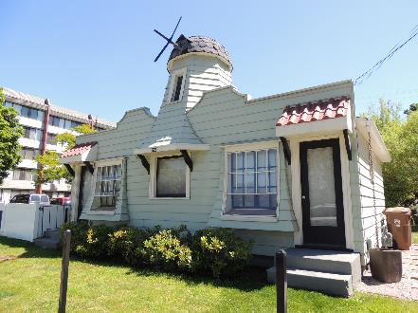
Local Historic District Basics
Made up of:
Spokane Register Nomination Document:
Includes description of property types in the district;
architectural styles;
period of significance;
boundary;
discussion of contributing/non-contributing evaluations;
historic context for the district;
a statement of significance
Resource Forms: Each building within the district boundary has a separate form that details
architectural style,
year built,
integrity and evaluations of each property
Design Standards and Guidelines: Gives property owners and developers direction concerning existing buildings (both contributing and non-contributing); new construction; demolition and how to receive approval for a Certificate of Appropriateness. Includes a framework for scoring compatibility for new construction.

Slide 12
Design Standards and Guidelines
Contributing properties (76% of properties – 229 properties) within the district shall follow all the required procedures for any individually listed property on the Spokane Register
Non-contributing properties (24% of properties – 73 properties)
Those found non-contributing due to loss of historic integrity will be ADMINISTRATIVELY reviewed based on the potential to bring them back into a contributing status which would enable the use of incentives
Those found non-contributing due to age would only be ADMINISTRATIVELY reviewed for the street facing façade

Slide 13
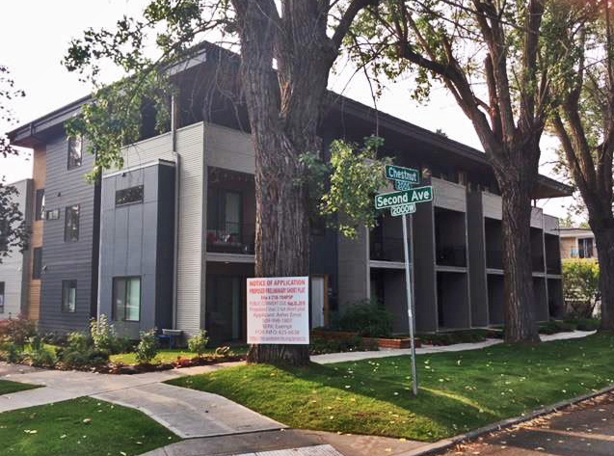
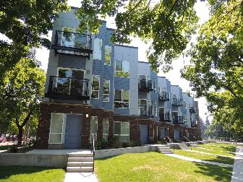
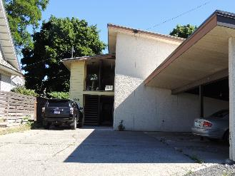
Design Standards and Guidelines
New Construction:
Historic preservation uses the concept of “context sensitive design” but uses the term “compatible”
Site specific review allows for a project that might only be compatible in one part of the district, but not in another
Framework for Compatible Design

Slide 14
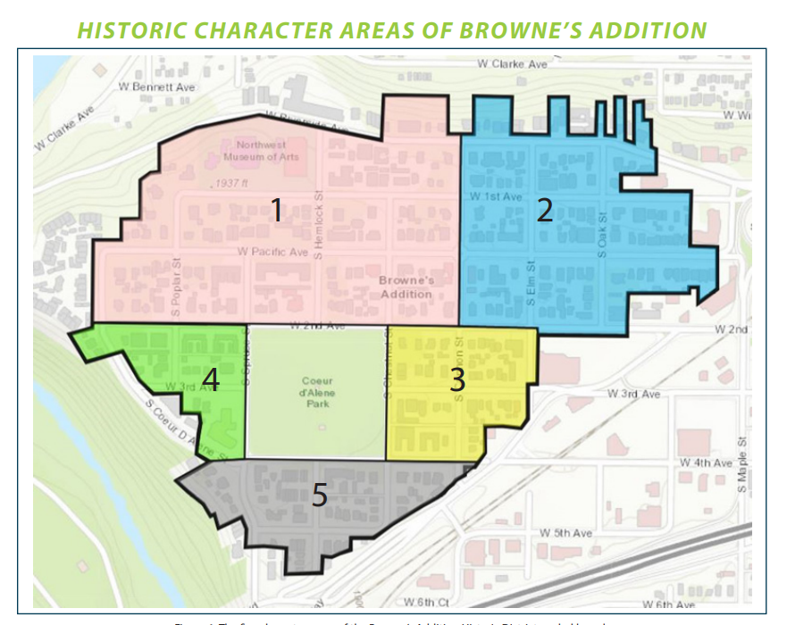
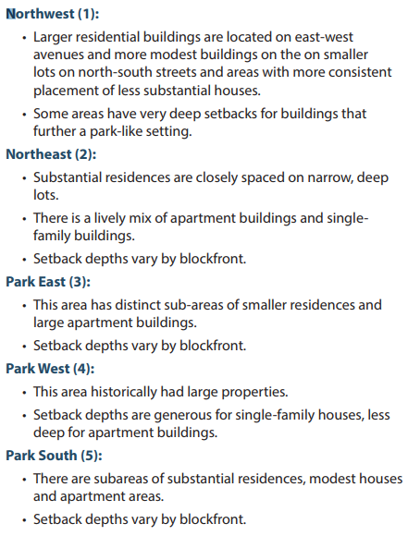

Slide 15
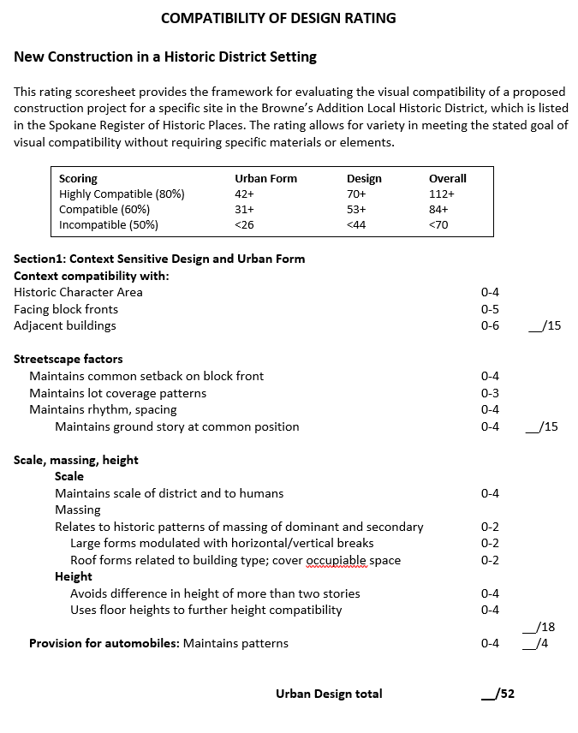
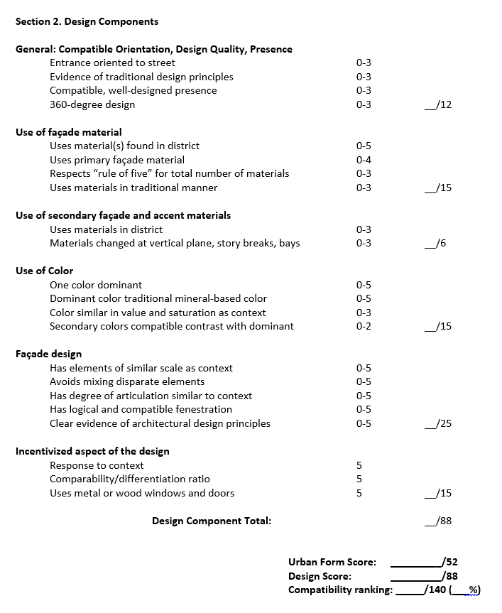

Slide 16
Process for the creation of the district
Public Outreach/Internal Process:
June 3, 2015 – Initial BANC Meeting
October 24, 2016 – BANC Committee for Local District meeting
November 2, 2016 – Browne’s Addition Local District strategy meeting (Neighborhood Services/HP staff)
November 14, 2016 - BANC Committee for Local District meeting
November 30, 2016 - HPO published Pro-Browne’s Addition Historic District website with FAQs, all other info on district
November 28, 2016 - BANC Committee for Local District meeting
December 7, 2016 - BANC Holiday Gathering, Brief update and discussion
April 2017 - Applied for DAHP Federal Pass-through funding for district project
June 2017 - Notice of receipt of grant – Project could not begin until October 1, 2017
February 2018 - Historic Preservation Ordinance Update passes City Council
February 2018 - RFP for district project advertised
March 2018 - Borth Preservation Consultant, LLC Hired for district nomination, resource forms, and design standards and guidelines document
May 10, 2018 - Browne’s Addition meetings/tour/kick-off with consultants and volunteers
June 7, 2018 - BANC Meeting Presentation to Neighborhood
July 24, 2018 - Browne’s Addition – training to volunteers for brochure distribution
August 8, 2018 - Consultant meets with BANC volunteers
August 29, 2018 - #1 Spokane Historic Landmarks Commission committee meeting on Design Standards
September 13, 2018 - BANC Meeting Presentation

Slide 17
Process for the creation of the district
Public Outreach/Internal Process:
October 3, 2018 - #2 Spokane Historic Landmarks Commission committee meeting on Design Standards
October 3, 2018 - Press Release on upcoming workshops/Browne’s progress
October 5, 2018 - Mailing sent to all property owners within the district boundaries
October 10, 2018 - Internal district adoption process – Planning, Legal & HP
October 12, 2018 - Local media interview with HPO on Browne’s Addition project
October 15, 2018 - Draft documents submitted to HPO
October 18, 2018 - #1 Browne’s Addition Workshop – Compatible New Construction in Browne’s
November 7, 2018 - #2 Browne’s Addition Workshop – Frequently Asked Questions
December 13, 2018- BANC Neighborhood Holiday Gathering – Update
February 18, 2019 - Final draft documents received from Consultant
March 1, 2019 - Draft documents added to Pro-Browne’s webpage on HPO website
March 14, 2019 - Postcard mailing to all property owners announcing availability of docs, workshop
March 20, 2019 - SHLC Preliminary Approval for Browne’s Addition documents
March 27, 2019 - #3 Browne’s Addition Workshop – Overview of Completed Documents/Discussion
March 29, 2019 - Survey to BANC for specific Design Standards and Guidelines questions
April 8, 2019 - Urban Experience City Council Committee update on BA District
April 24, 2019 - Plan Commission Workshop #1

Slide 18
Next Steps…
We continue to update resource forms, design standards as we receive comments from the neighborhood
We are on the agenda for a second Plan Commission workshop on May 8, 2019
We will go over the Design Standards and Guidelines document at that time. We anticipate that the neighborhood will have weighed in on changes by that point.
We will wait until the Plan Commission has made any recommendations before we go out for the Property Owner vote
Landmarks Commission will review suggested changes by Plan Commission before vote begins
In order to bring the historic district overlay zone to City Council, there needs to be a 50% +1 return of ballots in the affirmative (approximately 185 “yes” ballots returned)
Ballots not returned are considered a “no”
Final approval of the documents and recommendation to City Council will occur by the Spokane Historic Landmarks Commission
City Council will have the final action with the consideration of the Browne’s Addition Historic District Overlay Zone ordinance

Slide 19
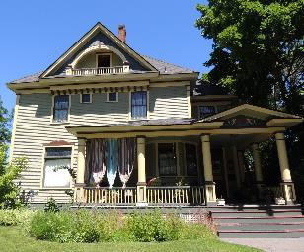
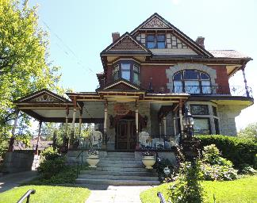
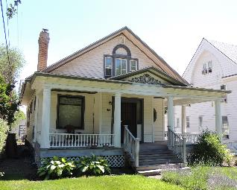
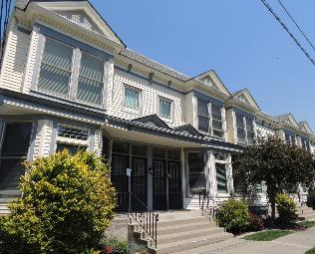
Questions?

