Slide 1
CLG Training Spokane, WA September 26, 2017 Karen Gordon
Legal Basics, Open Meetings, Executive Sessions, Conflict of Interest & Appearance of Fairness

Slide 2
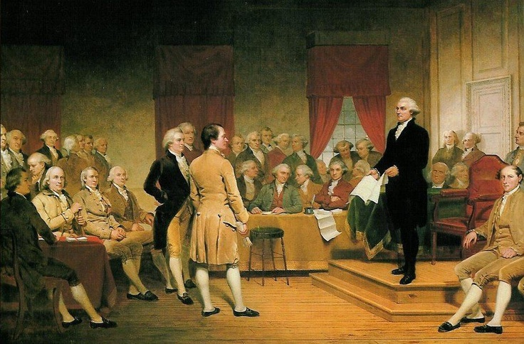

Slide 3
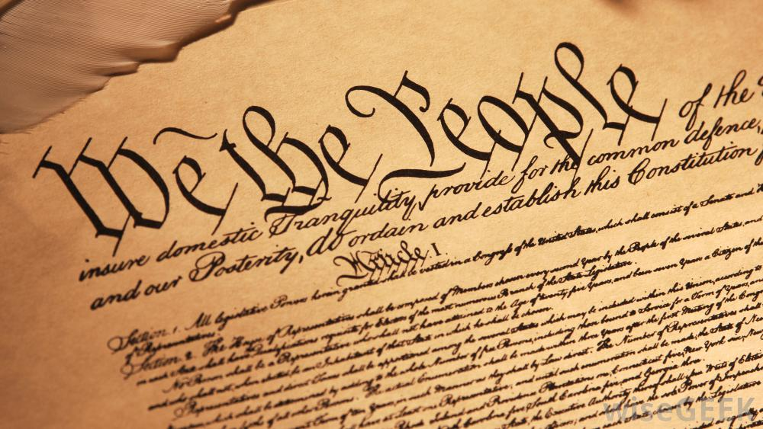
Amendment X
The powers not delegated to the United States by the Constitution, nor prohibited by it to the States, are reserved to the States respectively, or to the people.

Slide 4
Delegation of Authority
Dillon’s Rule
Narrow government authority
If there is a reasonable doubt if power has been conferred, then the power has not been conferred
Home Rule
Defined specifically by each state
Home rule creates local autonomy and limits state interference

Slide 5
Amendment V
. . . nor shall private property be taken for
public use, without just compensation

Slide 6
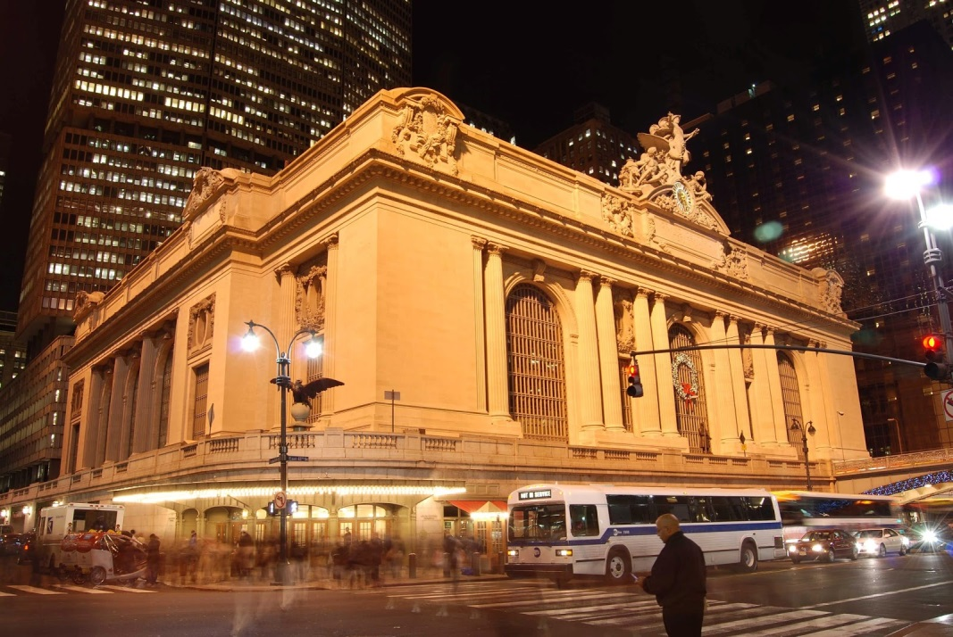
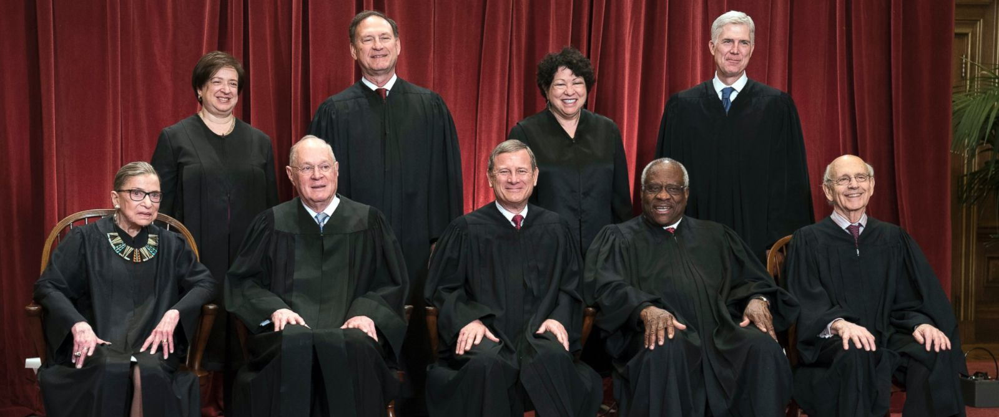
Legal Decisions

Slide 7
Legal Decisions
Euclid v. Ambler, 1926
Use of the police power as
a legitimate form of local
government regulation of land in
upholding zoning laws.
Berman v. Parker, 1954
“The concept of the public welfare is
broad and inclusive. . . .The values it
represents are spiritual as well as
physical, aesthetic as well as
monetary. It is within the power of
the legislature to determinate that
the community should be beautiful
as well as healthy . . . . “

Slide 8
Penn Central Transportation Co. v. New York City, 1978
Upheld historic preservation designation as
a legitimate use of the police power

Slide 9
Penn Central “three prong test”
Economic impact of the regulation on the private landowner
The degree to which the regulation interferes with the private landowner’s distinct investment-backed expectations
The character of the government action – “does it advance legitimate state interests.”

Slide 10
Federal Preservation Overview
Public
Antiquities Act of 1906
National Park Service – 1916
Historic American Building Survey – 1933
Historic Sites Act of 1935 (basis for formation of National Register of Historic Places)
National Trust for Historic Preservation - 1949
Private
Mount Vernon Ladies Association - 1853
Daughters of the American Revolution - 1890
Colonial Dames - 1890
Society for the Preservation of New England Antiquities - 1910
Colonial Williamsburg - 1926

Slide 11
National Historic Preservation Act of 1966
Expanded the National Register of Historic Places
Created Section 106 and the Advisory Council on Historic Preservation
Created State Historic Preservation Offices
Administers NRHP
Review and Compliance – Section 106
Survey & Inventory
Planning – State Preservation Plan
Grants
Federal Rehabilitation Tax Credits
Public Education and Technical Assistance

Slide 12
Amendments to the NHPA of 1966
1980 Amendments
Created Certified Local Governments
10% Pass through of federal appropriation
Review and approval of NR nominations
Provided for owner objection to listing in the National Register of Historic Places
1992 Amendments
Provided for a greater role for Native Americans and Native Hawaiians in federal and state preservation programs
Required federal agencies to establish their own internal procedures to incorporate historic preservation planning within their programs
Obligated federal agencies to withhold federal assistance in cases of anticipatory demolition

Slide 13
Open Meetings, Executive Session and Conflicts of Interest

Slide 14
DISCLAIMER
This presentation does not constitute “legal advice.” Use this presentation in consultation with your City Attorney and Ethics Officer.

Slide 15
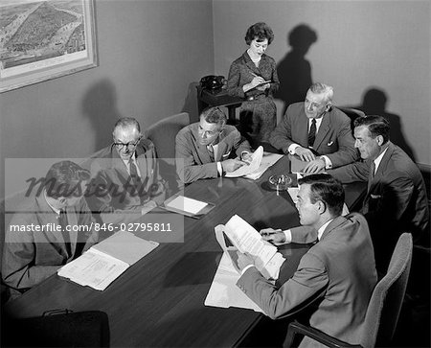
Open Meetings, Executive Sessions, Conflict of Interest & Appearance of Fairness

Slide 16
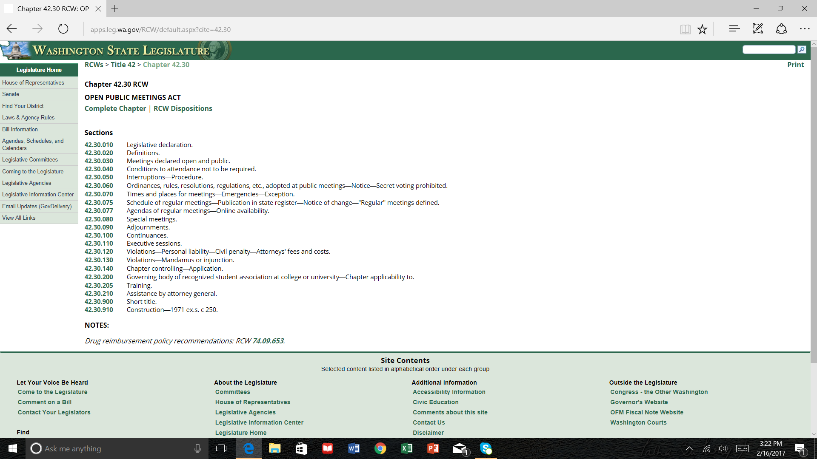

Slide 17
What is subject to the Act? Any meeting at which an action is taken What is an action? An action is the transaction of the official business of a public agency by a governing body including but not limited to receipt of public testimony, deliberations, discussions, considerations, reviews, evaluations, and final actions.

Slide 18
Public Comment
The Act does not require public comment . . . but you should include it. During public comment, be fair and consistent Apply time limits consistently (with the exception of the applicant who has a legitimate claim of having more time – but not “running out the clock.”) If time is an issue, ask people to submit written comments

Slide 19
Executive Session
The Act allows an Executive Session in the matter of: National Security Real Estate Transactions Litigation Confidential Information

Slide 20
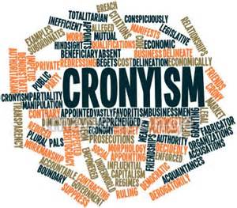
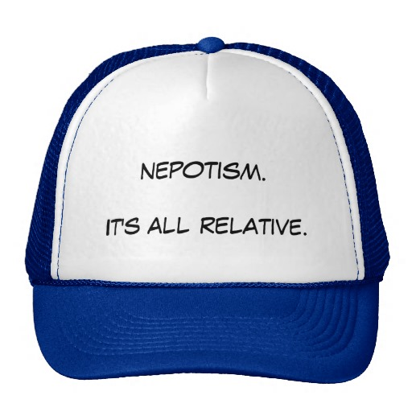
Appearance of Fairness, Conflicts of Interest

Slide 21
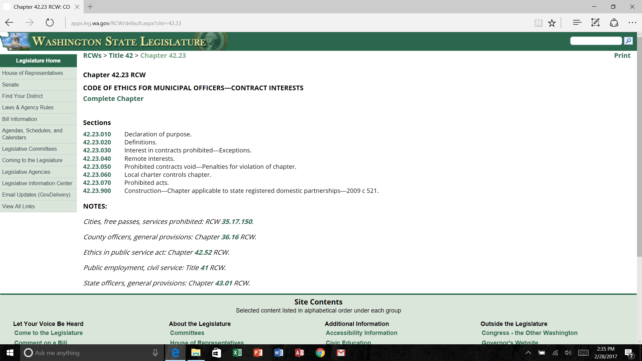

Slide 22
Code of Ethics
No municipal officer may:
use his or her position to secure special privileges or exemptions for himself, herself or others;
directly or indirectly, give or receive any compensation, gift, gratuity, or reward from any source, except the employing municipality, for a matter connected with or related to the officer’s services unless otherwise prohibited by law;
accept employment or engage in business that the officer might reasonably expect would require him or her to disclose confidential information acquired by reason of his or her official position;
disclose confidential information gained by reason of the officer’s position, nor may the officer use such information for his or her personal gain.

Slide 23
Code of Ethics
Most jurisdictions have their own Code of Ethics
Familiarize yourself with your local Code of Ethics
Ask the Ethics Officer in your jurisdiction to brief the Commission

Slide 24
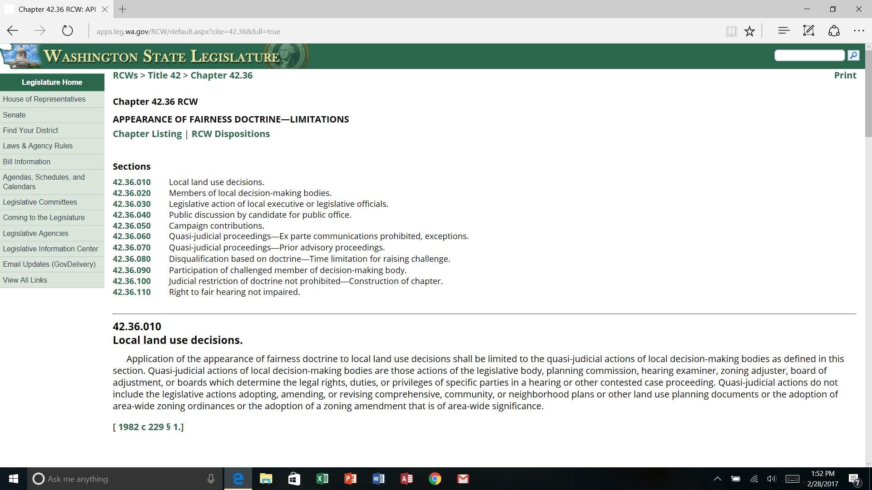
Public Comment

Slide 25
Appearance of Fairness Avoid conflicts of interest as outlined in the Code of Ethics Preserve an atmosphere of fairness and impartiality

Slide 26
Ex Parte Communications An ex parte communication is a one-sided discussion between a decision-maker and the proponent or opponent of a particular application or matter that takes place outside of the formal hearing process.

Slide 27
Ex Parte Communications When does it occur? The ban on ex parte communication applies only during the pendency of a proceeding, for example, the filing of an application.

Slide 28
Ex Parte Communications What happens if it occurs? An ex parte communication does not necessarily preclude your participation. It is important for you to disclose the contact in public including the substance of the interaction and allow any rebuttal of the substance of the interaction.

